Slide 1
Color

Slide 2
Color-
the visual response of the eye to reflected rays of light
element of design
3 dimensions
  hue
  value
  chroma
Notes:
The American Institute of Floral Designers. The AIFD Guide to Floral Design. Terms, Techniques, and Traditions. The Intelvid Group 2005.

Slide 3
Hue-
the descriptive name of color
(i.e. red, yellow, & green)
pure color w/o black, white, or gray added
defines a specific spot on the color wheel
  12 hues on the color wheel
Notes:
The American Institute of Floral Designers. The AIFD Guide to Floral Design. Terms, Techniques, and Traditions. The Intelvid Group 2005.

Slide 4
Value-
the lightness or darkness of a hue
relative to the gray scale
achieved by the addition of black, white, or gray
  Shade
  Tint
  Tone
Notes:
The American Institute of Floral Designers. The AIFD Guide to Floral Design. Terms, Techniques, and Traditions. The Intelvid Group 2005.

Slide 5
Gray Scale-
  a visual aid which represents the transitional graduations of value from white to black, encompassing all the varying degrees of gray
Notes:
The American Institute of Floral Designers. The AIFD Guide to Floral Design. Terms, Techniques, and Traditions. The Intelvid Group 2005.

Slide 6
Gray Scale

Slide 7
Shade-
a hue which has been darkened by the addition of black
deeper in appearance
  i.e. navy is a shade of blue
  i.e. burgundy is a shade of red
Notes:
The American Institute of Floral Designers. The AIFD Guide to Floral Design. Terms, Techniques, and Traditions. The Intelvid Group 2005.

Slide 9
Tint-
a hue which has been lightened by the addition of white
pastel in appearance
  i.e. baby blue is a tint of blue
  i.e. pink is a tint of red
Notes:
The American Institute of Floral Designers. The AIFD Guide to Floral Design. Terms, Techniques, and Traditions. The Intelvid Group 2005.

Slide 11
Tone-
a hue which has been muted by the addition of gray
dusty in appearance
  i.e. wedge wood blue is a tone of blue
  i.e. mauve is a tone of red
Notes:
The American Institute of Floral Designers. The AIFD Guide to Floral Design. Terms, Techniques, and Traditions. The Intelvid Group 2005.

Slide 13
Chroma-
the degree of strength, intensity, saturation or purity of a color
More pigment would make a color brighter; less would make the color more dull
Notes:
Chroma describes the amount of brightness or dullness of a color whereas value describes the amount of black, white, or gray added to the color.
The American Institute of Floral Designers. The AIFD Guide to Floral Design. Terms, Techniques, and Traditions. The Intelvid Group 2005.

Slide 14
Pigment
substance used to provide color to paints, dyes, plastics, and other materials
Notes:
The American Institute of Floral Designers. The AIFD Guide to Floral Design. Terms, Techniques, and Traditions. The Intelvid Group 2005.

Slide 15
Intensity
reflects the maximum amount of light back to the viewer’s eye
is not mixed with black, white, or gray
Notes:
The American Institute of Floral Designers. The AIFD Guide to Floral Design. Terms, Techniques, and Traditions. The Intelvid Group 2005.

Slide 16
Saturation
the measure of the intensity or brightness of a color, describing the amount of light reflecting from it
The greater the saturation of color, the higher the chroma
Notes:
The American Institute of Floral Designers. The AIFD Guide to Floral Design. Terms, Techniques, and Traditions. The Intelvid Group 2005.

Slide 17
Color wheel
Twelve hour color system which was developed by Louis Prang, an American Printer in 1876.
Notes:
The American Institute of Floral Designers. The AIFD Guide to Floral Design. Terms, Techniques, and Traditions. The Intelvid Group 2005.

Slide 18
Color Wheel

Slide 19
Primary colors-
red, yellow, & blue
spaced equidistantly apart on the color wheel
cannot be created by mixing any other colors together

Slide 20
Primary Colors

Slide 21
Secondary colors-
orange, green, & violet
created by mixing two primary colors
placed in between primary colors

Slide 22
Secondary Colors

Slide 23
Tertiary colors-
red-orange, red-violet, blue-violet, blue-green, yellow-green, & yellow-orange
between primary and secondary colors
mixing primary & secondary colors
primary color is always listed first with a hyphen in the center of the word

Slide 24
Tertiary Colors

Slide 25
Chromatic colors-
Colors derived from the visible spectrum
characterized by the presence of both hue and chroma
all colors other than black, white or gray
Notes:
The American Institute of Floral Designers. The AIFD Guide to Floral Design. Terms, Techniques, and Traditions. The Intelvid Group 2005.

Slide 26
Achromatic colors-
white, black, & any values of gray
do not appear on the color wheel
Notes:
The American Institute of Floral Designers. The AIFD Guide to Floral Design. Terms, Techniques, and Traditions. The Intelvid Group 2005.

Slide 27
Neutral colors-
achromatic color to which a small amount of hue has been added
Notes:
The American Institute of Floral Designers. The AIFD Guide to Floral Design. Terms, Techniques, and Traditions. The Intelvid Group 2005.

Slide 28
Advancing (warm) colors-
aggressive or warm
predominantly composed of red or yellow
visually move forward toward the viewer
Notes:
The American Institute of Floral Designers. The AIFD Guide to Floral Design. Terms, Techniques, and Traditions. The Intelvid Group 2005.

Slide 29
Warm colors
red, orange, yellow
association with warm and hot things
active, cheery, evoking warm and happy feelings
dominate, look larger and advance
informal and blend
irritating if too much
Notes:
The American Institute of Floral Designers. The AIFD Guide to Floral Design. Terms, Techniques, and Traditions. The Intelvid Group 2005.

Slide 30
Warm Colors

Slide 31
Receding (cool) colors-
passive or cool
predominantly composed of blues or greens
visually pull back from the viewer
Notes:
The American Institute of Floral Designers. The AIFD Guide to Floral Design. Terms, Techniques, and Traditions. The Intelvid Group 2005.

Slide 32
Cool Colors
blue, green, violet
association with cool things
restful, peaceful, soothing, quiet, melancholy, “less friendly”
recede, look smaller
may appear formal and lack unity
cannot be seen from a distance
using both increases depth in an arrangement
Notes:
The American Institute of Floral Designers. The AIFD Guide to Floral Design. Terms, Techniques, and Traditions. The Intelvid Group 2005.

Slide 33
Cool Colors

Slide 34
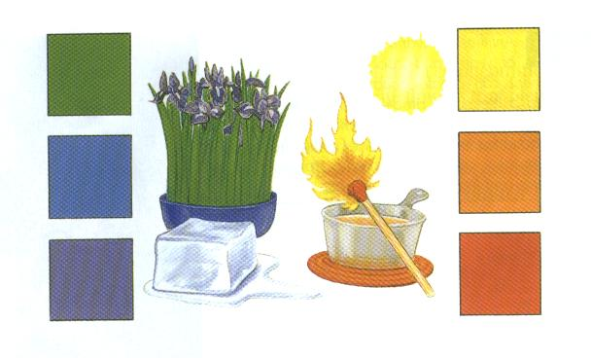

Slide 35
Color harmonies—
Groupings of specific hues and/or different values of a hue
resulting in a pleasing or useful combination
Color harmonies may display different values of the given hue and still be (i.e. pink and mint green) considered complementary color harmony.
Achromatic colors can be included in any color harmony
Notes:
The American Institute of Floral Designers. The AIFD Guide to Floral Design. Terms, Techniques, and Traditions. The Intelvid Group 2005.

Slide 36
Achromatic color harmony-
A grouping of colors without hue; white, black, and any values of gray.
Notes:
The American Institute of Floral Designers. The AIFD Guide to Floral Design. Terms, Techniques, and Traditions. The Intelvid Group 2005.

Slide 37
Monochromatic color harmony-
A grouping of different values of one hue
may include achromatic colors
An example would be red and tints, tones, shades of red—i.e. pink, mauve, red, & burgundy
Notes:
The American Institute of Floral Designers. The AIFD Guide to Floral Design. Terms, Techniques, and Traditions. The Intelvid Group 2005.

Slide 39
Analogous color harmony-
A color harmony featuring adjacent hues on the color wheel
no more than one primary color
colors form an angle of up to 90 degrees on the color wheel
one color usually dominates
one of the most harmonious and pleasing of all
i.e. green, blue-green, and yellow-green, with green dominating
Notes:
The American Institute of Floral Designers. The AIFD Guide to Floral Design. Terms, Techniques, and Traditions. The Intelvid Group 2005.

Slide 40
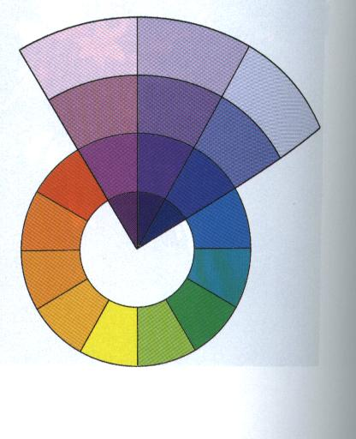
Notes:
Hunter, Norah T., The Art of Floral Design Second Edition Delmar 2000.

Slide 41
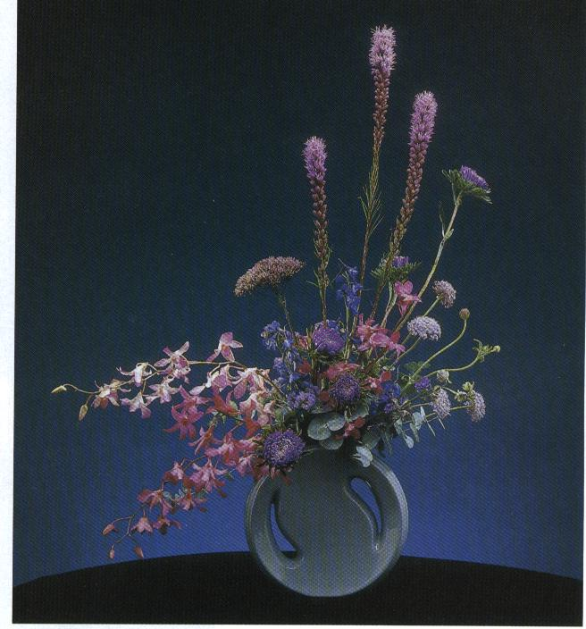
Notes:
Hunter, Norah T., The Art of Floral Design Second Edition Delmar 2000.

Slide 42
Complementary color harmony-
a pair of hues directly opposite each other on the color wheel
i.e. red & green, violet & yellow, or blue & orange
Many schools select their colors from a complementary color harmony.
Notes:
The American Institute of Floral Designers. The AIFD Guide to Floral Design. Terms, Techniques, and Traditions. The Intelvid Group 2005.

Slide 43
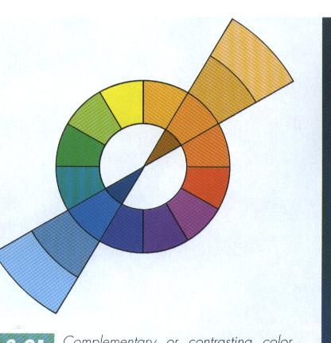
Notes:
Hunter, Norah T., The Art of Floral Design Second Edition Delmar 2000.

Slide 44
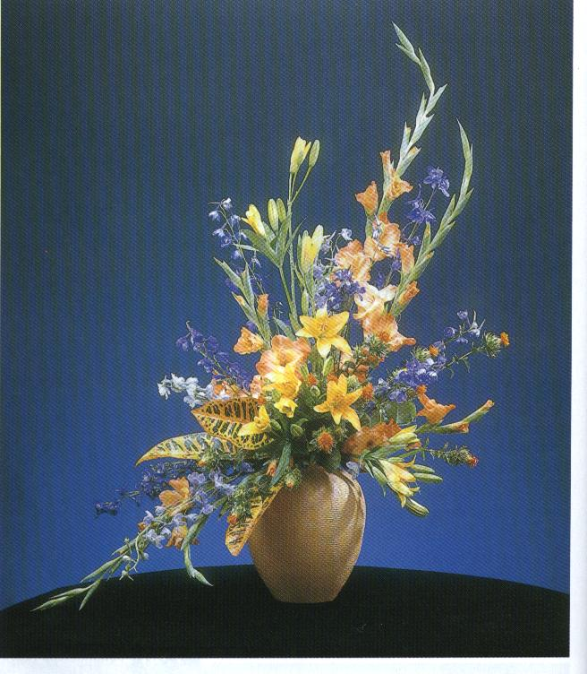
Notes:
Hunter, Norah T., The Art of Floral Design Second Edition Delmar 2000.

Slide 45
Split complementary color harmony
-a trio of hues, consisting of a hue and the two hues on either side of its direct complement
i.e. violet, yellow-orange, & yellow-green
Many restaurants use a split-complementary color scheme
Notes:
The American Institute of Floral Designers. The AIFD Guide to Floral Design. Terms, Techniques, and Traditions. The Intelvid Group 2005.

Slide 46
Triadic color harmony
a grouping of three hues which are equidistant on the color wheel
i.e. primary colors--red, blue & yellow
  Tints of primaries-pink, baby blue, & soft yellow
Changing the value does not change the color harmony.
Notes:
The American Institute of Floral Designers. The AIFD Guide to Floral Design. Terms, Techniques, and Traditions. The Intelvid Group 2005.

Slide 47
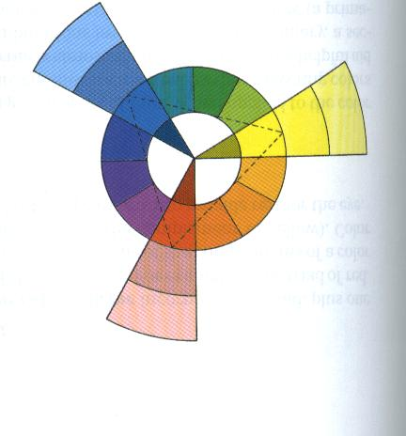
Notes:
Hunter, Norah T., The Art of Floral Design Second Edition Delmar 2000.

Slide 48
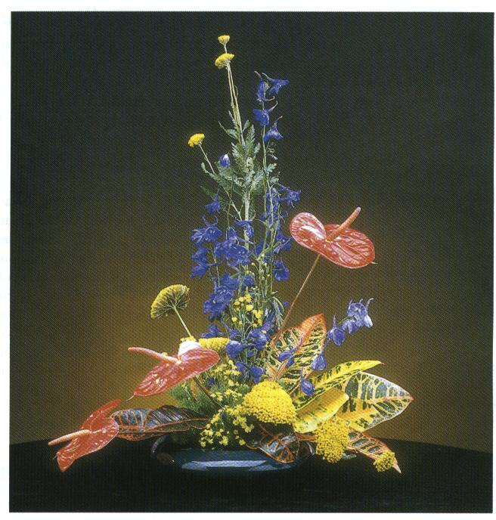
Notes:
Hunter, Norah T., The Art of Floral Design Second Edition Delmar 2000.

Slide 49
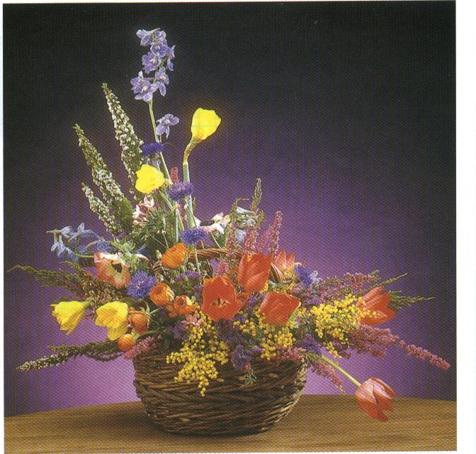
Notes:
Hunter, Norah T., The Art of Floral Design Second Edition Delmar 2000.

Slide 50
Tetradic color harmony-
A grouping of four hues which are equidistant on the color wheel
Notes:
The American Institute of Floral Designers. The AIFD Guide to Floral Design. Terms, Techniques, and Traditions. The Intelvid Group 2005.

Slide 51
Polychromatic color harmony
a multicolored grouping of many hues which may otherwise be unrelated
Notes:
The American Institute of Floral Designers. The AIFD Guide to Floral Design. Terms, Techniques, and Traditions. The Intelvid Group 2005.

Slide 52
Colors in Floral Designs
Notes:
Hunter, Norah T., The Art of Floral Design Second Edition Delmar 2000.

Slide 53
White
Blend easily
Cleaner, livelier
Useful neutral
Adds brightness and contrast
Achromatic-without color
Simple, elegance and sophistication
Notes:
Hunter, Norah T., The Art of Floral Design Second Edition Delmar 2000.

Slide 54
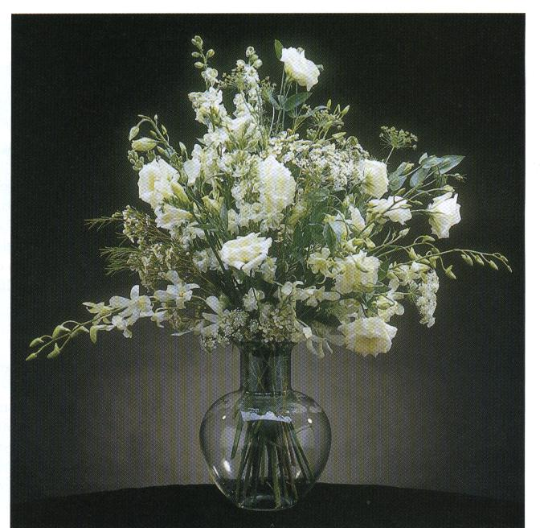
Notes:
Hunter, Norah T., The Art of Floral Design Second Edition Delmar 2000.

Slide 55
Red
Lively, stimulating
Strength and dominance
Use with care
Demands attention
Could overpower
Green foliage complement red
Notes:
Can look overcrowded
Room to visually grow—space around red flowers
Hunter, Norah T., The Art of Floral Design Second Edition Delmar 2000.

Slide 56
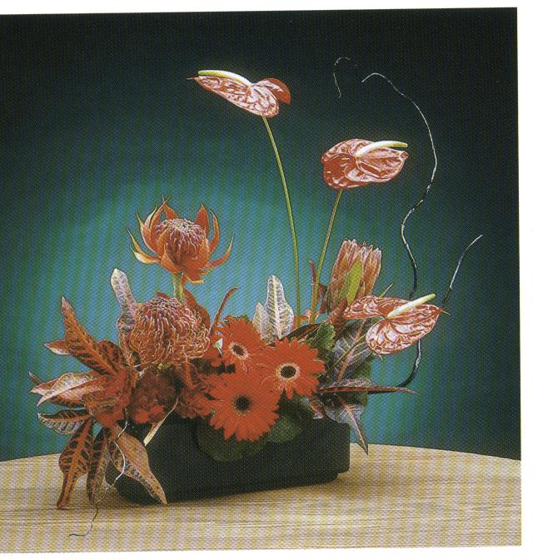
Notes:
Hunter, Norah T., The Art of Floral Design Second Edition Delmar 2000.

Slide 57
Pink
Combines with many colors
Romance, femininity
Often enhanced by use of stronger contrasting colors
Brighter pink—more attention
Notes:
Hunter, Norah T., The Art of Floral Design Second Edition Delmar 2000.

Slide 58
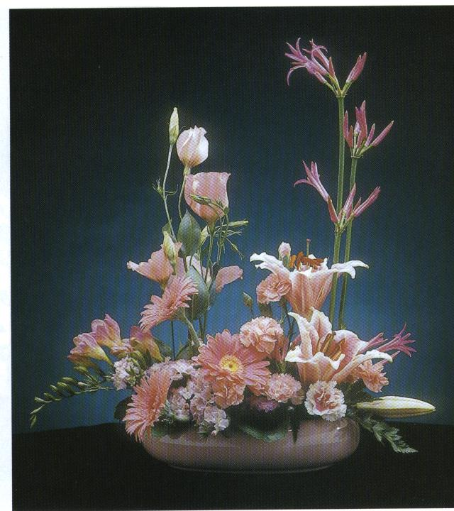
Notes:
Hunter, Norah T., The Art of Floral Design Second Edition Delmar 2000.

Slide 59
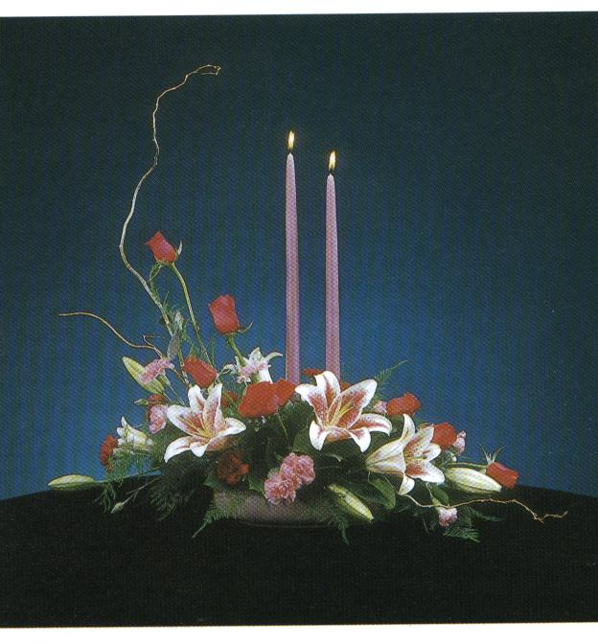
Notes:
Hunter, Norah T., The Art of Floral Design Second Edition Delmar 2000.

Slide 60
Orange
Stimulating
Compels attention
Adds brightness
Autumn
Tints and shades
Notes:
Stimulating but not as visually demanding as red
Hunter, Norah T., The Art of Floral Design Second Edition Delmar 2000.

Slide 61
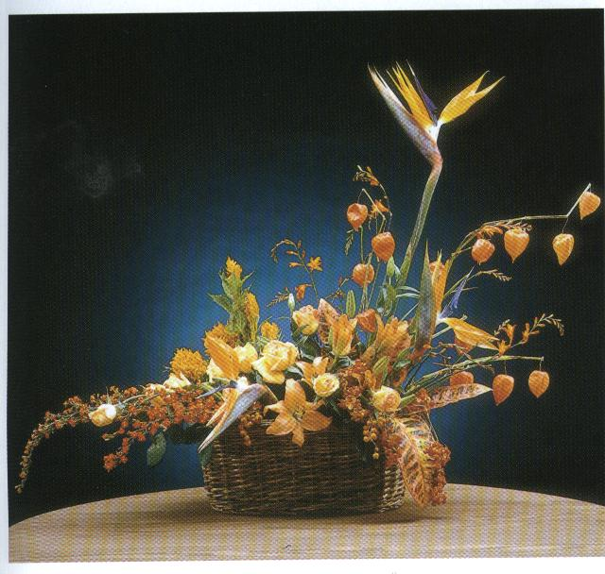
Notes:
Hunter, Norah T., The Art of Floral Design Second Edition Delmar 2000.

Slide 62
Yellow
Reflects a lot of light
Vibrant and highly visible
Friendly
Spirit and perk
Too much as monochromatic
Notes:
Hunter, Norah T., The Art of Floral Design Second Edition Delmar 2000.

Slide 63
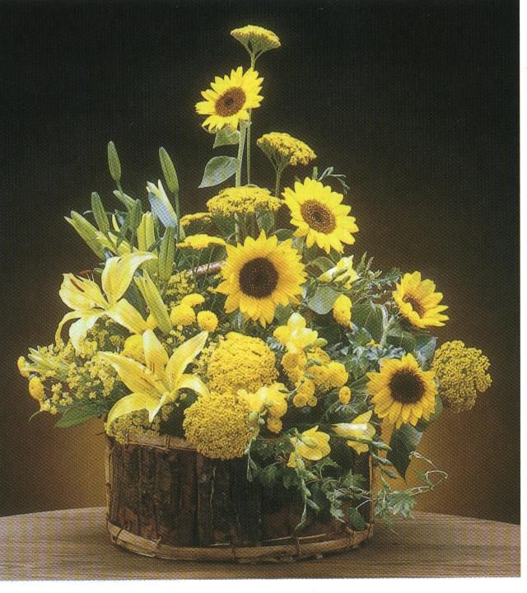
Notes:
Hunter, Norah T., The Art of Floral Design Second Edition Delmar 2000.

Slide 64
Green
Natural background
Soothing and restful
Containers
Notes:
Hunter, Norah T., The Art of Floral Design Second Edition Delmar 2000.

Slide 65
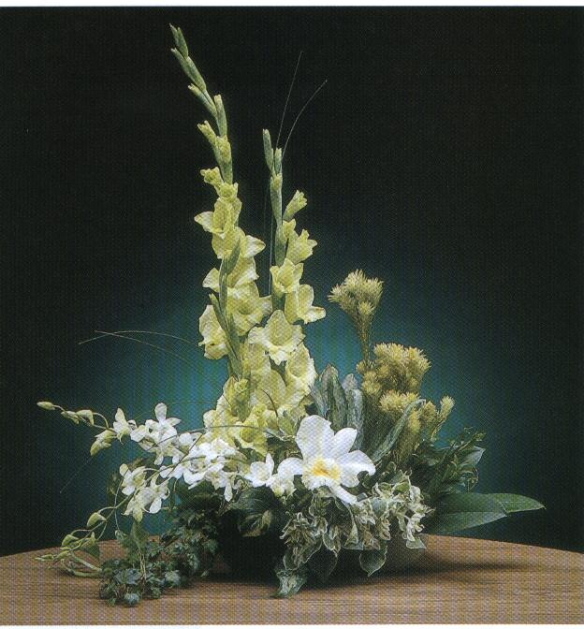
Notes:
Hunter, Norah T., The Art of Floral Design Second Edition Delmar 2000.

Slide 66
Blue
Peaceful, quiet, and cool
Different lighting—actually purple
depressing
Notes:
Hunter, Norah T., The Art of Floral Design Second Edition Delmar 2000.

Slide 67
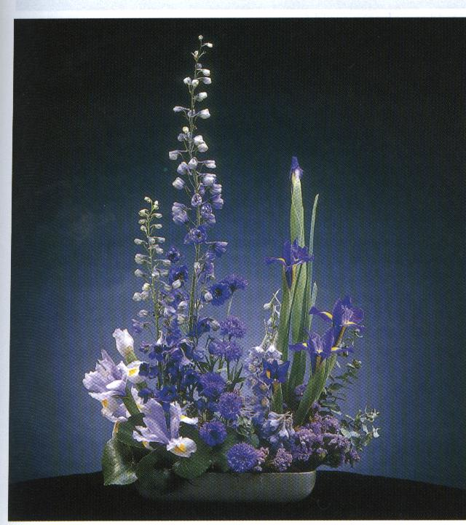
Notes:
Hunter, Norah T., The Art of Floral Design Second Edition Delmar 2000.

Slide 68
Purple
Rich and dramatic
Opposites in extremes (red and blue)
Cool or warm
Notes:
Hunter, Norah T., The Art of Floral Design Second Edition Delmar 2000.

Slide 69
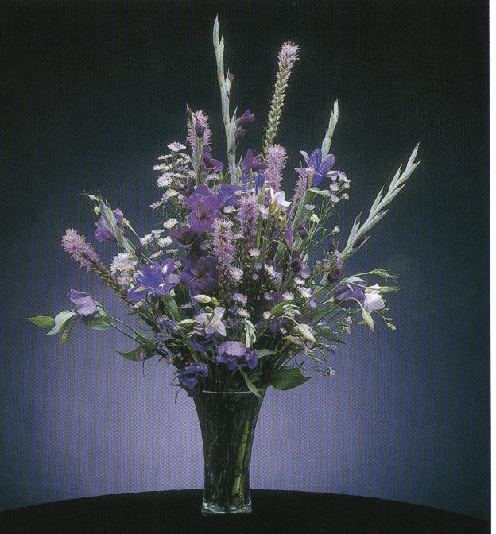
Notes:
Hunter, Norah T., The Art of Floral Design Second Edition Delmar 2000.

Slide 70
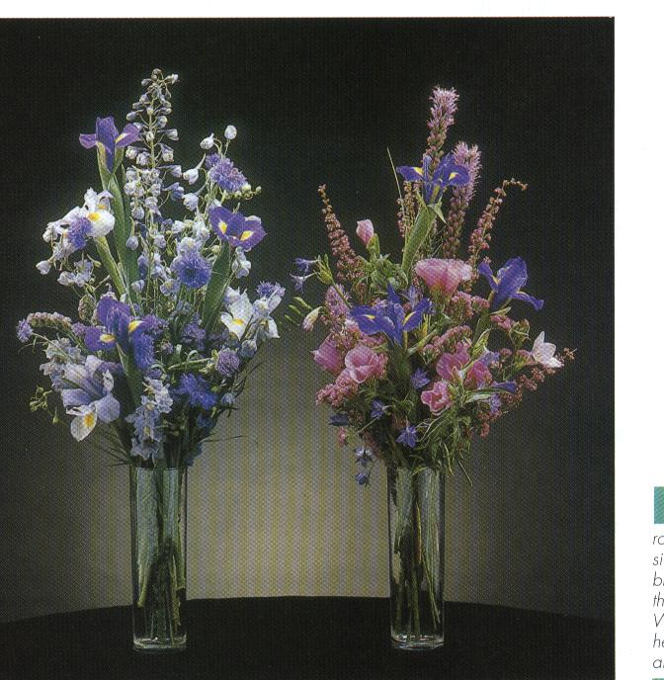
Notes:
Hunter, Norah T., The Art of Floral Design Second Edition Delmar 2000.

Slide 71
Examples of Color Activities

Slide 72
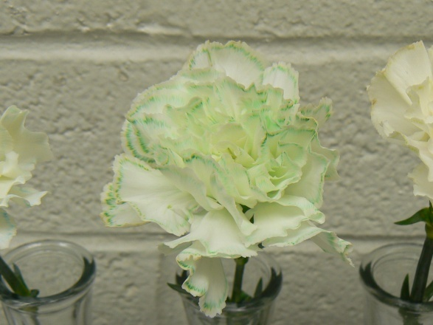
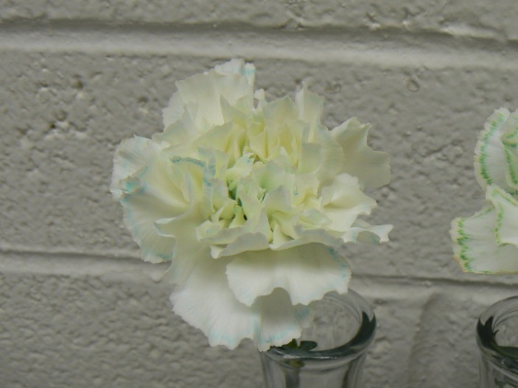
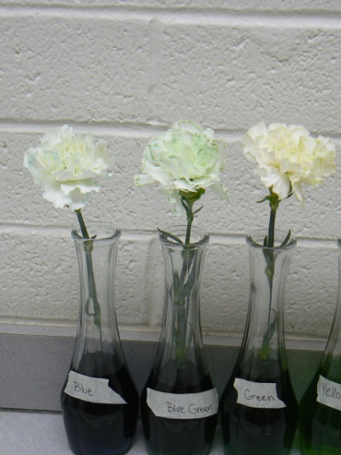
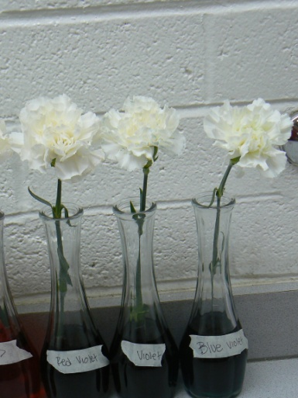
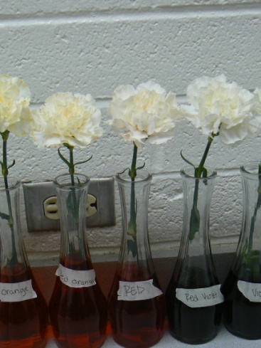
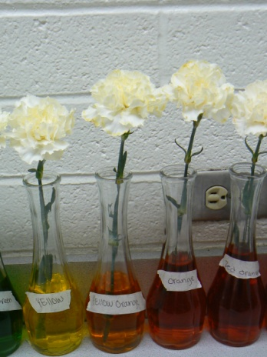
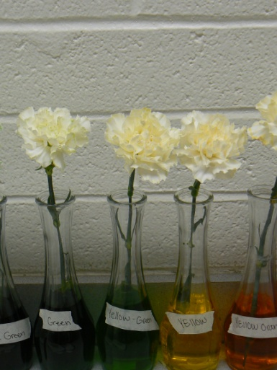
Coloring White Carnations

Slide 73
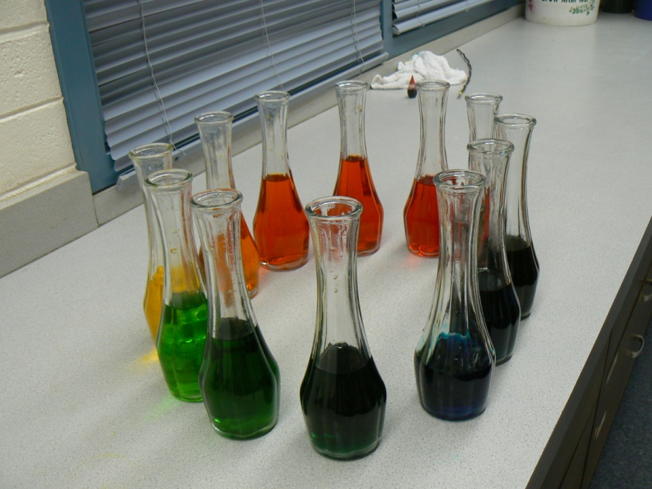
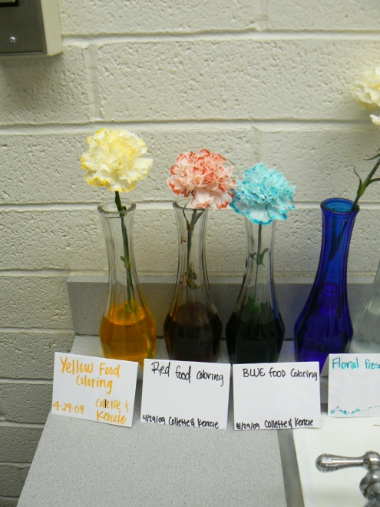
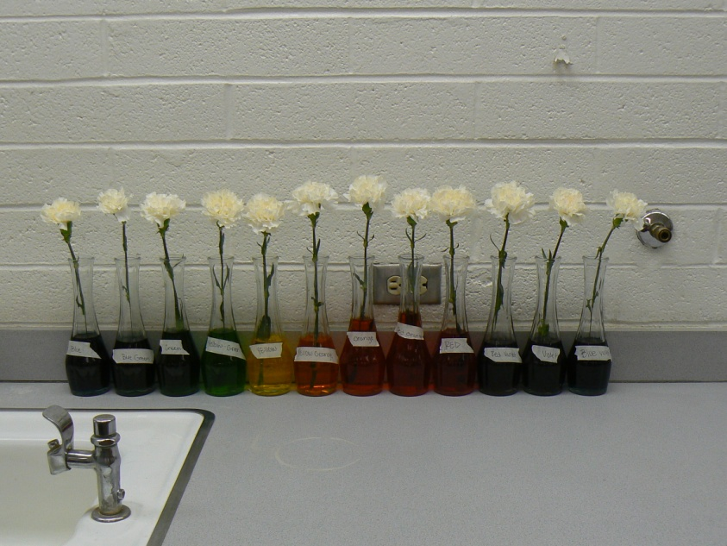

Slide 74
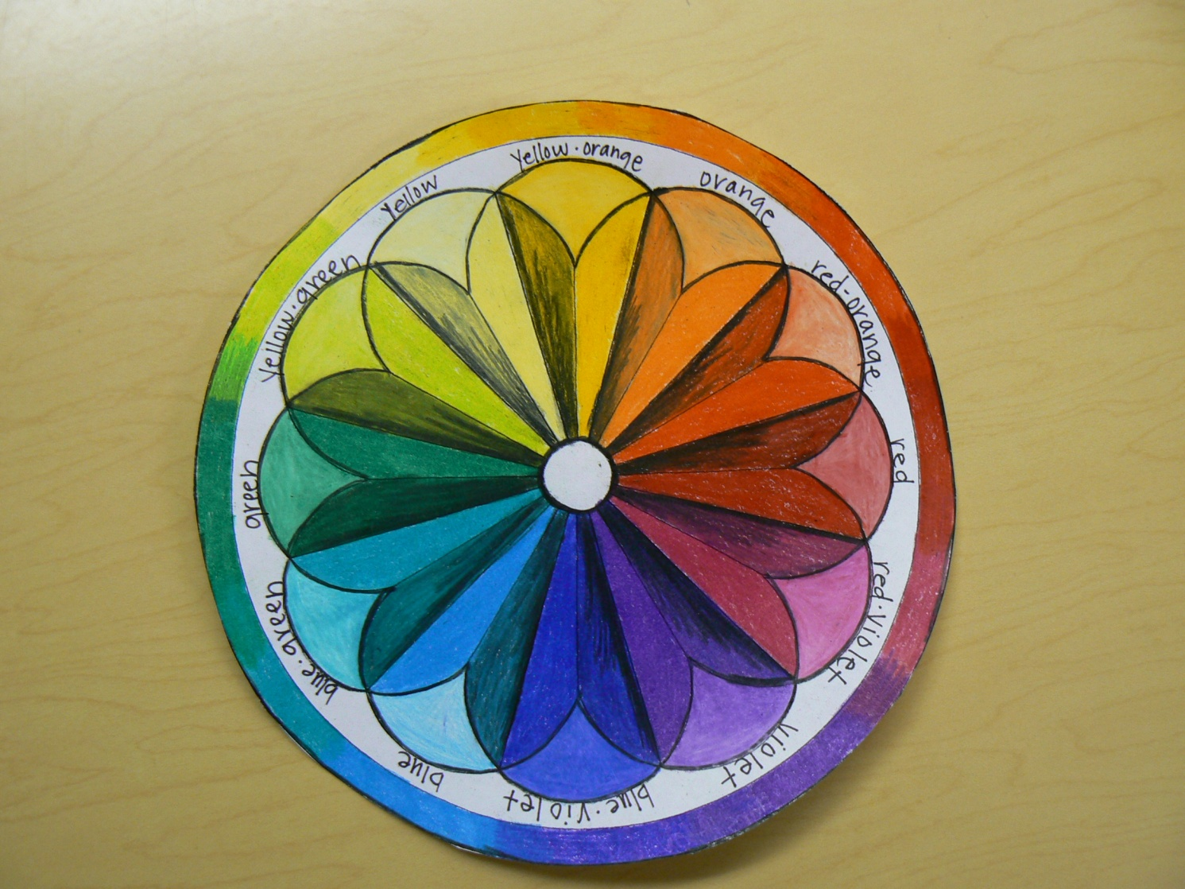
Mandala

