Slide 1
Floriculture Plant
Identification Quiz
A-C
101-134

Slide 2
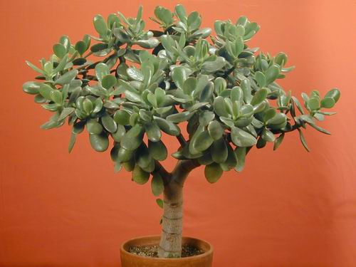
1
Notes:
132
Crassula argentea
Jade Plant
Freeinfosociety.com

Slide 3
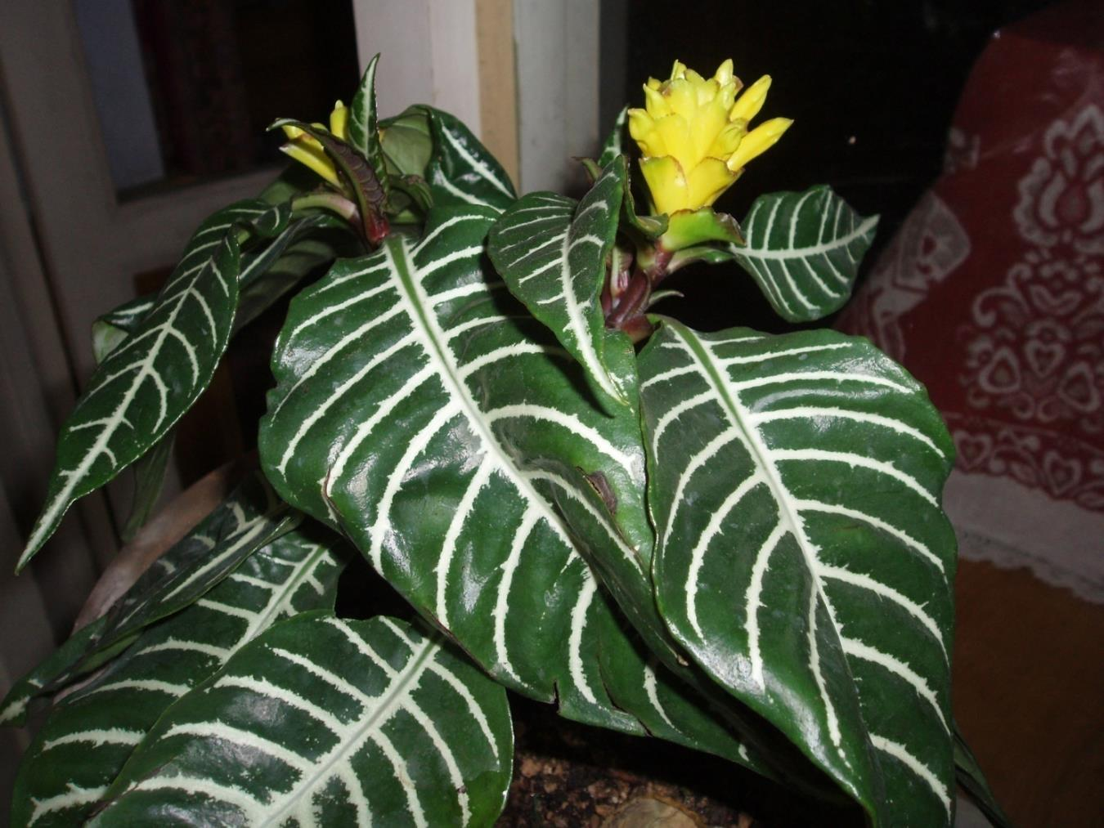
2
Notes:
107
Aphelandra squarrosa cv.
Aphelandra, Zebra Plant
Uploadwikimedia.org

Slide 4
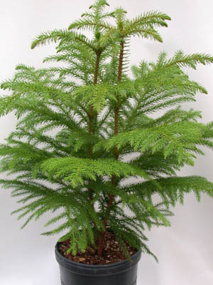
3
Notes:
108
Araucaria heterophylla
Norfolk Island Pine
Freeinformationsociety.com

Slide 5
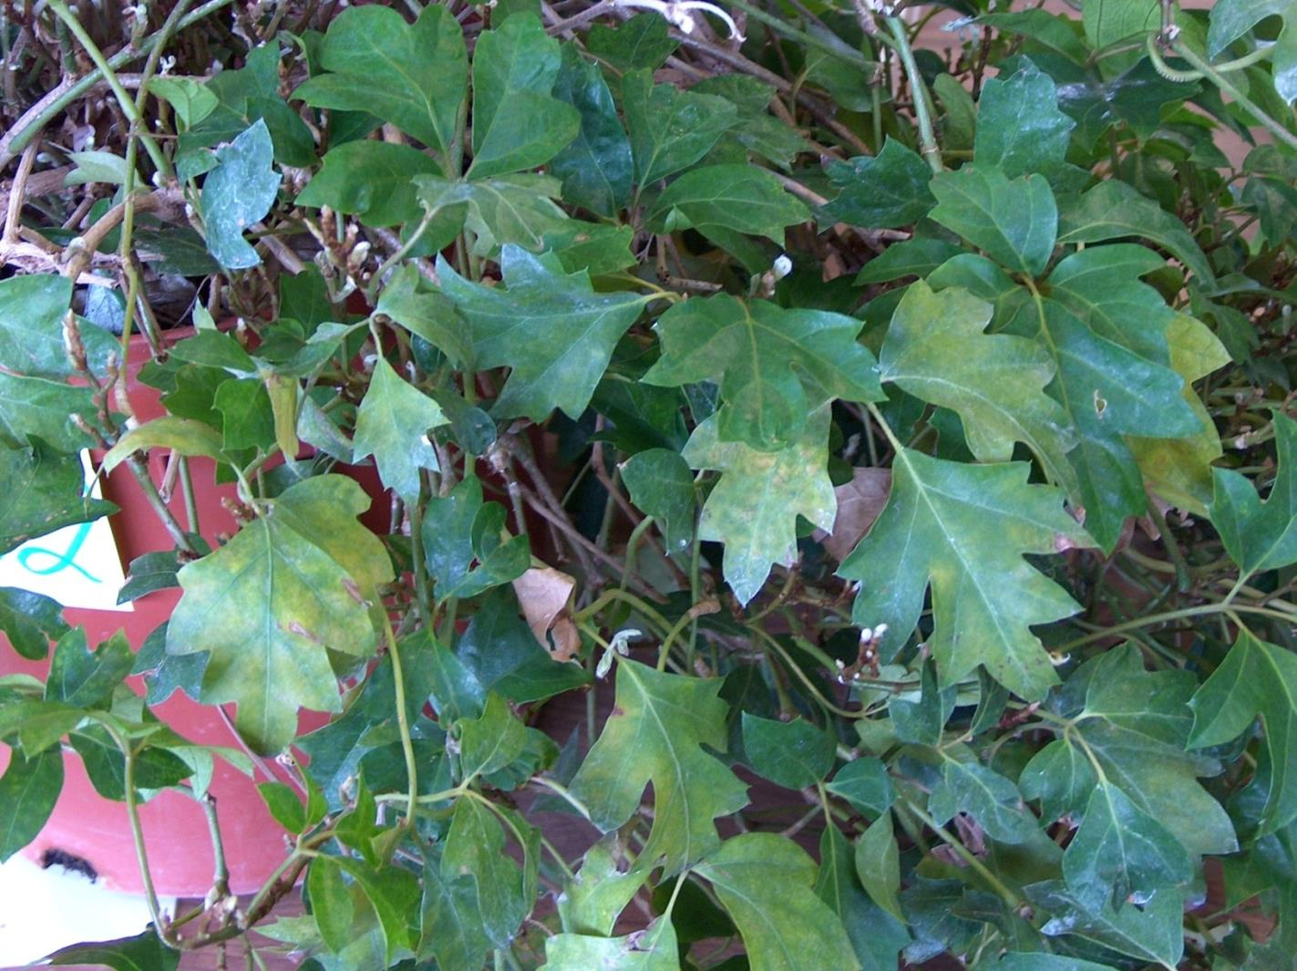
4
Notes:
128
Cissus rhombifolia ‘Mandaiana’
Grape Ivy
Photo courtesy of Allison Touchstone

Slide 6
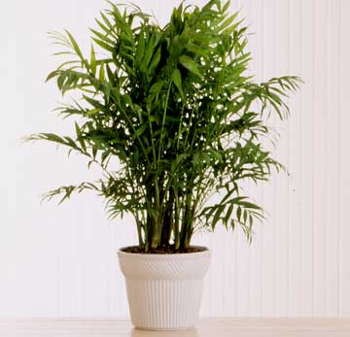
5
Notes:
122
Chamaedorea elegans
Parlor Palm
Bha.com

Slide 7
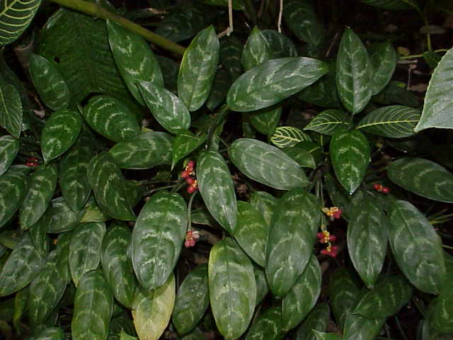
6
Notes:
103
Aglaonema commutatum cv.
Aglaonema
Uploadwikipedia.org
Toptropicals.com

Slide 8
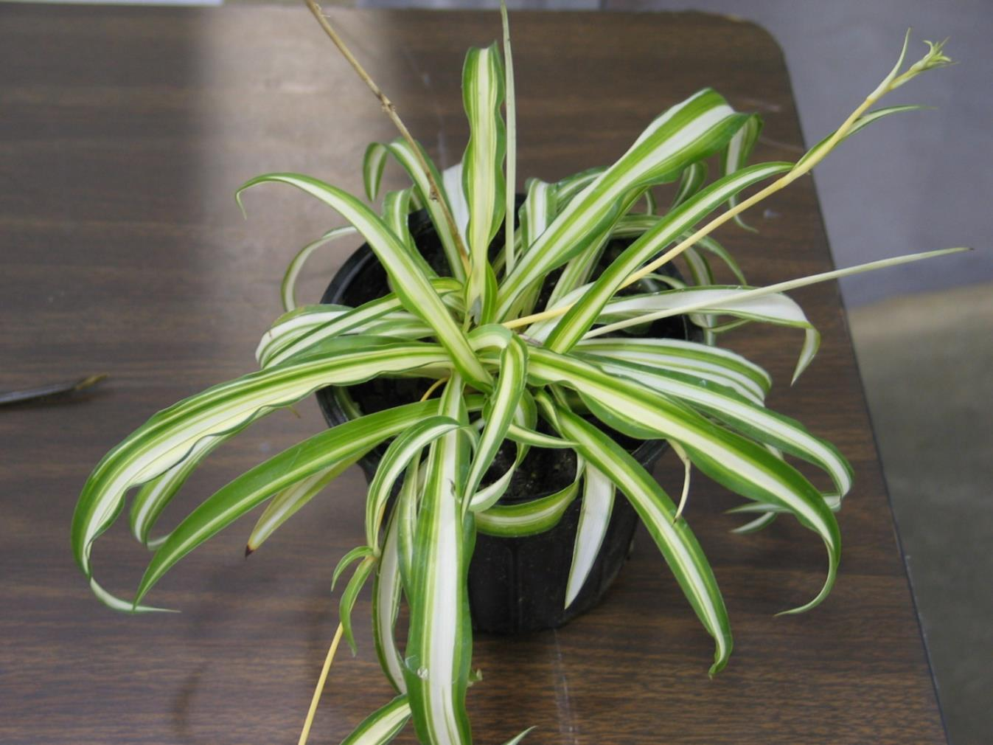
7
Notes:
124
Cholorophytum comosum cv.
Spider Plant
Photo courtesy of Allison Touchstone

Slide 9
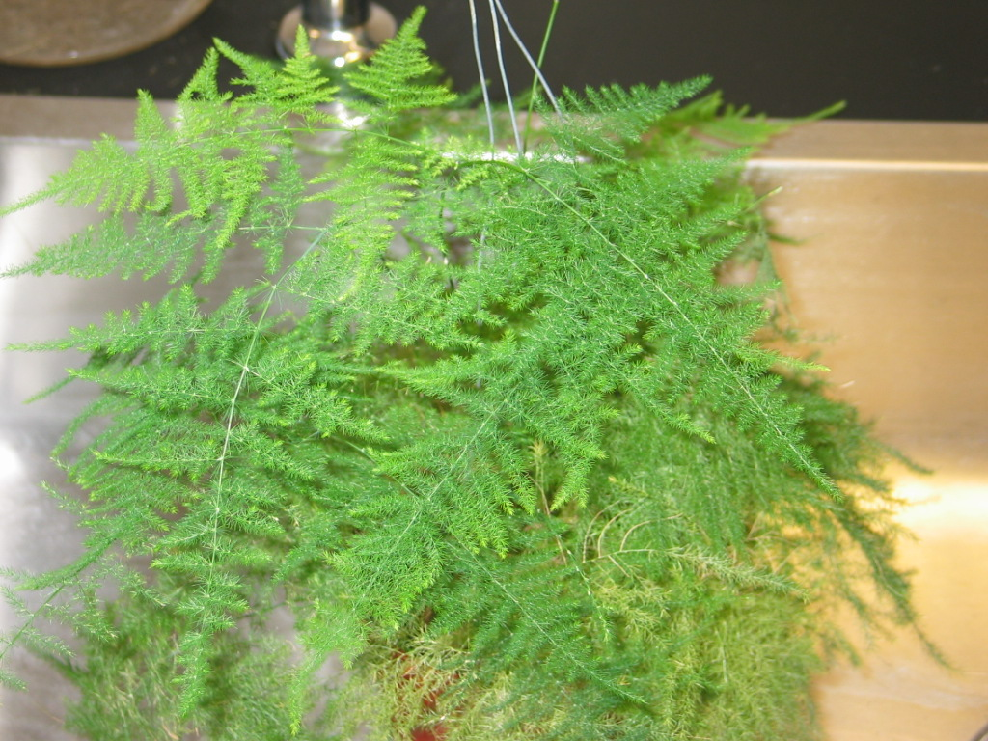
8
Notes:
110
Asparagus setaceus
Asparagus “Fern”
Photo courtesy of Allison Touchstone

Slide 10
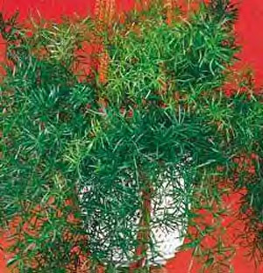
9
Notes:
109
Asparagus densiflorus ‘Sprengeri’
Sprengeri “Fern”
Seedman.com

Slide 11
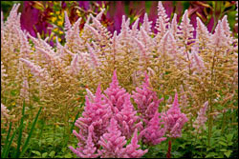
10
Notes:
111
Astilbe hybrid cv.
Astilbe
Americanmeadows.com

Slide 12
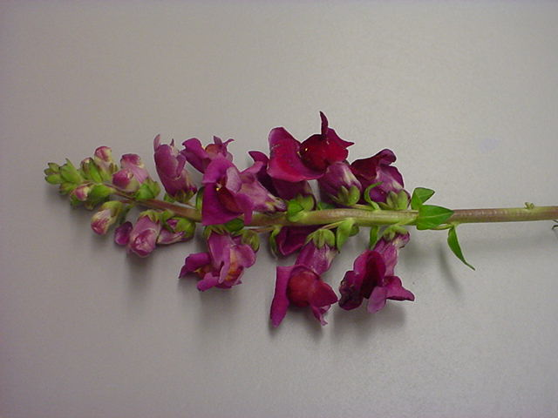
11
Notes:
105
Antirrhinum majus cv.
Snapdragon
Photo courtesy of Brenda Patten

Slide 13
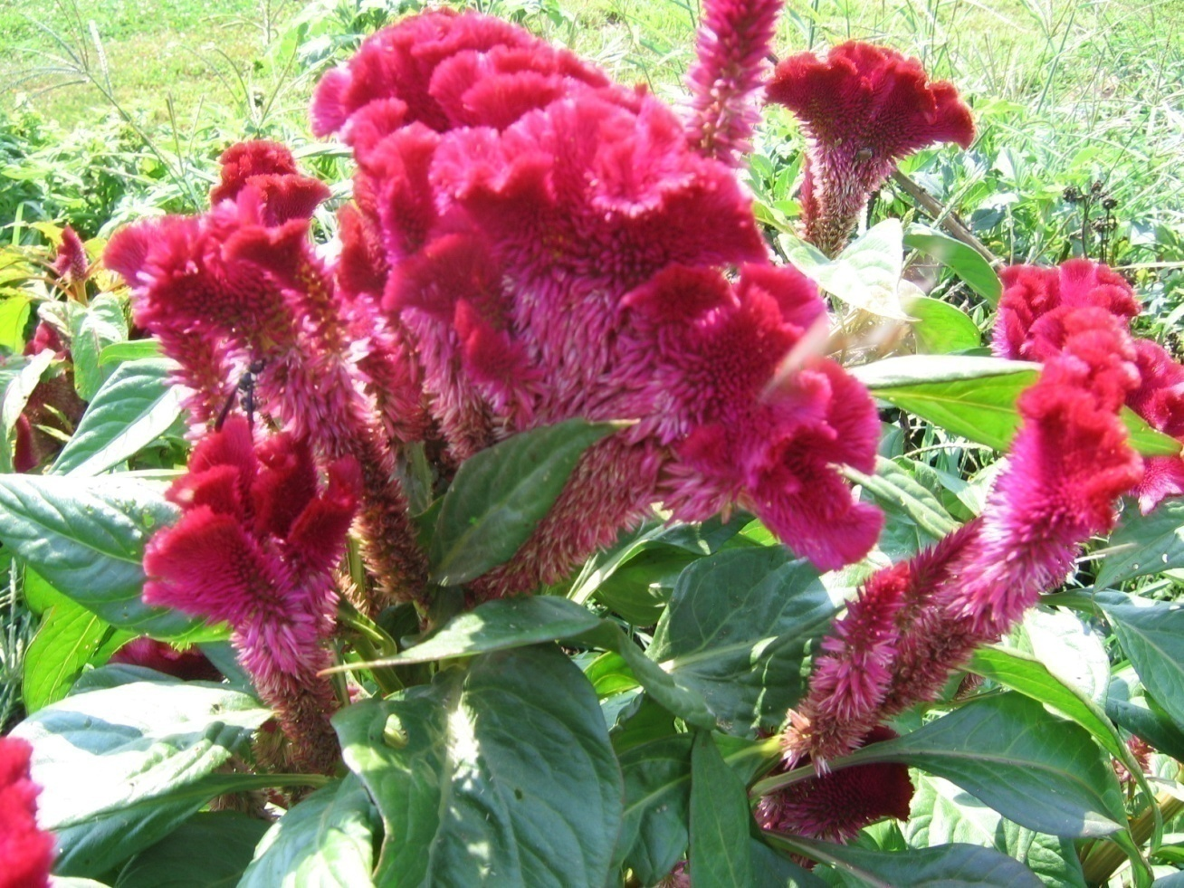
12
Notes:
121
Celosia argentea
Cockscomb
Horseandbuggyproduce.com
Flickr.com

Slide 14
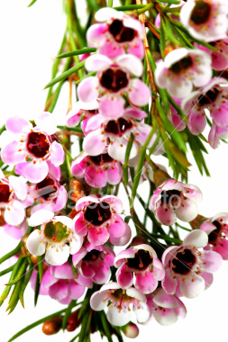
13
Notes:
123
Chamelaucium uncinatum
Wax flower
Toptropicals.com
Istockphoto.com

Slide 15
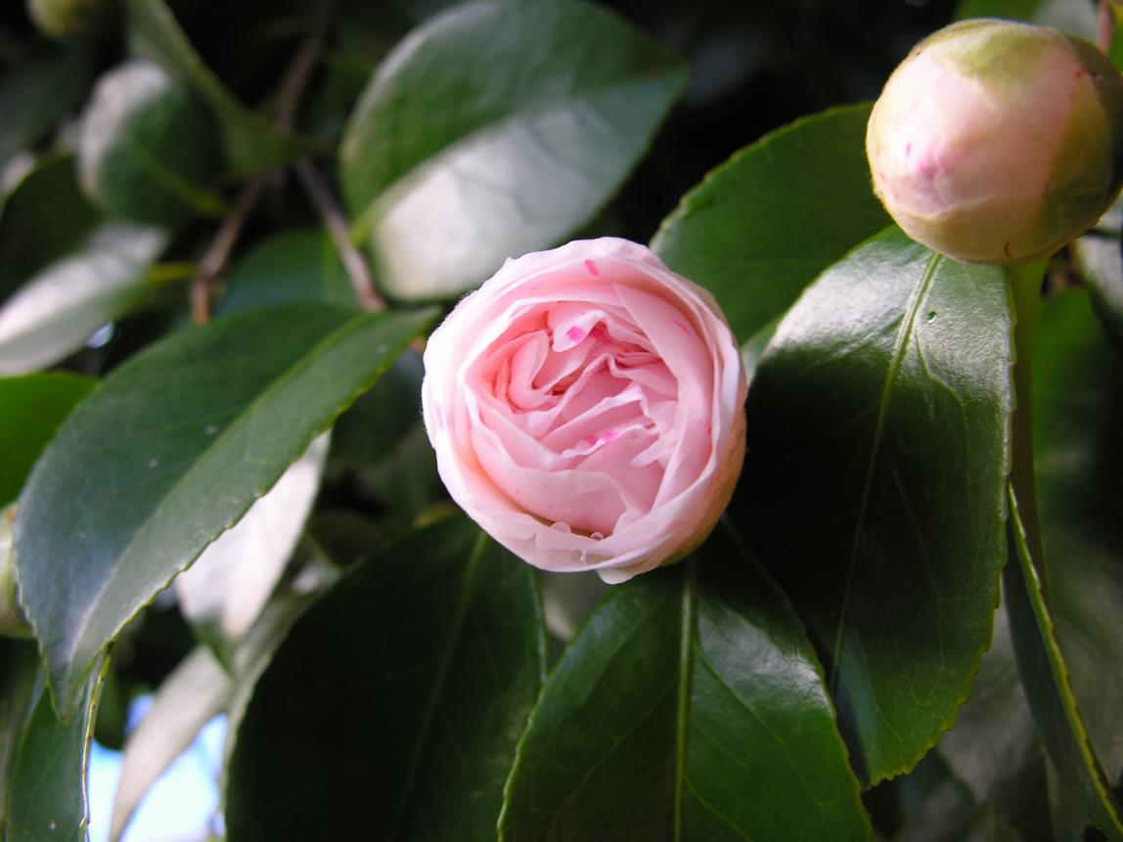
14
Notes:
117
Camellia japonica cv.
Common Camellia
Uploads.wikimedia.org

Slide 16
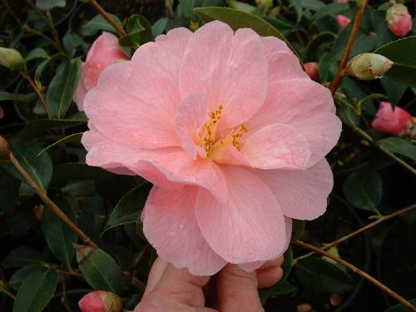
15
Notes:
112
Begonia x tuberhybrida cv.
Tuberous Begonia
Extension.unh.edu

Slide 17
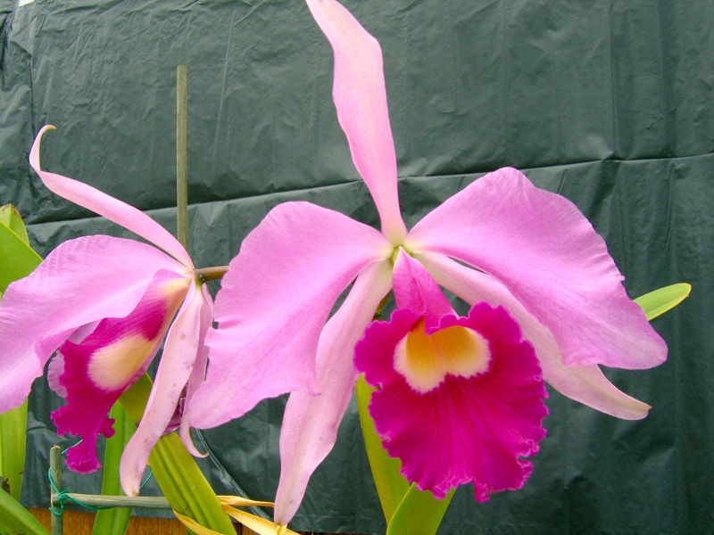
16
Notes:
120
Cattleya cv.
Cattleya Orchid Hybrid
Portchids.com
Imagesschack.us

Slide 18
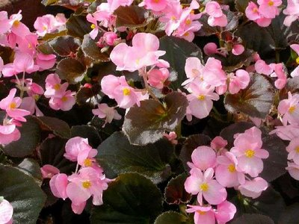
17
Notes:
113
Begonia x semperflorens-cultorum
Wax Begonia
Bpl.blogger.com

Slide 19
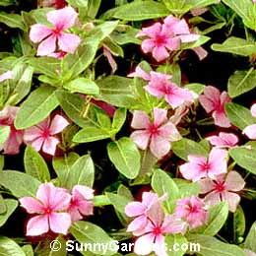
18
Notes:
119
Catharanthus roseus
Madagascar Periwinkle
Sunnygardens.com

Slide 20
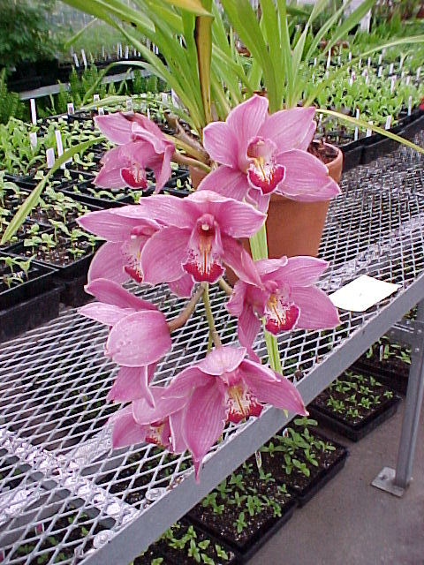
19
Notes:
134
Cymbidium cv.
Cymbidium Orchid
Photo courtesy of Allison Touchstone

Slide 21
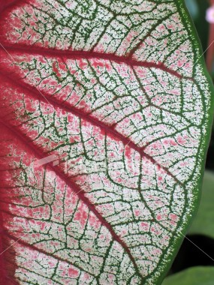
20
Notes:
114
Caladium x hortulanum cv.
Fancy-Leaved Caladium
Istockphoto.com

Slide 22
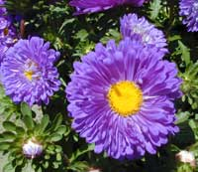
21
Notes:
116
Callistephus chinensis cv.
China Aster
Gardenmusic.com

Slide 23
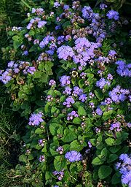
22
Notes:
102
Ageratum mexicanum cv.
Ageratum
Uploadwikipedia.org

Slide 24
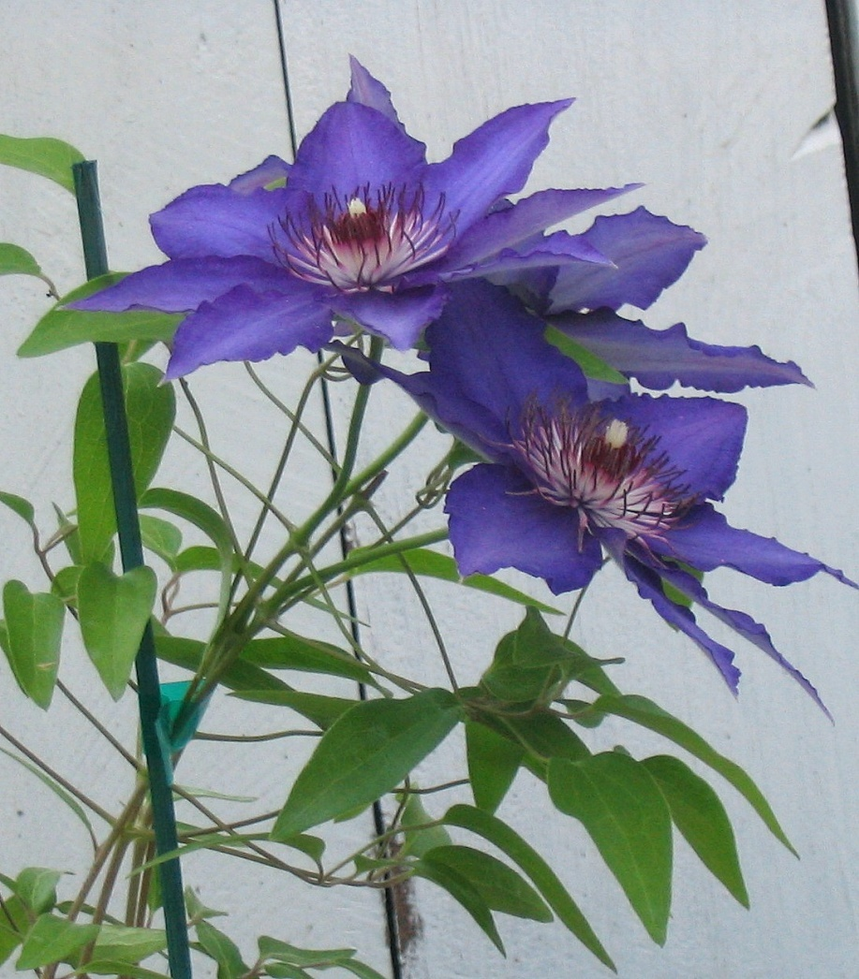
23
Notes:
129
Clematis Jackmanii Group cv.
Clematis
Wikimedia.org

Slide 25
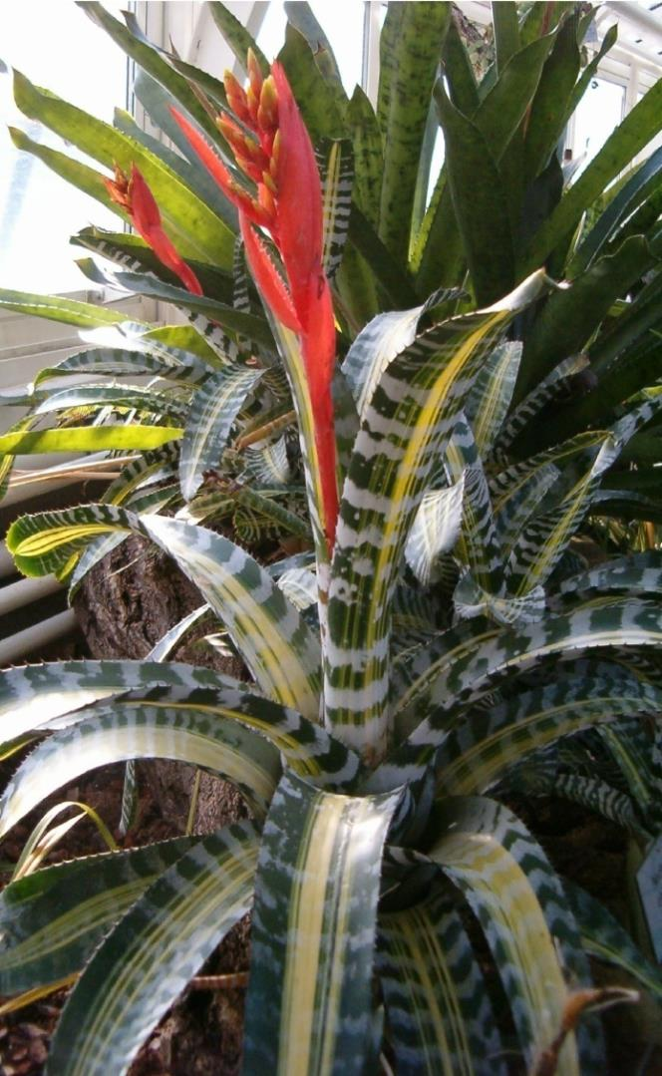
24
Notes:
101
Aechmea chantinnii cv.
Bromeliad
Uploadwikipedia.org

Slide 26
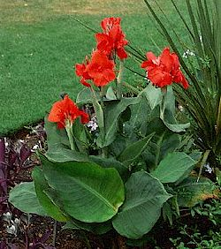
25
Notes:
118
Canna x generalis cv.
Common Garden Canna
Gardenguides.com

Slide 27
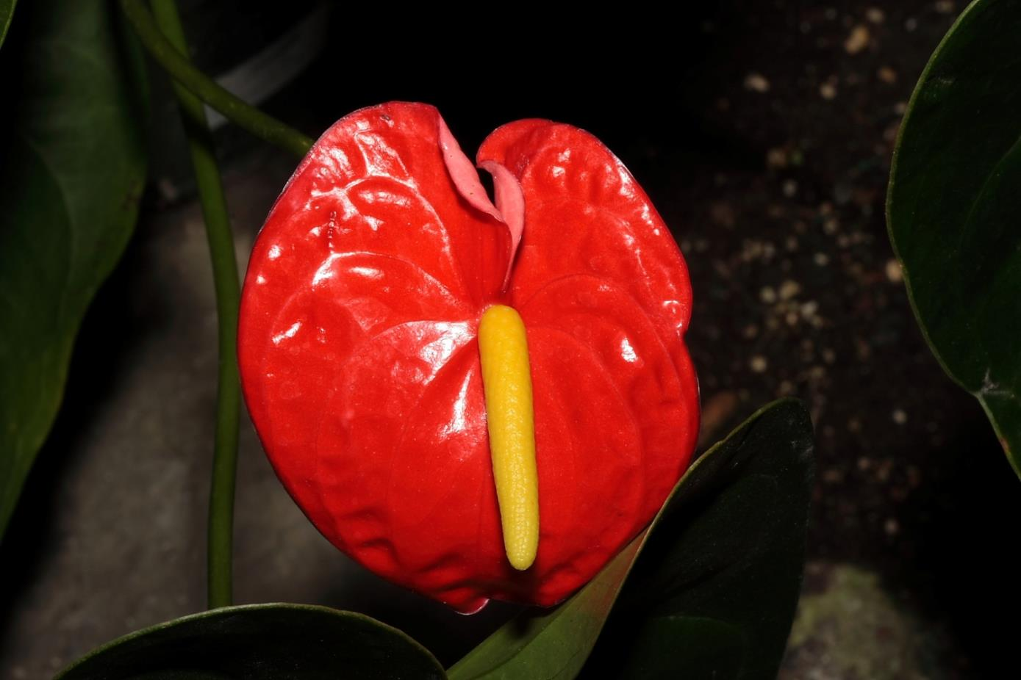
26
Notes:
106
Anthurium x andraeanum cv.
Anthurium, Flamingo Lily
Uploadwikimedia.org

Slide 28
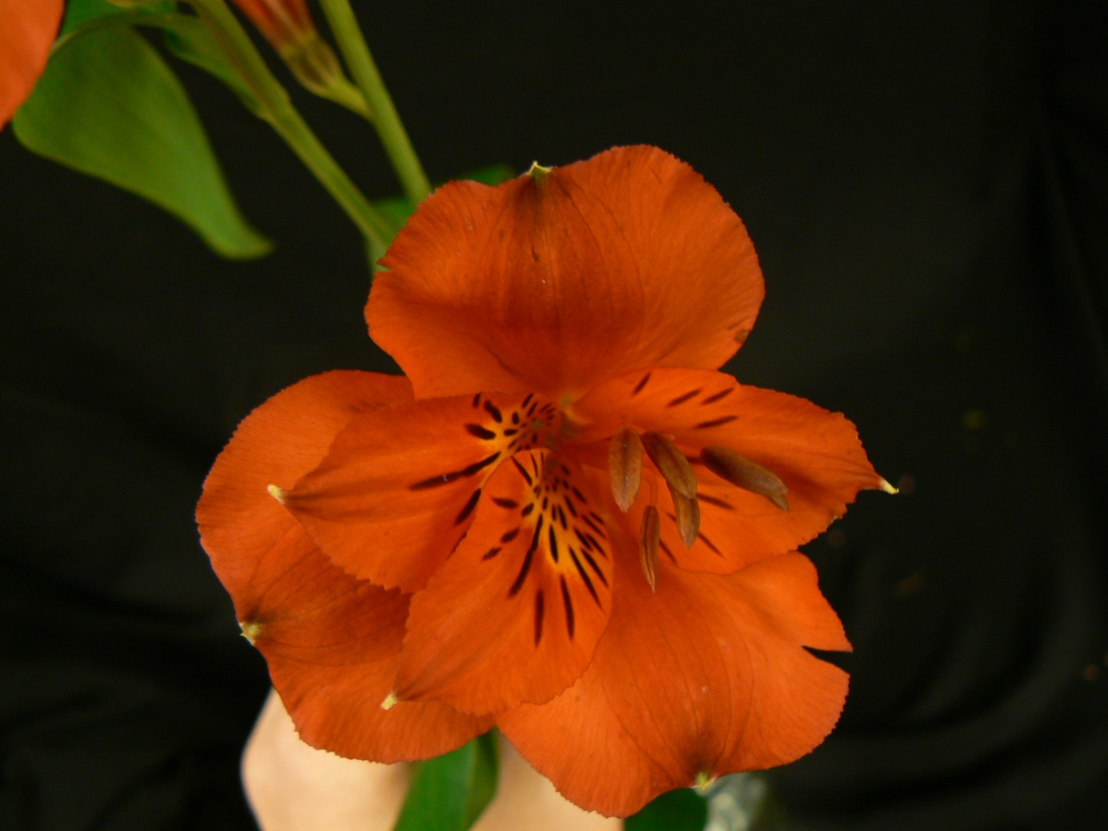
27
Notes:
104
Alstromeria aurantiaca
Peruvian Lily
Photo courtesy of Brenda Patten

Slide 29
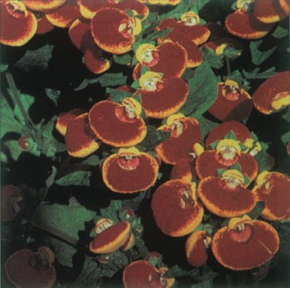
28
Notes:
115
Calceolaria crenatiflora cv.
Pocketbook Plant
Howstuffworks.com

Slide 30
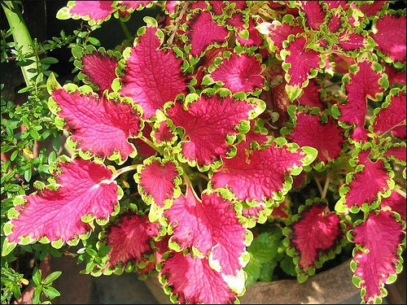
29
Notes:
131
Coleus x hybridus
Coleus

Slide 31
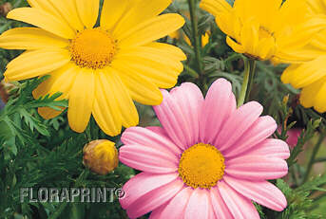
30
Notes:
125
Chrysanthemum x frutescens
Marguerite Daisy

Slide 32
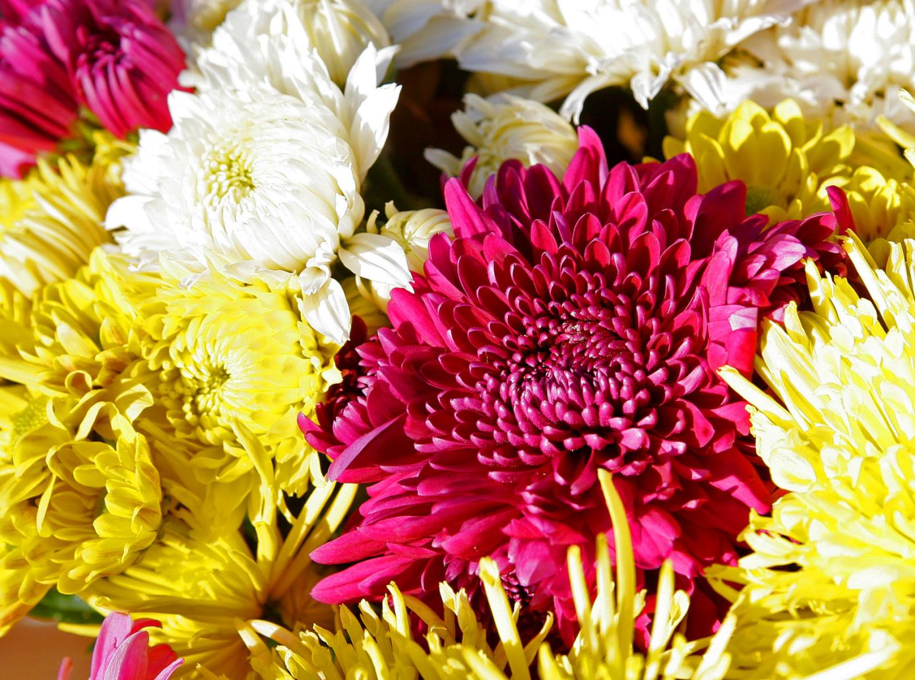
31
Notes:
126
Chrysanthemum x morifolium cv.
Florist’s Chrysanthemum
Wikimedia.org

Slide 33
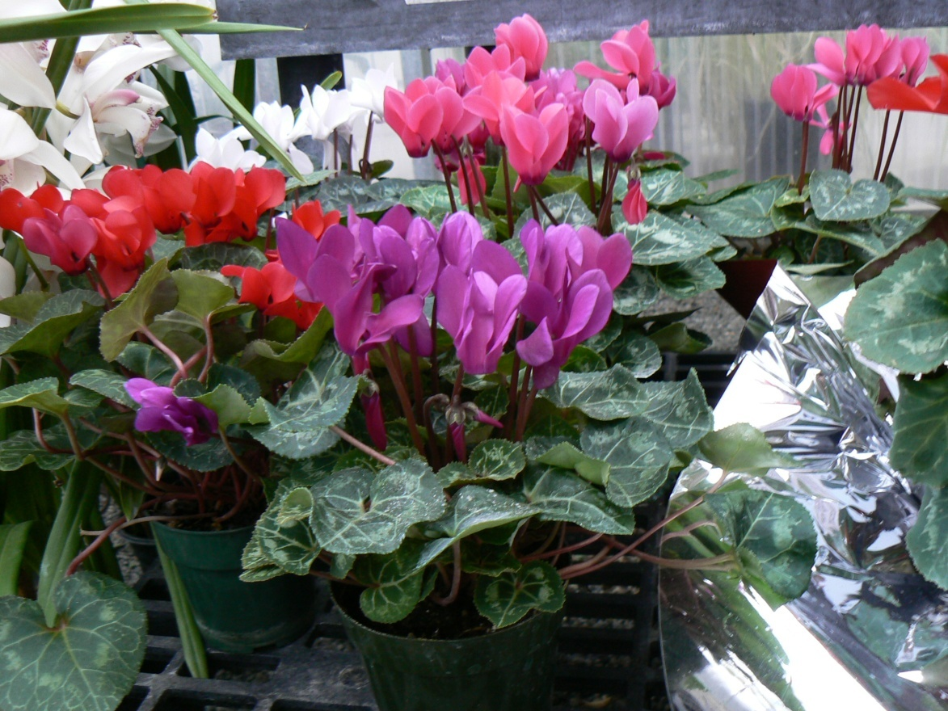
32
Notes:
133
Cyclamen x persicum cv.
Florist’s Cyclamen
Photo courtesy of Brenda Patten

Slide 34
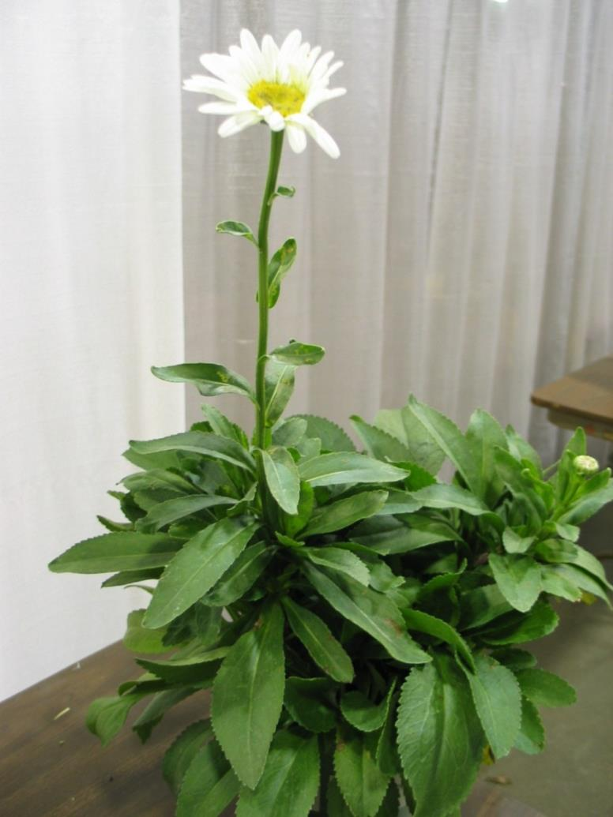
33
Notes:
127
Chrysanthemum x superbum cv.
Shasta Daisy

Slide 35
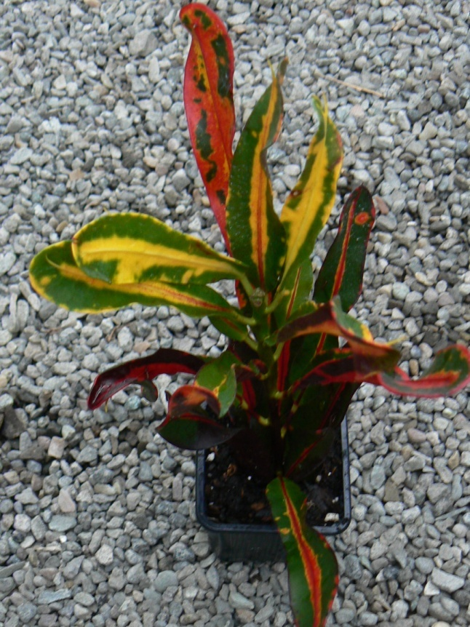
34
Notes:
130
Codiaeum variegatum pictum cv.
Croton
Photo courtesy of Brenda Patten

Slide 36
Floriculture Plant
Identification Quiz
D-F
135-151

Slide 37
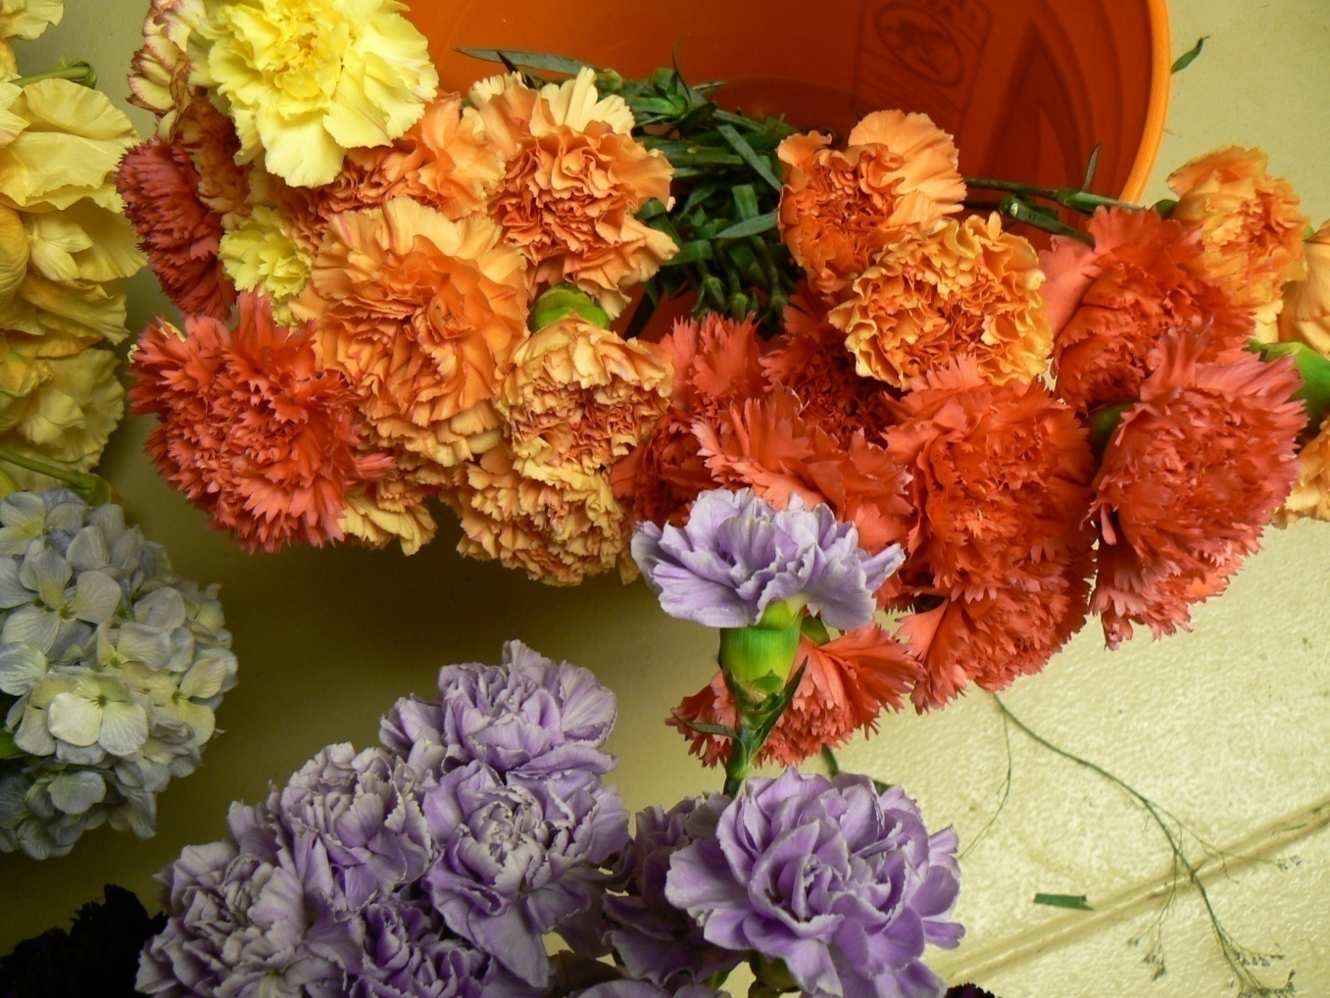
1
Notes:
135
Dianthus caryophyllus cv.
Carnation
Photo courtesy of Brenda Patten

Slide 38
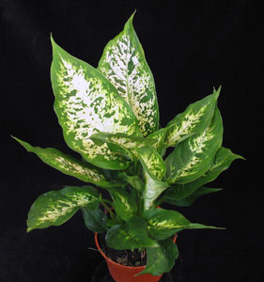
2
Notes:
136
Dieffenbachia maculata cv.
Spotted Dumbcane
Flowerservant.com

Slide 39
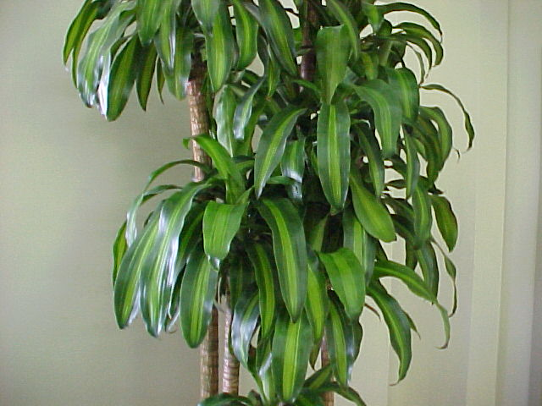
3
Notes:
137
Dracaena fragrans ‘Massangeana’
Corn Plant Dracaena
Mgonline.com

Slide 40
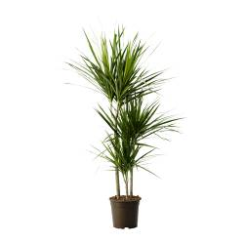
4
Notes:
138
Dracaena cincta
Red Edge Dracaena
Ikea.com

Slide 41
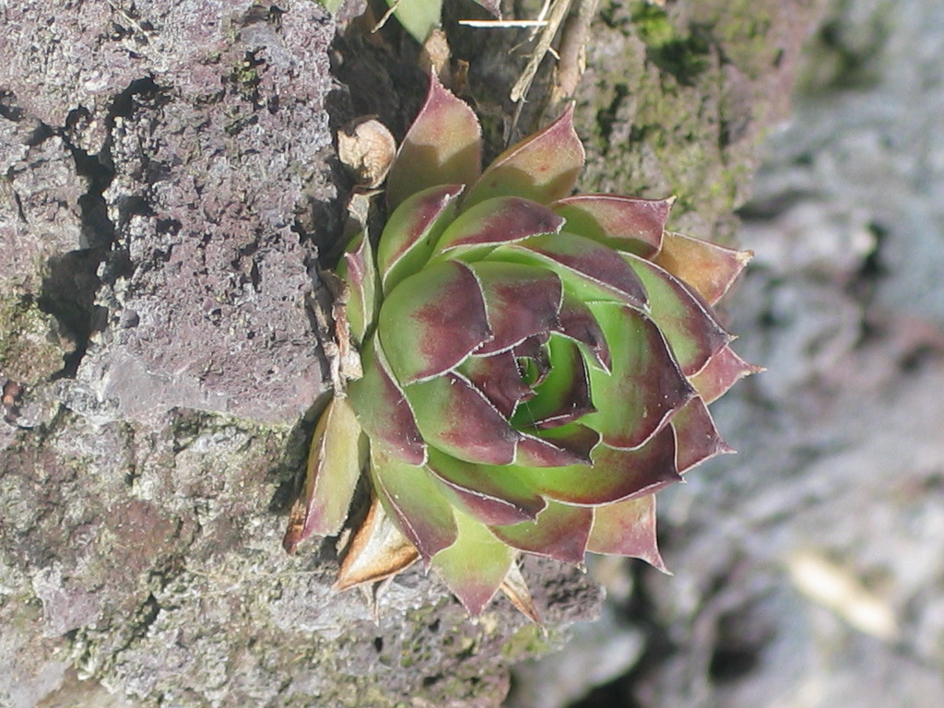
5
Notes:
139
Echeveria cv.
Hens and Chickens
Photo courtesy of Allison Touchstone

Slide 42
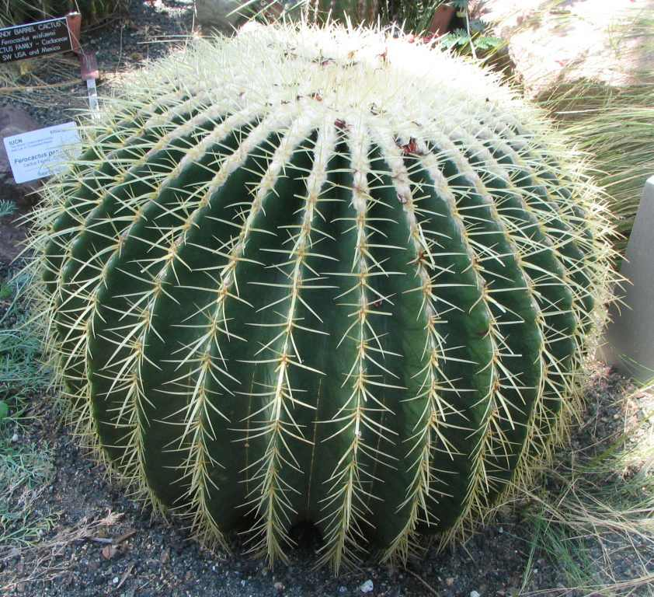
6
Notes:
140
Echinocactus cv.
Barrel Cactus
Wikimedia.org

Slide 43
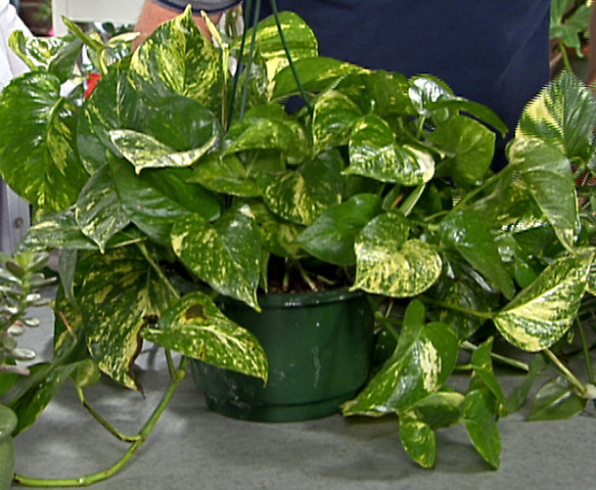
7
Notes:
141
Epipremnum aureum cv.
Golden Pothos, Devil’s Ivy
Img.hgtv.com

Slide 44
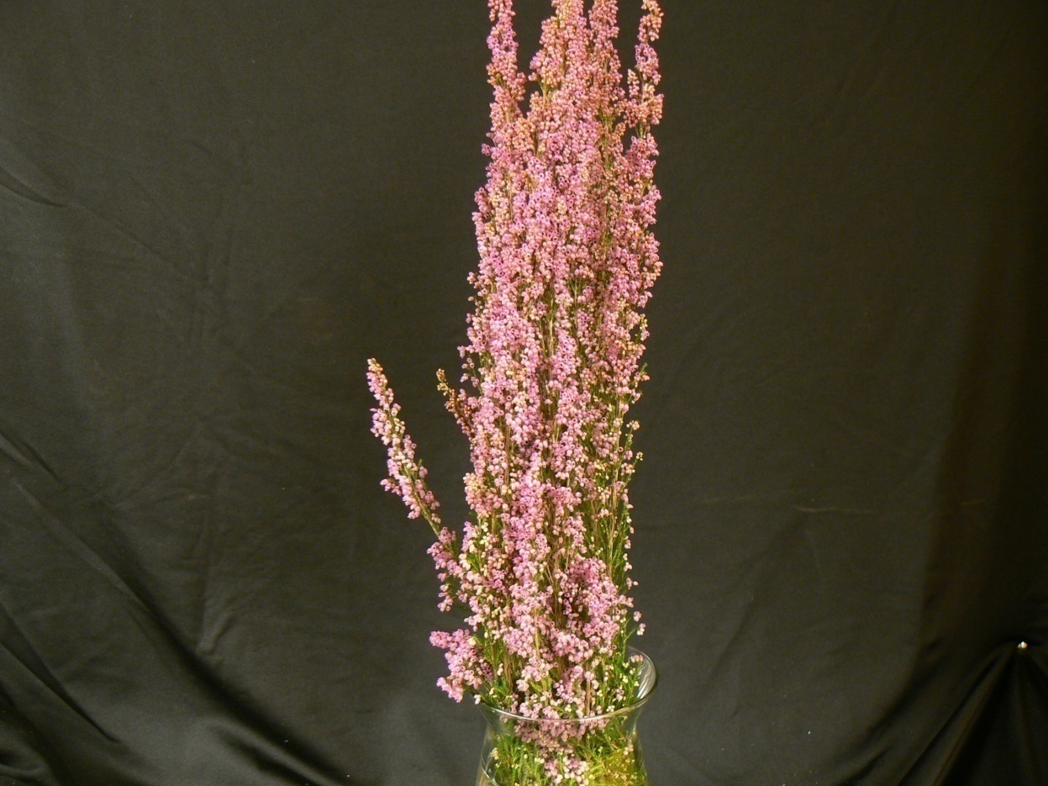
8
Notes:
142
Erica carnea cv.
Spring Heather
Photo courtesy of Brenda Patten

Slide 45
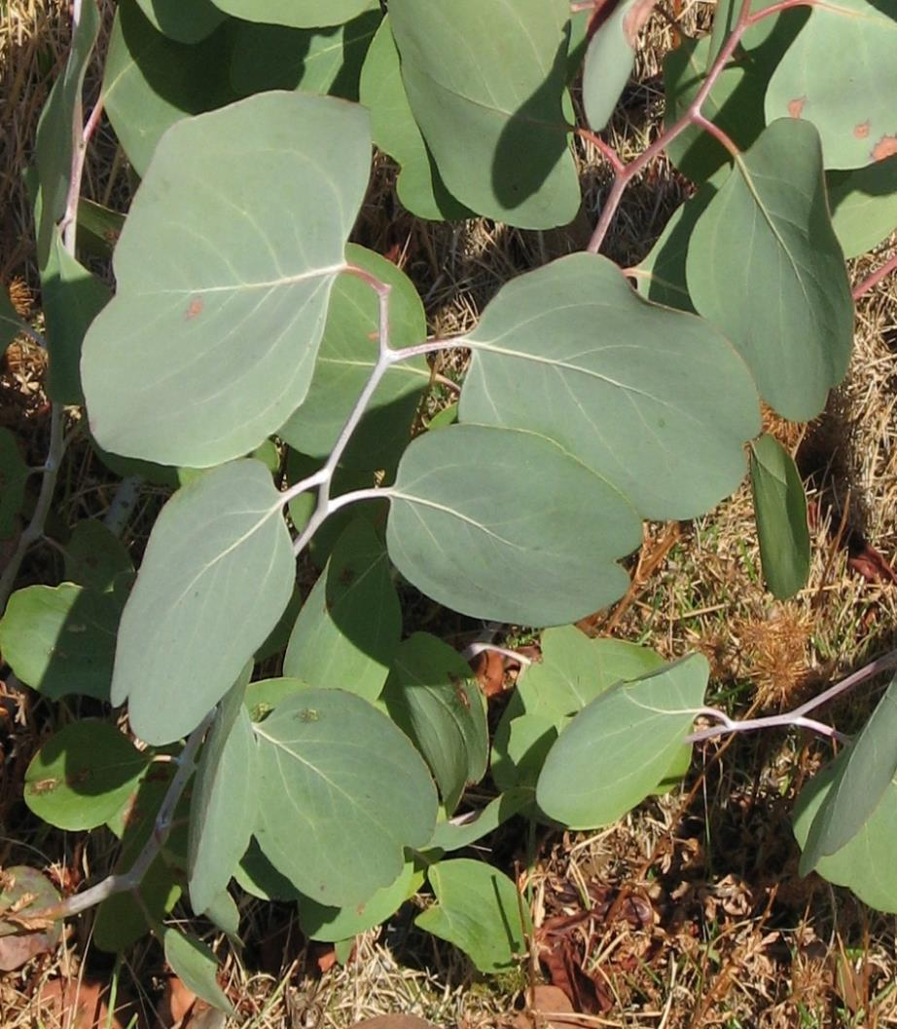
9
Notes:
143
Eucalyptus polyanthemos
Silver Dollar Gum
Upload.wikimedia.org

Slide 46
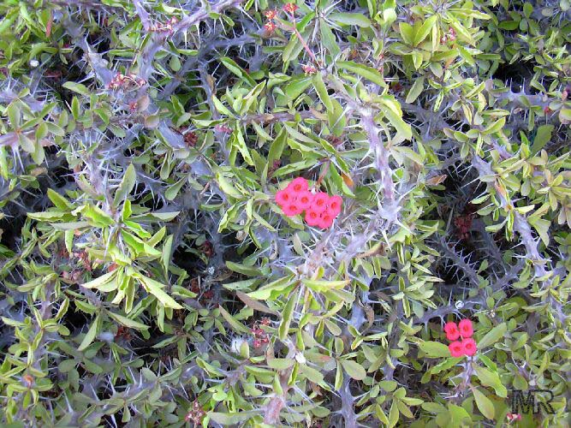
10
Notes:
144
Euphorbia milii splendens
Crown-of-Thorns
Toptropicals.com

Slide 47
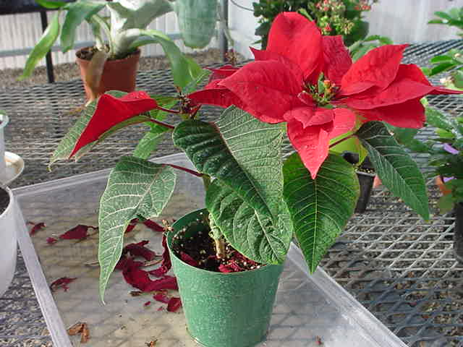
11
Notes:
145
Euphorbia pulcherrima cv.
Poinsettia
Photo courtesy of Brenda Patten

Slide 48
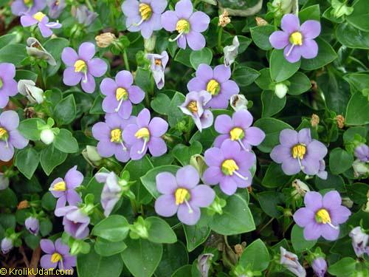
12
Notes:
146
Exacum affine
German (Persian) Violet
Toptropicals.com

Slide 49
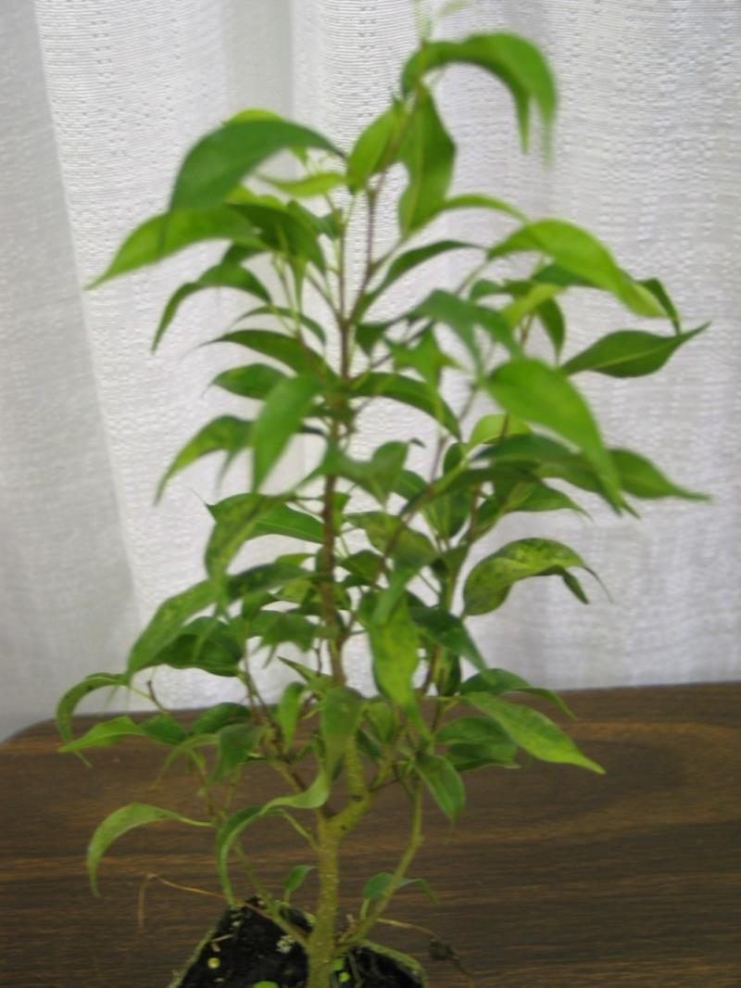
13
Notes:
147
Ficus benjamina ‘Exotica’
Benjamin Fig
Photo courtesy of Allison Touchstone

Slide 50
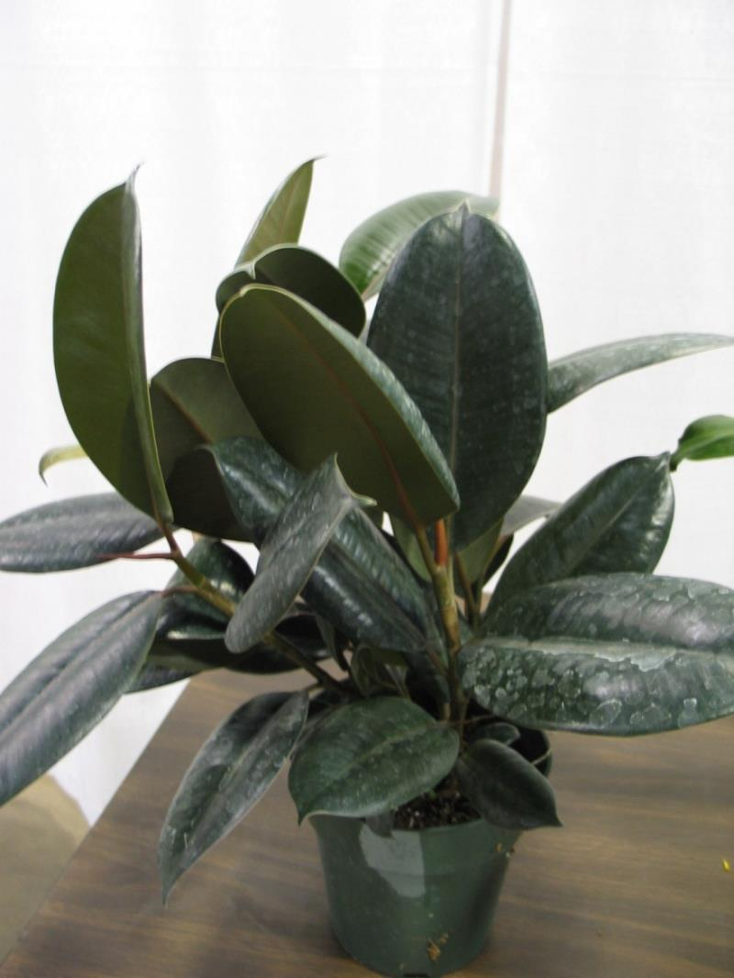
14
Notes:
148
Ficus elastica ‘Decora’
‘Decora’ Rubber Plant
Photo courtesy of Allison Touchstone

Slide 51
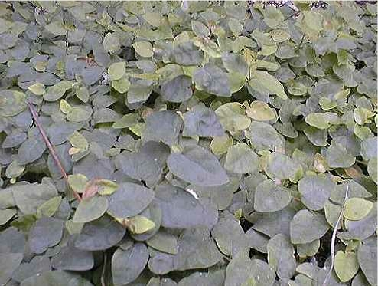
15
Notes:
149
Ficus pumia
Creeping Rubber Plant
Turfarm.com

Slide 52
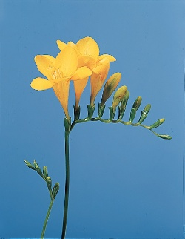
16
Notes:
150
Freesia x hybrida
Freesia
Dubaiflowers.net

Slide 53

17
Notes:
151
Frittonia verschaffeltii
Oklahoma State University

Slide 54
Floriculture Plant
Identification Quiz
G-L
152-174

Slide 55

1
Notes:
157
Hedra helix cv.
English Ivy
Photo courtesy of Allison Touchstone

Slide 56

2
Notes:
161
Hosta undulata
Plantain Lily
Photo courtesy of Allison Touchstone

Slide 57

3
Notes:
158
Heptapleurum arboricola
Dwarf Schefflera, Dwarf Octopus Plant
Cloveflorist.com

Slide 58

4
Notes:
162
Hoya carnosa
Wax Plant
Upload.wikimedia.org

Slide 59

5
Notes:
155
Gynura aurantiaca ‘Sarmentosa’
“Purple Passion”, Velvet Plant
Upload.wikimedia.org

Slide 60

6
Notes:
153
Gladiolus x hortulanus cv.
Garden Gladiolus
Photo courtesy of Brenda Patten

Slide 61

7
Notes:
156
Gypsophila elegans cv.
Baby’s Breath
Blossomswap.com

Slide 62

8
Notes:
152
Gardenia jasminoides ‘Fortuniana’
Gardenia
Upload.wikimedia.org

Slide 63

9
Notes:
171
Lilium longiflorum cv.
Trumpet (Easter) Lily
Content.answers.com

Slide 64

10
Notes:
174
Lobularia maritima
Sweet Alyssum
Upload.wikimedia.org

Slide 65

11
Notes:
159
Hemerocallis cv.
Daylily
Findmeplants.co.uk

Slide 66

12
Notes:
154
Gerbera jamesonii
Transvaal Daisy

Slide 67

13
Notes:
165
Impatiens hybrid cv.
Impatiens
Fotosearch.com

Slide 68

14
Notes:
172
Lilium x hybridum cv.
Hybrid (Garden) Lily
Worldofgardens.ca

Slide 69

15
Notes:
167
Iris x xiphium cv.
Dutch Iris
Easytogrowbulbs.com

Slide 70

16
Notes:
163
Hyacinthus orientalis cv.
Hyacinth
Istockphoto.com

Slide 71

17
Notes:
170
Liatris spicata
Liatris
Upload.wikimedia.org

Slide 72

18
Notes:
166
Iris x germanica florentina cv.
Flag (Bearded) Iris
Home.comcast.net

Slide 73

19
Notes:
173
Limonium sinuatum
Statice
Upload.wikimedia.org

Slide 74

20
Notes:
160
Hippeastrum hybrid cv.
Amaryllis
Photo courtesy of Allison Touchstone

Slide 75

21
Notes:
168
Justicia brandegeana
Shrimp Plant
Toptropicals.com

Slide 76

22
Notes:
164
Hydrangea macrophylla cv.
French (Florist’s) Hydrangea
Photo courtesy of Brenda Patten

Slide 77

23
Notes:
169
Kalanchoe x blossfeldiana cv.
Kalanchoe
Upload.wikimedia.org

Slide 78
Floriculture Plant
Identification Quiz
M-R
175-203

Slide 79

1
Notes:
191
Phalaenopsis cv.
Phalaenopsis (Butterfly) Orchid
Orchidconsultant.com

Slide 80

2
Notes:
176
Matthiola incana cv.
Flowering Stock
Photo courtesy of Brenda Patten

Slide 81

3
Notes:
201
Rhododenron cv.
Azalea
Photo courtesy of Brenda Patten

Slide 82

4
Notes:
198
Polianthes tuberosa
Tuberose
Kvbwholesale.com

Slide 83

5
Notes:
202
Rosa hybrid, Class Hybrid Tea cv.
Hybrid Tea Rose
Photo courtesy of Brenda Patten

Slide 84

6
Notes:
178
Narcissus pseudonarcissus cv.
Daffodil
Upload.wikimedia.org

Slide 85

7
Notes:
183
Paphiopedilum x hybrid cv.
Ladyslipper Orchid
I3.photobucket.com

Slide 86

8
Notes:
181
Opuntia tribe cv.
Cactus
Upload.wikimedia.org

Slide 87

9
Notes:
184
Pelargonium x domesticum cv.
Regal (Martha Washington) Geranium
Peoriagardens.com

Slide 88

10
Notes:
200
Primula malacoides cv.
Fairy Primrose
Photo courtesy of Brenda Patten

Slide 89

11
Notes:
190
Petunia x hybrida cv.
Common Garden Petunia
Photo courtesy of Allison Touchstone

Slide 90

12
Notes:
182
Paeonia cv.
Peony
Binnyplants.co.uk

Slide 91

13
Notes:
185
Pelargonium x hortorum cv.
(Zonal) Geranium
Upload.wikimedia.com

Slide 92

14
Notes:
188
Peperomia caperata
Emerald Ripple Peperomia
Photo courtesy of Brenda Patten

Slide 93

15
Notes:
177
Monstera deliciosa
Cutleaf “Philodendron”
Photo courtesy of Allison Touchstone

Slide 94

16
Notes:
193
Pilea cadierei
Aluminum Plant
Upload.wikimedia.org

Slide 95

17
Notes:
187
Peperomia argyreia
Watermelon Peperomia
Toptropicals.com

Slide 96

18
Notes:
203
Rumohra adiantiformis
Leatherleaf Fern
Photo courtesy of Allison Touchstone

Slide 97

19
Notes:
175
Marnata leuconeura var. kerchoviana
Prayer Plant
Photo courtesy of Brenda Patten

Slide 98

20
Notes:
195
Pilea microphylla
Artillery Plant
Upload.wikimedia.org

Slide 99

21
Notes:
186
Pelargonium peltatum cv.
Ivy Geranium
Photo courtesy of Allison Touchstone

Slide 100

22
Notes:
197
Plectranthus mummularis
Swedish Ivy
Photo courtesy of Allison Touchstone

Slide 101

23
Notes:
196
Pilea nummularifolia
Creeping Charley
Upload.wikimedia.org

Slide 102

24
Notes:
189
Peperomia obtusifolia ‘Variegata’
Variegated Peperomia
Waterroots.com

Slide 103

25
Notes:
180
Nephrolepis exalta cv.
Boston Fern
Photo courtesy of Allison Touchstone

Slide 104

26
Notes:
192
Philodendron scandens oxycardium
Heartleaf Philodendron
Photo courtesy of Allison Touchstone

Slide 105

27
Notes:
194
Pilea involucrata
Friendship Plant
Toptropicals.com

Slide 106

28
Notes:
179
Neoregelia carolinae ‘Tricolor’
Bromeliad
Waterroots.com

Slide 107

29
Notes:
199
Primula x polyanthus cv.
Polyanthus (Primrose)
Photo courtesy of Allison Touchstone

Slide 108
Floriculture Plant
Identification Quiz
S-Z
204-224

Slide 109

1
Notes:
208
Schlumbergera
Christmas Cactus
Photo courtesy of Allison Touchstone

Slide 110

2
Notes:
220
Tulipa cv.
Tulip
Photo courtesy of Allison Touchstone

Slide 111

3
Notes:
211
Senecio x hybridus cv.
Florist’s Cineraria
Howstuffworks.com

Slide 112

4
Notes:
212
Sinningia speciosa fiana
Group cv.
Gloxinia
Thefloweringgarden.com

Slide 113

5
Notes:
222
Viola x wittrockiana cv.
(Garden) Pansy
Photo courtesy of Allison Touchstone

Slide 114

6
Notes:
218
Tagetes species cv.
Marigold
Photo courtesy of Allison Touchstone

Slide 115

7
Notes:
214
Spathiphyllum clevelandii
White Athurium, Peace Lily
Photo courtesy of Allison Touchstone

Slide 116

8
Notes:
223
Zebrina pendula cv.
Wandering Jew

Slide 117

9
Notes:
215
Stephanotis floribunda
Stephanotis
Burncoose.co.uk

Slide 118

10
Notes:
205
Salvia splendens cv.
Salvia
Landscaping.about.com

Slide 119

11
Notes:
209
Schlumbergera truncata cv.
Thanksgiving Cactus, Crab Cactus
Photo courtesy of Brenda Patten

Slide 120

12
Notes:
213
Solanum pseudocapsicum cv.
Jerusalem Cherry
Worldofstock.com

Slide 121

13
Notes:
216
Strelitzia reginae
Bird-of-Paradise
Flickr.com

Slide 122

14
Notes:
221
Vaccinium ovatum
Florist’s “Huckleberry”

Slide 123

15
Notes:
207
Saxifraga stolonifera
Strawberry Plant
Davesgarden.com

Slide 124

16
Notes:
224
Zinnia elegans
Zinnia
Flickr.com

Slide 125

17
Notes:
217
Syngonium podophyllum
Nephthytis

Slide 126

18
Notes:
204
Saintpaulia ionantha cv.
African Violet
shootgardening.co.uk

Slide 127

19
Notes:
219
Tolmiea menziesii
Pickaback Plant
Flickr.com

Slide 128

20
Notes:
210
Senecio cineraria ‘Diamond’
Diamond Dusty Miller
Home.howstuffworks.com

Slide 129

21
Notes:
206
Sansevieria trifasciata cv.
Snake Plant
Evergrowing.com

