Slide 1
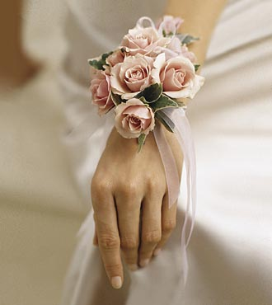
Personal flowers
Notes:
FTD

Slide 2
Personal flowers
Personal flowers: collectively, flowers designed to be worn or carried; also known as body flowers.
Boutonniere (old French-‘buttonhole’) a flower or cluster of flowers and/or foliage designed to be worn on the lapel.
Notes:
The American Institute of Floral Designers. The AIFD Guide to Floral Design. Terms, Techniques, and Traditions. The Intelvid Group, 2005.

Slide 3
Boutonnieres
Formal Dances
Groom
Male members of wedding party
Ring bearer
Special Occasions

Slide 4
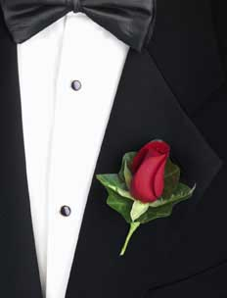
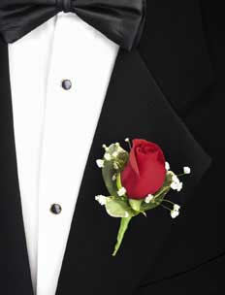
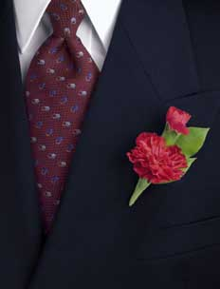
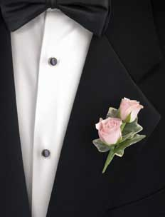
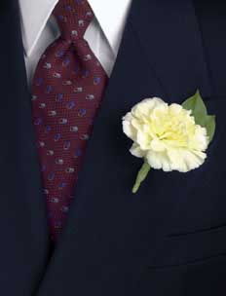
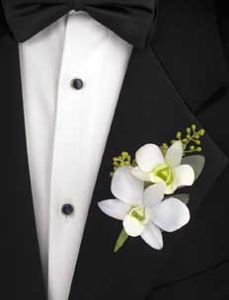

Slide 5
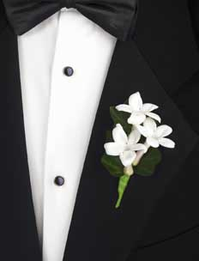
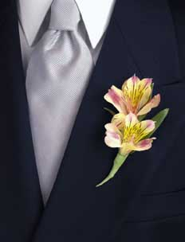
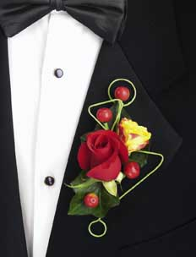

Slide 6
Corsages
Corsage: (old French, cors-‘body’) a decorative floral accessory typically worn on a woman’s garment.
Wrist corsage: a cluster of flowers to be worn on the wrist.
  Wristlet: a band or a strap with a device that is designed to secure a corsage which is then worn on the wrist.
Notes:
The American Institute of Floral Designers. The AIFD Guide to Floral Design. Terms, Techniques, and Traditions. The Intelvid Group, 2005.

Slide 7
Corsages
Formal Dances
Mother’s Day
Mothers of the Bride & Groom
Female members of the Bridal Party
Special Occasions

Slide 8
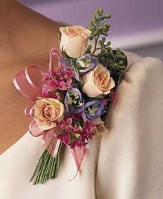
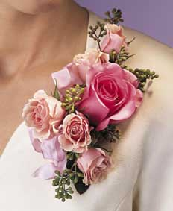

Slide 9
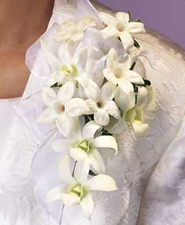
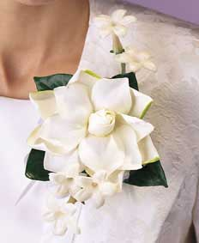

Slide 10
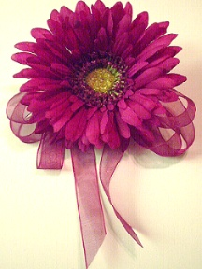

Slide 11
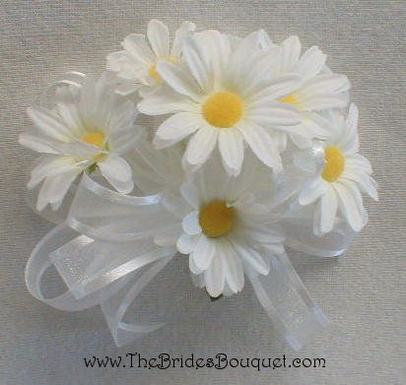

Slide 12
Notes:
FTD

Slide 13
Personal FLOWERS
Chaplet: a wreath or garland for the head, usually constructed of flowers and foliage
Notes:
The American Institute of Floral Designers. The AIFD Guide to Floral Design. Terms, Techniques, and Traditions. The Intelvid Group, 2005.

Slide 14
Lei: a garland of flowers or foliage strung, bound or woven together to be worn around the neck or shoulders; of Polynesian origin.
Notes:
The American Institute of Floral Designers. The AIFD Guide to Floral Design. Terms, Techniques, and Traditions. The Intelvid Group, 2005.

Slide 15
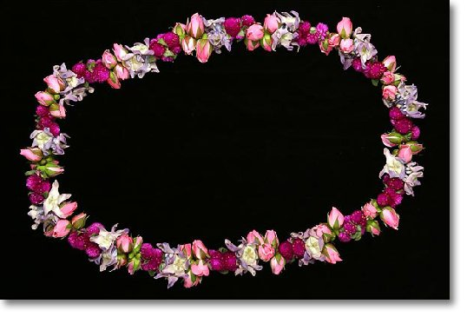
lei
Notes:
Paradiseflowers.com

Slide 16
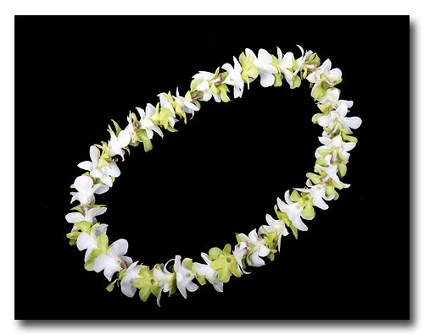
lei
Notes:
Paradiseflowers.com

Slide 17
Composite flowers: a hand-tailored ‘flower’ created by reassembling detached petals or other plant parts. Plant materials are wired and/or glued together, forming a new flower.
Notes:
The American Institute of Floral Designers. The AIFD Guide to Floral Design. Terms, Techniques, and Traditions. The Intelvid Group, 2005.

Slide 18
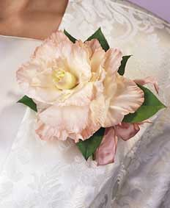

Slide 19
Floral jewelry: finely detailed fashion flowers created in the manner of select jewelry; Examples include floral necklaces, bracelets, anklets and rings.
  Anklet: a narrow band of flowers designed to be worn around the ankle.
  Bracelet: a narrow ornamental band or chain of flowers worn around the wrist. This design is often constructed using an inexpensive metal or plastic bracelet with flowers affixed or glued to it.
Notes:
The American Institute of Floral Designers. The AIFD Guide to Floral Design. Terms, Techniques, and Traditions. The Intelvid Group, 2005.

Slide 20
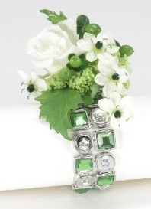

Slide 21
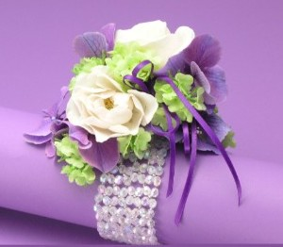

Slide 22
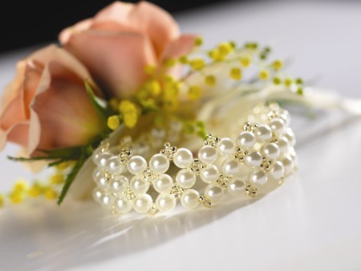

Slide 23
Examples of Student Activities

Slide 24
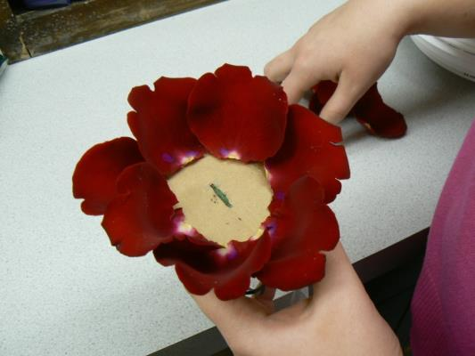
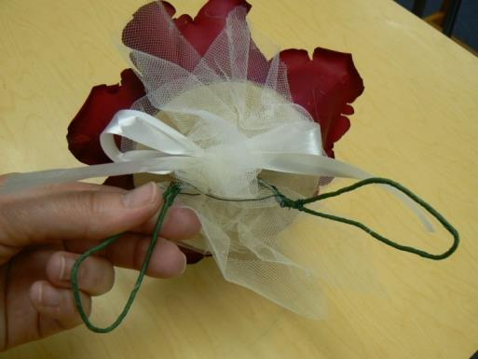
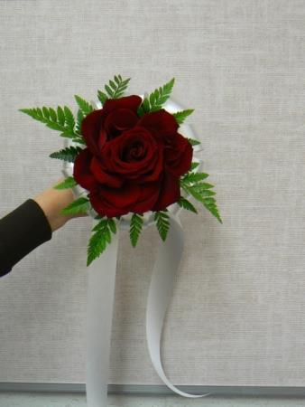
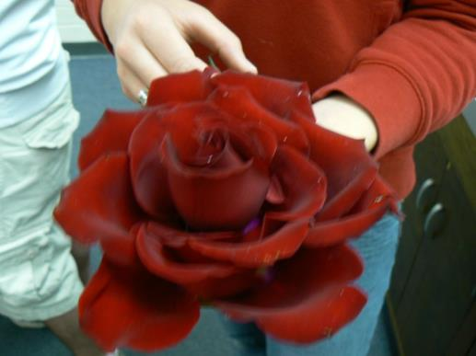
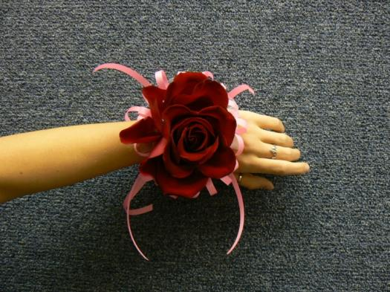
Composite Flowers

Slide 25
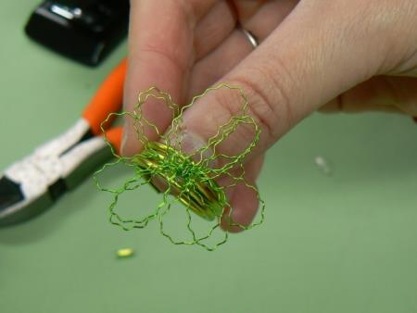
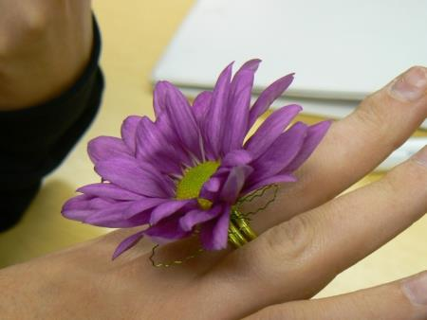
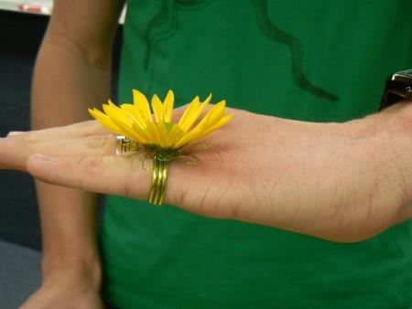
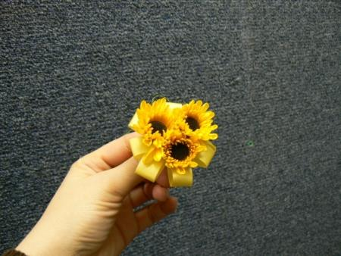
Flower Rings

Slide 26
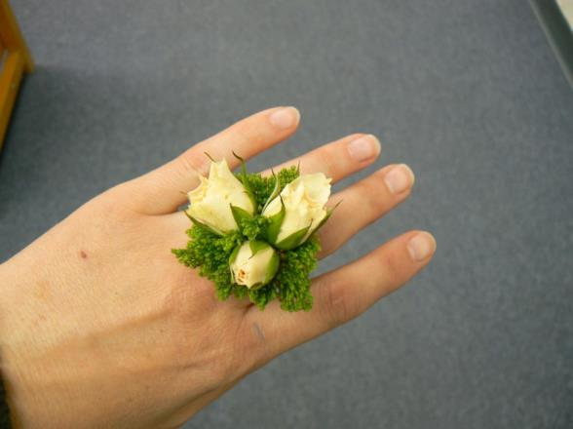
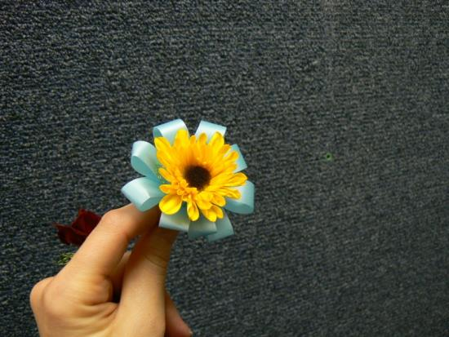
Flower Rings

Slide 27
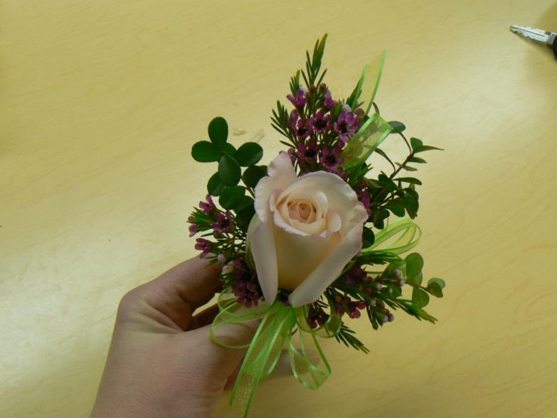
Single Rose Corsage

