Slide 1
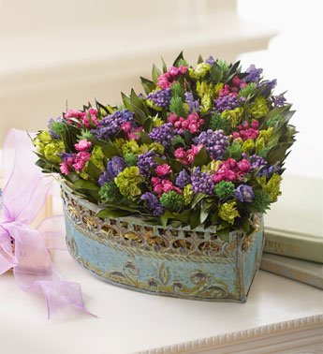
Permanent & Preserved Botanicals
Notes:
FTD

Slide 2
Advantages to Permanent & Preserved Botanicals
Made prior to sale
Store easily
No water
Container
Time
Stem length
No wilting
Dismantled
Exact colors
Allergies
Relatively inexpensive
Notes:
Hunter, Norah T., The Art of Floral Design Second Edition Delmar 2000.

Slide 3
Disadvantages to Permanent & Preserved Botanicals
Dust, fading, outdated
Storage
Lack fragrance
Not really permanent
Notes:
Hunter, Norah T., The Art of Floral Design Second Edition Delmar 2000.

Slide 4
Permanent Botanicals
Artificial flowers: a general term for products manufactured to simulate natural plant materials.
Permanent flowers and foliage: nonperishable plant materials such as fabric-based artificial flowers.
Notes:
The American Institute of Floral Designers, The AIFD Guide to Floral Design: Terms, Techniques, and Traditions. Intelvid Group 2005

Slide 5
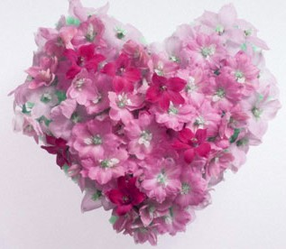
Artificial Flowers
Notes:
Saveoncrafts.com

Slide 6
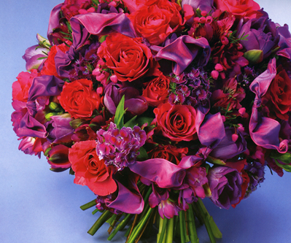
Artificial Flowers
Notes:
Saveoncrafts.com

Slide 7
Permanent Botanicals
Silk flowers: artificial plant materials constructed with a wide variety of fabrics, not necessarily made of silk.
Fabric flowers: an artificial flower or other plant material made from any of several different types of fabric. Fabrics such as Rayon, linen, cotton, polyester, silk, etc. are frequently used.
Plastic flowers: a term originally used to define artificial flowers made from polyurethane
Notes:
The American Institute of Floral Designers, The AIFD Guide to Floral Design: Terms, Techniques, and Traditions. Intelvid Group 2005

Slide 8
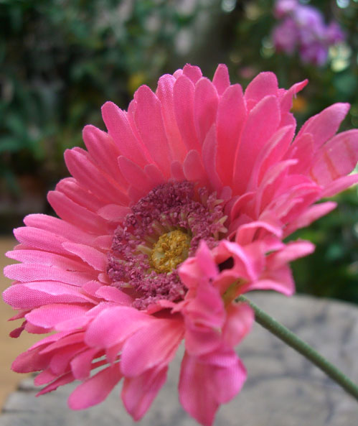
Artificial Flowers
Notes:
Saveoncrafts.com

Slide 9
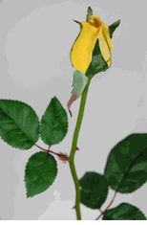
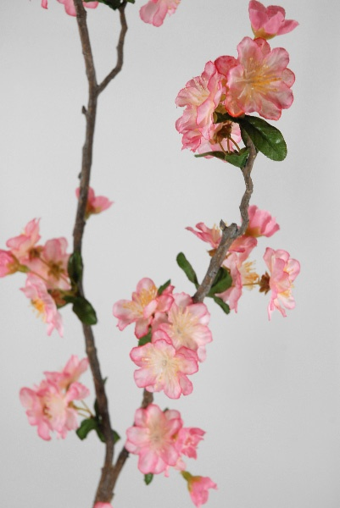
Artificial Flowers
Notes:
Saveoncrafts.com

Slide 10
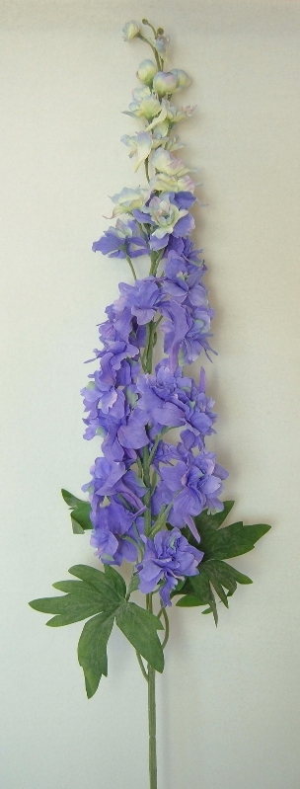
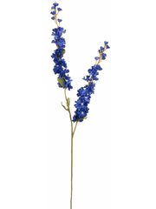
Artificial Flowers
Notes:
Saveoncrafts.com

Slide 11
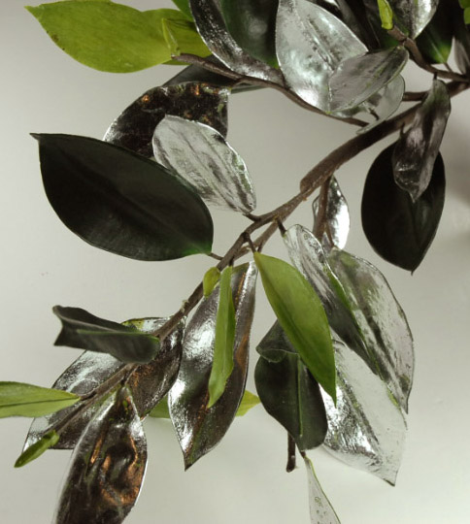
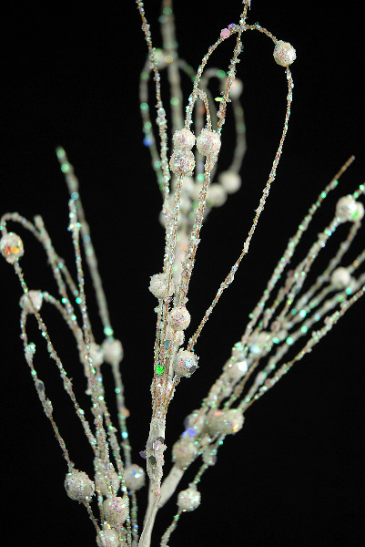
Artificial greenery & branches
Notes:
Saveoncrafts.com

Slide 12
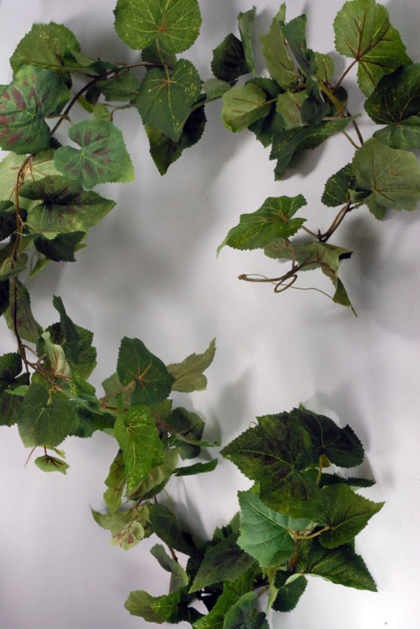
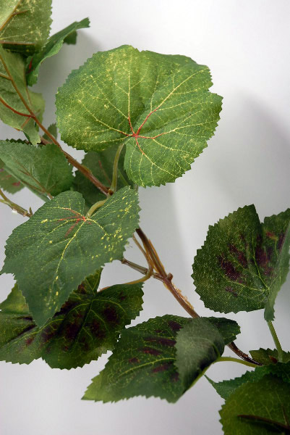
Artificial Greenery
Notes:
Saveoncrafts.com

Slide 13
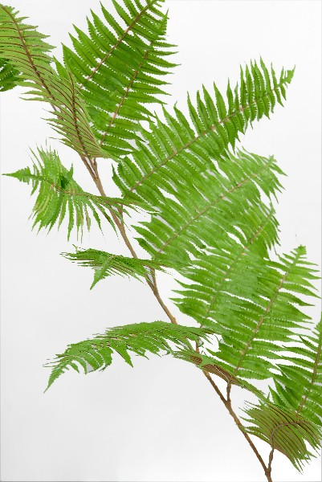
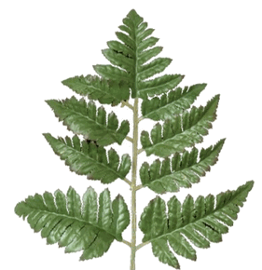
Artificial Greenery
Notes:
Saveoncrafts.com

Slide 14
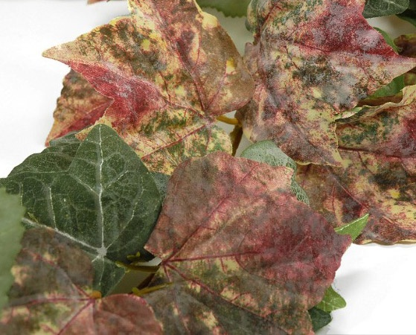
Artificial Greenery
Notes:
Saveoncrafts.com

Slide 15
Permanent Botanicals
Poly-vinyl chloride/PVC: a general term used to define artificial evergreens, such as pine, fir, and spruce, manufactured from PVC and used to make wreaths, garlands, Christmas trees, etc.
Notes:
The American Institute of Floral Designers, The AIFD Guide to Floral Design: Terms, Techniques, and Traditions. Intelvid Group 2005

Slide 16
Permanent Botanicals
Botanically correct: manufactured or assembled in a way that accurately reproduces the appearance or habit of a natural plant material.
Latex botanical flower: an artificial plant material having stems, leaves, and/or petals coated with a latex-based product to simulate the feel and appearance of realism.
Notes:
The American Institute of Floral Designers, The AIFD Guide to Floral Design: Terms, Techniques, and Traditions. Intelvid Group 2005

Slide 17
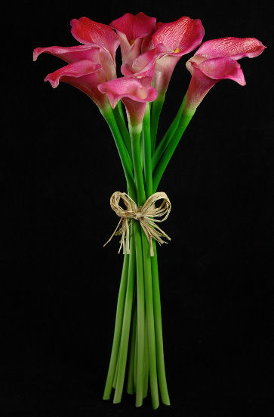
Permanent Botanicals
Notes:
Saveoncrafts.com

Slide 18
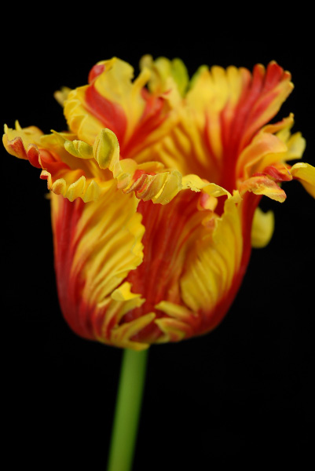
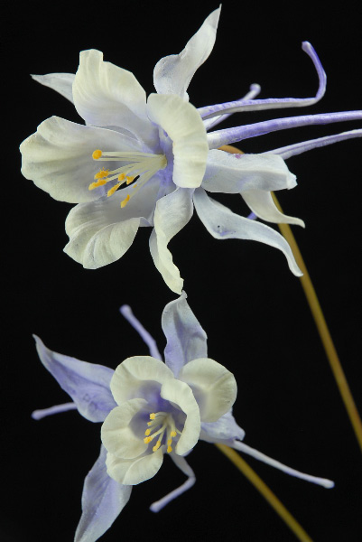
Permanent Botanicals

Slide 19
Permanent Botanicals
Hand wrapped: a category of artificial plant materials whose stems have been covered with floral tape. The item has been assembled and taped by hand vs. machine.
Molded stem: an artificial plant material having a synthetic stem which is made in a mold which gives it a botanically correct shape, texture, and overall appearance.
Notes:
The American Institute of Floral Designers, The AIFD Guide to Floral Design: Terms, Techniques, and Traditions. Intelvid Group 2005

Slide 20
Permanent Botanicals
Plastic stemmed: an artificial plant material having a polyurethane stem with a wire core and fabric flowers and leaves that have snap-on attachment.
Natural stemmed: a permanent botanical specimen with an authentic, dried stem from a natural plant material, such as a branch, on which artificial foliage and/or flowers are secured.
Notes:
The American Institute of Floral Designers, The AIFD Guide to Floral Design: Terms, Techniques, and Traditions. Intelvid Group 2005

Slide 21
Permanent Botanicals
Bush: a typically inexpensive cluster of artificial flowers with stems joined together at the base into a single unit.
Notes:
The American Institute of Floral Designers, The AIFD Guide to Floral Design: Terms, Techniques, and Traditions. Intelvid Group 2005

Slide 22
Permanent Botanicals
Petal count: the number of flower petals manufactured to duplicate the natural bloom. A higher petal count can achieve a more realistic construction in flowers such as a peony or an open rose. Generally, the more layers of petals and artificial flower has, the higher the cost.
Double-petaled: hand wrapped artificial flowers having wire placed between two layers of a petal, resulting in a more realistic appearance.
Notes:
The American Institute of Floral Designers, The AIFD Guide to Floral Design: Terms, Techniques, and Traditions. Intelvid Group 2005

Slide 23
Preserved Botanicals
Dried flowers: fresh plant materials that are preserved by means of moisture removal.
Everlasting: a general term for dried flowers and seed heads which dry naturally, retaining their original appearance. Examples include plant materials such as statice, yarrow, globe amaranth, wheat, etc., that do not require a special preservation method.
Notes:
The American Institute of Floral Designers, The AIFD Guide to Floral Design: Terms, Techniques, and Traditions. Intelvid Group 2005

Slide 24
Preserved Botanicals
Preserved flowers/foliage: plant materials that have been treated in a way, such as by using glycerin, that prevents them from drying out.
Glycerin: an organic oil- or fat-based liquid used for preserving foliage and some flowers. When properly absorbed by the stems, it keeps plant materials soft and pliable.
Notes:
The American Institute of Floral Designers, The AIFD Guide to Floral Design: Terms, Techniques, and Traditions. Intelvid Group 2005

Slide 25
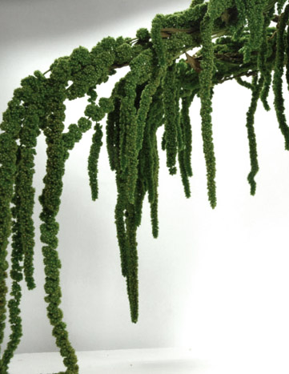
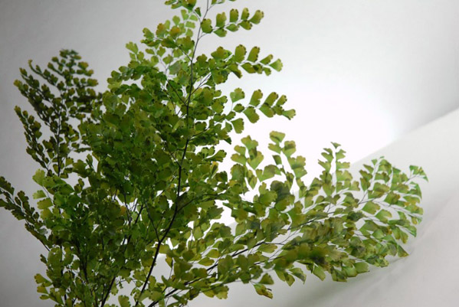
Preserved foliage
Notes:
Saveoncrafts.com

Slide 26
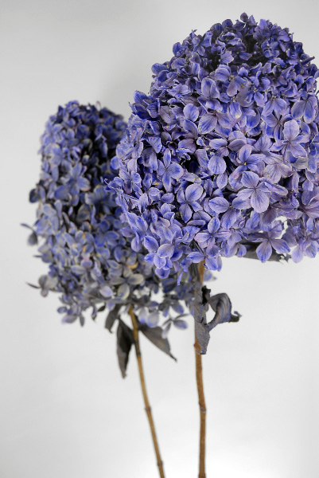
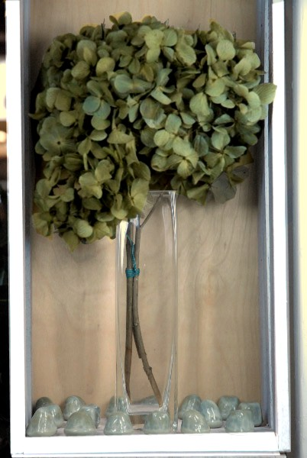
Glycerin preserved hydrangea
Notes:
Saveoncrafts.com

Slide 27
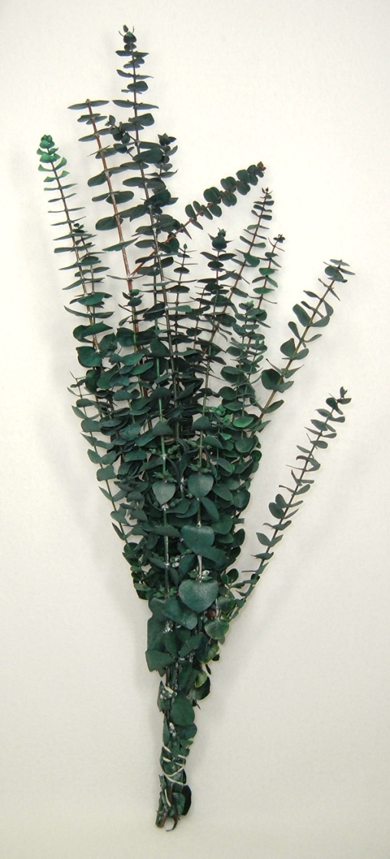
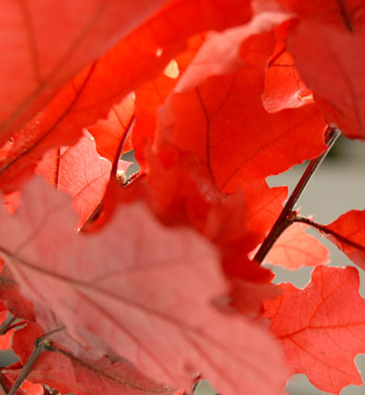
Glycerin preserved foliage
Notes:
Saveoncrafts.com

Slide 28
Preserved Botanicals
Desiccant: a substance that absorbs moisture; e.g., sand, alum, borax, cornmeal, and silica gel; often used to dry flowers and foliage.
Silica gel: a highly absorbent, amorphous form of silica that resembles white sand, used chiefly as a dehydrating agent for drying fresh plant materials
Notes:
The American Institute of Floral Designers, The AIFD Guide to Floral Design: Terms, Techniques, and Traditions. Intelvid Group 2005

Slide 29
Preserved Botanicals
Freeze drying: a process of drying plant materials. Materials are first frozen, then ice crystals are slowly removed from the plant cells through a vacuum system within a freeze-drying unit. Most flowers retain shape, suppleness, texture and color.
Notes:
The American Institute of Floral Designers, The AIFD Guide to Floral Design: Terms, Techniques, and Traditions. Intelvid Group 2005

Slide 30
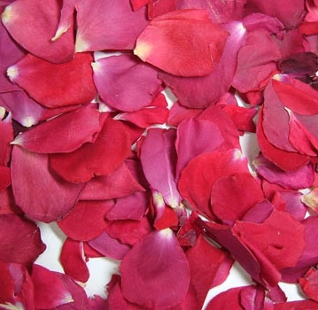
Freeze-dried Rose petals
Notes:
Saveoncrafts.com

Slide 31
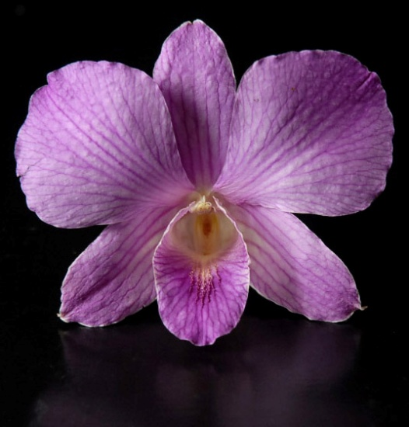
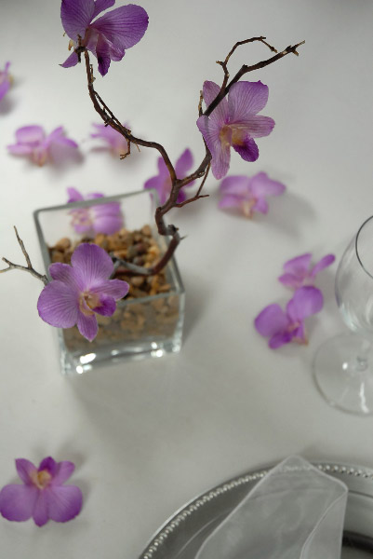
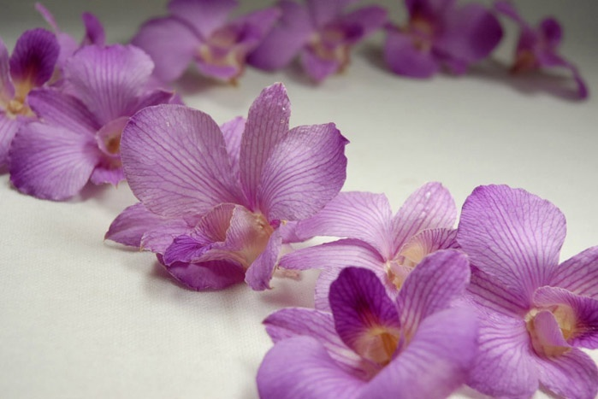
Freeze-dried dendrobium orchid
Notes:
Saveoncrafts.com

Slide 32
Air drying: a method of drying fresh flowers and foliage by leaving them out of water in the open air and allowing moisture of dissipate, often accomplished by hanging the plant material upside-down.
Notes:
The American Institute of Floral Designers, The AIFD Guide to Floral Design: Terms, Techniques, and Traditions. Intelvid Group 2005

Slide 33
Preserved Botanicals
Rack drying: a method of drying fresh materials by laying the plant material on an elevated, flat surface or screen to allow free movement of air, permitting moisture in the material to dissipate
Hanging: a method of air drying by hanging plant materials upside-down so as to prevent flower heads from drooping, thereby retaining their natural position.
Notes:
The American Institute of Floral Designers, The AIFD Guide to Floral Design: Terms, Techniques, and Traditions. Intelvid Group 2005

Slide 34
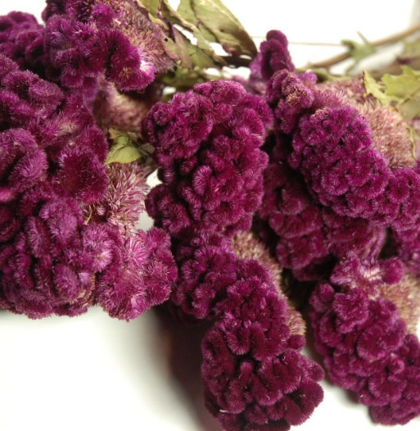
Air dried cockscomb
Notes:
Saveoncrafts.com

Slide 35
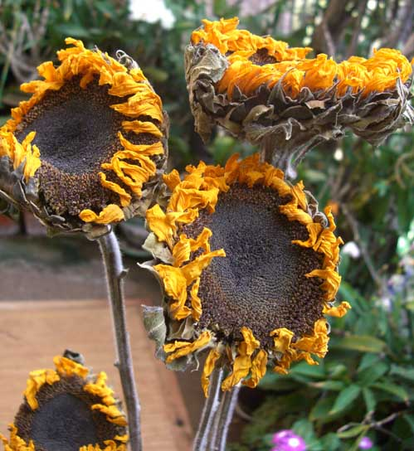
Air dried sunflowers
Notes:
Saveoncrafts.com

Slide 36
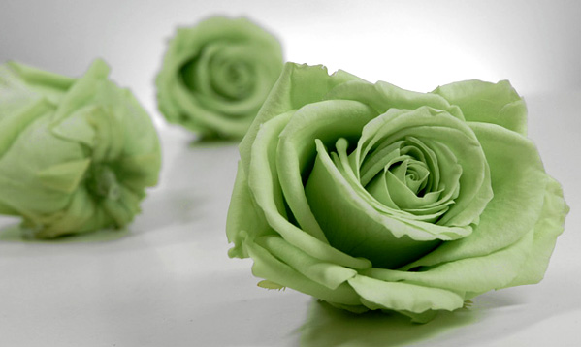
Preserved green roses
Notes:
Saveoncrafts.com

Slide 37
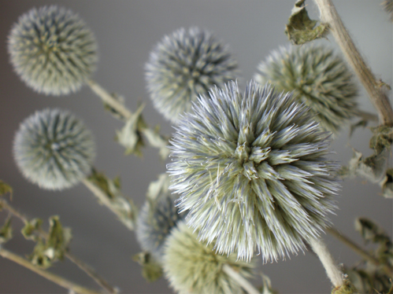
Air Dried flowers
Notes:
Saveoncrafts.com

Slide 38
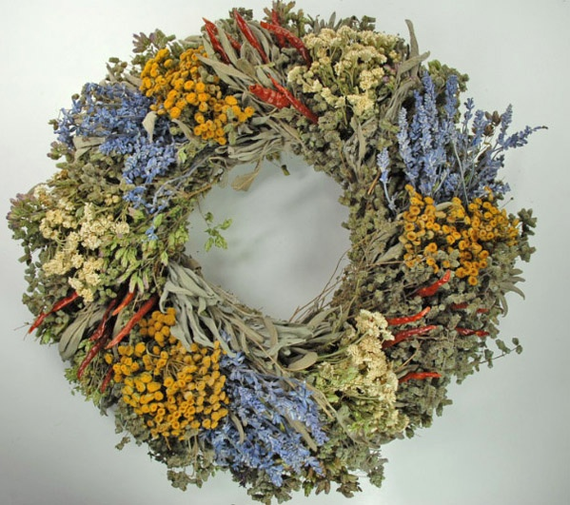
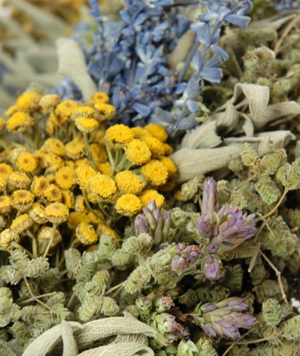
Air-dried wreath
Notes:
Saveoncrafts.com

Slide 39
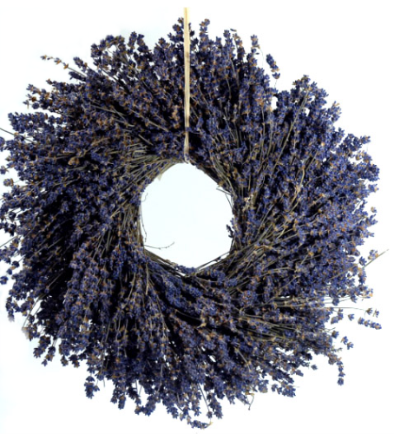
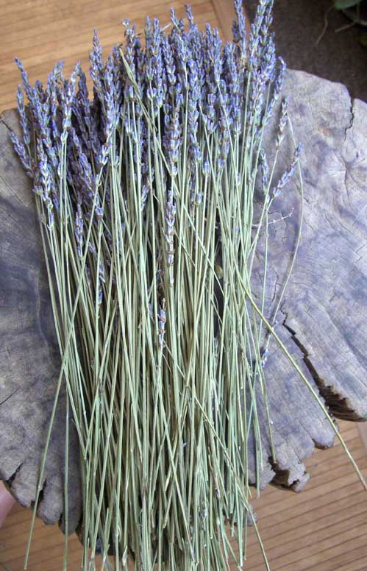
Air-dried lavender
Notes:
Saveoncrafts.com

Slide 40
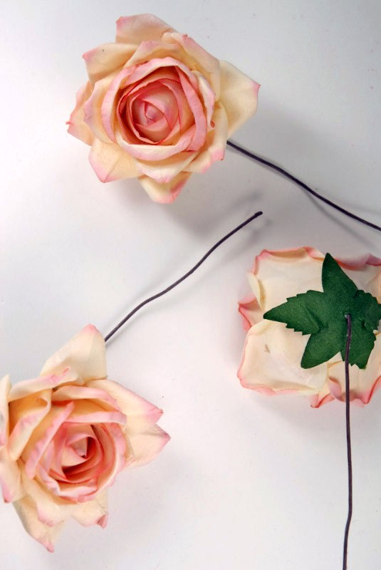
Parchment paper roses
Notes:
Saveoncrafts.com

Slide 41
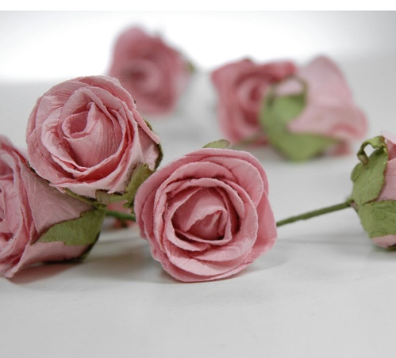
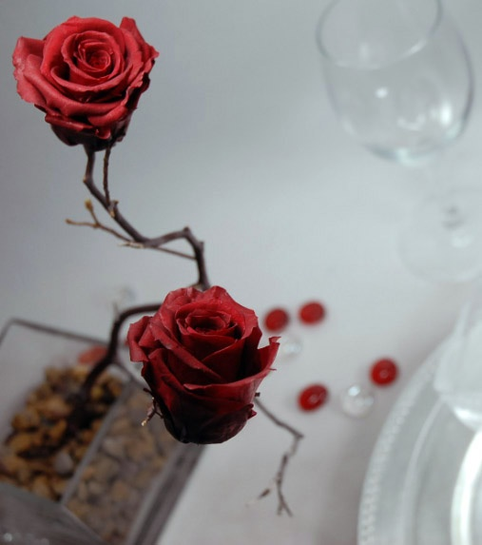
Hand-made paper roses
Notes:
Saveoncrafts.com

Slide 42
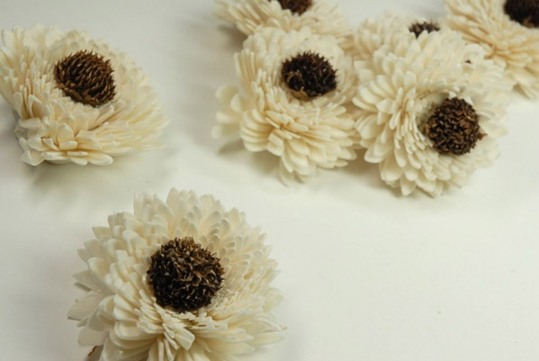
Flowers made out of Sola wood
Notes:
Saveoncrafts.com

Slide 43
Preserved Botanicals
Kiln drying: a method of removing moisture from plant materials by placing the plant or flower structures into a low temperature (100 degree) conventional oven.
Microwave drying: a preservation method whereby plant materials are placed in silica gel and heated in a microwave oven to quickly remove moisture from the plant material.
Notes:
The American Institute of Floral Designers, The AIFD Guide to Floral Design: Terms, Techniques, and Traditions. Intelvid Group 2005

Slide 44
Preserved Botanicals
Pressing: a method of drying plant materials between absorbent sheets of paper upon which weight or pressure is applied, resulting in flattened specimens.
Notes:
The American Institute of Floral Designers, The AIFD Guide to Floral Design: Terms, Techniques, and Traditions. Intelvid Group 2005

Slide 45
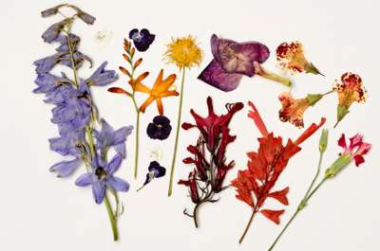
Pressing
Notes:
Howstuffworks.com

Slide 46
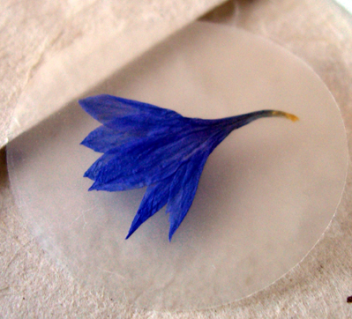
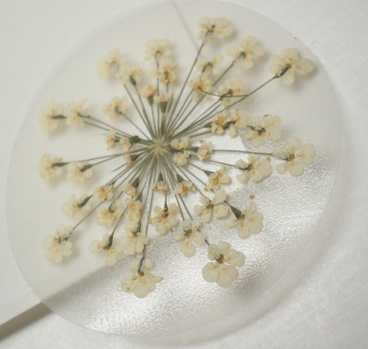
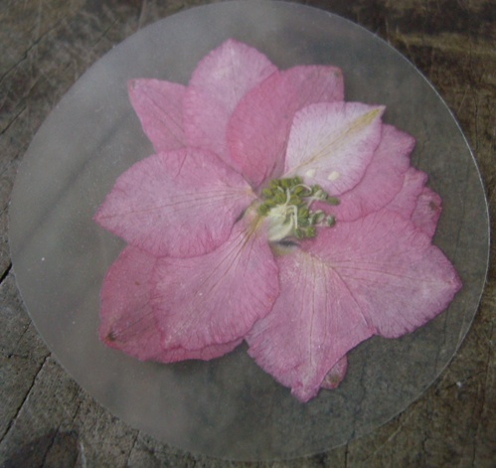
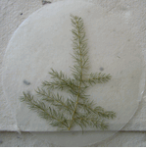
Pressed Flower Stickers
Notes:
Saveoncrafts.com

Slide 47
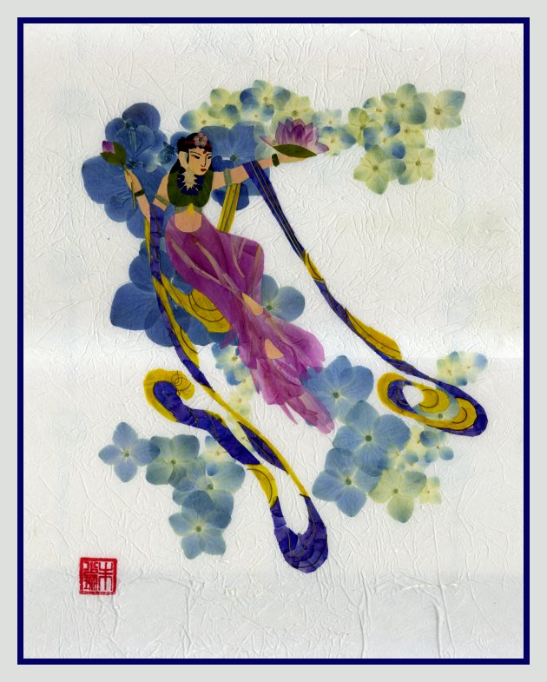
Pressed Flower Pictures
Notes:
Pressed-flowers.info
Kaite Chu

Slide 48
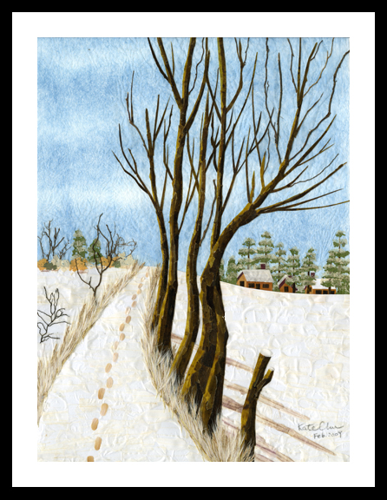
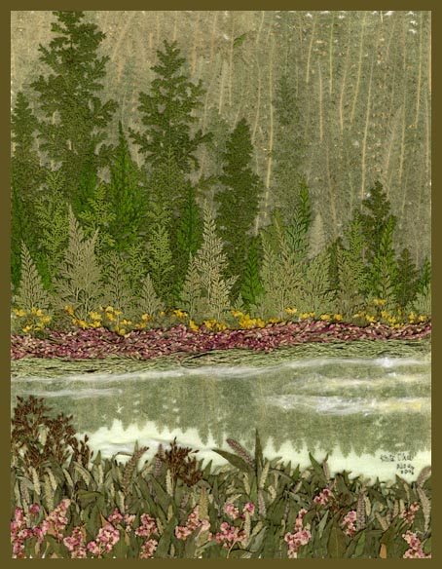
Pressed Flower Pictures
Notes:
Pressed-flowers.info
Kaite Chu

Slide 49
Pressed Flower Pictures
Notes:
Pressed-flowers.info
Kaite Chu

Slide 50
Pressed Flower Pictures
Notes:
Pressed-flowers.info
Kaite Chu

Slide 51
Pressed Flower Pictures
Notes:
Pressed-flowers.info
Kaite Chu

Slide 52
Preserved Botanicals
Potpourri: a mixture of dried and preserved petals, herbs, and other materials, either naturally fragrant or blended with oils or spices, used to perfume rooms and personal items.
Notes:
The American Institute of Floral Designers, The AIFD Guide to Floral Design: Terms, Techniques, and Traditions. Intelvid Group 2005

Slide 53
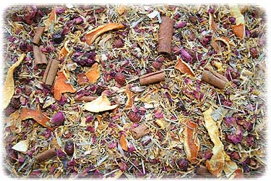
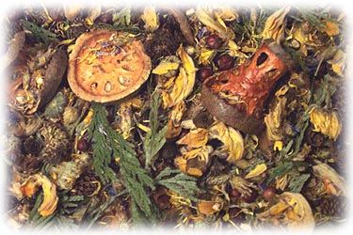
Potpourri
Notes:
Yankeescents.com

Slide 54
Preserved Botanicals
Acrylic water: a product composed of two liquids which, when mixed together, gradually harden into a transparent solid that resembles clear water. Acrylic water is often used in glass vase arrangement of artificial flowers to create the appearance of fresh flowers arranged in water.
Notes:
The American Institute of Floral Designers, The AIFD Guide to Floral Design: Terms, Techniques, and Traditions. Intelvid Group 2005

Slide 55
Acrylic water
Notes:
darbycreektrading.com

Slide 56
Preserved Botanicals
Moss: a small, primitive, spore-bearing plant found growing in damp areas on soil, bark, rocks, etc.
Notes:
The American Institute of Floral Designers, The AIFD Guide to Floral Design: Terms, Techniques, and Traditions. Intelvid Group 2005

Slide 57
Sheet & Spanish Moss
Notes:
Driednaturals.com

Slide 58
Gathering Plant Material for preserving
Dry day in afternoon—no dew
Very best specimens
Cut with sharp pruning shears
Place in water
Avoid over mature materials
Before shedding pollen
Avoid endangered, protected, toxic
Notes:
Hunter, Norah T., The Art of Floral Design Second Edition Delmar 2000.

Slide 59
Storing preserved plant material
Hang in bunches
Layered between tissue paper
Glycerin flowers store alone
Notes:
Hunter, Norah T., The Art of Floral Design Second Edition Delmar 2000.

Slide 60
Maintenance and cleaning
Clean once a week
Foliage cleaners and conditioners
Salt
Blow dryer
Feather duster
Soft paintbrush
Cloth
Swish in warm soapy water
Store unused in box or bag
Notes:
Hunter, Norah T., The Art of Floral Design Second Edition Delmar 2000.

Slide 61
Examples of Student Activities

Slide 62
Pressed Flower Designs

Slide 63
Drying methods—borax vs. hanging

Slide 64
Permanent Arrangements

Slide 65
Permanent Arrangements

Slide 66
Permanent Wreath

Slide 67
Permanent Arrangements

Slide 68
Permanent Arrangement

