Slide 1
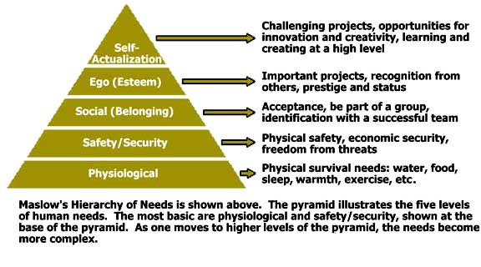
Maslow’s Hierarchy of Needs

