Slide 1
The FFA
History and Opportunities

Slide 2
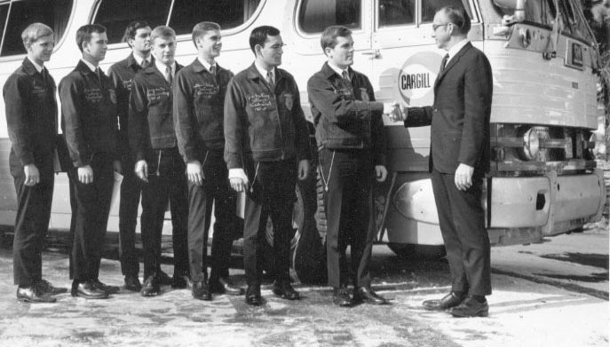
History
Started in 1928 due to convention of Agricultural Education students in Kansas City, Missouri for a Livestock Show.

Slide 3
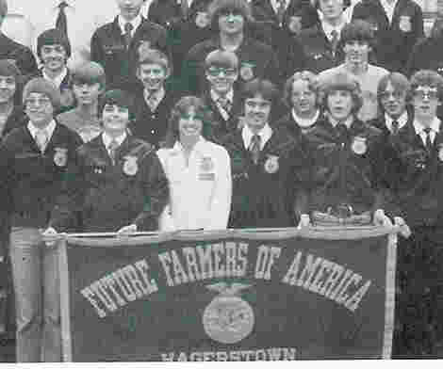
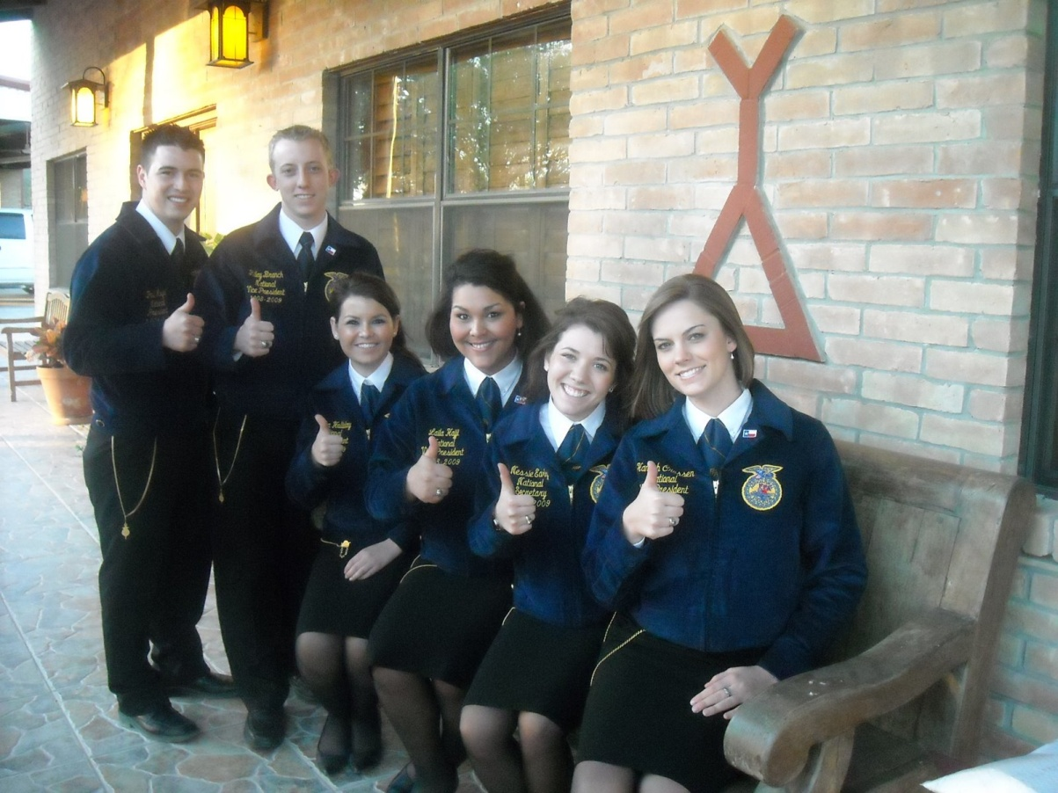
Girls could join in1969

Slide 4
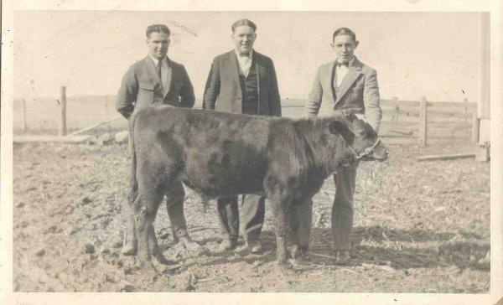
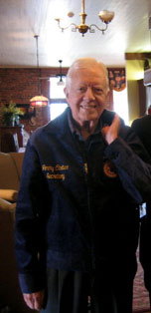
FFA
Future Farmers of America
  Cows, Plows, Sows

Slide 5
Meridian FFA Chapter
Established in 1929 and has been operating solely out of Meridian High School until 2007.
Meridian, Idaho is home of some of the best farm ground in the state.
With growing urban community the PTC was created in 2007 and the Meridian Agricultural Department has grown to have 7 agricultural educators at 5 high schools.
Meridian FFA is now the largest and most diverse chapter in the state of Idaho.

Slide 6
FFA Opportunities
The FFA is the largest student leadership organization in the country. Travel with us and you will see.
Convention Video*

Slide 7
Classes
Hort 1
Botany/Plant/Soil
Hort 2
Landscape Design
Floral Design
Forestry

Slide 8
Intro to Animal Science
Animal Zoology
Equine 1
Equine 2
Nutrition
Food Science
Fish and Wildlife
Botany/Range
Small Animal Care
Vet Tech

Slide 9
Small Engines
Welding 1
Welding 2
Advanced Small Engines
Automotive
Welding 3
Ag Structures
Fabrication

Slide 10
Ag Electives
Personal Skills
Agricultural Economics

Slide 11
CDE- Career Development Events
Ag Communications
Environmental & Natural Resources
Livestock Evaluation
Ag Issues
Extemporaneous Public Speaking
Ag Mechanics
Farm Business Mgmt
Meats Evaluation & Tech
Ag Sales
Floriculture
Nursery& Landscape

Slide 12
Agronomy
Food Science & Technology
Parliamentary Procedure
Creed Speaking
Forestry
Poultry Evaluation
Dairy Cattle
Horse Evaluation
Prepared Public Speaking
Dairy Handlers Activity
Job Interview
Dairy Foods

Slide 13
SAE-Supervised Agricultural Experience
Entrepeneurship
Placement
Exploratory
Research

Slide 14
Scholarships
National FFA gives out 2 million dollars in scholarships per year.
The local FFA gives out over 4 thousand in scholarships each year.

