Slide 1
Impromptu Speaking
Speaking without preparation

Slide 2


Slide 3
“It usually takes me more than three weeks to prepare a good impromptu speech”
-Mark Twain

Slide 4
Is it possible
To learn how to speak “off the cuff?”
To be prepared to speak “off the cuff?”

Slide 5
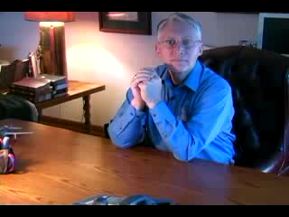

Slide 6
Top 10 People Who Need to Learn Impromptu Speaking
Sales Representatives
Telemarketers
Attorneys
Comedians
TV Journalists
Coaches
Students
Teachers
Team Captains
1. Managers

Slide 7
Benefits
Improve oral expression of thought
Develop confidence in public speaking
Think quickly on your feet
Develop leadership and communication skills

Slide 8
Speech Structure
Opening
  Opening Sentence
  Attention Getting
    Use stories, shocking facts, personal connections, etc.
Body
  Supporting materials and stories
Conclusion
  Conclude with impact; summarize review, or restate
  Be brief and links back to the opening

Slide 9
P.R.E.P. Method
When asked to express an opinion – to inform, persuade, or inspire
  Point Make your point (Opening)
  Reason Reasons for the point (Body)
  Example Examples to justify (Body)
  Point Links back to opening (Conclusion)

Slide 10
Past Present Future Method
When asked for your comment on a particular subject
  Point Make your point (Opening)
  Past What happened (Body)
  Present What is happening (Body)
  Future What will/could happen (Body)
  Point Links back to opening (Conclusion)

Slide 11
Other Methods
Problem, cause, remedy
Before, the event, results
Local, state, federal
Good, bad, indifferent

Slide 12


Slide 13
Speaking Tips
Open your mouth when you speak
Practice, Practice, Practice
Entertain your friends
Ask for feeback
Watch yourself
  In a mirror, or videotape

Slide 14
Write down your speech ideas
Personalize
Your opinions
Humor
Current events

Slide 16
Assignment
Give an impromptu speech that lasts 1-2 minutes.
Write down a topic that you would like to hear about.
  How to give a cat a bath…
  Which is better, cats or dogs?
  Who is the best leader that you know, and why?

