Slide 1
Use of Time
How do I begin to grow?
HS 41
Stage One of Development
ME

Slide 2
What is Time Management?
Time – the measurable period during which an action exists
Management – the act or art of managing
Time Management – the act or art of managing time
Objective 1
HS 41 TM A

Slide 3
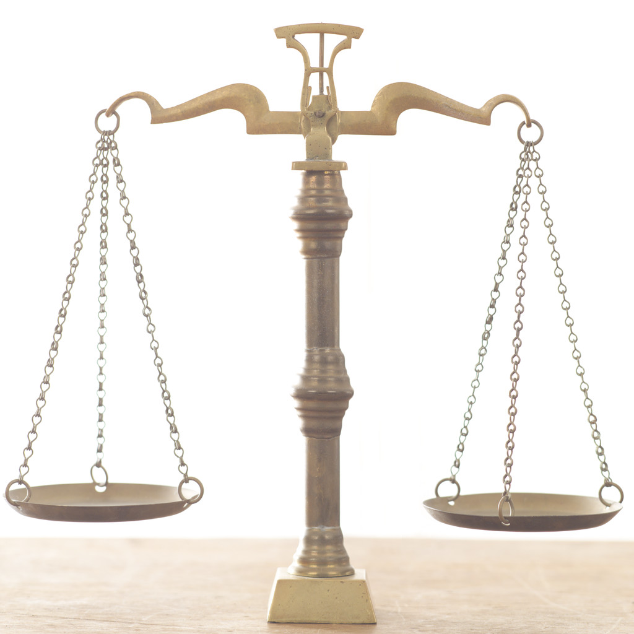
Benefits of Time Management
Be more productive
More time for other things
Less stress
Balance in your life
Objective 2
HS 41 TM B

Slide 4
Activity Priority Codes
A – Very Important
B – Important
C – Not Important
Objective 3
HS 41 TM C

Slide 5
Strategies for Managing Time
Develop a prioritized to-do list
  1. Identify what needs to be done and when it must be done by
  2. Identify which things should be done first
Objective 3
HS 41 TM D1

Slide 6
Strategies for Managing Time
Utilize a planner
  1. Keep track of when activities are scheduled
  2. Allocate time to each activity
  3. Prevents you from volunteering for or attempting activities for which you do not have time
Objective 3
HS 41 TM D2

