Slide 1
Landscape Design
Drafting Equipment
Bertanski, Tony. Plan Graphics for the Landscape Designer. Prentice Hall 2003.

Slide 2
Drawing surface
smooth surface without bumps or grooves in the table top
straight edge allowing for horizontal and vertical lines to be drawn with the T-square.
Notes:
Bertanski, Tony. Plan Graphics for the Landscape Designer. Prentice Hall 2003.

Slide 3
Tracing paper
thin and translucent paper used to sketch ideas and designs.
Notes:
Bertanski, Tony. Plan Graphics for the Landscape Designer. Prentice Hall 2003.

Slide 4
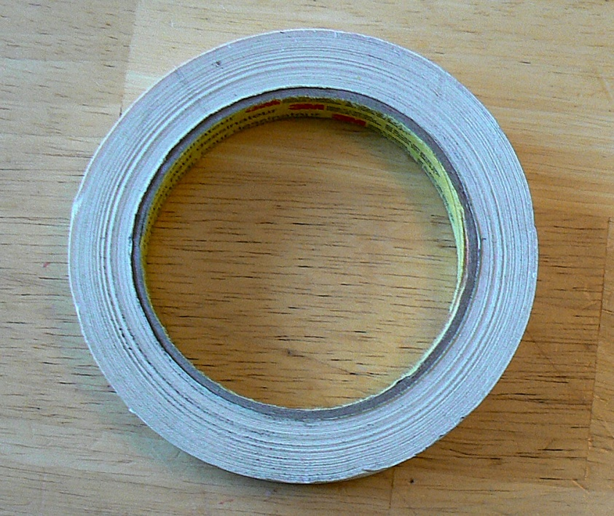
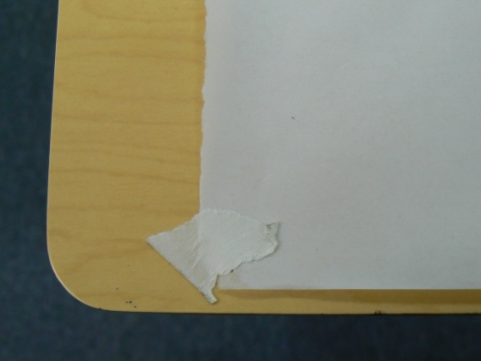
Drafting tape or dots
secures paper to the drawing surface
Secure all four corners after lining up with a T-square to make sure the paper is square on the drawing surface.
Notes:
Bertanski, Tony. Plan Graphics for the Landscape Designer. Prentice Hall 2003.

Slide 5
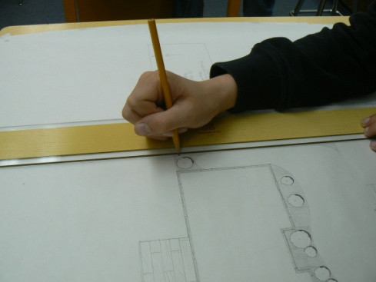
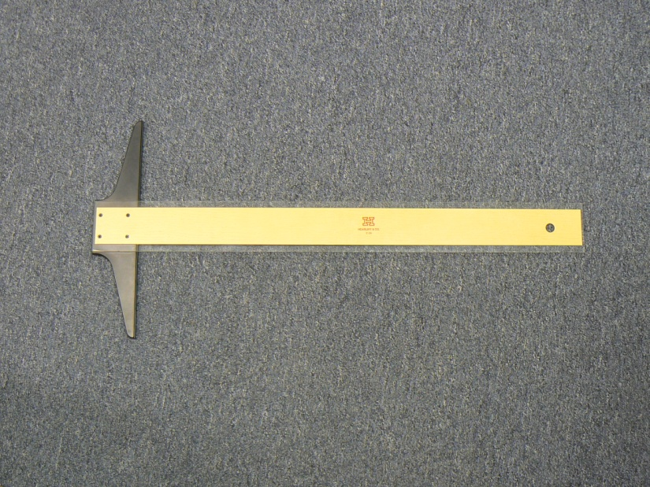
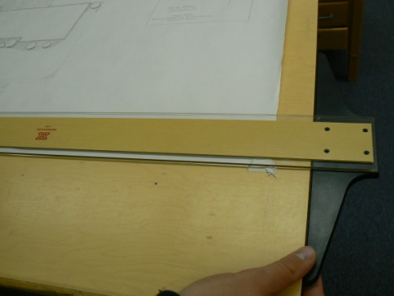
T-square
used to draw consistent vertical and horizontal lines on the paper
Notes:
Bertanski, Tony. Plan Graphics for the Landscape Designer. Prentice Hall 2003.

Slide 6
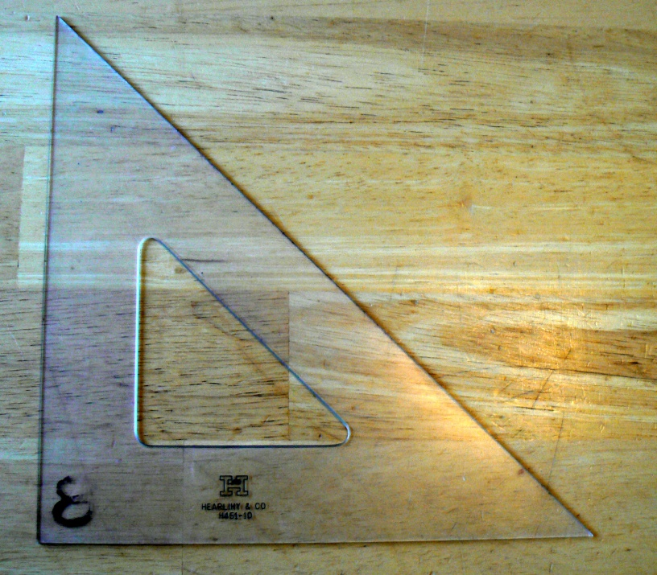
45/45 degree triangle
used to draw 45 or 90 degree lines.
Notes:
Bertanski, Tony. Plan Graphics for the Landscape Designer. Prentice Hall 2003.

Slide 7
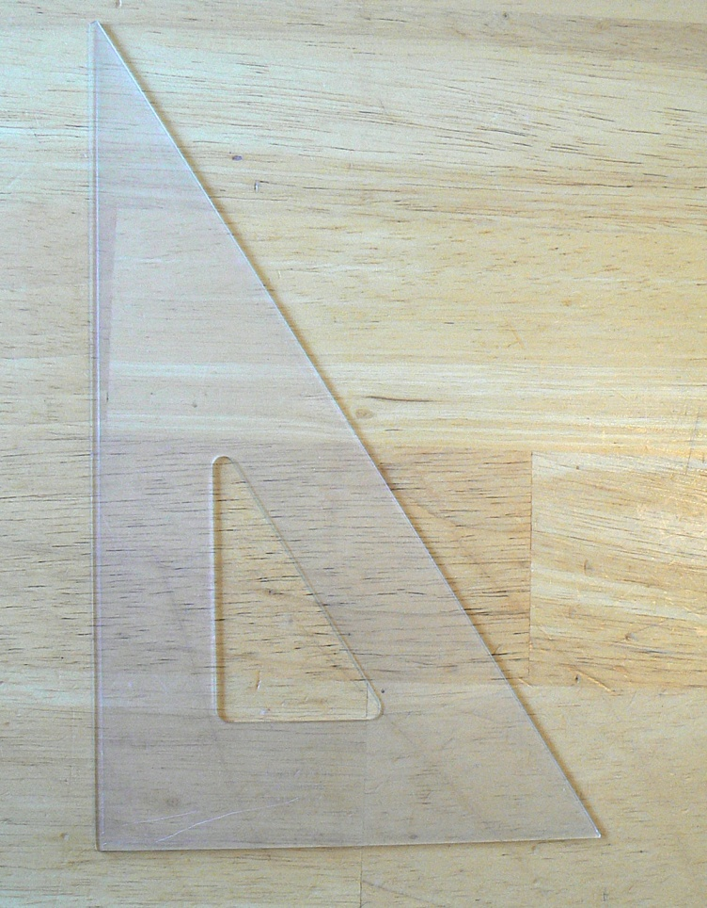
30/60 degree triangle
used to draw 30, 60, or 90 degree lines.
Notes:
Bertanski, Tony. Plan Graphics for the Landscape Designer. Prentice Hall 2003.

Slide 8
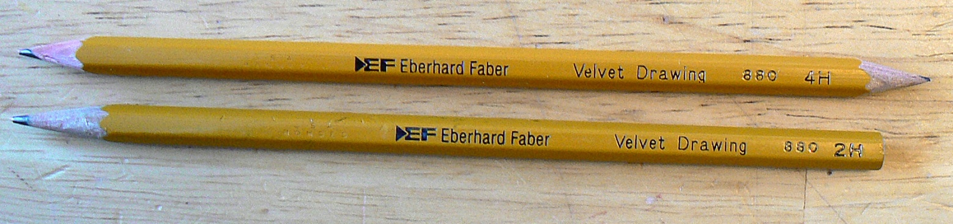
Pencils
come in a variety of lead hardness or softness. H designates the degree of hardness and is used to make light/thin lines. B designates the degree of softness of the lead and is used to draw dark/thick lines. HB is used for general drawing or to draw shadows.
Notes:
Bertanski, Tony. Plan Graphics for the Landscape Designer. Prentice Hall 2003.

Slide 9
Pencil Sharpener
a high quality pencil sharpener must be available to keep pencils sharp and lines consistent.
Notes:
Bertanski, Tony. Plan Graphics for the Landscape Designer. Prentice Hall 2003.

Slide 10
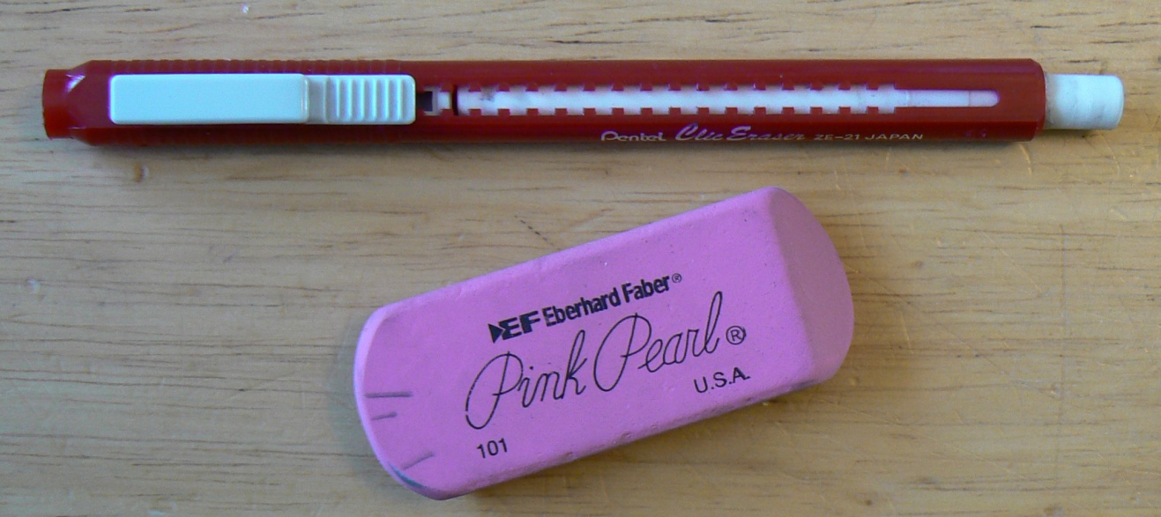
Eraser
most generally white, use with caution to avoid smudging lines with soft lead. Can be washed or cut to sharpen edges. Pink may be used but harden over time.
Notes:
Bertanski, Tony. Plan Graphics for the Landscape Designer. Prentice Hall 2003.

Slide 11
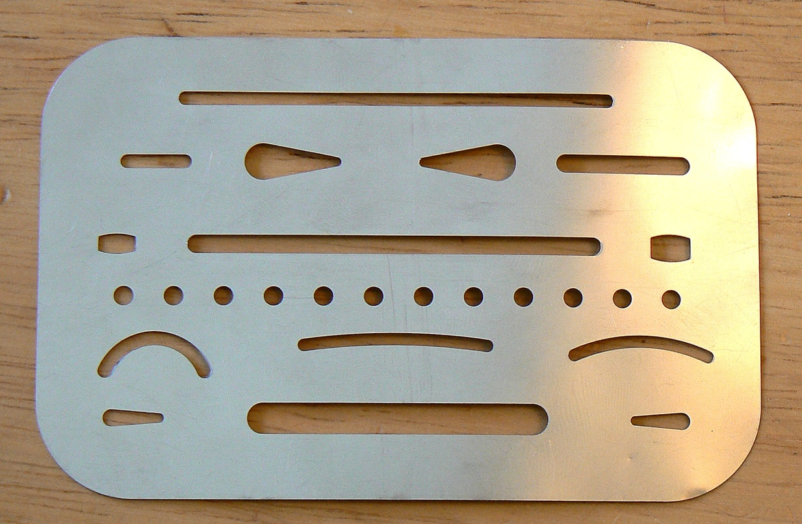
Eraser shield
not essential but useful to erase lines close to other lines.
Notes:
Bertanski, Tony. Plan Graphics for the Landscape Designer. Prentice Hall 2003.

Slide 12
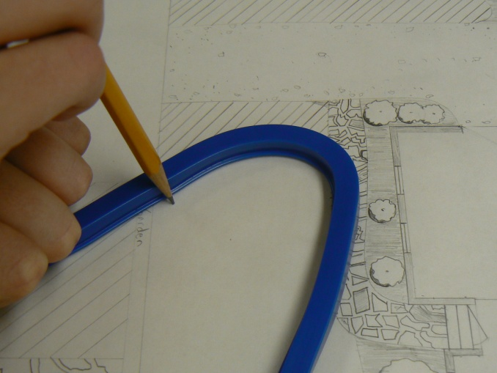
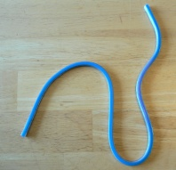
Flexi-curve
Used to draw curving lines. May be picked up and the line repeated.

Slide 13
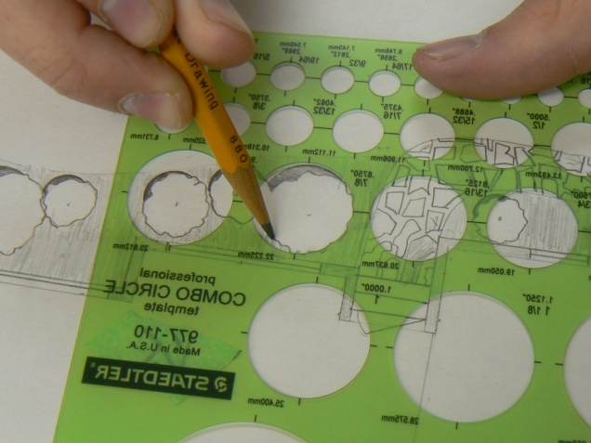
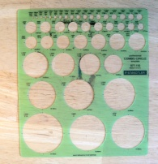
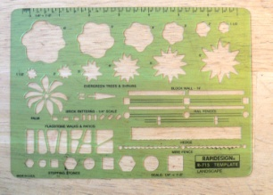
Circle template
used to draw circles quickly and to scale.
Notes:
Bertanski, Tony. Plan Graphics for the Landscape Designer. Prentice Hall 2003.

Slide 14
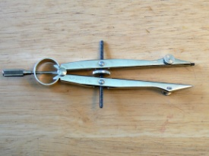
Compass
used to draw large circles.
Notes:
Bertanski, Tony. Plan Graphics for the Landscape Designer. Prentice Hall 2003.

Slide 15
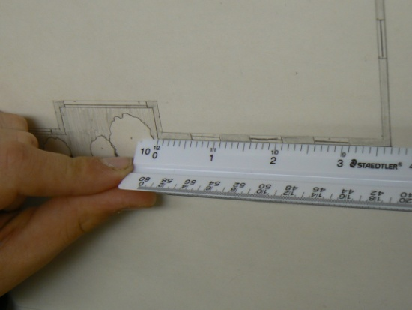


Scale
a scale is a ruler that has units that represent feet in a landscape plan. Available as engineer or architect depending on preference and project.
Each mark represents a foot on the scale. Scale is written as 1”=10’.
Notes:
Bertanski, Tony. Plan Graphics for the Landscape Designer. Prentice Hall 2003.

Slide 16
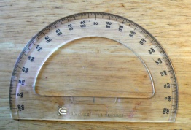
Protractor
used to measure and draw angles.
Notes:
Bertanski, Tony. Plan Graphics for the Landscape Designer. Prentice Hall 2003.

