Slide 1
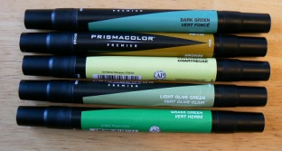
Coloring Techniques
Coloring the Final Plan Using:
Prisma Color Dual Tip Markers

Slide 2
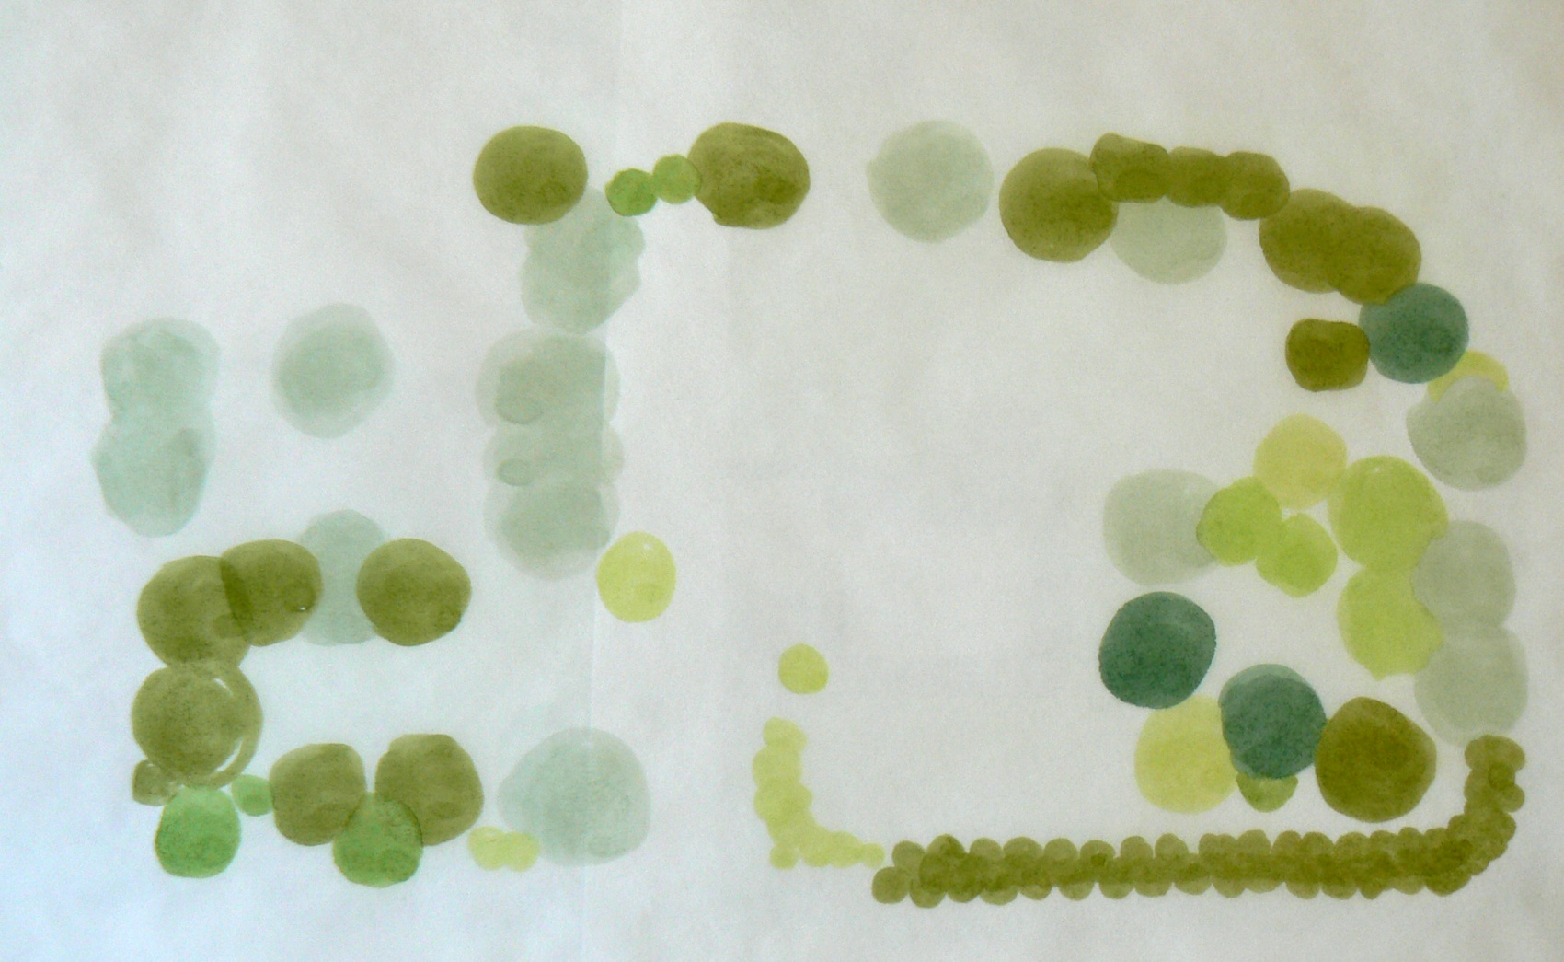
1. Color in basic shapes.
One layer of marker.
Note: The final plan is placed under the tracing paper for object placement. The photos were taken without it to show coloring techniques.

Slide 3
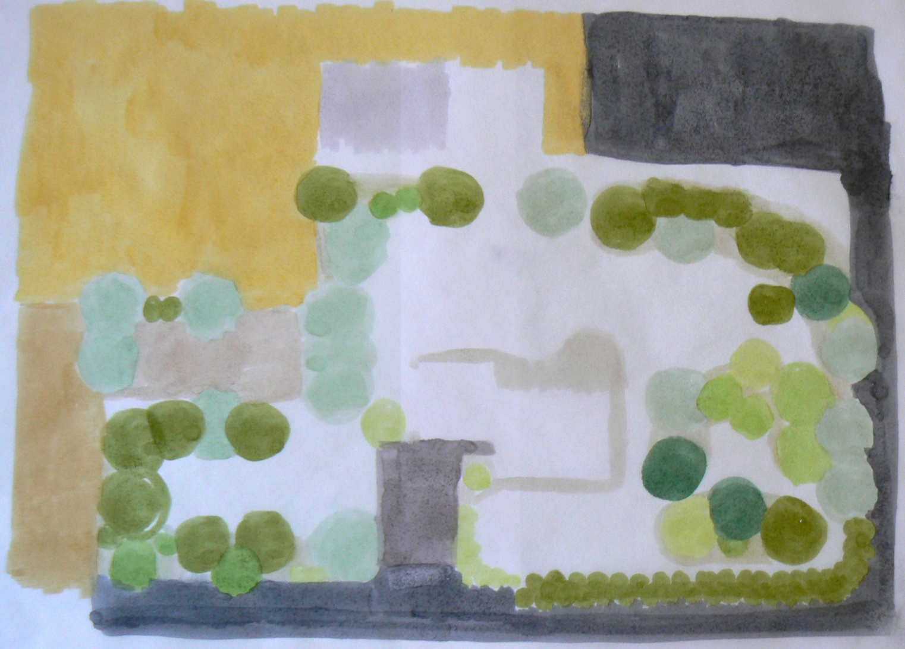
2. Color in hardscape

Slide 4
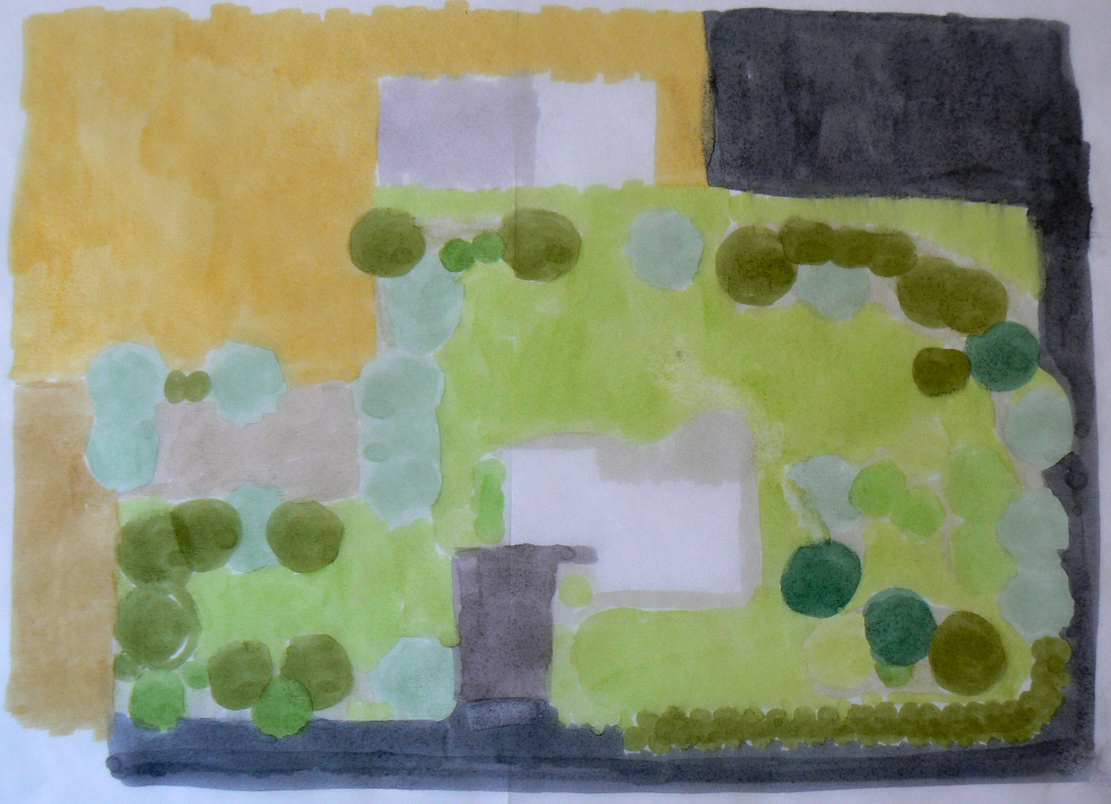
3. Color in ground plane

Slide 5
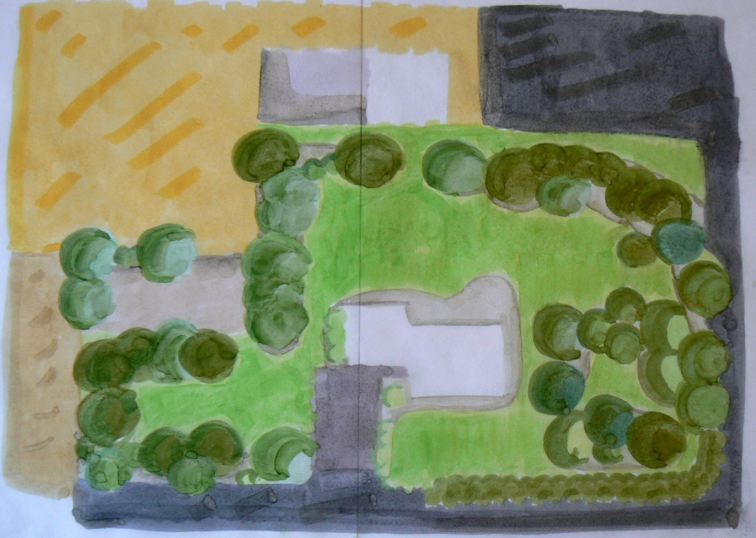
4. Color over shapes to add dimension--use more than one color to layer trees.

Slide 6
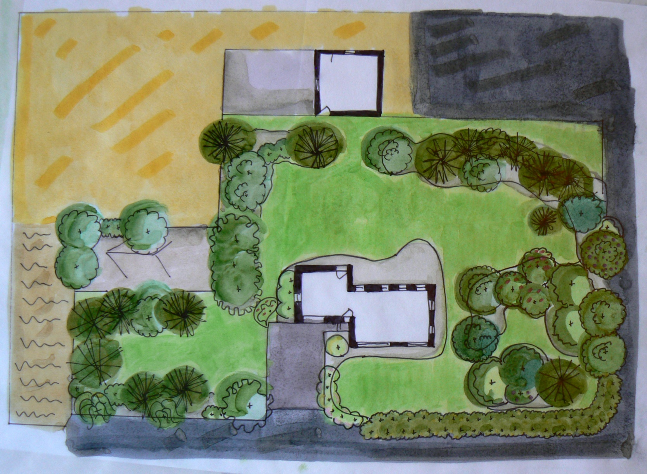
5. Draw in lines of trees, beds, and hardscape.

Slide 7
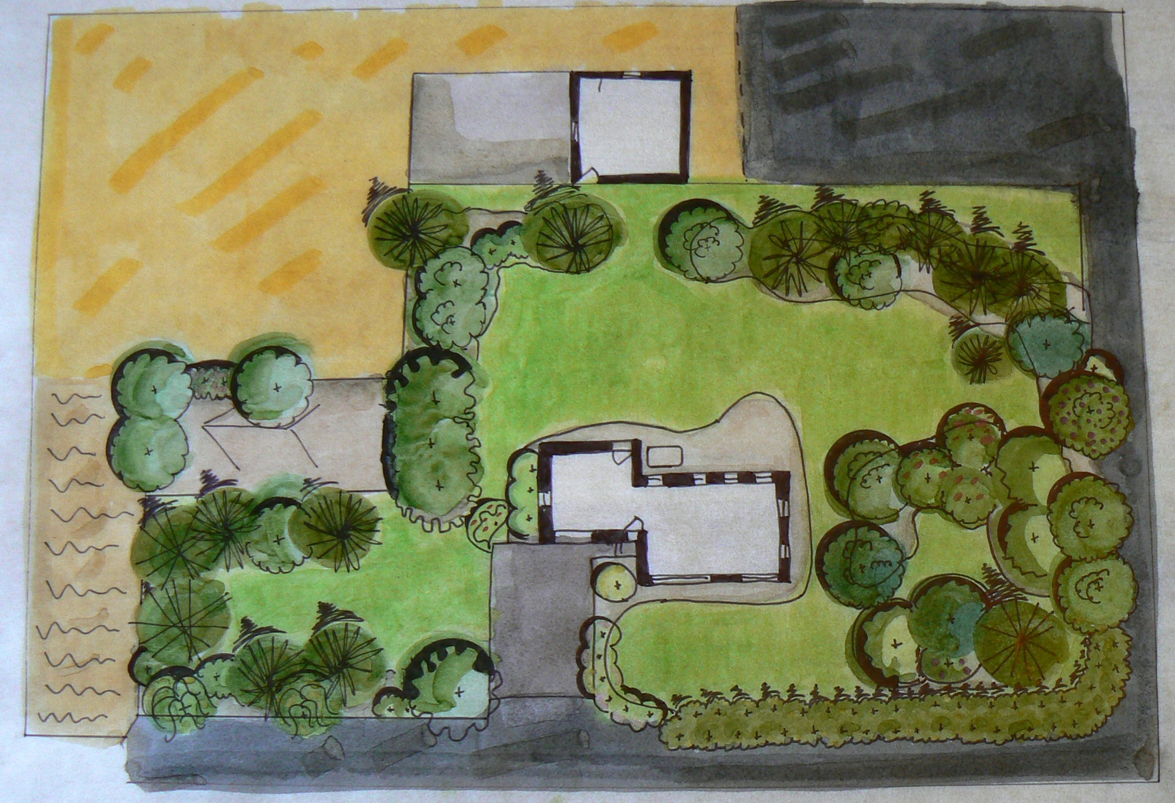
6. Draw in shadows.

Slide 8
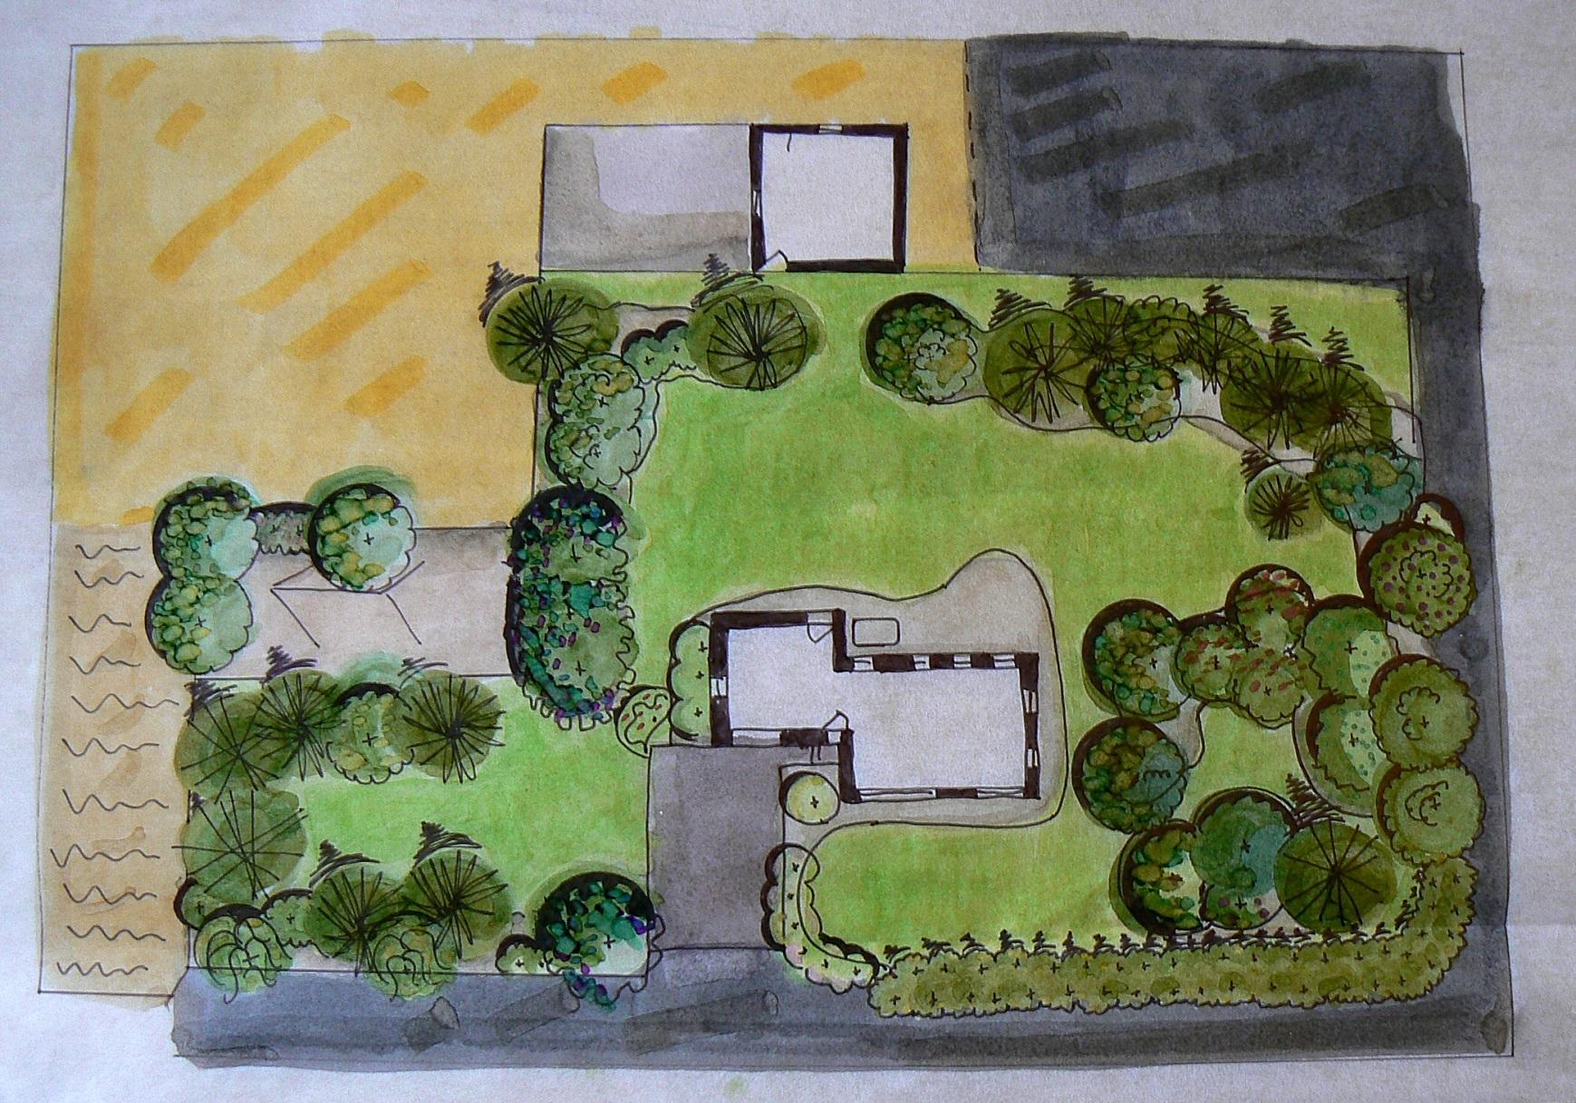
7. Add in more detail as needed.

Slide 9
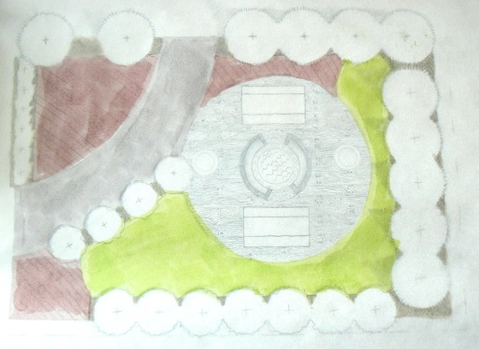
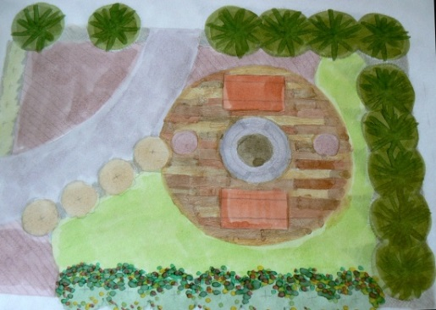
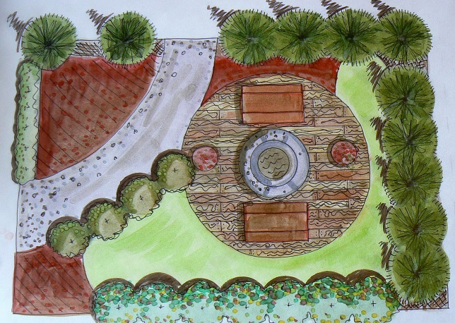
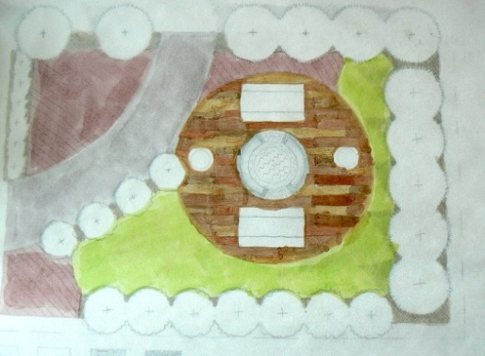
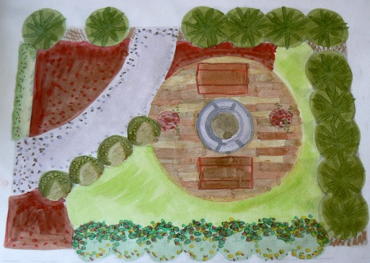
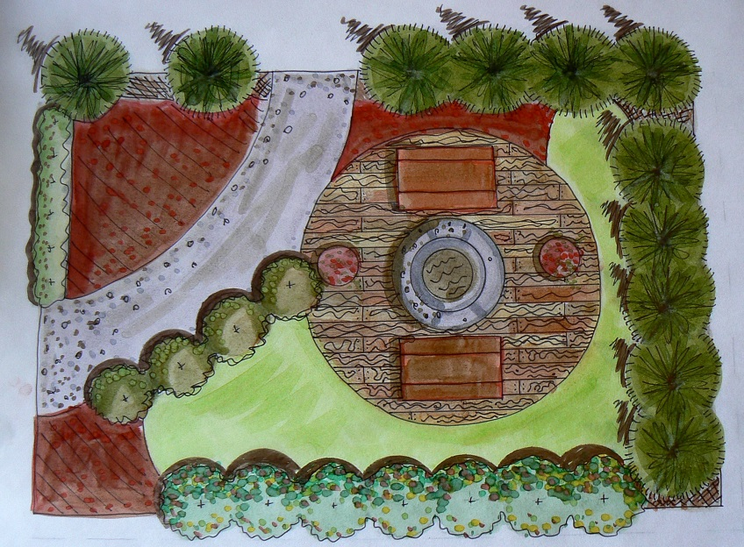
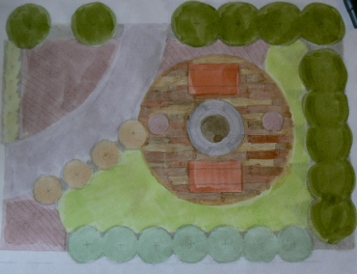
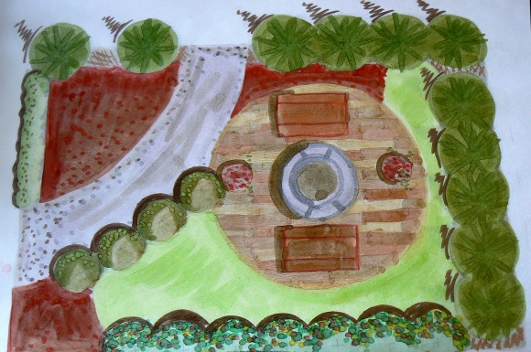
Progression of coloring

Slide 10

