Slide 1
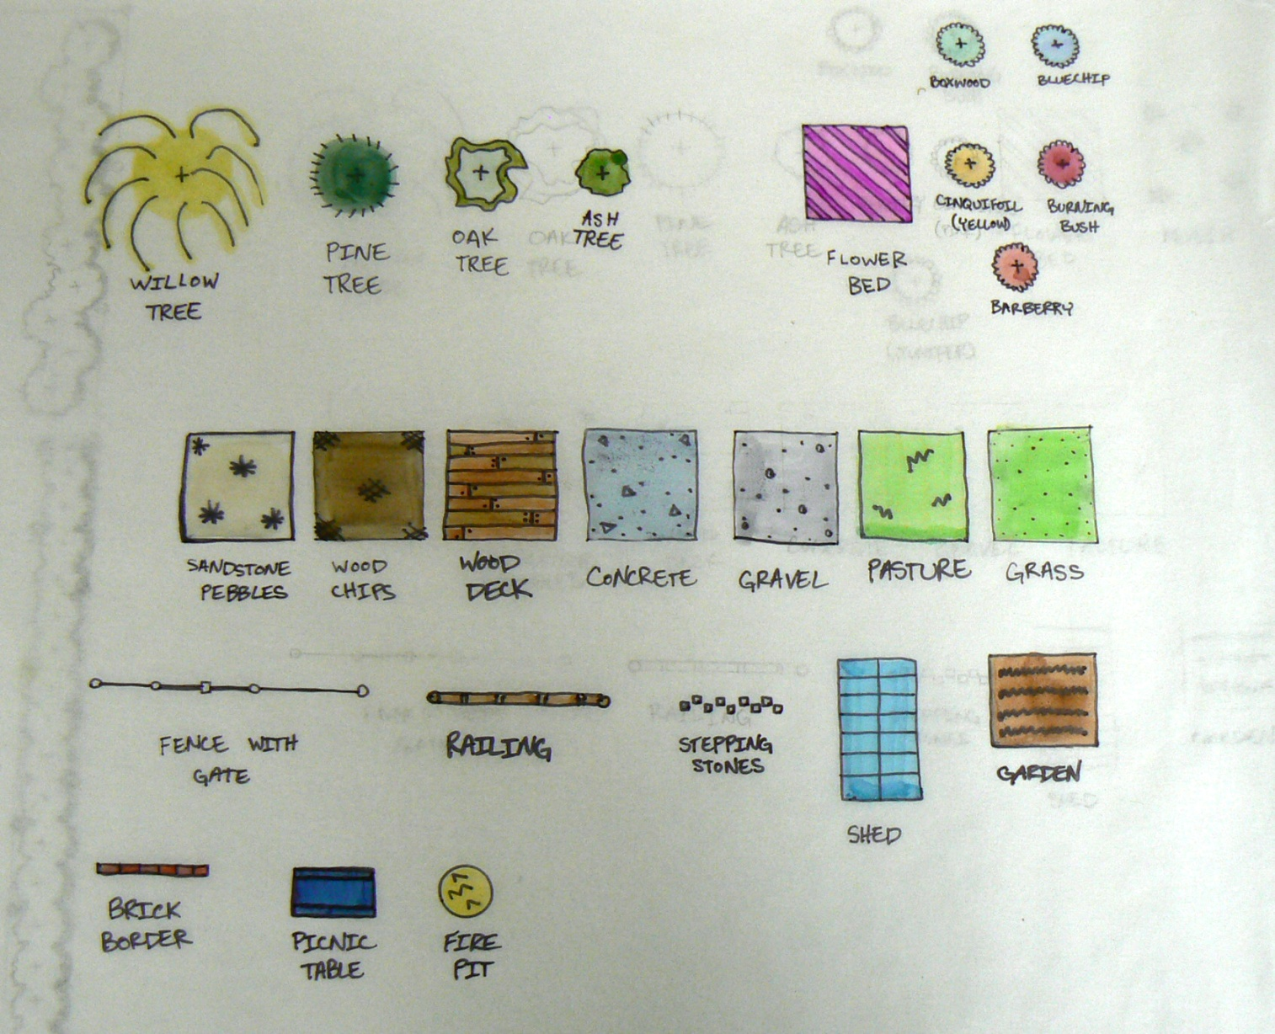
Hardscape &tree planting legend

Slide 2
Marker Coloring Tips:
Marker bleeds through most paper—but not tracing paper.
Place tracing paper over final design and color in detail on the tracing paper.
Don’t use the black outlining pen until all of the color is finished. The color markers make the sharpie bleed.
Base color all the shapes in a light color. Add layers of darker colors on top.
Have a piece of scratch paper to test colors and combinations on before adding to color design.
Use a blending marker to blend harsh lines.
To keep the color from pooling, lift quickly and blend out pools of marker with blending marker.
Keep a list of markers used to lessen confusion if you have to go back and color a spot again.
Don’t be afraid to use different colors on trees—they don’t have to be all green. Purple, blue, or yellow stippling added gives depth.

Slide 3
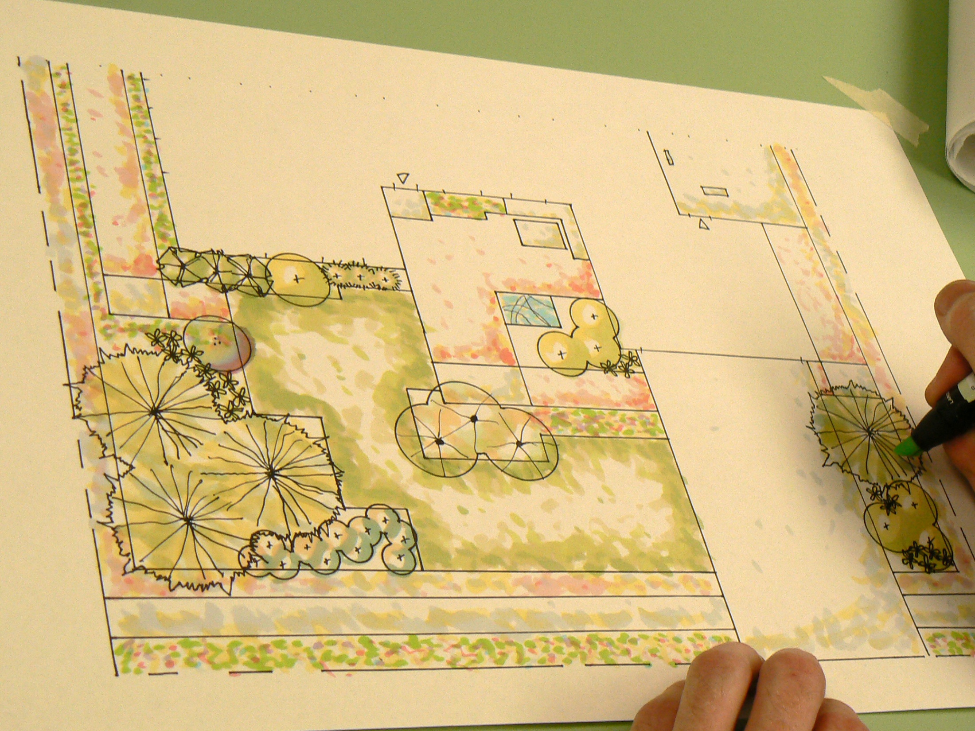
Final Plan Examples

Slide 4
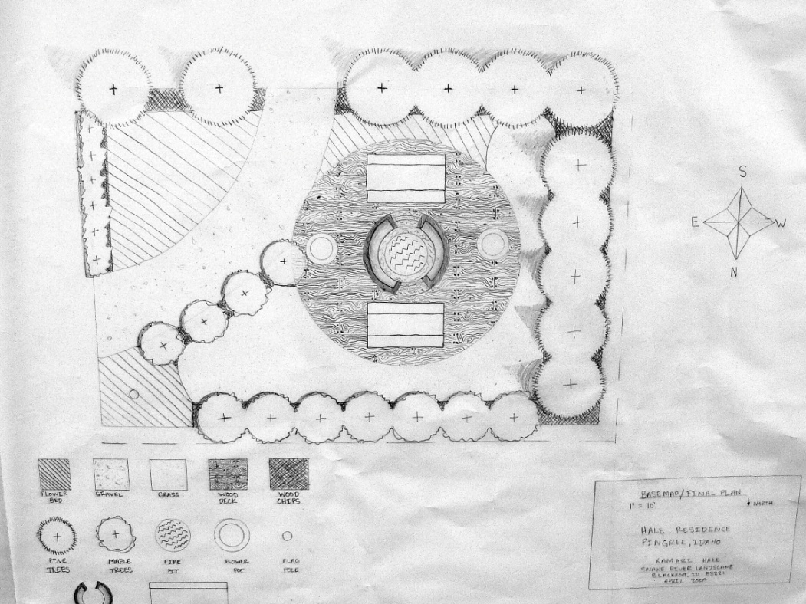
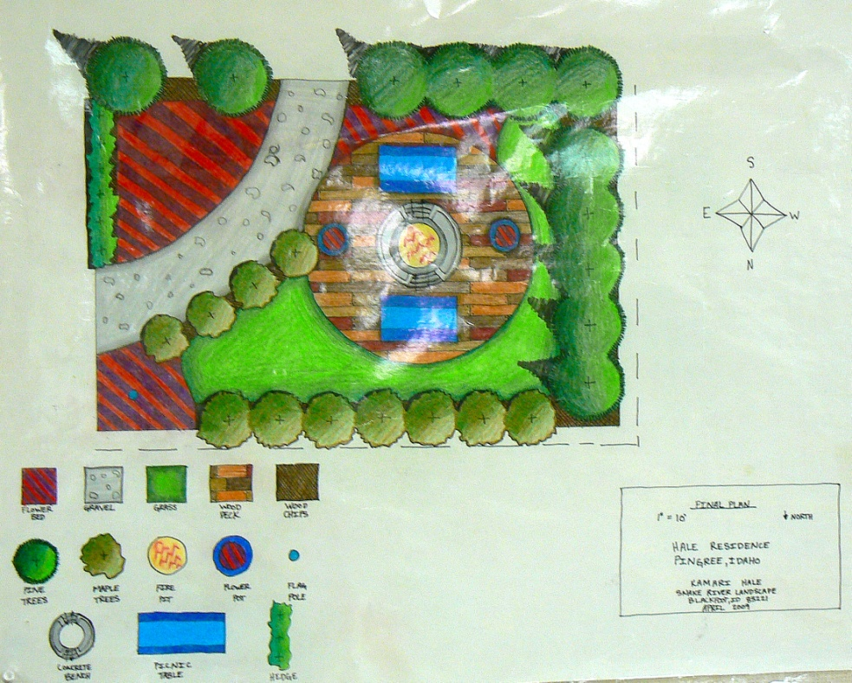
Using colored pencils

Slide 5
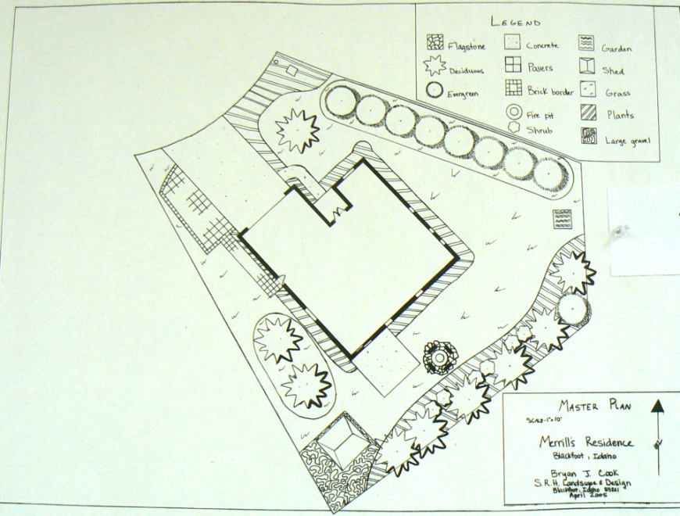
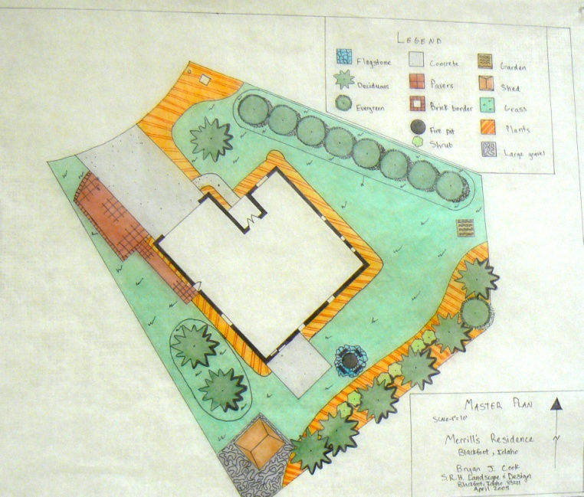
Using Prisma color markers

