Slide 1
The Landscape Design Process

Slide 2
thelandscapedesigncenter.com
Just as you would not build a house without blueprints, you should not put together a landscape without a design, no matter how small.
Notes:
http://www.google.com/imgres?imgurl=http://www.thelandscapedesigncenter.com/images/pictures/patios/BlueandLilacPAflagstone.jpg&imgrefurl=http://www.thelandscapedesigncenter.com/design.html&usg=__6KaeNC64Xy6VUSSAbrCZaqYnL_Q=&h=413&w=550&sz=288&hl=en&start=39&sig2=n23kmnEqaiGSCAa9Cty-nw&itbs=1&tbnid=myxRXpeuECBM_M:&tbnh=100&tbnw=133&prev=/images%3Fq%3Dlandscape%2Bdesign%26start%3D36%26hl%3Den%26sa%3DN%26gbv%3D2%26ndsp%3D18%26tbs%3Disch:1&ei=gPkFTKClKo6sMdn0rIUJ

Slide 3
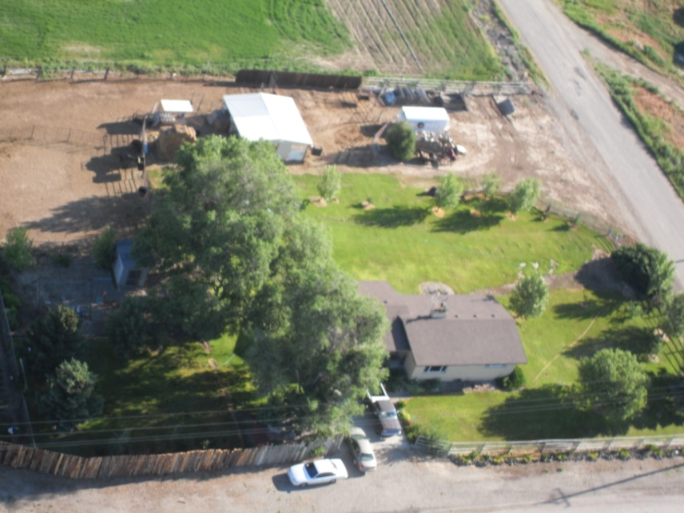
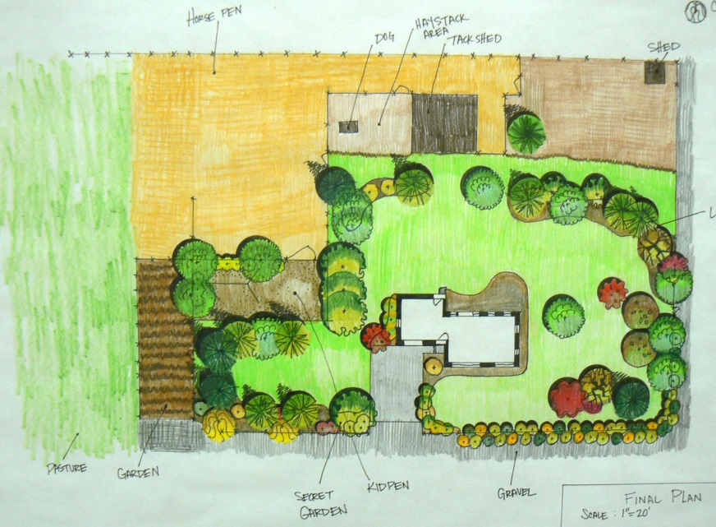
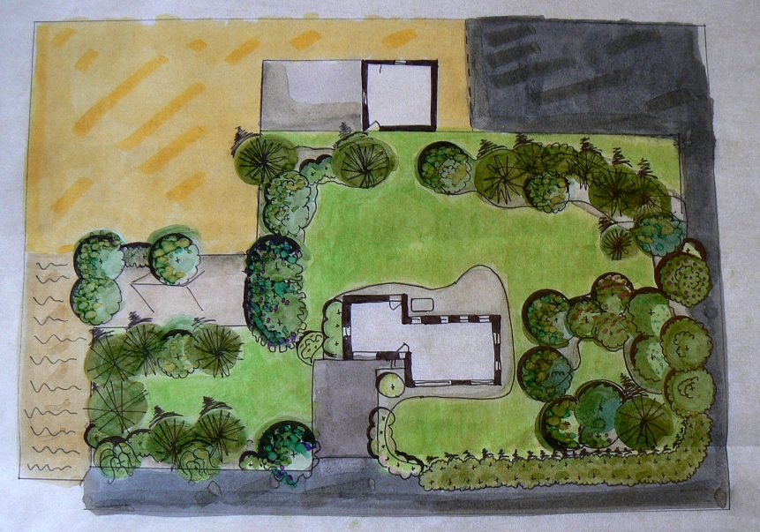
Landscape plans are drawn from a bird’s eye view.
Aerial photo and plans drawn for the landscape.

Slide 4
Steps In Design
Assemble the Base Plan
Conduct a Site Analysis
Client Evaluation
  Assess family needs and desires
Develop a Bubble Diagram
  Locate private, public, service, and utility areas
Design Landscape Plan
  Pencil drawing, then color
Plant selection and placement

Slide 5
Assembling the Base Plan
edis.ifas.ufl.edu.
Obtain architect drawings
  Plan view drawings (house plans) floor plans
  Sections—side view or cut away slice
  Perspectives or elevations
  Contour map or topographic
  Site or deed map—dimensions with proper angles
  These plans maybe secured from the builder, developer or county or city property records.

Slide 6
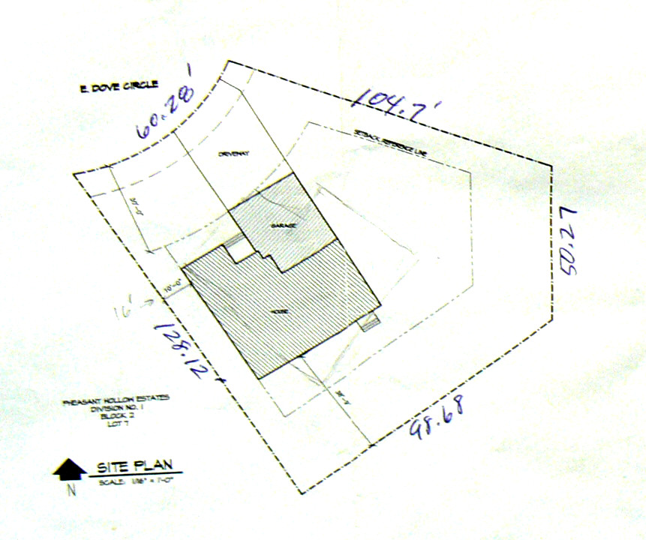
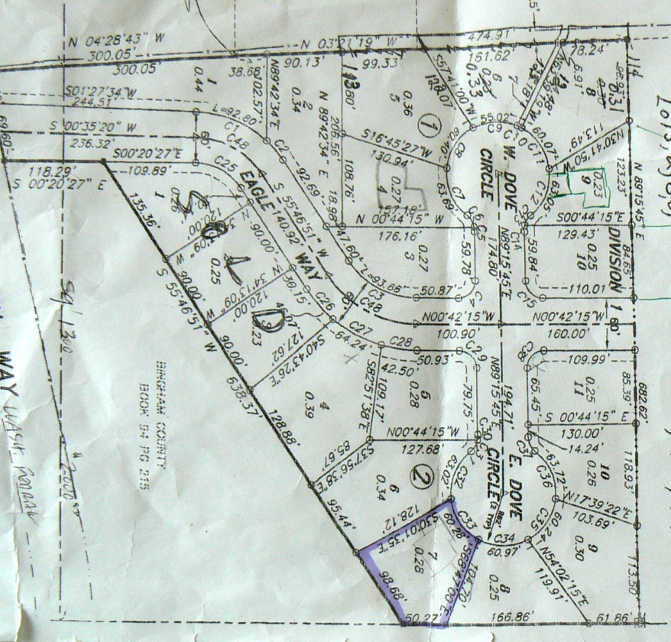
Architect drawing examples:

Slide 7
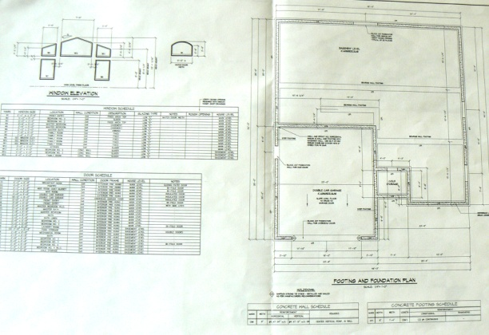
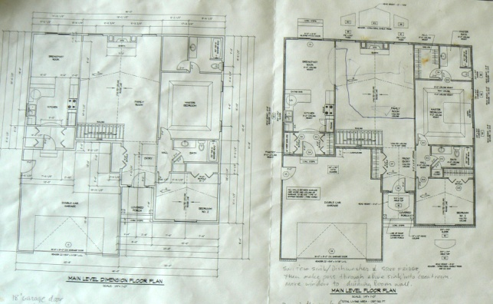
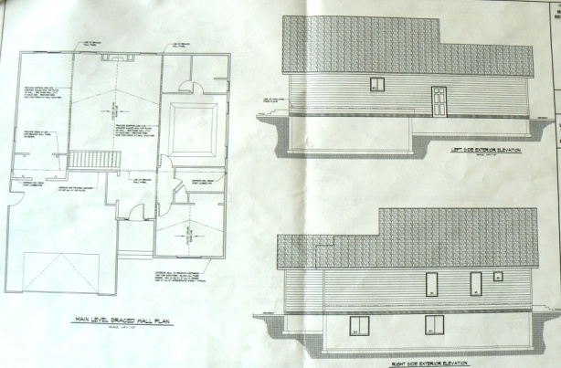
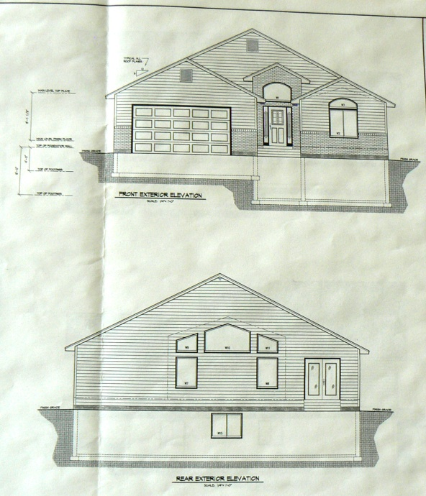
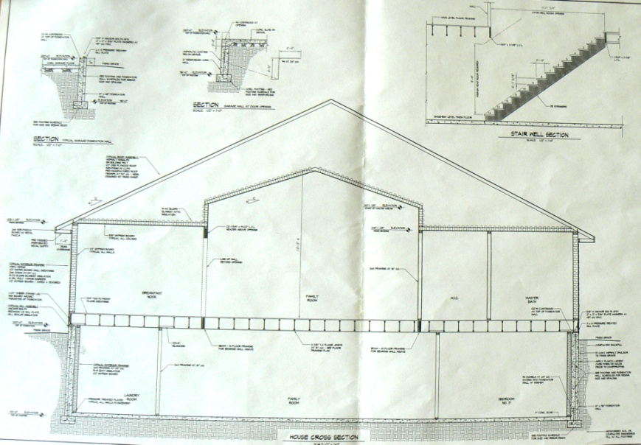
Architect drawing examples:

Slide 8
Assembling the Base Plan
edis.ifas.ufl.edu.
  The base plan should consist of
    accurate house placement on the lot
    accurate lot and house dimensions with window & door placement
    existing driveways &/or walks (hardscape)

Slide 9
Conducting A Site Analysis
edis.ifas.ufl.edu.
Features that will stay
  Existing vegetation
    tree and shrub condition and placement
    trees on adjoining property that affect shade patterns
    Protect existing vegetation during construction
  Hardscape
  Permanent features

Slide 10
Conducting A Site Analysis
Views to preserve or block
  Panoramic views--Takes in a wide area, distance from viewer
      Distant mountain range
      Valley below
      Adjoining golf course
  Concentrated or focused view--particular point
      Sculpture
      Unique tree
      Bed of showy flowers
  Blocked view--undesirable, needs screened
      High plant materials
      Walls
      fences
Notes:
Booth, Norman K. & James E. Hiss. Residential Landscape Architecture: Design Process for the
Private Residence, 3rd Edition. Prentice Hall 2002.

Slide 11
Conducting A Site Analysis
edis.ifas.ufl.edu.
Poor Drainage
  slope or land elevation changes
    determines surface water drainage patterns
Traffic
  provide proper access
City/County Ordinances

Slide 12
Conducting A Site Analysis
edis.ifas.ufl.edu.
Noise Levels
  Identify distractions
    question neighbors or the property owner
  Record noise sources like roads, factories, saw mills, etc
    time of day for peak noise levels
  Plot the direction and distance of the source
    Record other distractions--glare or odors

Slide 13
Conducting A Site Analysis
edis.ifas.ufl.edu.
Utility Placement
    on poles or underground
    locate the electrical meter, the air-conditioner unit &water outlets
    television and telephone cables, water lines and sewage lines, or a septic tank and field line
Easements/setback lines
Primary architectural features of the house
  Shape of windows, style, and items that can be repeated in the landscape

Slide 14
Conducting A Site Analysis
edis.ifas.ufl.edu.
House orientation
  affects the exposure of various portions of the house to the sun
    provide shade
    southeastern exposure- most comfortable spot year-round
    western slope- hot in summer and cold in winter
Soil conditions
  determines selection and placement of plants
  Consider soil pH, nutrient and water holding capacity and drainage

Slide 15
Conducting A Site Analysis
edis.ifas.ufl.edu.
Seasonal wind pattern—prevailing winds
  differ with the area of the state, the season and the time of day
  existing wind breaks
    plants and structures on the property or on adjacent property
Microclimate
  conditions in a isolated spot may differ considerably from the conditions in another area of the landscape
Other:
  Snow removal, pile-up

Slide 16
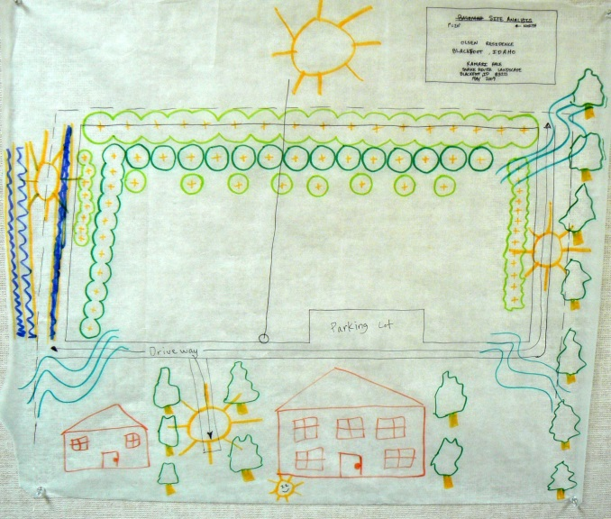
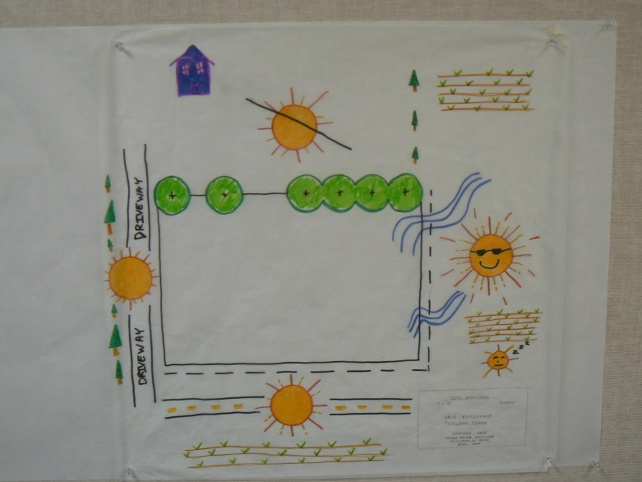
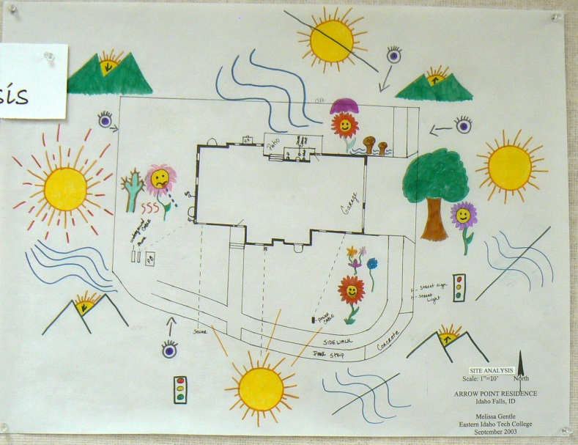
Site Analysis Examples

Slide 17
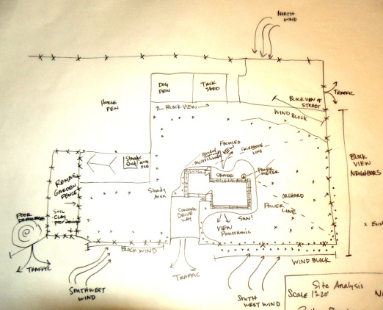
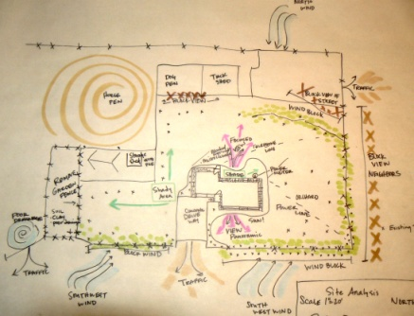
Use of color on Site Analysis

Slide 18
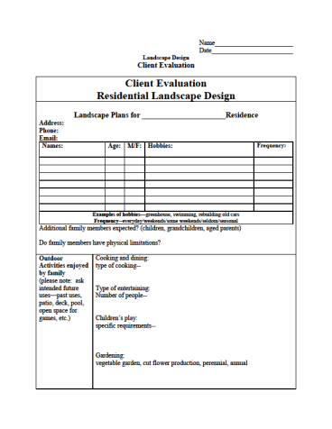
Client Evaluation
Landscape Plans for ______________________Residence Address: Phone: Email:
Names: | Age: | M/F: | Hobbies: | Frequency:
Examples of hobbies—greenhouse, swimming, rebuilding old cars Frequency--everyday/weekends/some weekends/seldom/seasonal Additional family members expected? (children, grandchildren, aged parents) Do family members have physical limitations?

Slide 19
Outdoor Activities Enjoyed By Family (please note: ask intended future uses— past uses, patio, deck, pool, open space for games, etc.)
Cooking and dining: | Type of cooking— Type of entertaining: Number of people— Children’s play: Specific requirements--
Gardening: | Vegetable Garden, Cut Flower Production, Perennial, Annual
Pets (please note: indoors, outdoors, confinement
Plants (please note: ask what are favorite trees, shrubs, flowers?) | Wanted: Avoid: Are family members allergic to specific plants?
Privacy issues: | Satisfied with current privacy or needs changed— What changes?

Slide 20
Landscape Maintenance
 | Sprinkling system available | Yes/No
Maintenance job | Willing to do | Hire out
Mow grass
Prune trees
Fertilize & water lawn
Rake leaves
Mix and spray pesticides
Prepare planting areas
deadhead
Other:

Slide 21
Service Needs
Utility Item | Need | Have
Clothes Line
Compost Pile
Trash Can Storage And Protection
Firewood Storage
Delivery Access
Enclosed Work Area
Additional Parking Or Vehicle Storage
Other:

Slide 22
Client Considerations
Preferences: colors, materials, styles, brands, themes
Views: important views into the landscape from major rooms within the house
Interior: formal or casual types of décor—original art, crafty, themes, etc
Budget: range in mind, one step completion, over time, most important first
Time Frame:
Changes planned: additions to the home, etc.
Other Considerations:

Slide 23
Bubble Diagram
edis.ifas.ufl.edu.
Establish:
  Public area
  Private area
  Utility area
  Play area
Slow down and think broadly or generally
  More creative design
  Think of alternatives
  Go beyond preconceived notions or ideas

Slide 24
Public Area
(Entrance area or front yard)
edis.ifas.ufl.edu.
1. Puts the house into an attractive setting
  Enhance architecture
  Focus of viewer’s attention
  Recognize value of home
2. Identify & provide access to the point of entry
  Greatest priority
  Not complicated
    Front walk to front door
    guest parking easy access
3. Includes:
  lawn, foundation plants, walks, and drives/parking
    Should not include:
      cheap plastic animals, recreation equipment, play equipment, swimming pools

Slide 25
Private Area
(Living Area or backyard)
edis.ifas.ufl.edu.
  Outside extension of the private living area inside the home
  Use of plants and/or fences to make private
  Open space needed for games, etc.
  Include: Deck or patio, area of open lawn, plants that provide an attractive view
    may include swimming pool, athletic facilities, barbecue or picnic facilities, trails, view gardens, reflection pools

Slide 26
Utility Area (service/work area)
edis.ifas.ufl.edu.
Smallest space possible and still functional
Screen from private area
Locate on driveway side of yard for access
May have two or more locations
Includes:
  Clothesline
  compost bin
  Firewood
  fuel tanks
  garbage containers
  garden supplies storage
  Greenhouse
  pet facilities
  tool storage
  utility buildings
  vegetable gardens
  workshops

Slide 27
Play Area
edis.ifas.ufl.edu.
May or may not be part of private area
Visible from kitchen
Easy access to rear entry door
  Grass warn under play equipment
    Use mulch, fine gravel, or sand
  Includes: swings, slides, sandbox, shade trees

Slide 28
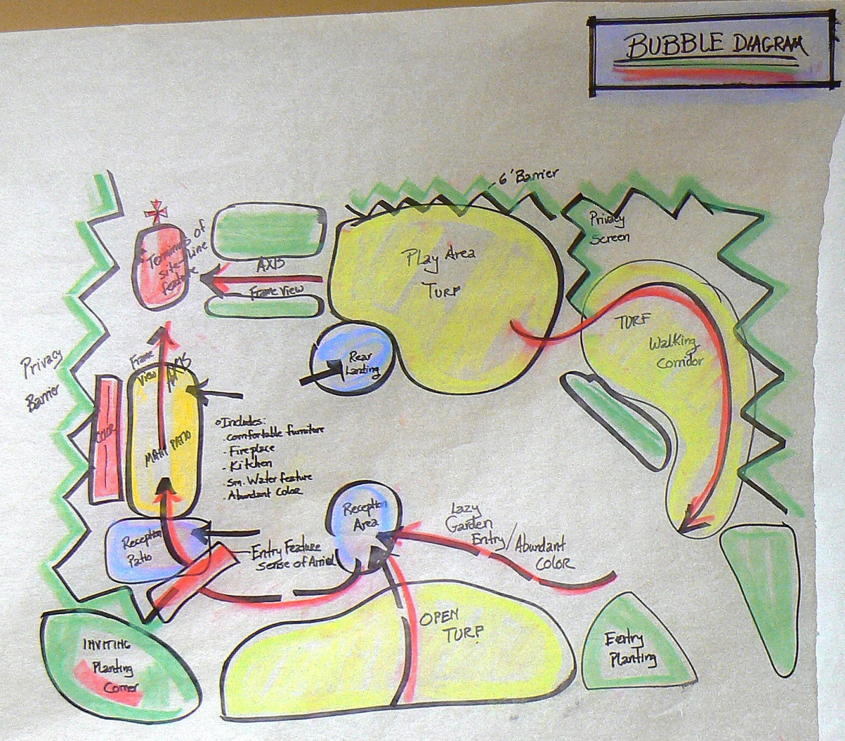
Bubble Diagram Examples

Slide 29
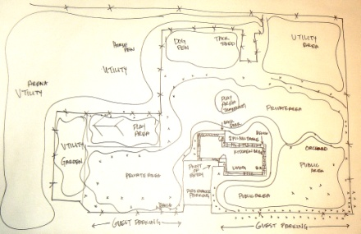
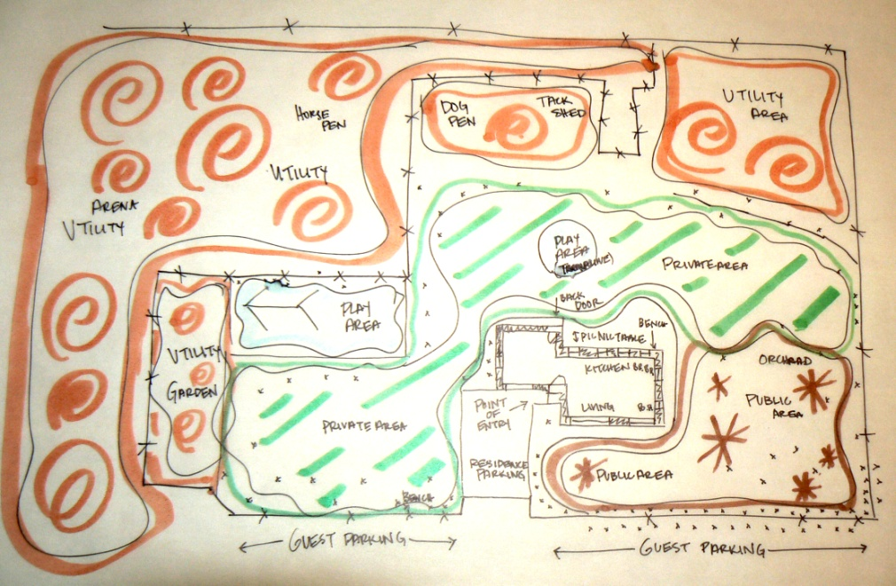
Use of color on Bubble Diagram

Slide 30
Final Design Plan (form composition)
edis.ifas.ufl.edu.
Form composition—the organization, placement, or relationship of basic shapes so as to produce a naturally and logically connected image
Detailed plans for planting and construction
  show sizes, locations, and quantity of plants and materials
  drawn to scale

Slide 31

Final Plan Example

Slide 32
Outdoor Room Concept

Slide 33
Outdoor Room Concept
Outdoor wall
Outdoor floor
Outdoor ceiling

Slide 34
Outdoor wall
Defines the limits or size of the outdoor room
Slow or prevent movement in a certain direction
Should not be placed in the middle of areas, but sides instead
Materials include: shrubs, small trees, ground covers, flowers fencing, masonry

Slide 35
Outdoor floor
Provides the surface
Materials grass, ground covers, sand, gravel, or water, brick, concrete, patio blocks, tile.

Slide 36
Outdoor ceiling
Defines the upper limits of the outdoor room
May offer physical protection—awning or aluminum covering
Shade in summer, drop leaves, warm house in winter

Slide 37
Foundation Plantings:
  Focalize the main entrance with noticeable plants
  Compliment architectural style
  Break long continuous lines of the house
  Avoid competing elements
  Select plants
    Easily be maintained to proper scale with the house
    Height not to exceed two-thirds the wall at house corners
    Use taller plants on corners
    Medium-size shrubs for one-story homes; large shrubs for two story or taller.
    Use dwarf shrubs or ground covers under windows 4’ or less above ground level.
    Balance the planting with equal “foliage mass.”
    Repeat some of the same plants on each end
    Use variety in plants—texture, color, form
    Mass plants
    Mature size allowed to touch adjacent plants
Notes:
1. This document is CIR536, one of a series of the Environmental Horticulture Department, Florida Cooperative Extension Service, Institute of Food and Agricultural Sciences, University of Florida. Original publication date June 1991. Reviewed October 2003. Visit the EDIS Web Site at http://edis.ifas.ufl.edu.
2.
Dewayne L. Ingram, former professor and extension horticulturalist, Environmental Horticulture Department, Cooperative Extension Service, Institute of Food and Agricultural Sciences, University of Florida, Gainesville FL 32611.
The Institute of Food and Agricultural Sciences (IFAS) is an Equal Opportunity Institution authorized to provide research, educational information and other services only to individuals and institutions that function with non-discrimination with respect to race, creed, color, religion, age, disability, sex, sexual orientation, marital status, national origin, political opinions or affiliations. For more information on obtaining other extension publications, contact your county Cooperative Extension service.
U.S. Department of Agriculture, Cooperative Extension Service, University of Florida, IFAS, Florida A. & M. University Cooperative Extension Program, and Boards of County Commissioners Cooperating. Millie Ferrer-Chancy, Interim Dean.

Slide 38
Foundation Mistakes
Overgrown effect
  plants too large for rooflines or windows
  dwarfs home and requires high maintenance to control size
Crowded effect
  large mass of confusion
  plants too close at time of planting
    gives instant fullness but plants lose their identity over time
Clipped effect
  plants get a regular “haircut”
  maintained with very smooth edge
  plants loose unique growth habits
Unbalanced effect
  too many plants or larger plants occur on one side or at the end of the planting
  appears tilted and is out of balance
Toy Solider effect
  Landscape uses one species of landscape plants, often round which are spaced equally with noticeable gaps between plants
  monotonous, boring and lack creativity
Hedge effect
  plants are trimmed to continuous box shape
  lacks variety and gives foundation no relief from horizontal lines
  hedges are used as borders or living fence

Slide 39
Designing a Flower Garden
Gates, Christina, Diane Erickson, Shelly Zollinger & Larry Sagers.
Temple Square Gardening. Ingland Press 2003.

Slide 40
Steps in Garden designing:
Choose a configuration
  Explosion
  Sine curve
  C curve
  E curve
  Place skeletal flowers on the ground in a triangular shape with three unequal sides along the curved line
  Draw line in soil with shovel or use a hose for the line
  One side of that triangle is then used to form the base of the next triangle of a different size
  Continue pattern throughout the design until if forms the configuration you have chosen
  Configurations that don’t work
    Straight lines, concentric circles, checkerboards, zipper patterns
Notes:
Gates, Christina, Diane Erickson, Shelly Zollinger & Larry Sagers.
Temple Square Gardening. Ingland Press 2003.

Slide 41
Skeleton
Dominance main design principle
  Shown by plant form, texture, color or position
    Qualify a plant as skeletal:
      Strong, tall, vertical (for dominant form)
      Broad and dramatic (for dominant form)
      Coarse texture (for dominant texture)
      Vivid bright blossoms or leaves (for dominant color)
    10 to 20 % of flowers used in design
Notes:
Gates, Christina, Diane Erickson, Shelly Zollinger & Larry Sagers.
Temple Square Gardening. Ingland Press 2003.

Slide 42
Tendon
Positioned after the skeleton plants have been placed
  Chosen to connect and blend the skeletal flowers, helping to hold together the form of the skeleton
  Complement skeleton flowers according to principle you choose
    form might be shorter or less dominant
    texture might be softer or smaller
    color might contrast or complement
  Tendon maintains the configuration line
  Triangles interlock with the skeleton plant triangles along the configuration line
  10 to 20 % of flowers in the design
Notes:
Gates, Christina, Diane Erickson, Shelly Zollinger & Larry Sagers.
Temple Square Gardening. Ingland Press 2003.

Slide 43
Flesh
More subordinate flowers
Scattered in and among the other flowers to complete and fill out the design
Place in clusters that form asymmetrical shapes with fractured edges
Group together to form clusters around the skeletal and tendon flowers
  creates a shifting mosaic with the groupings of plants
60-80% of the number of plants
Notes:
Gates, Christina, Diane Erickson, Shelly Zollinger & Larry Sagers.
Temple Square Gardening. Ingland Press 2003.

Slide 44
Sparkle
Final touch
Few special or highly contrasting flowers
Odd-numbered groups of three, five or seven
Placed randomly
Notes:
Gates, Christina, Diane Erickson, Shelly Zollinger & Larry Sagers.
Temple Square Gardening. Ingland Press 2003.

Slide 45
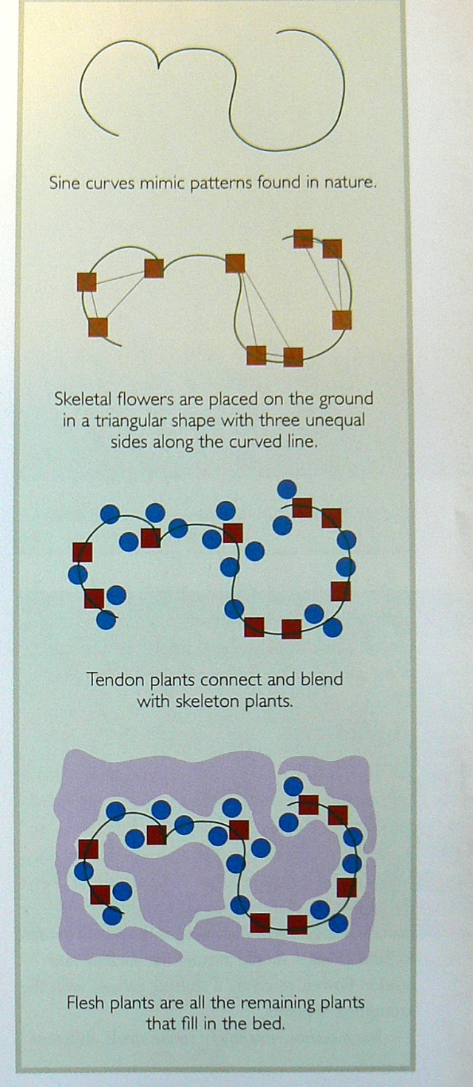
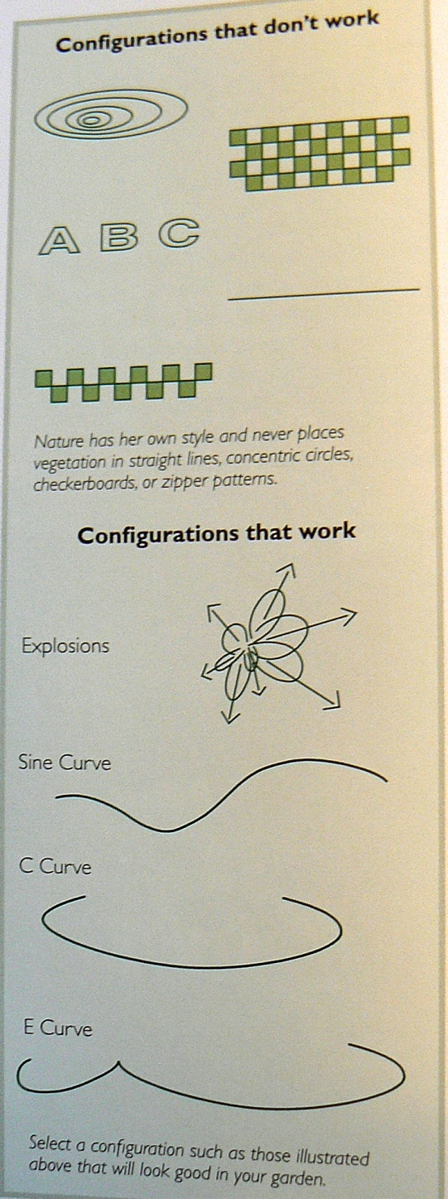
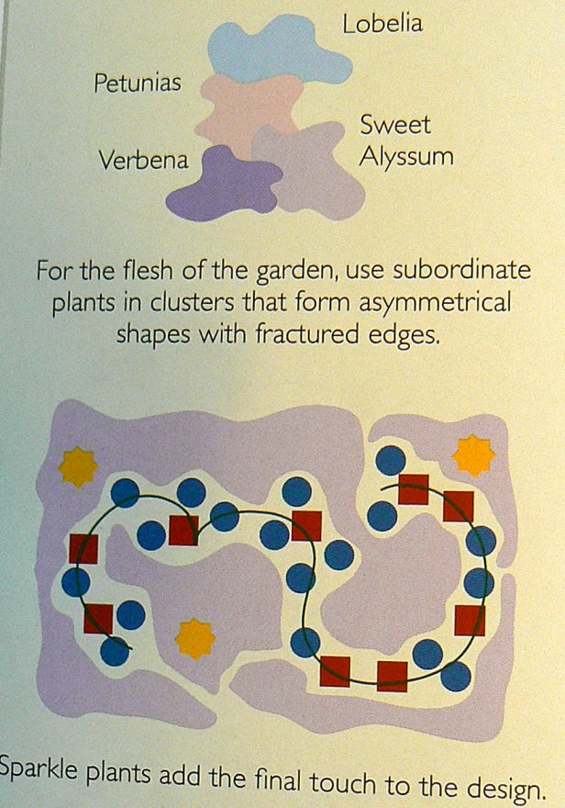
Notes:
Gates, Christina, Diane Erickson, Shelly Zollinger & Larry Sagers.
Temple Square Gardening. Ingland Press 2003.

Slide 46
Choosing plants
Massing
Group alike plants together
  placed close enough to look like a mass without overcrowding
Variety
Makes design interesting
Vary time of bloom or leaf color, and mature height, spring blooming, fall color
Texture
Most often associated with leaf size
  don’t use all coarse or fine textured plants
Repetition
Repeat same plants throughout the design
Same plant used on one side should be repeated on the other
Symmetrical all same number
Asymmetrical not necessary to use same number of plants
Notes:
1. This document is CIR536, one of a series of the Environmental Horticulture Department, Florida Cooperative Extension Service, Institute of Food and Agricultural Sciences, University of Florida. Original publication date June 1991. Reviewed October 2003. Visit the EDIS Web Site at http://edis.ifas.ufl.edu.
2.
Dewayne L. Ingram, former professor and extension horticulturalist, Environmental Horticulture Department, Cooperative Extension Service, Institute of Food and Agricultural Sciences, University of Florida, Gainesville FL 32611.
The Institute of Food and Agricultural Sciences (IFAS) is an Equal Opportunity Institution authorized to provide research, educational information and other services only to individuals and institutions that function with non-discrimination with respect to race, creed, color, religion, age, disability, sex, sexual orientation, marital status, national origin, political opinions or affiliations. For more information on obtaining other extension publications, contact your county Cooperative Extension service.
U.S. Department of Agriculture, Cooperative Extension Service, University of Florida, IFAS, Florida A. & M. University Cooperative Extension Program, and Boards of County Commissioners Cooperating. Millie Ferrer-Chancy, Interim Dean.

Slide 47
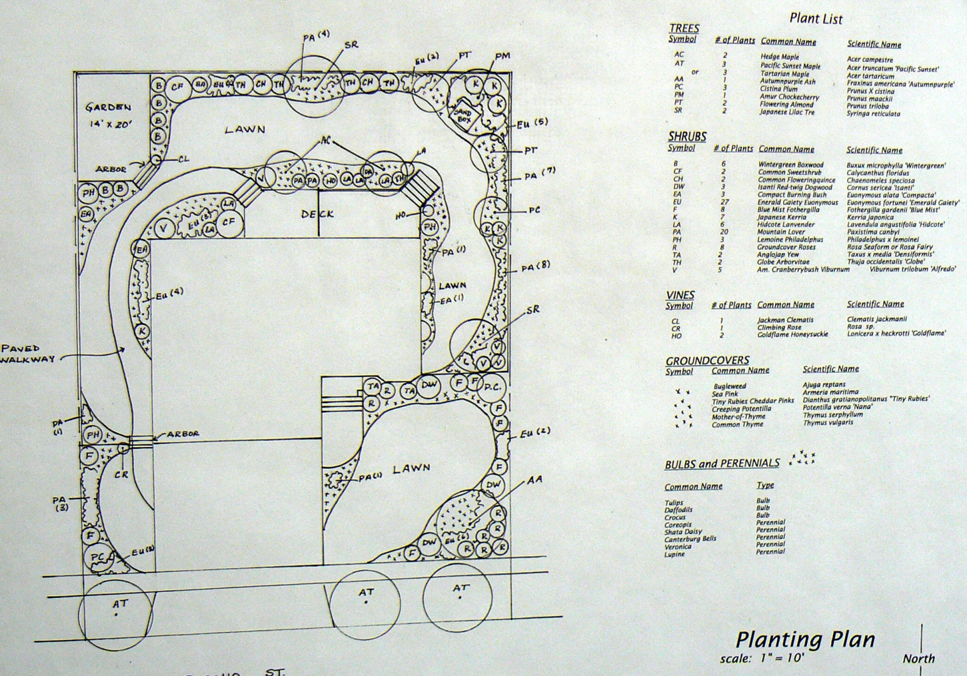
Planting Plan Examples

Slide 48
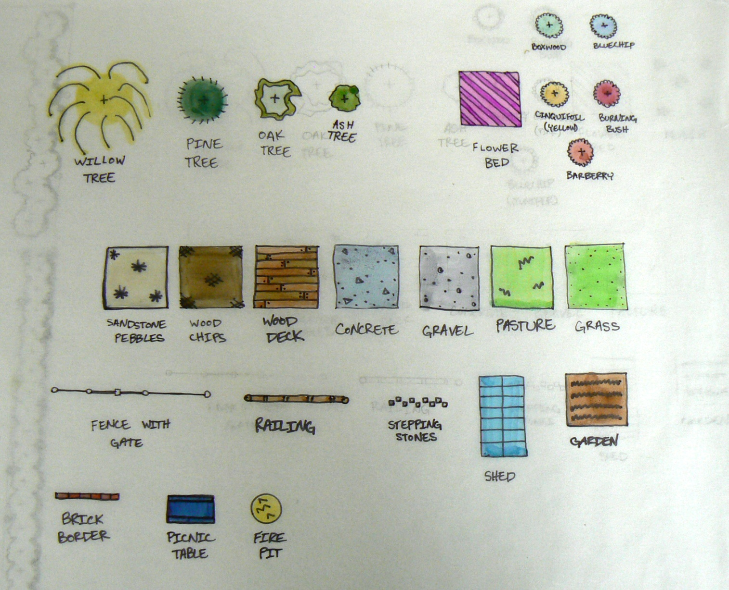
Hardscape & tree planting legend

Slide 49
Low-Maintenance
Landscape Design Planning
Even the perfectly designed and installed landscape will fail if maintenance fails
Many maintenance problems are designed into landscapes
Complex designs usually require more maintenance

Slide 50
Design
Keep outlines of grass, decks, sidewalks simple
  Use curing lines in the borders--more natural
Keep lawn out of small wedges and acute angles
  Avoid acute angles—obtuse is allowable
If it can be mowed with a riding lawnmower without a lot of trimming, it is a low maintenance design
When lines and forms intersect a square, connect them at right angles--90 degrees
Landscape the borders of the property—especially the rear garden

Slide 51
Trees and Shrubs
Avoid improper plant selection, spacing and installation
Own planting bed
  Less edging and trimming if not planted in grass
Next to building Placement
  Genetically small w/ slow rate of growth
Selection
    Little pruning
    Pest resistance
    Avoid messy fruit drop

Slide 52
Lawn
Keep plant materials separate from grass
Leave open areas of lawn
Learn to use weed barrier fabrics, mulches, groundcovers and chemicals to reduce weeds
Only plant grass where it is actually needed
Use edging materials that are impregnable
  Bender board, metal or concrete edging
  Distinct mowing edge, clean lawn boundary

Slide 53
Flowers
Use annuals sparingly
  Plant every year
  Labor and money intensive
Rely more heavily on perennial flowers, ground covers, flowering shrubs & vines

