Slide 1
Nursery/Landscape Equipment & Supplies
Identification

Slide 2
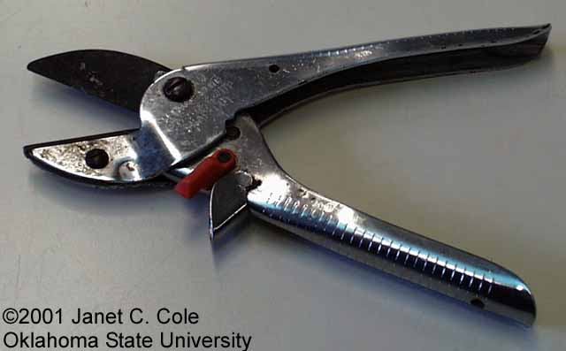
255 anvil-and-blade pruner
okstate.edu
Notes:
http://www.okstate.edu/ag/asnr/hortla/needham/Images/equipment/anvil_and_blade_pruners.JPG

Slide 3
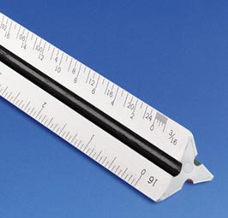
256 architect’s scale
kk.org
Notes:
http://www.google.com/imgres?imgurl=http://www.kk.org/cooltools/alvin-scale-sm.jpg&imgrefurl=http://www.kk.org/cooltools/archives/003771.php&usg=__7TTr_v6lWU-WE7FWgh9mlhqE-cg=&h=255&w=266&sz=10&hl=en&start=2&itbs=1&tbnid=R9-KbVO1fJDjlM:&tbnh=108&tbnw=113&prev=/images%3Fq%3Darchitect%25E2%2580%2599s%2Bscale%26hl%3Den%26sa%3DG%26gbv%3D2%26tbs%3Disch:1

Slide 4
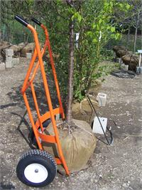
257 ball cart (B&B truck)
cartsandanchors.com
Notes:
http://cartsandanchors.com/images/products/thumb/Diablo_side_rootball_paint.JPG

Slide 5
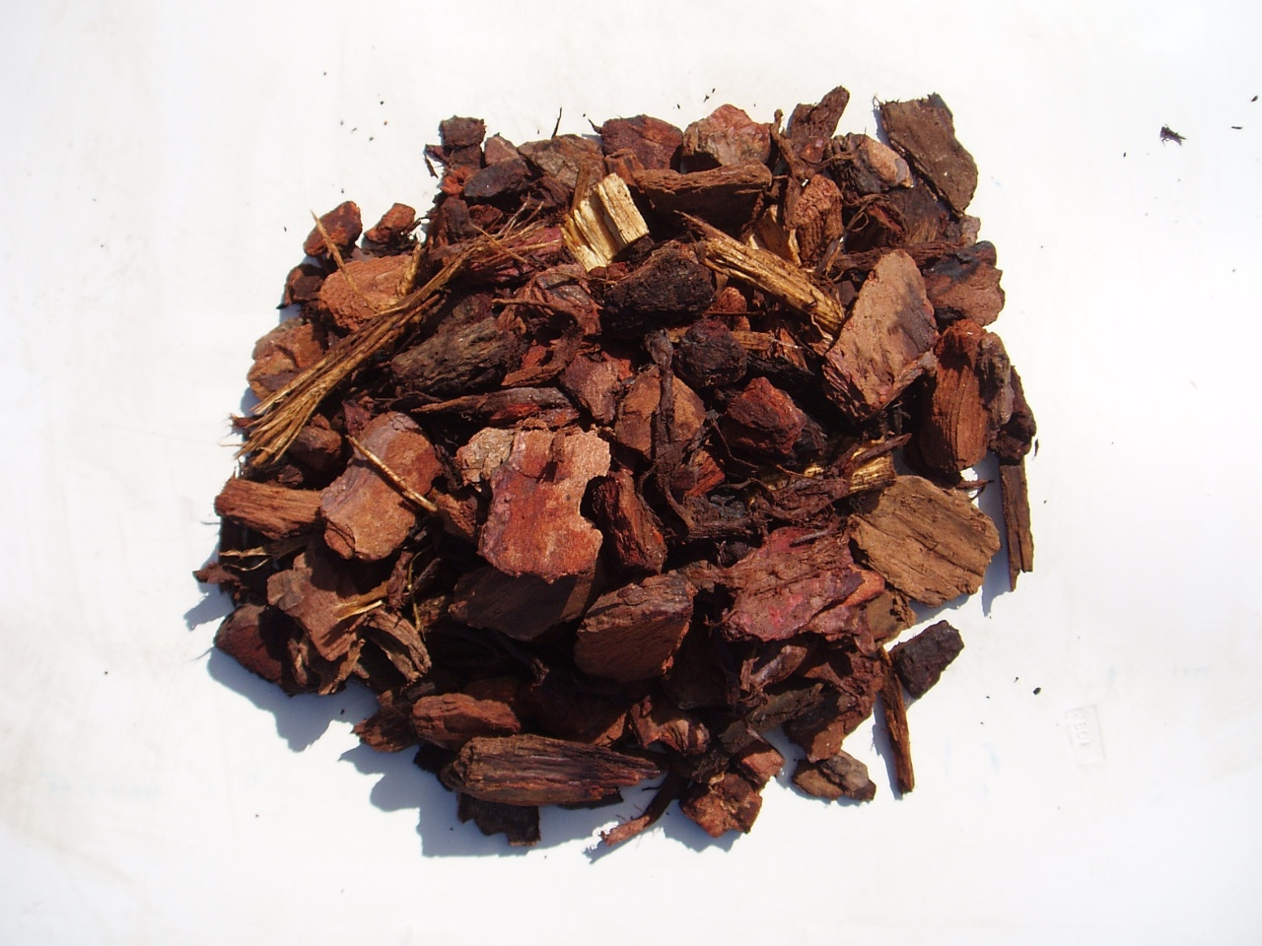
258 bark mulch
crew1717.org
Notes:
http://www.crew1717.org/VC/mulch/vapine_bark_mulch.jpg

Slide 6
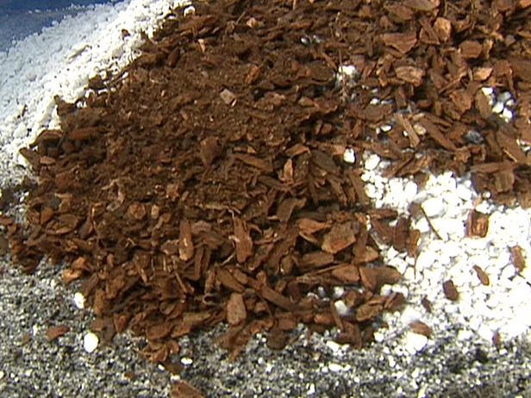
259 bark medium
img.hgtv.com
Notes:
http://img.hgtv.com/HGTV/2008/07/14/gby1702_3c-mixing-soil-media_lg.jpg

Slide 7
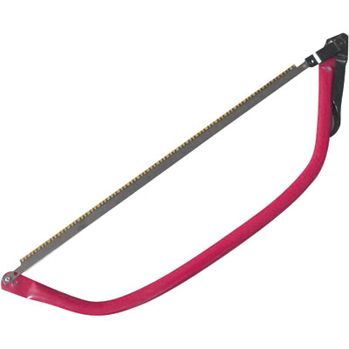
260 bow saw
drumsanders.net
Notes:
http://www.drumsanders.net/images/pictures/northern-industrial-bow-saw--21in..jpg

Slide 8
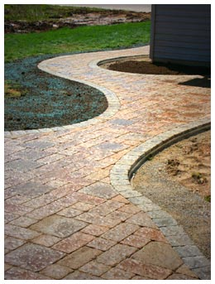
261 brick paver
landscapingwisconsin.com
Notes:
http://www.landscapingwisconsin.com/images/appleton_brick_paver_walk.jpg

Slide 9
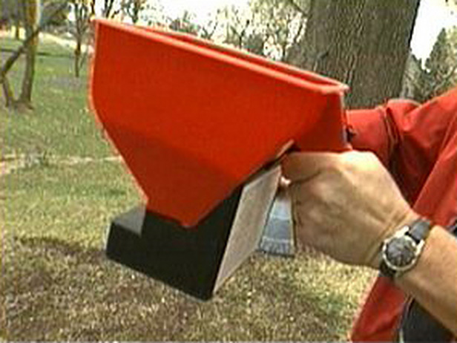
262 broadcast (cyclone) spreader
img.hgtv.com
Notes:
http://img.hgtv.com/HGTV/2003/03/06/gby506_1e_lg.jpg

Slide 10
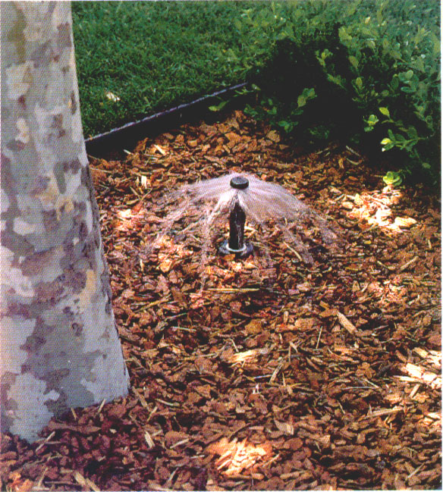
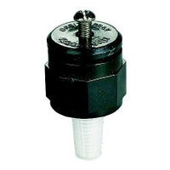
263 bubbler head, irrigation
imitationrain.com
s7d5.scene7.com
Notes:
http://www.imitationrain.com/images/bubbhigh.jpg
http://s7d5.scene7.com/is/image/HardwareandTools/046878541191?wid=200&hei=200

Slide 11
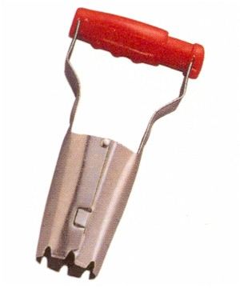
264 bulb planter
2.bp.blogspot.com
Notes:
http://2.bp.blogspot.com/_unxwHMygDLQ/SvIsnjzXnuI/AAAAAAAAFOU/VNqhpNnQ3pU/s400/shorthandle_bulb_planter.jpg

Slide 12
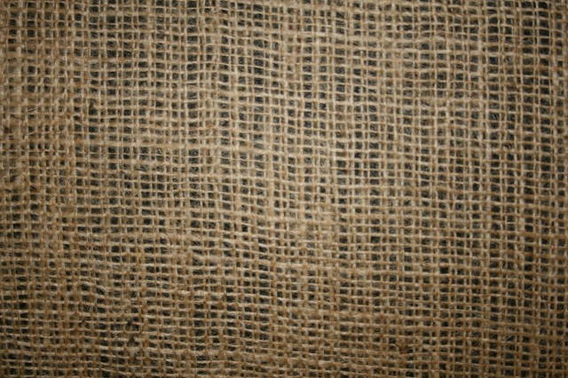
265 burlap
catalogclearance.com
Notes:
http://www.catalogclearance.com/itm_img/burlap.jpg

Slide 13
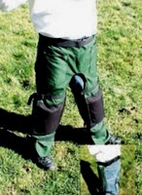
266 chaps
1.bp.blogspot.com
Notes:
http://1.bp.blogspot.com/_QV7qTOVGe9M/SbGZKmrHFlI/AAAAAAAAAHQ/V8e0UiWtIgQ/s200/wraps%2520too%2520far%2520set%2520022405.jpg

Slide 14
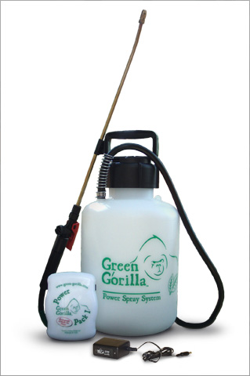
267 compressed air sprayer
rittenhouse.ca
Notes:
http://www.rittenhouse.ca/content/images/big%5Cgreen-gorilla-1gal.jpg

Slide 15
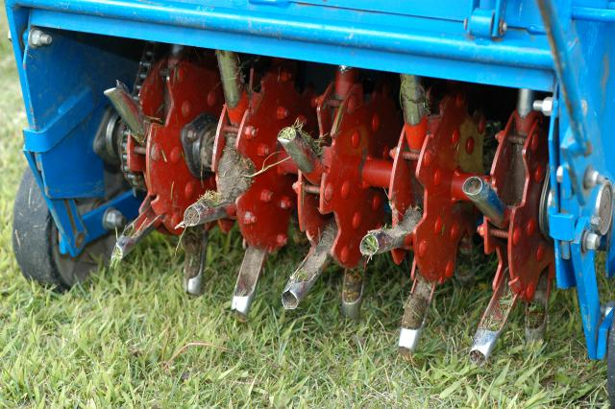
268 core aerifier
turf.msu.edu
Notes:
http://www.turf.msu.edu/assets/ArticlePhotos/_resampled/LargePhoto-Cultivation112.JPG

Slide 16
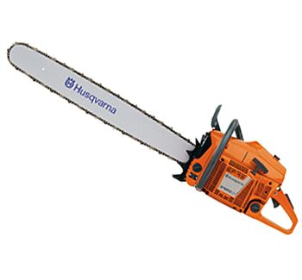
269 chain saw
portable-electric-power-generators.com
Notes:
http://www.portable-electric-power-generators.com/images/powertools/husqvarna/HUS_3120xp_lg.jpg

Slide 17
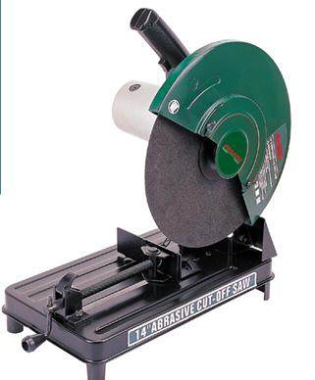
270 cut-off machine
image.made-in-china.com
Notes:
http://image.made-in-china.com/2f0j00SMetckIaOUpL/Cut-off-Machine-Chop-Saw-CK72355-.jpg

Slide 18
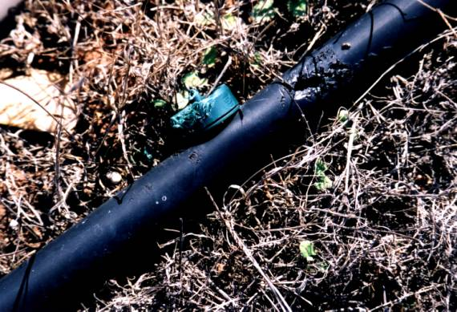
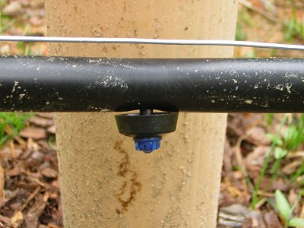
271 drip emitter, irrigation
2.bp.blogspot.com
sci.sdsu.edu
Notes:
http://www.sci.sdsu.edu/SERG/restorationproj/chaparraland/miramar/mitigation2/fig2.jpg
http://2.bp.blogspot.com/_NmecAwc7NVo/SDLhWinLCYI/AAAAAAAAAEE/PSuvExP7I3s/s400/irrigation+drip+emmitter.JPG

Slide 19
272 dry-lock wall block
igoe.ie/
Notes:
http://igoe.ie/cms/images/stories/products/RepairnRestoration/drylok.jpg

Slide 20
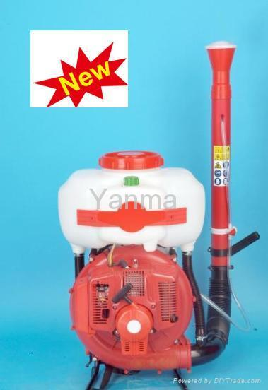
273 duster
img.diytrade.com
Notes:
http://img.diytrade.com/cdimg/931628/9157027/0/1243387015/Mist_Duster_Power_Knapsack_Sprayer_Italy_Standard.jpg

Slide 21
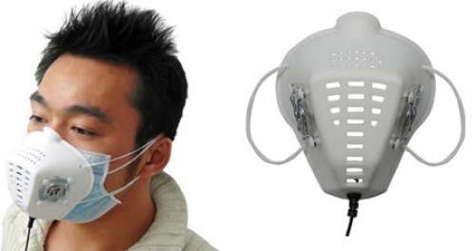
274 dust mask
hackedgadgets.com
Notes:
http://hackedgadgets.com/wp-content/_USB_dust_mask.jpg

Slide 22
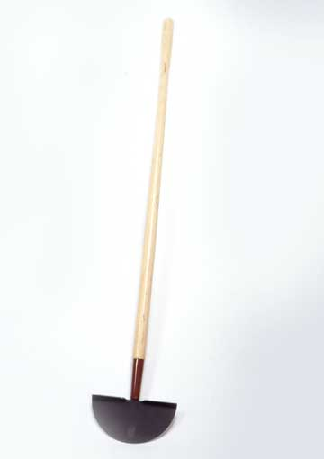
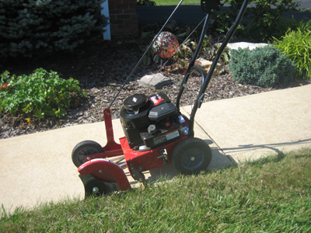
275 edger (power or hand)
auction.uufh-nc.org
images.meredith.com
Notes:
http://auction.uufh-nc.org/uploaddir/a-Edger.jpg
http://images.meredith.com/bhg/images/03/p_ORT701218.jpg

Slide 23
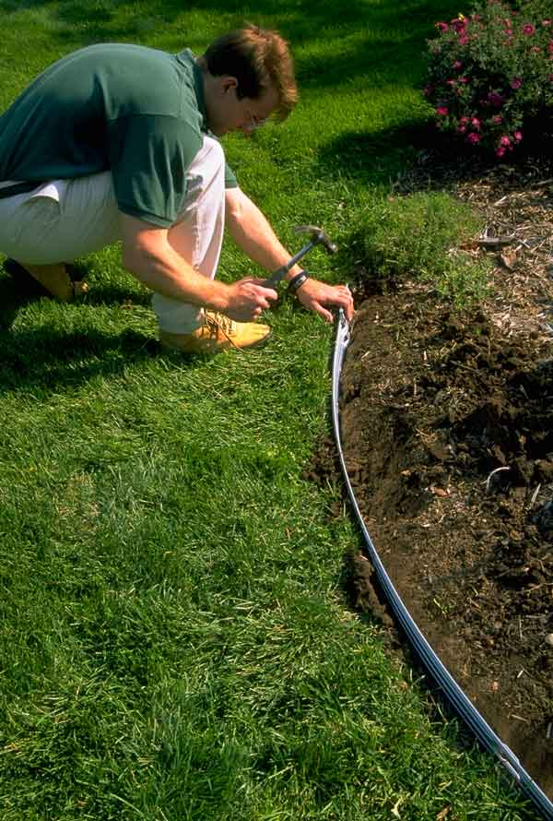
276 edging
suburbanlandscapesupply.com
Notes:
http://www.suburbanlandscapesupply.com/catalog/images/landscapepictures/edging.jpg

Slide 24
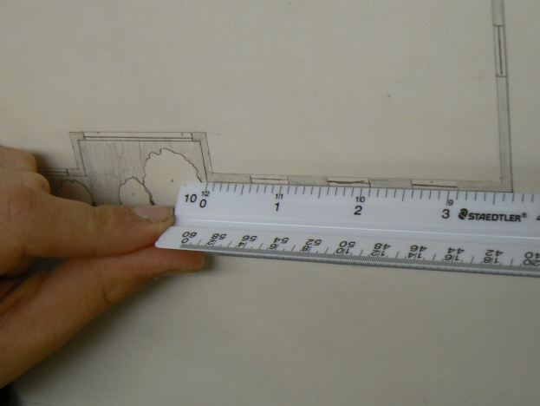
277 engineer’s scale

Slide 25
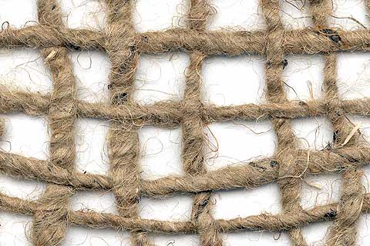
278 erosion netting
emeraldseedandsupply.com
Notes:
http://www.emeraldseedandsupply.com/photos/JuteNet.jpg

Slide 26
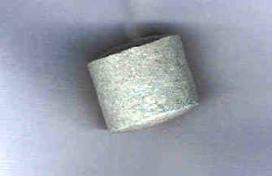
279 fertilizer tablet
kiowacd.org
Notes:
http://www.kiowacd.org/images/fertilizer_tablet.jpg

Slide 27
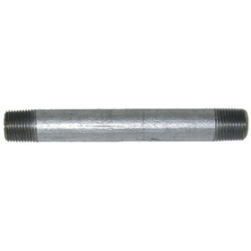
280 galvanized pipe
qcsupply.com
Notes:
http://www.qcsupply.com/images/products/130100PCLG.jpg

Slide 28
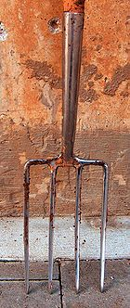
281 garden (spading) fork
wikipedia.com
Notes:
Wikipedia.com

Slide 29
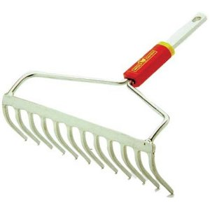
282 garden (bow) rake
ecx.images-amazon.com
Notes:
http://ecx.images-amazon.com/images/I/410J64P4REL._SL500_AA300_.jpg

Slide 30
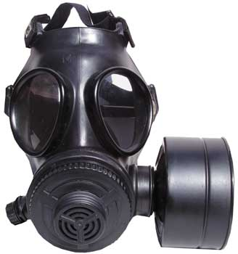
283 gas mask
approvedgasmasks.com
Notes:
http://www.approvedgasmasks.com/images/evo5000-mask.jpg

Slide 31
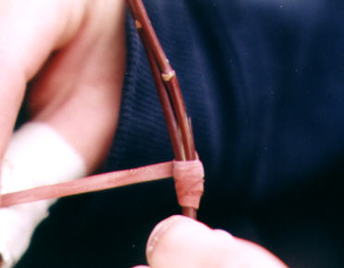
284 grafting band
freeplants.com
Notes:
http://www.freeplants.com/Grafting_10.jpg

Slide 32
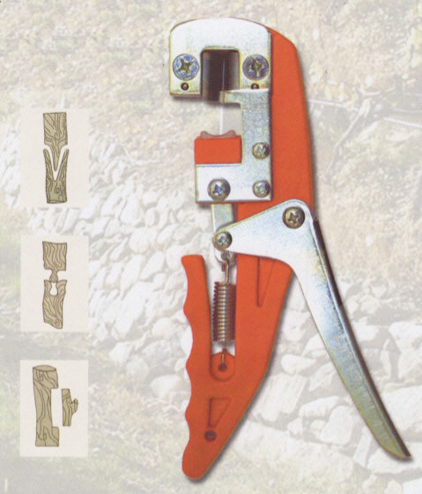
285 grafting tool
otteruk.com
Notes:
http://www.otteruk.com/it040001.jpg

Slide 33
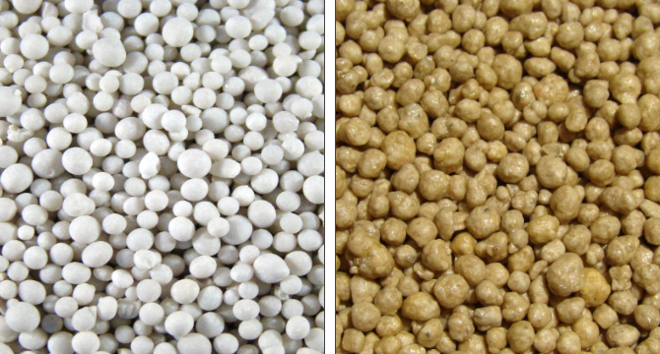
286 granular fertilizer
continentalrollomixer.com
Notes:
http://www.continentalrollomixer.com/samples/before_and_after/13-13-13_Un-Coated_Granular_Fertilizer~13-13-13_Fertilizer_with_12%2B_Polymer_Coating.jpg

Slide 34
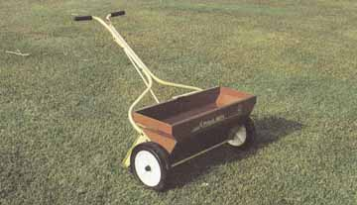
287 gravity (drop) spreader
ohioline.osu.edu
Notes:
http://ohioline.osu.edu/b817/images/b817_10.jpg

Slide 35
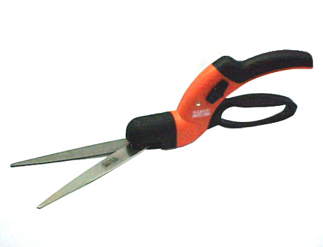
288 grass shears
rittenhouse.ca
Notes:
http://www.rittenhouse.ca/content/images/big%5Cbahco_gs-180.jpg

Slide 36
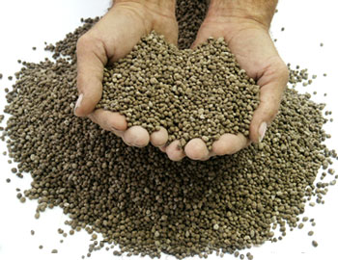
289 ground/pelleted limestone
mineralprocess.com
Notes:
http://www.mineralprocess.com/pellets-1.jpg

Slide 37
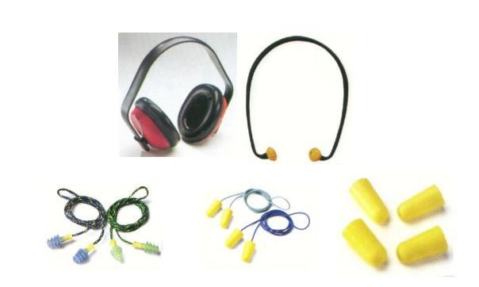
290 hearing protection
montrosesupply.com
Notes:
http://www.montrosesupply.com/shop/images/HEARING%20PROTECTION.JPG

Slide 38
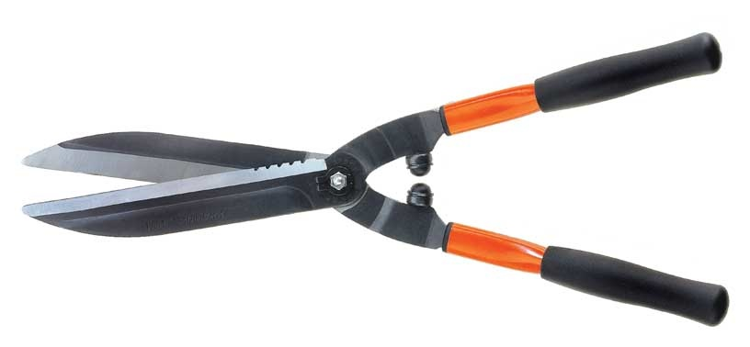
291 hedge shears
dawsonindia.com
Notes:
http://www.dawsonindia.com/product/Garden%20and%20Hand%20Tools/HEDGE%20SHEAR.jpg

Slide 39
292 hoe
southernobserver.com
Notes:
http://www.southernobserver.com/images/hoe.jpg

Slide 40
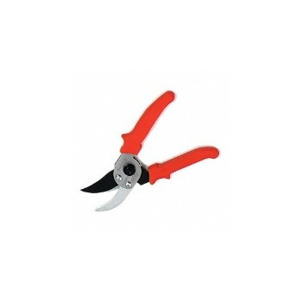
293 hook-and-blade pruners
hardwareworld.com
Notes:
https://www.hardwareworld.com/files/pi/l8/L/9W7B.jpg

Slide 41
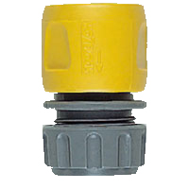
294 hose-end repair fitting
thegarden.co.uk
Notes:
http://www.thegarden.co.uk/stock_images/1112214.jpg

Slide 42
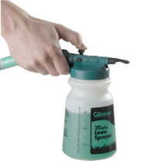
295 hose-end sprayer
1.zoysiafarms.com
Notes:
http://www1.zoysiafarms.com/images/products/LG_HoseEndSprayer.jpg

Slide 43
296 hose-end washer
secure.demonweb.co.uk
Notes:
https://secure.demonweb.co.uk/earls100/earls_shop/images/copper_washers.jpg

Slide 44
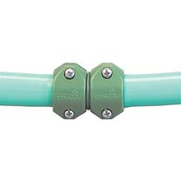
297 hose repair coupling
farmtek.com
Notes:
http://www.farmtek.com/wcsstore/EngineeringServices/allbizunits/prodimages/full/wf1790a.jpg

Slide 45
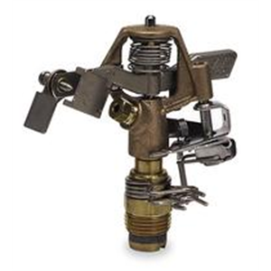
298 impulse sprinkler
drillspot.com
Notes:
http://www.drillspot.com/pimages/85/8534_300.jpg

Slide 46
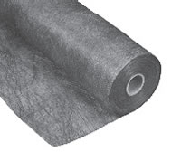
299 landscape fabric
diy-green-home-improvement.com
Notes:
http://diy-green-home-improvement.com/wp/wp-content/uploads/2009/06/landscapefabric.jpg

Slide 47
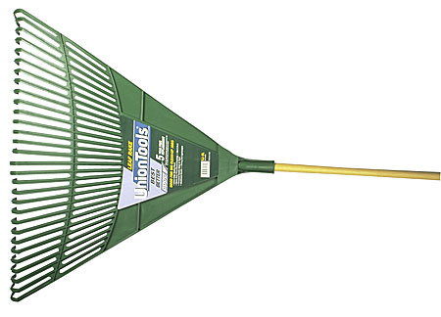
300 leaf rake
benmeadows.com
Notes:
http://www.benmeadows.com/images/xl/UNION-Poly-Leaf-Rake-BEN_i_bmw161683.jpg

Slide 48
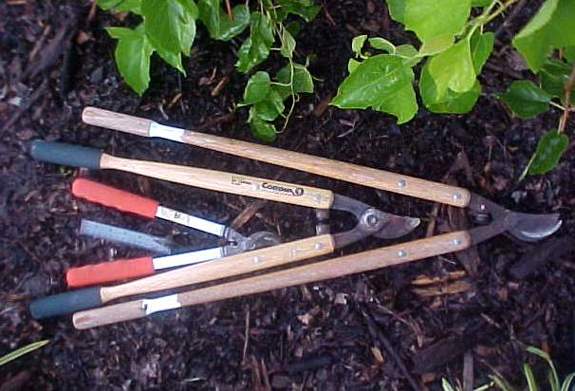
301 loppers
tlcfortrees.info
Notes:
http://www.tlcfortrees.info/images/Loppers.jpg

Slide 49
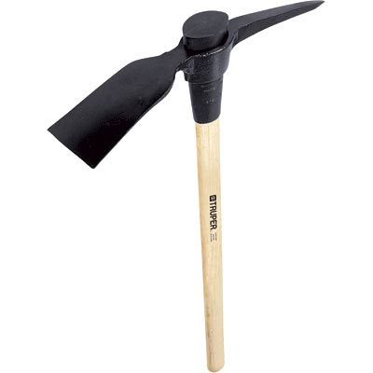
302 mattock
williamthecoroner.files.wordpress.com
Notes:
http://www.google.com/imgres?imgurl=http://williamthecoroner.files.wordpress.com/2008/06/mattock.jpg&imgrefurl=http://williamthecoroner.wordpress.com/2008/06/05/somewhere-between-gardening-and-exasperation/&usg=__AUhy2SjMGOPVjUvE63rrlapypDQ=&h=400&w=400&sz=8&hl=en&start=1&itbs=1&tbnid=QGZxBQUDC_Q-lM:&tbnh=124&tbnw=124&prev=/images%3Fq%3Dmattock%26hl%3Den%26sa%3DG%26gbv%3D2%26tbs%3Disch:1

Slide 50
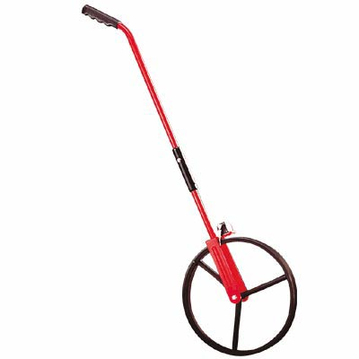
303 measuring wheel
northerntool.com/
Notes:
http://www.northerntool.com/images/product/images/163321_lg.jpg

Slide 51
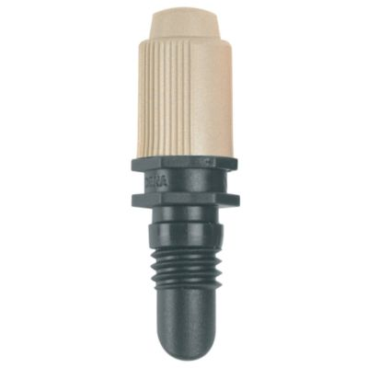
304 mist nozzle (mist bed)
verobeachbusinessdirectory.com
dripdepot.com
s7g1.scene7.com
Notes:
http://s7g1.scene7.com/is/image/BandQ/4078500137102_001c_v001_zp
http://www.dripdepot.com/images/product/1119-2.jpg
http://www.verobeachbusinessdirectory.com/images/mosquito-mist.jpg

Slide 52
305 mower blade balancer
ecx.images-amazon.com
Notes:
http://ecx.images-amazon.com/images/I/21NJ4F%2B4IcL._SL160_.jpg

Slide 53
306 nursery container
gthydroponics.com
Notes:
http://gthydroponics.com/images/NP300%5B1%5D.jpg

Slide 54
307 oscillating sprinkler
rumfordgardener.com
Notes:
http://www.rumfordgardener.com/ca/images/SL2500.jpg

Slide 55
308 peat moss
upload.wikimedia.org
Notes:
http://upload.wikimedia.org/wikipedia/commons/9/9a/Schultz_Sphagnum_Peat_Moss.jpg

Slide 56
309 pick axe
dawsonindia.com
Notes:
http://www.dawsonindia.com/product/Garden%20and%20Hand%20Tools/PICK%20AXE.jpg

Slide 57
310 planting/earth/soil auger
eijkelkamp.com
Notes:
http://www.eijkelkamp.com/Portals/2/Eijkelkamp/Images/thumb/0305SB%20Motorized%20soil%20auger%20set.JPG

Slide 58
311 planting bar
karlkuemmerling.com
Notes:
http://karlkuemmerling.com/store/media/189/18900110.jpg

Slide 59
312 pole pruner
acohardware.com
Notes:
http://www.acohardware.com/uploaded/images/GardenPageII/Pole%20Pruner%2022233333.jpg

Slide 60
313 polyethylene film
homedepot.com
Notes:
http://www.homedepot.com/catalog/productImages/400/1f/1f7b398f-7411-452a-8b93-04b846591cf6_400.jpg

Slide 61
314 Polyethylene pipe
reaselackpolymers.com
Notes:
http://www.reaselackpolymers.com/full-images/1039088.jpg

Slide 62
315 pop-up irrigation head
longfence.com
plumbersurplus.com
Notes:
http://www.plumbersurplus.com/images/prod/1/Orbit_54070.jpg
http://www.longfence.com/assets/Image/SprinklerHeadRGB.jpg

Slide 63
316 post-hole digger
prosupplydepot.com
Notes:
http://www.prosupplydepot.com/catalog/images/QPIPostHoleDigger92380.gif

Slide 64
317 power blower
wise4living.com
Notes:
http://www.wise4living.com/hgblower/images/electric_leaf_blower.jpg

Slide 65
318 power hedge trimmer
wilkinsonplus.com
Notes:
http://www.wilkinsonplus.com/content/ebiz/wilkinsonplus/invt/0227665/0227665_m.jpg

Slide 66
319 pot-in-pot units
clark.wsu.edu
Notes:
http://clark.wsu.edu/horticulture/GardenCenter/images/PotInGround.jpg

Slide 67
320 propagation mat
cooltropicalplants.com
Notes:
http://www.cooltropicalplants.com/image-files/greenhouse-equipment-03.jpg

Slide 68
321 pruning saw
image.made-in-china.com
Notes:
http://image.made-in-china.com/2f0j00lBjtFbaGhIko/Pruning-Saw.jpg

Slide 69
322 PVC (polyvinylchloride) pipe
suppliers.jimtrade.com
furniture.lovetoknow.com
Notes:
http://furniture.lovetoknow.com/Make_PVC_Furniture
http://suppliers.jimtrade.com/resize_image.aspx?MaxSize=228&filen=88/87492/103938.jpg

Slide 70
323 reel mower
fivenonblondes.files.wordpress.com
Notes:
http://fivenonblondes.files.wordpress.com/2008/04/reel-mower.jpg

Slide 71
324 resin-coated fertilizer
image.made-in-china.com
Notes:
http://image.made-in-china.com/2f0j00pMqaOLhghouS/Urea-Resin-Coated.jpg

Slide 72
325 respirator
2.sunysuffolk.edu
Notes:
http://www2.sunysuffolk.edu/greens/home/images/tools/materials%20%20%20hardware/Respirator.jpg

Slide 73
326 rotary mower
gardening-tools-direct.co.uk
Notes:
http://www.gardening-tools-direct.co.uk/images/rotarymowerhayterrang53prol.jpg

Slide 74
327 rototiller
gear.tinyfarmblog.com
Notes:
http://gear.tinyfarmblog.com/wp-content/uploads/2007/12/troy-bilt_horse.jpg

Slide 75
328 round point shovel
img.alibaba.com
Notes:
http://img.alibaba.com/photo/262872397/round_point_shovel_with_firblglass_handle.jpg

Slide 76
329 safety goggles
alligata.co.uk
Notes:
http://www.alligata.co.uk/media/gbu0/prodsm/safety-goggles.jpg

Slide 77
330 sand
free-background-wallpaper.com
Notes:
http://www.free-background-wallpaper.com/images/Wallpapers1280/Beach-Wallpaper/Sand-Dunes-Soft.jpg

Slide 78
331 scoop shovel
877joebark.com
Notes:
http://877joebark.com/yahoo_site_admin/assets/images/scoop_shovel.18163454_std.jpg

Slide 79
332 shade fabric
americannettings.com
Notes:
http://www.americannettings.com/images/large/woven_shadecloth_large.jpg

Slide 80
333 sharpening stone
creativeglassguild.co.uk
Notes:
http://www.google.com/imgres?imgurl=https://www.creativeglassguild.co.uk/catalog/images/sharpening-stone.jpg&imgrefurl=https://www.creativeglassguild.co.uk/catalog/index.php%3FcPath%3D45_55&usg=__BcDhXuaOKStP7256Fsn25VOTPEg=&h=300&w=300&sz=7&hl=en&start=2&itbs=1&tbnid=WR-n9eIgE3oOsM:&tbnh=116&tbnw=116&prev=/images%3Fq%3Dsharpening%2Bstone%26hl%3Den%26sa%3DG%26gbv%3D2%26tbs%3Disch:1

Slide 81
334 siphon proportioner
tnfarmsupply.com
Notes:
http://tnfarmsupply.com/images/hoz.jpg

Slide 82
335 soaker hose
hollywoodsandvines.com
Notes:
http://www.hollywoodsandvines.com/images/SoakerHose.jpg

Slide 83
336 soil sampling tube
sciencefirst.com
Notes:
http://sciencefirst.com/images/6244010.jpg

Slide 84
337 solenoid valve
jelpc-pneumatic.com
Notes:
http://www.jelpc-pneumatic.com/images/Solenoid%20valve/2W250-25.jpg

Slide 85
338 spade
gwestern.com
Notes:
http://www.gwestern.com/images/superior%20wood%20spade.jpg

Slide 86
339 spark plug gap gauge
aircraftspruce.com
Notes:
http://www.aircraftspruce.com/catalog/graphics/12-21375.jpg

Slide 87
340 sphagnum moss
repotme.com
Notes:
http://www.repotme.com/potting-media/img/Premium-Sphagnum-Moss-600.jpg

Slide 88
341 spray suit
catalog.ehgriffith.com
Notes:
http://catalog.ehgriffith.com/images/Spraysuit.jpg

Slide 89
342 square point (flat) shovel
877joebark.com
Notes:
http://877joebark.com/yahoo_site_admin/assets/images/square_point_shovel.3213712_std.jpg

Slide 90
343 string trimmer
ecx.images-amazon.com
Notes:
http://ecx.images-amazon.com/images/I/315MZ848KEL.jpg

Slide 91
344 tape measure
beingwife.files.wordpress.com
Notes:
http://beingwife.files.wordpress.com/2009/02/tape_measure.jpg

Slide 92
345 timeclock
grocerystorefeet.files.wordpress.com
Notes:
http://grocerystorefeet.files.wordpress.com/2009/11/punch-time-clock.jpg

Slide 93
346 topsoil
thecompostshop.co.uk
Notes:
http://www.thecompostshop.co.uk/images/topsoil2.jpg

Slide 94
347 tree caliper
benmeadows.com
Notes:
http://www.benmeadows.com/images/xl/Aluminum-Tree-Caliper-BEN_i_bmw152264.jpg

Slide 95
348 tree wrap
img.hgtv.com
Notes:
http://img.hgtv.com/HGTV/2009/02/27/gby1804_4c-tree-wrap2_s4x3_lg.jpg

Slide 96
349 trowel
ultimatehandyman.co.uk
Notes:
http://www.ultimatehandyman.co.uk/pointing%20trowel.jpg

Slide 97
350 T-square

Slide 98
351 vermiculite
plantpropagation.com
veggiesmith.com
Notes:
http://plantpropagation.com/PlantPropagatePics/VermiculitePot300.jpg
http://veggiesmith.com/blog/wp-content/uploads/2009/05/vermiculite.jpg

Slide 99
352 vertical mower
pubs.caes.uga.edu
Notes:
http://pubs.caes.uga.edu/caespubs/pubcd/B1329/B1329-5-2.jpg

Slide 100
353 water breaker
acwsupply.com
Notes:
http://www.acwsupply.com/~acwsycom/images/400AL.jpg

Slide 101
354 wire tree basket
oregonwireproducts.com
Notes:
http://www.oregonwireproducts.com/product_thumbs/t_basket_OutlinedSmall.jpg

