Slide 1
Nursery/Landscape
Pests & Disorders
Identification

Slide 2
Insects

Slide 3
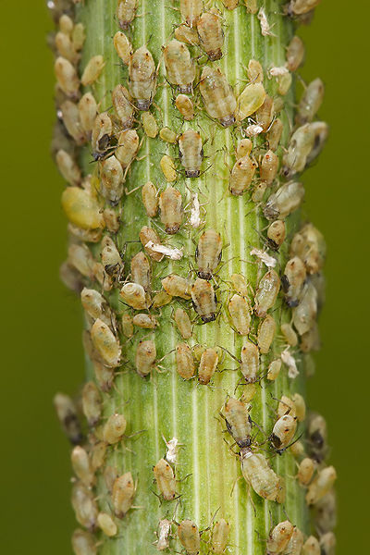
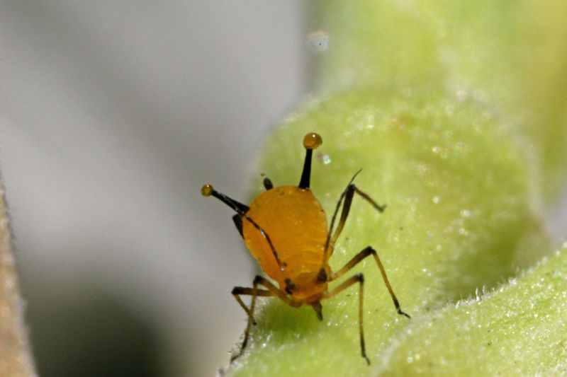
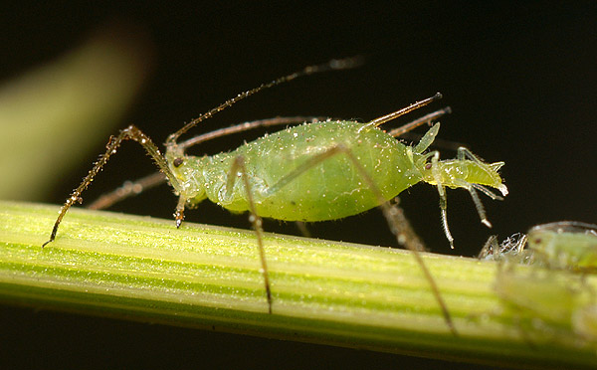
217
Aphid
Wikimedia.org
Notes:
Upload.wikimedia.org

Slide 4
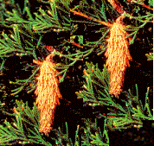
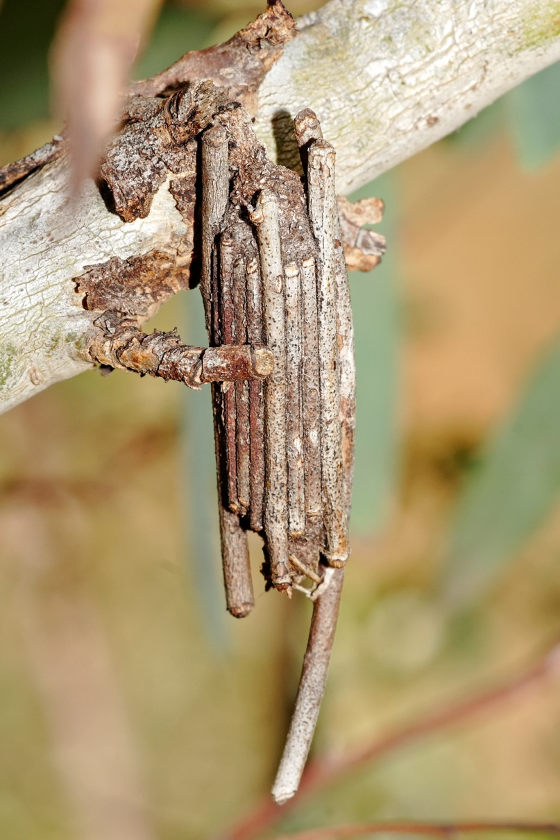
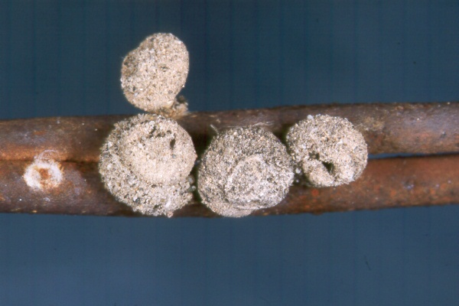
218
Bagworm
Pestproducts.com
Notes:
Pestproducts.com
Bagworms are caterpillars that make distinctive spindle-shaped bags on a variety of trees and shrubs throughout Kentucky USA. They attack both deciduous trees and evergreens, but are especially damaging to juniper, arborvitae, spruce, pine and cedar. Large populations of bagworms can strip plants of their foliage and eventually cause them to die. Infestations often go unnoticed because people mistake the protective bags for pine cones or other plant structures.
Uky.edu

Slide 5
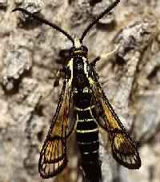
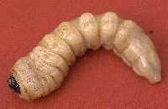
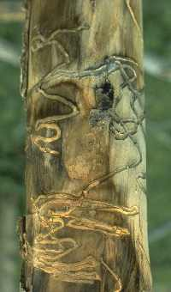
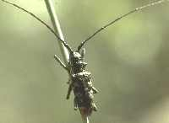
219
Borer
Colostate.edu
Notes:
Colostate.edu

Slide 6
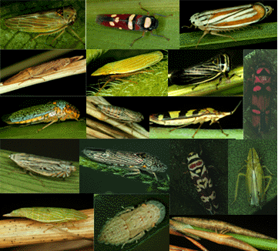
220
Leafhopper
Inhs.uiuc.edu
Notes:
Inhs.uiuc.edu
Leafhoppers are one of the largest families of plant-feeding insects. There are more leafhopper species worldwide than all species of birds, mammals, reptiles, and amphibians combined. Leafhoppers feed by sucking the sap of vascular plants, and are found almost anywhere such plants occur, from tropical rainforests, to arctic tundra. Several leafhopper species are important agricultural pests.

Slide 7
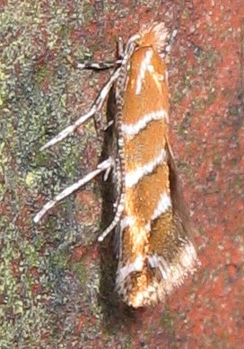
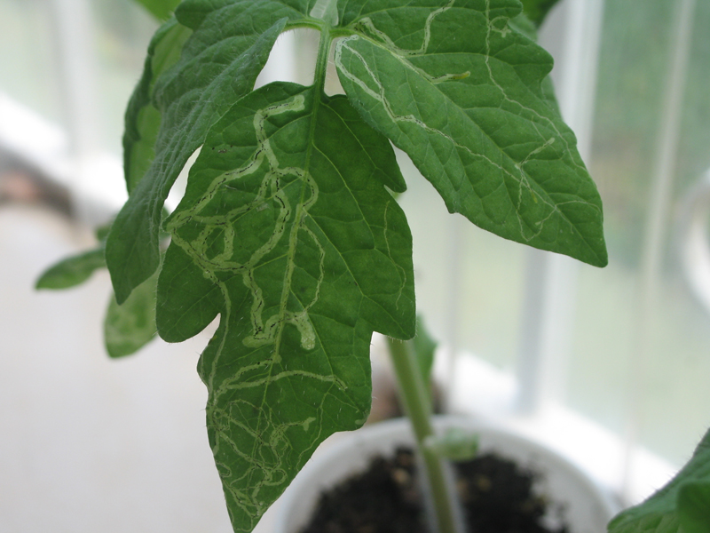
221
Leaf Miner
Wikipedia.org
Notes:
Wikipedia.org
Wikipedia.org
Leaf miners are regarded as pests by many farmers and gardeners as they can cause damage to agricultural crops and garden plants, and can be difficult to control with insecticide sprays as they are protected inside the plant's leaves. Spraying the infected trees/plants with Spinosad, an organic insecticide, will control the leaf miner. Spinosad does not kill on contact but must be ingested by the leaf miner. Two or three applications may be needed in a season, being careful not to spray when bees are around.
Leaf miner infection can be reduced or prevented by planting trap crops near the plants to be protected. For example, lambsquarter, columbine, and velvetleaf will distract leaf miners, drawing them to those plants and therefore reducing the incidence of attack on nearby crops. This is a method of companion planting.

Slide 8
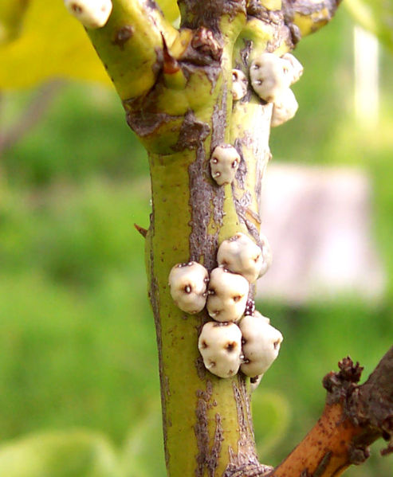
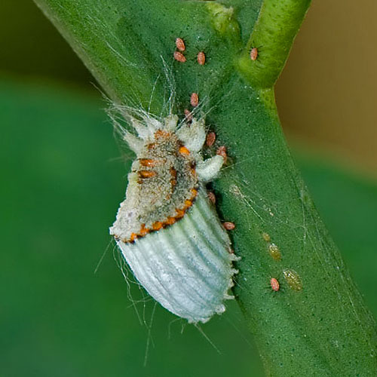
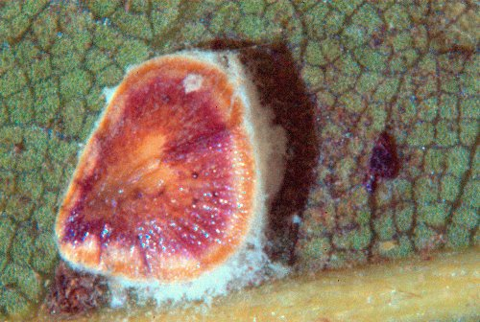
222
Scale
Wikipeida.org
Notes:
Wikipeida.org

Slide 9
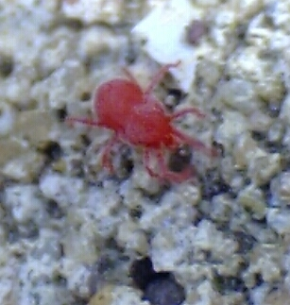
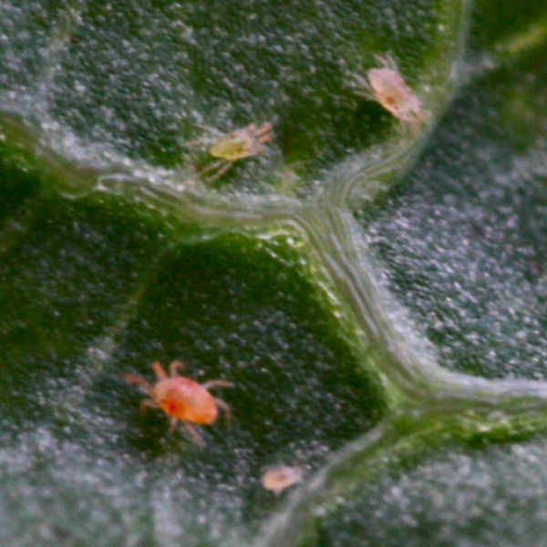
223
Spider Mite
Wikipeida.org
Notes:
Spider mites are members of the Acari (mite) family Tetranychidae, which includes about 1600 species. They generally live on the under sides of leaves of plants, where they may spin protective silk webs, and they can cause damage by puncturing the plant cells to feed. Spider mites are known to feed on several hundred species of plant.
Wikipeida.org

Slide 10
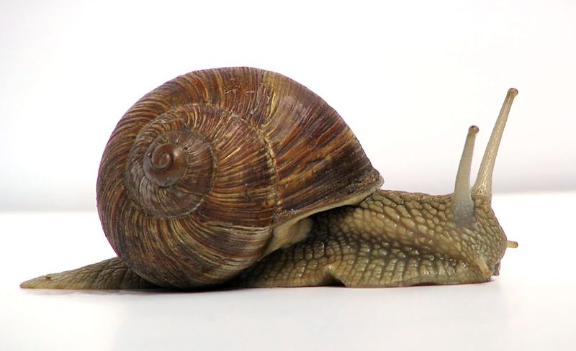
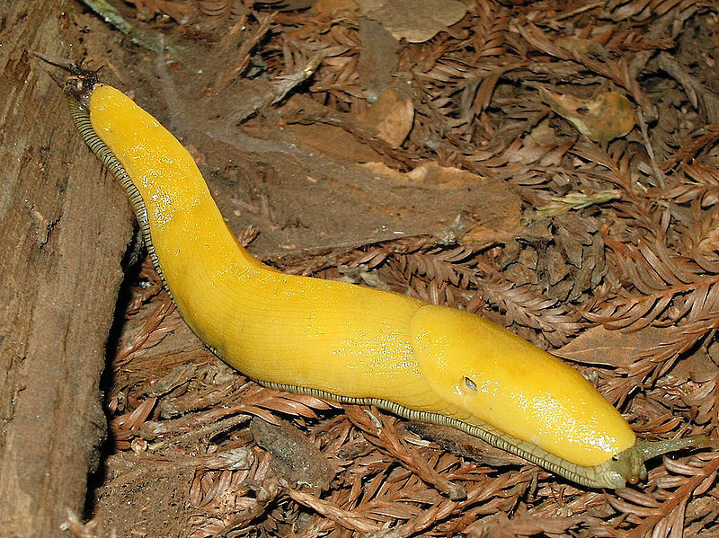
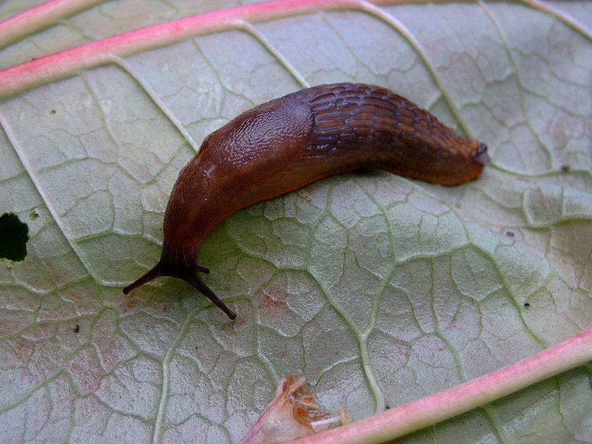
224
Snail/Slug
Wikipeida.org
Notes:
Snail is a common name for almost all members of the molluscan class Gastropoda that have coiled shells in the adult stage. When the word is used in a general sense, it includes sea snails, land snails and freshwater snails. Otherwise snail-like creatures that lack a shell (or have only a very small one) are called slugs.
Slug is a common name that is normally applied to any gastropod mollusc that lacks a shell, has a very reduced shell, or has a small internal shell. This is in contrast to the common name snail, which is applied to gastropods that have coiled shells that are big enough to retract into.
Wikipeida.org

Slide 11
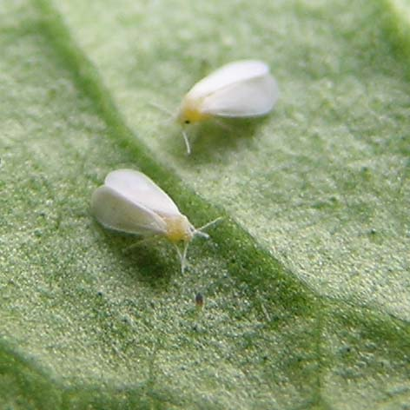
225
Whitefly
Wikipeida.org
Notes:
The whiteflies, comprising only the family Aleyrodidae, are small hemipterans. More than 1550 species have been described. Whiteflies typically feed on the underside of plant leaves.
Wikipeida.org

Slide 12
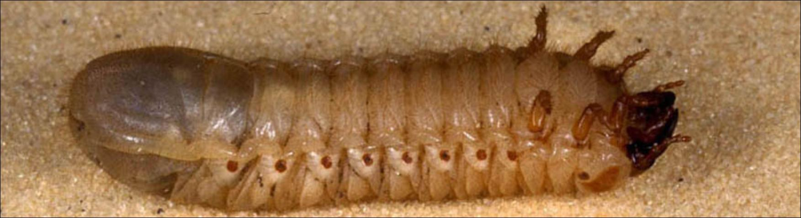
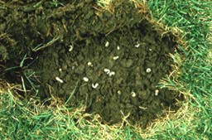
226
White Grub
Ohiolin.osu.edu
Edis.ifas.ufl.edu
Notes:
Ohiolin.osu.edu
Edis.ifas.ufl.edu
White grubs or Grubworms are the larvae of scarabs (beetles). Grubs commonly attack the roots of turfgrasses and ornamental plants. Damage first appears as drought stress such as wilting and drooping.
Wikipeida.org

Slide 13
Diseases

Slide 14
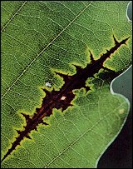
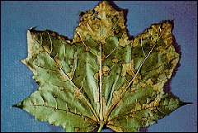
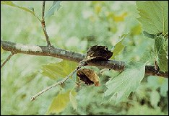
227
Anthracnose
Na.fs.fed.us
Notes:
Na.fs.fed.us
Anthracnose fungi attack numerous hardwood species, including ash, basswood, birch, catalpa, elm, hickory, horsechestnut, London planetree, maple, oak, sycamore, tuliptree, and walnut (table 1).
Although anthracnose diseases have been found wherever these trees grow, not all hardwoods are equally affected. The diseases are particularly severe on American sycamore, white oak and other oaks in the white oak group, and black walnut. Sometimes, these species are almost completely defoliated; and on black walnut, nut production is affected. Infections are frequently found on other oak species, including scarlet, black, red, and southern red oaks; but the red oaks appear to be less susceptible than the white oaks. Pin oak, swamp chestnut oak, bur oak, and London planetree are only occasionally infected by the fungi.
Table 1. Hardwoods affected by anthracnose diseases
Host Causal Fungi Parts of tree affected Ash, several species Discula umbrinella
(Berk. et Br.) Sutton
( = Gloeosporium addum) Leaves Basswood Apiognomonia tiliae
(Rehm) v. Hoehnel
( = Gnomonia tiliae) Leaves, twigs Birch, several species Asteroma microspermum
(Peck) Sutton
( = Gloeosporium betulaeluteae) Cryptocline betularum
(Ell. et Mart.) v. Arx
( = Gloeosporium betularum)
Leaves Catalpa, northern and southern Colletotrichum gloeosporioides
(Penz.) Sacc.
( = Gloeosporium catalpae) Leaves Elm, several species Asteroma inconspicuum
(Cav.) Sutton
( = Gloeosporium inconspicuum) Leaves, twigs Hickory, several species Gnomonia caryae Wolf Leaves, twigs Horsechestnut Glomerella cingulata
(Stonem.) Spauld. & Schrenk Leaves, twigs Maple, several species Kabatiella apocrypta
(Ell. et Ev.) v. Arx
( = Gloeosporium apocryptum) Leaves, twigs Oak, many species Apiognomonia quercina
(Kleb.) v. Hoehnel
( = Gnomonia quercina) Leaves, twigs, buds, shoots London planetree Apiognomonia veneta
(Saec. et Speg.) v. Hoehnel
( = Gnomonia platani) Leaves, twigs, buds, shoots Sycamore, American and European Apiognomonia veneta
(Saec. et Speg.) v. Hoehnel
( = Gnomonia platani) Leaves, twigs, buds, shoots Tuliptree or yellow-poplar Colletotrichum gloeosporioides
(Penz.) Sacc.
( = Gloeosporium liriodendri) Leaves Walnut, several species Gnomonia leptosyla
Ell. et Ev. Leaves, twigs, fruit Evidence of Infection
Symptoms on infected leaves range from tiny dead spots to large circular or irregular dead blotches, depending on the tree species. Dead areas are black, brown, or purple. On sycamore (cover photo) and maple (fig. 1), infected areas are often found along the veins and midrib of the leaf. The dead areas may merge until the whole leaf dies.
Infection in the early spring may turn the leaves black so that they resemble leaves damaged by frost (fig. 2). If they are not killed by the fungi, young leaves may become distorted by the unequal growth in healthy and infected parts. Distorted leaves are common on oaks.
Figure 1. Anthracnose on Norway maple. Figure 2. Healthy and anthracnose-damaged leaves on sycamore.
When severely infected, trees may lose their leaves. But if defoliation occurs in spring or early summer, a tree will usually produce a second crop of leaves (fig. 3).
Symptoms on most trees are confined to the leaves. On sycamores and oaks, however, the fungi may also affect twigs, buds, and shoots.
Figure 3. Severely infected tree is refoliating. Symptoms: Sycamores, Oaks
Figure 5. Anthracnose infection along the vein of an oak leaf.On sycamores, there are four distinct stages of anthracnose: twig blight, bud blight, shoot blight, and leaf blight. These stages often overlap (fig. 4); any one or more stages can be seen during the spring or summer when weather conditions are just right for the development of the disease.
On oaks in the white oak group, symptoms are similar to those on sycamore (fig. 5), but less severe.
Figure 4. Twig, bud, shoot, and leaf blight on sycamore.
Twig blight. Twig blight occurs in the spring before the leaves emerge. After the tips of 1-year-old twigs are killed, small, black fruiting bodies of the fungus soon break through the bark of the dead twigs (fig. 6). Later, cankers-dead areas in the bark-may appear on older branches below the dead twigs (fig. 7). These cankers girdle and kill the branches.
Figure 6. Fungal fruiting bodies break through the bark of a dead sycamore twig. Figure 7. Canker below dead sycamore branch. Bud blight. Bud blight occurs at the same time as twig blight. When cankers girdle the individual buds, the buds die before the bud caps begin to break.
Shoot blight. During the shoot blight stage, emerging shoots and new immature leaves suddenly die.
Leaf blight. In the leaf blight stage, both young and mature leaves are infected with spores produced on twigs and branch cankers. Necrotic spots or blotches are found on the leaves, and dark-brown fruiting bodies of the fungus are found on diseased leaf tissue.
Spread of Infection
The fungi that cause anthracnose overwinter on infected debris from the tree or on infected buds and cankered twigs.
In the spring during rainy periods, large numbers of microscopic spores are discharged by the fungi. The spores are windblown or splashed by the rain onto the young, growing leaves of host trees. During wet weather, the spores germinate; and the fungi penetrate the leaves, killing the new leaf tissue.
On some species, the fungi in the infected areas of new leaves produce secondary spores, called summer spores. Wind and splashing rain spread the summer spores from leaf to leaf. The rapid increase of anthracnose in the summer and early fall is caused by these summer spores. Summer spores are common on ash and walnut.
Influence of Weather
The severity of sycamore anthracnose appears to be related to prevailing temperatures during March or early April. Twig, bud, and shoot blight are more severe if the prevailing average daily temperature remains relatively cool during the period - below 70 °F (21 °C). Prolonged warm periods of 2 to 3 days when day temperatures reach 80 °F (27 °C) will prevent the development of the fungus and thereby limit the disease severity.
Anthracnose spores are spread by wind and rain. In addition, the spores need wet weather to germinate and penetrate the leaves. Therefore, anthracnose diseases may be severe in years with long, cool, rainy periods. If the following year is warm and dry, anthracnose may be inconspicuous or absent.
Control
In forest stands, anthracnose is impractical to control: spraying and pruning are far too expensive. However, management practices that allow better air movement and more sunshine, such as thinning, may inhibit the diseases by helping the foliage dry rapidly after a rain. Air circulation should be considered when planting trees susceptible to anthracnose.
On shade and ornamental trees and nursery stock, anthracnose can be controlled by destroying the overwintering fungi in plant materials. Raking leaves and pruning infected twigs and branches reduce the amount of inoculum available. This infected material should be burned or otherwise destroyed.
Anthracnose diseases on high-value trees and nursery stock can also he controlled by applying fungicides in the spring. Benomyl, plus a spreader-sticker applied at bud break, will provide good control. A chemical mixture of hydrated lime, copper sulfate, and water (4-4-50), known as Bordeaux mixture, is registered for use against anthracnose on elm, maple, and sycamore; dodine can be used against anthracnose of sycamore and walnut. Specific recommendations on the use of these fungicides differ with the type of anthracnose and with the locality.
Other management practices include fertilization and planting less susceptible species. The application of a complete fertilizer, such as 12-12-12, will improve the vigor of trees weakened by repeated attacks of anthracnose. Some species are less affected. London planetree is much less susceptible than American sycamore; oaks in the red oak group are generally more resistant than white oaks.
Information
Pesticides are reviewed continuously by the U.S Environmental Protection Agency; persons contemplating their use should ensure that the materials are registered.
Private landowners can get information about anthracnose diseases from a Cooperative Extension agent at their land-grant college, a State agricultural experiment station, a county Extension office, the local State forestry office, or the Forest Pest Management staff, U.S. Department of Agriculture, Forest Service.
Bibliography
Carter, J. Cedric. Illinois trees: their diseases. Circ. 46. Urbana, IL: State of Illinois, Illinois Natural History Survey; 1964. 96 p.
Neeley, Dan; Rimelick, E.B. Temperature and sycamore anthracnose severity. The Plant Disease Reporter. Beltsville, MD: U.S. Department of Agriculture, Crops Research Division; 1963; 47 (3): 171-175.
Sinclair, W.A.; Johnson, W.T. Anthracnose diseases of trees and shrubs. Tree Pest Leafl. A 2. Ithaca, NY: NY State College of Agriculture and Life Sciences, Cornell University; 1977. 7 p.
Pesticides used improperly can be injurious to human beings, animals, and plants. Follow the directions and heed all precautions on labels. Store pesticides in original containers under lock and key - out of the reach of children and animals - and away from food and feed. Apply pesticides so that they do not endanger humans, livestock, crops, beneficial insects, fish, and wildlife. Do not apply pesticides where there is danger of drift when honey bees or other pollinating insects are visiting plants, or in ways that may contaminate water or leave illegal residues.
Avoid prolonged inhalation of pesticide sprays or dusts, wear protective clothing and equipment, if specified on the label.
If your hands become contaminated with a pesticide, do not eat or drink until you have washed. In case a pesticide is swallowed or gets in the eyes, follow the first aid treatment given on the label, and get prompt medical attention. If a pesticide is spilled on your skin or clothing remove clothing immediately and wash skin thoroughly.
NOTE: Some States have restrictions on the use of certain pesticides. Check your State and local regulations. Also, because registrations of pesticides are under constant review by the U.S. Environmental Protection Agency, consult your local forest pathologist, county agriculture agent, or State extension specialist to be sure the intended use is still registered. Revised December 1985
Formatted for the Internet April 1998

Slide 15
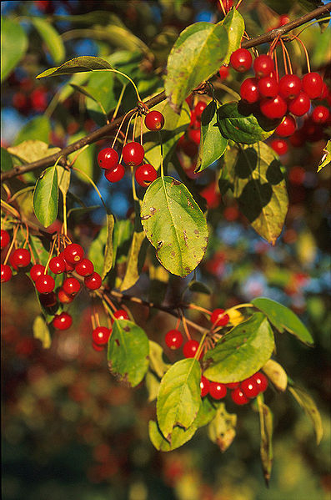
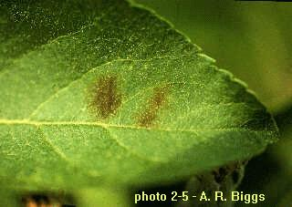
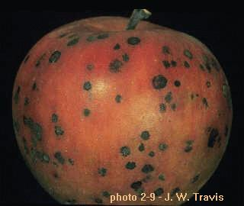
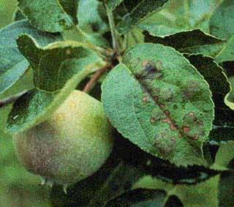
228
Apple Scab
Caf.wvu.edu
Notes:
Caf.wvu.edu
Apple scab is a disease of apple trees (genus Malus) caused by the ascomycete fungus Venturia inaequalis. The disease manifests as dull black or grey-brown lesions on the surface of tree leaves, buds or fruits. Lesions may also appear less frequently on the woody tissues of the tree. Fruits and the undersides of leaves are especially susceptible. The disease rarely kills its host, but can significantly reduce fruit yields and fruit quality. Affected fruits are less marketable due to the presence of the black fungal lesions.
Wikipeida.org

Slide 16
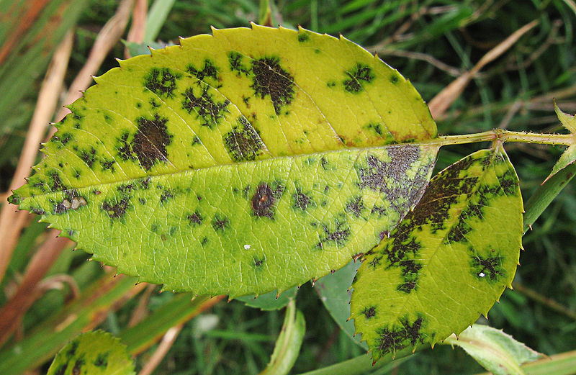
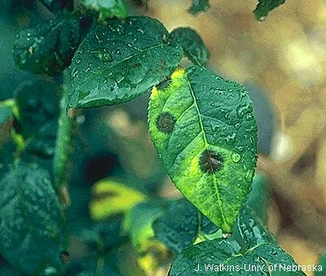
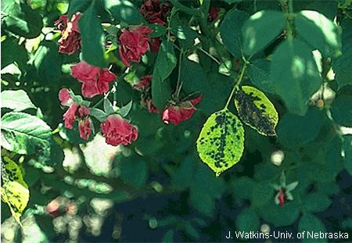
229
Black Spot
Nu-distance.unl.edu
Wikipeida.org
Notes:
Diplocarpon rosae is a fungus that causes the rose disease Black Spot.^{[1]} Because it was observed by people of various countries around the same time (around 1830), the nomenclature for the fungus varied with about 25 different names. The asexual stage is now known to be Marssonina rosae while the sexual and most common stage is known as Diplocarpon rosae.
Wikipeida.org
Nu-distance.unl.edu

Slide 17
229
Black spot
Nu-distance.unl.edu
Wikipeida.org
Notes:
229
Black Spot
Diplocarpon rosae is a fungus that causes the rose disease Black Spot.^{[1]} Because it was observed by people of various countries around the same time (around 1830), the nomenclature for the fungus varied with about 25 different names. The asexual stage is now known to be Marssonina rosae while the sexual and most common stage is known as Diplocarpon rosae.
Wikipeida.org
Nu-distance.unl.edu

Slide 18
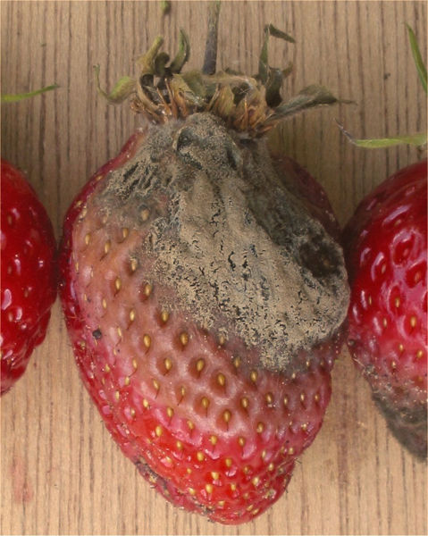
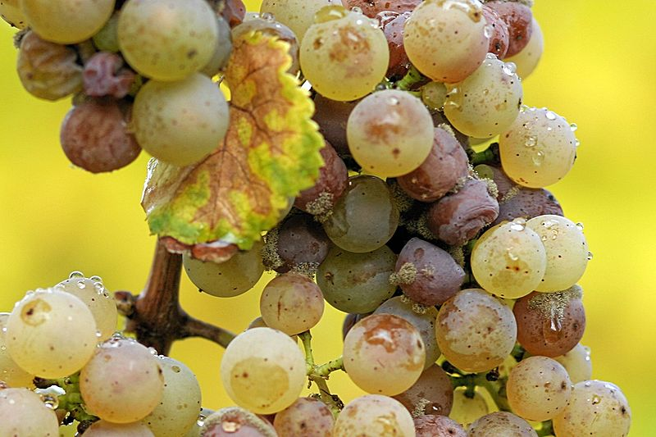
230
Botrytis
Wikipeida.org
Notes:
Botrytis cinerea is a necrotrophic fungus that affects many plant species, although its most notable hosts may be wine grapes. In viticulture, it is commonly known as botrytis bunch rot; in horticulture, it is usually called grey mould or gray mold.
Wikipeida.org

Slide 19
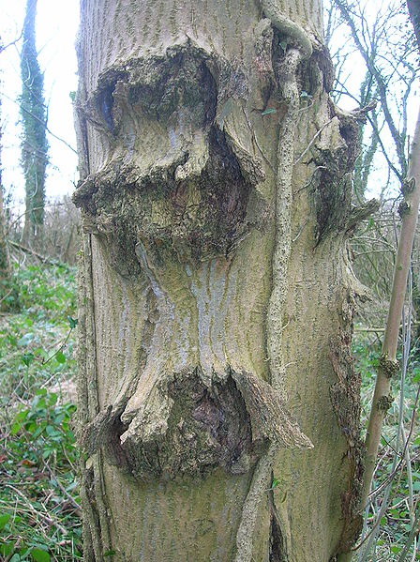
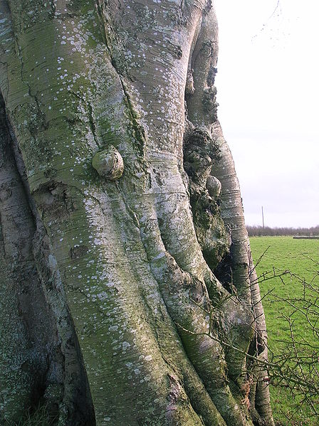
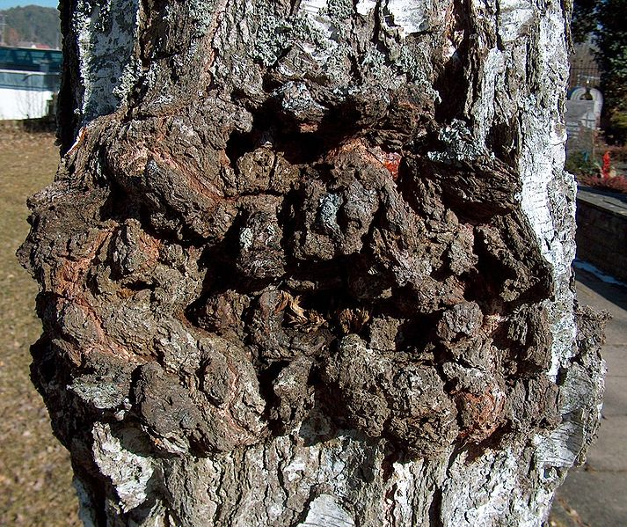
231
Canker
Wikipeida.org
Notes:
Wikipeida.org
Canker and anthracnose are general terms for a large number of different plant diseases, characterised by broadly similar symptoms including the appearance of small areas of dead tissue, which grow slowly, often over a period of years. Some are of only minor consequence, but others are ultimately lethal, and of major economic importance in agriculture and horticulture. Different cankers and anthracnoses are caused by a wide range of organisms, including fungi, bacteria, mycoplasmas and viruses. The majority of canker-causing organisms are tied obligately to a single host species or genus, but a few will attack a wider range of plants. Canker can be spread by weather and animals, making an area that even has a slight amount of canker hazardous.

Slide 20
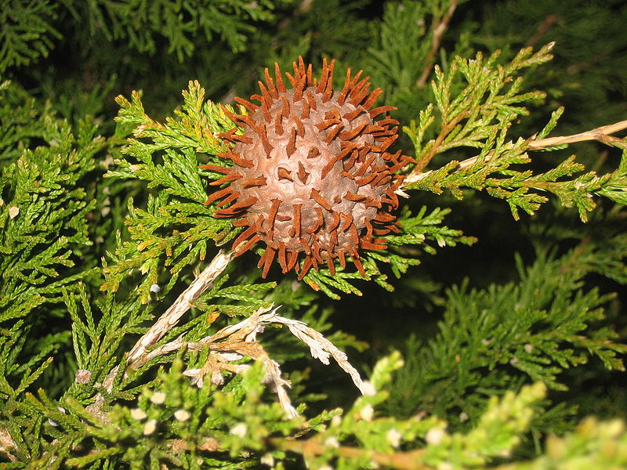
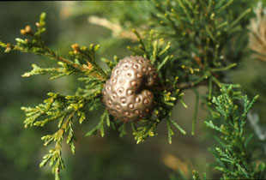
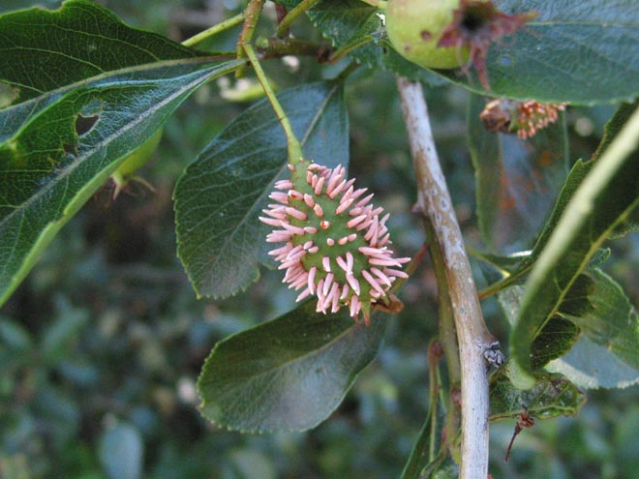
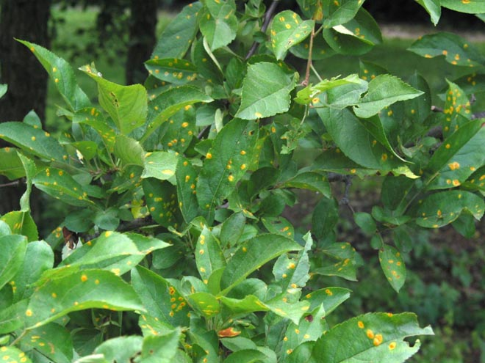
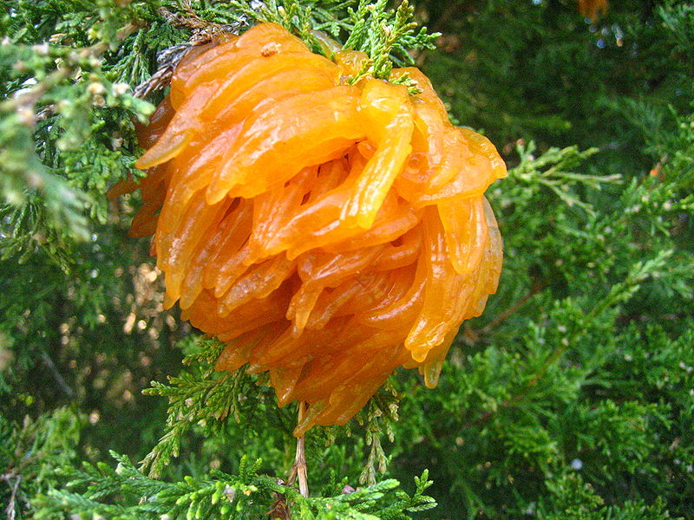
232
Cedar-Apple Rust
Cornell.edu
Illinois.edu
Wikipedia.org
Notes:
Photo-Wikipedia.org--Before and after rain
Illinois.edu
Cedar apple rust is caused by a fungal pathogen called Gymnosporangium juniperi-virginianae. This fungus attacks crabapples and apples (Malus sp.) and eastern red cedar (Juniper) as well as a few other junipers not commonly grown in Illinois. In order to survive, the fungus must "move" from one type of host to another (e.g., from juniper to crabapple
Cornell.edu

Slide 21
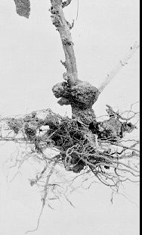
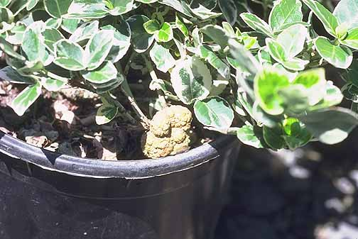
233
Crown Gall
Wsu.edu
Orst.edu
Notes:
Wsu.edu
Orst.edu
Agrobacterium tumefaciens is the causal agent of crown gall disease (the formation of tumours) in over 140 species of dicot. It is a rod shaped, Gram negative soil bacterium (Smith et al., 1907). Symptoms are caused by the insertion of a small segment of DNA (known as the T-DNA, for 'transfer DNA') into the plant cell,^{[1]} which is incorporated at a semi-random location into the plant genome.
Wikipeida.org

Slide 22
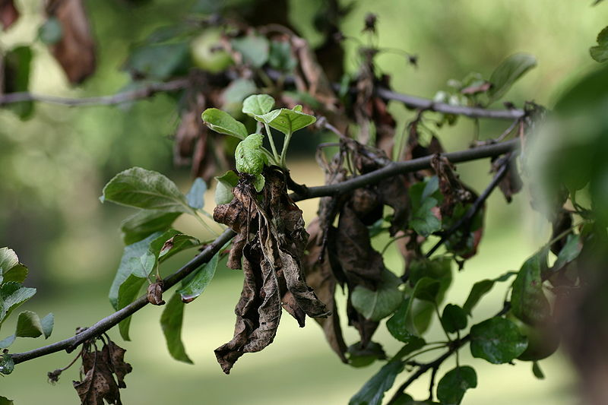
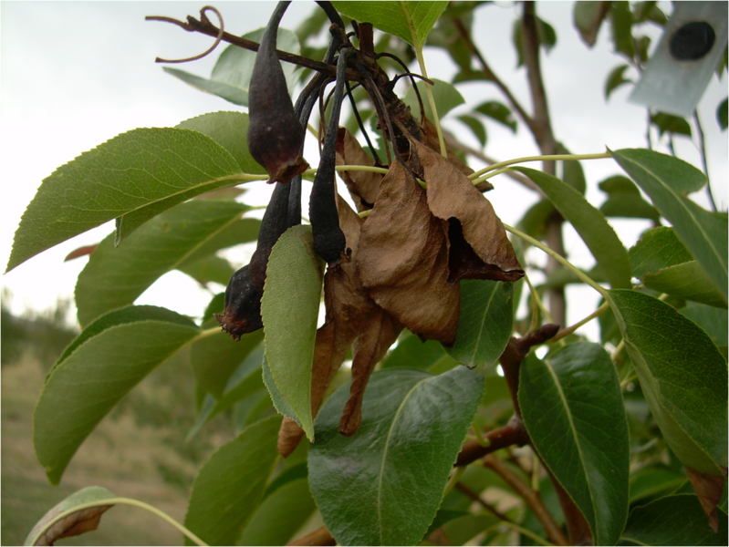
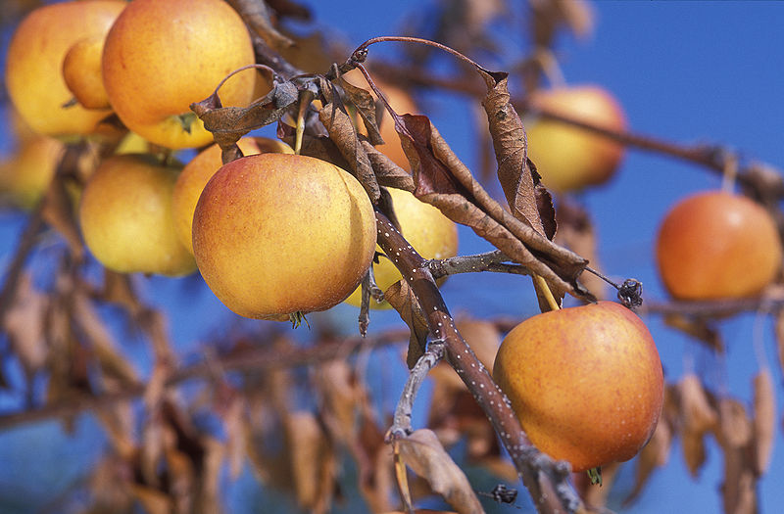
234
Fireblight
Wikipeida.org
Notes:
Fireblight is a contagious disease affecting apples, pears, and some other members of the family Rosaceae. It is a serious concern to producers of apples and pears. Under optimal conditions, it can destroy an entire apple or pear orchard in a single growing season. Fireblight is a systemic disease. The term "fireblight" describes the appearance of the disease, which can make affected areas appear blackened, shrunken and cracked, as though scorched by fire.
Primary infections are established in open blossoms and tender new shoots and leaves in the spring when blossoms are open.
Wikipeida.org

Slide 23
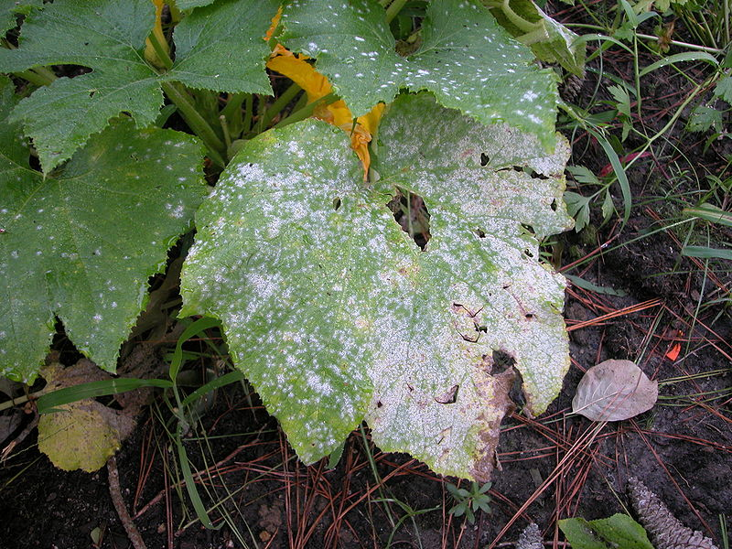


235
Powdery Mildew
Wikipeida.org
Notes:
Powdery mildew is a fungal disease that affects a wide range of plants. Powdery mildew diseases are caused by many different species of fungi in the order Erysiphales. It is one of the easier diseases to spot, as its symptoms are quite distinctive. Infected plants display white powder-like spots on the leaves and stems. The lower leaves are the most affected, but the mildew can appear on any part of the plant that shows above the ground. As the disease progresses, the spots get larger and thicker as massive numbers of spores form, and the mildew spreads up and down the length of the plant.
Wikipeida.org

Slide 24

236
Root Rot
Uwex.edu
Wikipeida.org
Notes:
Root rot is a condition found in both indoor and outdoor plants, although more common in indoor plants with poor drainage. As the name states, the roots of the plant rot. Usually, this is a result of overwatering. In houseplants, it is a very common problem, and is slightly less common in outdoor plants. In both indoor and outdoor plants, it is usually lethal and there is no treatment.
The excess water makes it very difficult for the roots to get air that they need, making them rot. To avoid root rot, it is best to only water plants when the soil becomes dry, and to put the plant in a well-drained pot. Using a heavy soil, such as one dug up from outdoors can also cause root rot.
A large number of root rots are caused by members of the water mould genus Phytophthora. Perhaps the most aggressive is Phytophthora cinnamomi. Spores from root rot do contaminate other plants, but the rot cannot take hold unless there is adequate moisture. Spores are not only airborne, but are also carried by insects and other arthropods in the soil.
A plant with root rot will not normally survive, but it can often be propagated so it won't be lost completely. Plants with root rot should be removed and destroyed.
Wikipeida.org
Uwex.edu

Slide 25
Weeds

Slide 26


237
Annual Bluegrass
Ucdavis.edu
Notes:
Ucdavis.edu
Annual bluegrass, Poa annua, is one of the most common weeds of turf, ornamental plantings, and gardens in the United States. It is native to Europe but is distributed worldwide. Commonly referred to as "Poa," it is a particular problem in golf course greens and fairways throughout the world. It also can be a weed in vegetable crops and agronomic crops. Though present in tree and vine crops in California, it is usually not a significant problem. The genus Poa consists of about 200 species worldwide. Their typical "boat-shaped" leaf tips, which curve up like the bow of a boat, are a distinguishing characteristic of the genus.
Three members of the genus Poa are commonly found in turf. Kentucky bluegrass (Poa pratensis) is a common cool-season turf species that is well adapted to cool, well-watered sites such as coastal and intermountain areas. Rough bluegrass (Poa trivialis) is a less desirable turf/weed species that does well in moist, shaded areas, but lacks heat and drought tolerance. Annual bluegrass is a weed species that, unlike Kentucky and rough bluegrass, is able to survive low mowing heights (less than 1 inch) and still reseed. A fourth species, bulbose bluegrass (Poa bulbosus) is sometimes found as a weed in northern California turfgrass.
IDENTIFICATION AND LIFE CYCLE
Annual bluegrass is a misnomer because there are two plant types of annual bluegrass: a true annual (P. annua var. annua) and a perennial type (P. annua var. reptans). While the two types are not easy to distinguish from each other, the annual type is more upright in its growth habit and produces more seed than the lower-growing perennial type. The annual type also tends to produce a higher percentage of dormant seed. The perennial type produces seed that germinate readily under optimum conditions. Depending on the site there may be a predominance of one type or a mixture of both. The perennial type is common in such sites as golf course greens, while the annual type may be more common in lawns and parkways (although both types can be found in either of these situations).
Annual bluegrass starts germinating in late summer or fall as soil temperatures fall below 70°F. It continues to germinate throughout winter, allowing several flushes of germination at any one site throughout winter. Annual bluegrass grows to a height of 6 to 8 inches when left unmowed. It has light green, flattened stems that are bent at the base and often rooted at the lower stem joint. Leaf blades are often crinkled part way down and vary from 1 to 3 inches in length with typical Poa, boat-shaped leaf tips. The inflorescence (flowering structure) is a terminal panicle that varies from 1 to 4 inches in length. Seed head initiation can start as soon as plants are 6 weeks old in early fall and continue until early summer, but most seed heads are formed in spring.
The annual form of annual bluegrass is a rapid and prolific seeder. Each small plant can produce about 100 seeds in as few as 8 weeks. Viable seed can be produced just a few days after pollination, which allows the plant to reseed even in frequently mowed turf. The seed is amber colored and about 1/16 inch long.
Annual bluegrass has a fairly weak and shallow root system and needs available moisture from rainfall or frequent irrigation to survive. It grows well in moist areas in full sun. However, it can also do well in semi-shaded conditions. Annual bluegrass also can grow in compacted soil conditions. In coastal regions or in moderate temperature areas where turf is frequently irrigated, annual bluegrass may persist all year. In warmer areas, it usually dies in summer.

Slide 27

238
Broadleaf Plantain
Wikipeida.org
Notes:
Plantago major is a species of Plantago, family Plantaginaceae. The plant is native to most of Europe and northern and central Asia.^{[1][2][3]} It is widely naturalised elsewhere in the world, where it is a common weed.^{[4]} The standard native English name is Greater Plantain,^{[1][5][6]} though it is also called Common Plantain in some areas where it is introduced, particularly North America. Another one of its common names was "Soldier's Herb" for its use on the battlefield as a field dressing.^{[7]}
It is a herbaceous perennial plant with a rosette of leaves 15-30 cm diameter. Each leaf is oval, 5-20 cm long and 4-9 cm broad, rarely up to 30 cm long and 17 cm broad, with an acute apex and a smooth margin; there are five to nine conspicuous veins. The flowers are small, greenish-brown with purple stamens, produced in a dense spike 5-15 cm long on top of a stem 13-15 cm tall (rarely to 70 cm tall).^{[3][8]}
There are three subspecies:^{[2]}
Plantago major subsp. major.
Plantago major subsp. intermedia (DC.) Arcang.
Plantago major subsp. winteri (Wirtg.) W.Ludw.
[edit] Ecology
It grows better than most other plants in compacted soils, and is abundant beside paths, roadsides, and other areas with frequent soil compaction. It is also common in grasslands and as a weed in crops. It is wind-pollinated, and propagates primarily by seeds, which are held on the long, narrow spikes which rise well above the foliage.^{[8]}

Slide 28




239
Buckhorn Plantain
Vt.edu
Notes:
Vt.edu

Slide 29


240
Chickweed
Gardeningknowhow.com
Altnature.com
Wildmanstevebrill.com
Notes:
Wildmanstevebrill.com
DESCRIPTION: A low, inconspicuous, European annual 3 to 8 inches tall, chickweed forms mats up to 16 inches long. Tiny, pointed, oval, untoothed leaves, ‡ to 1 inch long, grow in pairs (theyíre opposite). A fine line of hair extends along the length of the slender, delicate stem.
Tiny white flowers 1/8 inch across, with 5 petals so deeply cleft they look like 10, distinguish chickweedÝfrom other plants (StellariaÝmeans ìstar,î referring to the flower). Five green sepals (modified leaves) grow as long as the petals they underlie.
Gardeningknowhow.com
Altnature.com

Slide 30

241
Crabgrass
Wikipeida.org
Notes:
Digitaria is a genus of about 300 species of grass (family Poaceae) native to tropical and warm temperate regions. Common names include crabgrass, finger-grass, and fonio. They are slender monocotyledonous annual and perennial lawn, pasture, and forage plants; some are often considered lawn pests. Digitus is the Latin word for "finger", and they are distinguished by the long, finger-like inflorescences they produce.
All crabgrasses have similar growth habits and flowering structures, but species are separated by minor differences in the flower structures and leaf pubescence.^{[1]} They typically have spreading stems with wide flat leaf blades that lie on the ground with the tips ascending. The inflorescence is a panicle in which the spike-like branches are arranged in digitate fashion. The spikelets are arranged in two rows on an angled or winged rachis. Each spikelet has two florets, only one of which is fertile. The first bracts at the base of the spikelets are either very minute or absent.^{[2]}
Crabgrass seed has a long germination period; if conditions are right, it can germinate throughout the growing season. Crabgrasses occur in tropical, subtropical, and temperate regions of both hemispheres.
Crabgrasses have uses despite being classified by many as weeds. The seeds, most notably those of fonio, can be toasted and ground into a flour, which can be used to make porridge or fermented to make beer. Fonio has been widely used as a staple crop in parts of Africa. It also has decent nutrient qualities as a forage for cattle.
Wikipeida.org

Slide 31



242
Dandelion
Wikipeida.org
Notes:
Taraxacum is a large genus of flowering plants in the family Asteraceae. They are native to Europe and Asia, and two species, T. officinale and T. erythrospermum, are found as weeds worldwide.^{[1]} Both species are edible in their entirety.^{[2][3]} Named for their sharp, serrated leaves that resemble lion's teeth.^{[4]} The common name Dandelion (pronounced /ˈdændɨlaɪ.ən/ (DAN-dih-ly-un) is given to members of the genus, and like other members of the Asteraceae family, they have very small flowers collected together into a composite flower head. Each single flower in a head is called a floret. Many Taraxacum species produce seeds asexually by apomixis, where the seeds are produced without pollination, resulting in offspring that are genetically identical to the parent plant.^{[5]}
Wikipeida.org

Slide 32


243
Henbit
Wikipeida.org
Notes:
Lamium amplexicaule (Henbit Deadnettle, Greater Henbit) is a species of Lamium native to Europe, western Asia and northern Africa.
It is a low-growing annual plant growing to 10-25 cm tall, with soft, finely hairy stems. The leaves are opposite, rounded, 2-3 cm diameter, with a lobed margin. The flowers are pink to purple, 1.5-2 cm long.
It flowers very early in the spring even in northern areas, and for most of the winter and the early spring in warmer areas such as the Mediterranean region.
A Field of Henbit, closeup
It propagates freely by seed and is regarded as a minor weed. Sometimes entire fields will be reddish-purple with its flowers before spring ploughing. Where common, is an important nectar and pollen plant for bees, especially honeybees, where it helps start the spring buildup.
It is widely naturalised in eastern North America and elsewhere, where it is often considered to be an invasive weed. However, its edibility and readiness to grow in many climes often mean it is permitted to grow when other 'weeds' are not.
Wikipeida.org

Slide 33


244
Nutsedge
Wikipeida.org
Notes:
It is a perennial plant, that may reach a height of up to 40 cm. The names "nut grass" and "nut sedge" (shared with the related species Cyperus esculentus) are derived from its tubers, that somewhat resemble nuts, although botanically they have nothing to do with nuts.
As in other Cyperaceae, the leaves sprout in ranks of three from the base of the plant. The flower stems have a triangular cross-section. The flower is bisexual and has three stamina and a three-stigma carpel. The fruit is a three-angled achene.
The root system of a young plant initially forms white, fleshy rhizomes. Some rhizomes grow upward in the soil, then form a bulb-like structure from which new shoots and roots grow, and from the new roots, new rhizomes grow. Other rhizomes grow horizontally or downward, and form dark reddish-brown tubers or chains of tubers.
Wikipeida.org

Slide 34


245
Oxalis
Wikipeida.org
Notes:
Oxalis (pronounced /ˈɒksəlɪs/)^{[1]} is by far the largest genus in the wood-sorrel family Oxalidaceae: of the approximately 900 known species in the Oxalidaceae, 800 belong here. The genus occurs throughout most of the world, except for the polar areas; species diversity is particularly rich in tropical Brazil, Mexico and South Africa.
Many of the species are known as wood-sorrels (in American English typically written "woodsorrels" or "wood sorrels") as they have an acidic taste reminiscent of the unrelated sorrel (Rumex acetosa) proper. Some species are called yellow-sorrels or pink-sorrels after the color of their flowers instead. Other species are colloquially known as false shamrocks, and some are rather misleadingly called "sourgrasses". For the genus as a whole, the term oxalises is also used.
Contents
[hide]
Wikipeida.org

Slide 35


246
Purslane
Wikipeida.org
Notes:
Portulaca oleracea (Common Purslane, also known as Verdolaga, Pigweed, Little Hogweed or Pusley), is an annual succulent in the family Portulacaceae, which can reach 40 cm in height. About 40 varieties are currently cultivated.^{[1]} It has an extensive old-world distribution extending from North Africa through the Middle East and the Indian Subcontinent to Malesia and Australasia. The species status in the New World is uncertain: it is generally considered an exotic weed; however, there is evidence that the species was in Crawford Lake deposits (Ontario) in 1430-89, suggesting that it reached North America in the pre-Columbian era^{[2]}. It is naturalised elsewhere and in some regions is considered an invasive weed. It has smooth, reddish, mostly prostrate stems and alternate leaves clustered at stem joints and ends. The yellow flowers have five regular parts and are up to 6 mm wide. The flowers appear depending upon rainfall and may occur year round. The flowers open singly at the center of the leaf cluster for only a few hours on sunny mornings. Seeds are formed in a tiny pod, which opens when the seeds are ready. Purslane has a taproot with fibrous secondary roots and is able to tolerate poor, compacted soils and drought.
Wikipeida.org

Slide 36




247
White Clover
Wikipeida.org
Notes:
It is a herbaceous perennial plant. It is low growing, with heads of whitish flowers, often with a tinge of pink or cream that may come on with the aging of the plant. The heads are generally 1.5-2 cm wide, and are at the end of 7 cm peduncles or flower stalks ^{[1]}. The leaves, which by themselves form the symbol known as shamrock, are trifoliolate, smooth, elliptic to egg-shaped and long-petioled. The stems function as stolons, so white clover often forms mats with the stems creeping as much as 18 cm a year, and rooting at the nodes ^{[1]}.

Slide 37
Physiological Problems

Slide 38






248
Frost/Freeze Injury
Purdue.edu
Iastate.edu
Tamu.edu
Bing.com
Notes:
Purdue.edu
Iastate.edu
Tamu.edu
Bing.com
Many perennials and bulbs send up shoots when warm weather occurs in early spring. This foliage is very cold tolerant and not usually damaged by frost. When a cold period follows a long period of unseasonably warm temperatures, temporary leaf damage may occur, which appears as white, bleached areas on leaves. Most plants outgrow this type of cold injury.
Frost injury usually occurs on annuals planted outside before the last frost date or after the first hard frost in the fall. Diagnosis is easy because frozen tissue becomes limp, appears water-soaked and quickly turns blackish brown. Leaves may be entirely blighted or portions of the leaf may be spotted. If damage is limited to the top portion of the plant, simply prune off the damage. Severe damage may warrant replacement of the entire plant. After a hard frost in the fall, clean up and removal of dead foliage will help reduce disease and insect problems for the next season.
Several problems may occur when the temperatures are not freezing, but dip below the minimum temperature preferred by many tender plants. Tender plant roots may be unable to absorb nutrients from cold wet soils, causing a temporary phosphorus deficiency, which appears as leaf purpling. Flower production is reduced or halted and plant growth may be stunted.
Problems associated with frost damage and cold injury can largely be avoided by waiting until after the last frost date in your area to plant warm season annuals. Plants will become established faster and perform better when planted after the frost-free date, when soil temperatures are warmer. Reduce problems by allowing seedlings or newly purchased plants to become acclimated to your garden before planting. Place the plants outside for two to three hours per day and gradually increase the exposure over a one-week period.

Slide 39



249
Iron Deficiency
Plant-shed.com
Pbsgrow.com
Wsu.edu
Notes:
Plant-shed.com
Pbsgrow.com
Wsu.edu
An insufficient supply of mineral nutrients can result in a variety of symptoms on plants. Nitrogen deficiency typically causes a chlorotic yellowing of older leaves. Iron deficiency symptoms are observed on the new growth as interveinal chlorosis (leaves yellow between the veins, while the major veins remain green). High pH soils which bind iron can cause tip chlorosis and necrosis on certain plants. Magnesium deficiency can also cause interveinal chlorosis. Boron deficiency can cause necrotic spotting or flecking on leaves.

Slide 40





250
Leaf Scorch (drought/winter burn)
Colostate.edu
Notes:
Colostate.edu

Slide 41


251
Nitrogen Deficiency
Associatedcontent.com
Bing.com
Notes:
Bing.com
Nitrogen deficiencies often appear first in older leaves, and will manifest as a light green overall appearance.
As symptoms progress, the leaves turn a yellow color and stems become weak and lower leaves drop off. Necrosis develops in older leaves. New growth becomes weak and spindly. Tops and roots grow poorly.
When plants are in the mid to later growth or flowering stages, older growth and large fan leaves may show nitrogen deficiency.
This is normal during the late stage of floral development because plants near the end of their lives are using up their nutrient and carbohydrate reserves. As leaves turn completely yellow, remove them from the plant.
Nitrogen excess turns foliage very dark green and can make plants susceptible to drought, disease and insect predation.
Nitrogen is crucial to photosynthesis and reproductive function. Nitrogen makes proteins and is essential to new cell growth. Nitrogen is mainly utilized for leaf and stem growth, as well as overall plant size and vigor.
Nitrogen moves easily to active young shoots and leaves and moves more slowly to older leaves. Nitrogen is involved in the structuring of amino acids, enzymes (specialized proteins that perform duties inside plants), proteins and nucleic acids. All of these are essential for cell division and most other plant functions. Obviously, nitrogen is essential to plant growth.
This is about nitrogen compounds in plant nutrition. For shortage of nitrogen compounds in human and animal nutrition, see protein deficiency. Nitrogen (N) deficiency in plants can occur when woody material such as sawdust is added to the soil. Soil organisms will utilise any nitrogen in order to break this down, thus making it temporarily unavailable to growing plants. 'Nitrogen robbery' is more likely on light soils and those low in organic matter content, although all soils are susceptible. Cold weather, especially early in the season, can also cause a temporary shortage.
All vegetables apart from nitrogen fixing legumes are prone to this disorder. Symptoms include poor plant growth, leaves are pale green or yellow in the case of brassicas. Lower leaves show symptoms first. Leaves in this state are said to be etiolated with reduced chlorophyll. Flowering and fruiting may be delayed.
Prevention and control of nitrogen deficiency can be achieved in the short term by using grass mowings as a mulch, or foliar feeding with manure, and in the longer term by building up levels of organic matter in the soil. Sowing green manure crops such as grazing rye to cover soil over the winter will help to prevent nitrogen leaching, while leguminous green manures such as winter tares will fix additional nitrogen from the atmosphere.
Associatedcontent.com
Nitrogen deficiency in plants results in reduced growth and fruit production. Without adequate amounts of nitrogen in the soil plants are unable to properly build plant proteins and nucleic acid. What that means to you is that you must provide your flowers and vegetables with adequate
amounts of usable nitrogen for them to grow and produce fruit. A nitrogen deficiency may go unnoticed at first or may be misdiagnosed as a lack of moisture. Careful inspection of your plants will reveal that the real culprit is lack of usable nitrogen in the soil.
1. Old leaves turn pale green and may eventually yellow and fall from the plant. Although some yellowing of old leaves may be normal, if more than a leaf or two on your plant suddenly begins to yellow it is a good indication that your plants are suffering from a nitrogen deficiency.
2. New leaves are paler green than existing leaves and appear to be smaller than normal. Young leaves should be a rich green and should grow rapidly. If they are tiny and fail to increase in size within a few days, they may need a boost of Nitrogen.
3. Plant growth slows or stalls. This should not be confused with plants that have reached their mature size. If the plant has not reached maturity or fails to produce new leaves and branching ceases, the culprit may be a Nitrogen Deficiency.
4. Undersides of leaves may take on a red or purple hue. Although this depends on the type of plant you are growing, leaves that discolor on the underside may be a sign for you to add Nitrogen to the soil.
5. Wilting easily under normal weather conditions. Plants suffering from a lack of Nitrogen wilt quickly at the first sign of stress. If your plants are wilting when it is not excessively hot or they are not suffering from excessive dryness, a Nitrogen Deficiency may be causing them to wilt under stress.

Slide 42

252
Pot-bound roots
Notes:
A plant becomes root bound if it is allowed to grow in the same pot for numerous years. In nature, a plant’s root system naturally extends three times the length that it does into the sky. As plants grow fresh foliage above soil they are simultaneously extending and thickening their root systems. If left to grow in the same space for an extended amount of time, a plant will literally suffocate itself like a boa constrictor.
There is not a distinctive period of time in which one can conclusively determine that a plant will become root bound. Depending on the plant’s species and size of its container, it may take over fifteen years before symptoms of severely constrained roots appear. A root bound plant will eventually suffocate itself regardless of how often one may water or fertilize. Unexplainable foliage decay is typically the first noticeable sign of this condition It is important to diagnose a root bound plant right away and take appropriate action to preserve the life and vitality of the plant.
Other indicators of a root bound plant include:
Roots visible from drainage holes or in masses above soil.
Poor water retention; the water is not properly absorbed.
impenetrable top soil.
There are three general rules pertaining to container gardens and re-potting that one should remember at all times:
All houseplants should be repotted once every two or three years.
It is wise to purchase a pot that is no larger than double the size that you’re currently using. This will allow your plant to reach its full potential and stay healthy.
Do not be afraid to remove up to 1/3 the root system when repotting.
The strength required to remove a root bound plant from its pot will be incredible. Therefore, one should try to saturate the soil before removing the plant from its pot. The water will act as a lubricant against the sides of the pot; simultaneously loosening its soil.
Read more at Suite101: Recognizing a Root Bound (Pot Bound) Plant: Signs, Symptoms, Treatment and Prevention http://houseplants.suite101.com/article.cfm/recognizing_a_root_bound_pot_bound_plant#ixzz0cdCrsu1T
If your indoor potted plants have any of the following characteristics, they may be pot-bound. Pot-bound roots have outgrown their container and are starting to circle around the inside or poke out the drainage holes in search of more growing room.
Stunted
Deformed
Pale and dull
Top-heavy
Generally declining
Water drains quickly through soil
To see for yourself, tilt the plant on its side and gently slide the plant a few inches out of the pot. If the roots look like ropes winding around in circles or they're matted at the bottom the plant's overdue for a change. The solution is "stepping up" -- moving the plant to a larger pot. By stepping up, you fix several problems at once: restricted root space, replenish tired potting soil and you make the plant look better in a container more in scale with its larger size.
Which container is best?
Resist the urge to move a plant to a substantially bigger pot. Select one a couple of inches bigger. If you use too large a container, the extra soil will soak up too much water, the plant’s roots will grow more than necessary (like moving into a larger house and filling the space with stuff) and foliage and flower growth will decrease.
Re-Potting, Step By Step (I promise)
1) First you'll need to identify pot-bound plants. Gently roll or tap the container to loosen the plant and gently ease it out. Tip: Dry soil tends to hang onto the inner walls of the container, so watering your plant help grease the skids a little. Catch it in your other hand, with the foliage peeking between your fingers and the surface of the root ball supported in your palm. If the plant is a giant one, such as a fern, fig, or avocado tree, lay it over onto a tarp or newspapers spread on the floor.
2) With your fingers, carefully loosen the roots at the base and along the sides of the root ball. At this point, many experts say to use a knife to split the lower third of the root ball to encourage new roots to grow outward and down, rather than to keep spiraling. I say, put the knife away and use your fingers. Using a knife to hack and slash at a plant's root system is overkill. If you find any dead or damaged roots however, use pruning shears to trim them off.
3) Center the plant in the new, larger container, making sure it’s upright. There's nothing like going through the whole process only to gaze at your plant a month later to see that it's leaning in one direction. Buy a high quality potting soil and adjust the soil level so the top of the root ball is about 1/2 inch below the rim of the pot; more for larger plants. Using your hand, sift new potting soil in around the plant and firm it with your fingers. Tip: Those flexible cutting boards makes the job of sifting soil around the plant easier, and cleaner!
Water the plant until water runs out of the drainage holes. This will help settle the soil and give it good contact with the roots. Add more soil if necessary.
Re-potting your indoor plants is like sending it to a health spa. It really improves overall plant health. We tend to ignore indoor plants, treating them like green statues, until they look so awful there's no way you can not see them. Take some time this year to make a difference in your houseplant's life!

Slide 43

253
String Trimmer Injury
utahstate.edu
Notes:
utahstate

Slide 44

254
2,4-D Injury
illinios.edu
Notes:
University illinios
In recent years much damage has been caused in some home gardens and yards by the careless use of 2,4-D and related weed-control chemicals. Often 2,4-D drifts in from nearby lawns and fields. Tomatoes, melons, sweet potatoes, and beans are some of the vegetables susceptible to 2,4-D. If you must use 2,4-D or similar weed killers, follow these precautions:
Spray only when wind is quiet.
Keep pressure very low and nozzle directed downward.
Do not apply insecticides or fungicides with a sprayer that has been used for weed killers. It is exceedingly difficult to remove all of the residue from a sprayer contaminated with 2,4-D.

