Slide 1
Nursery/Landscape Plant Identification
M-P
161-189

Slide 2
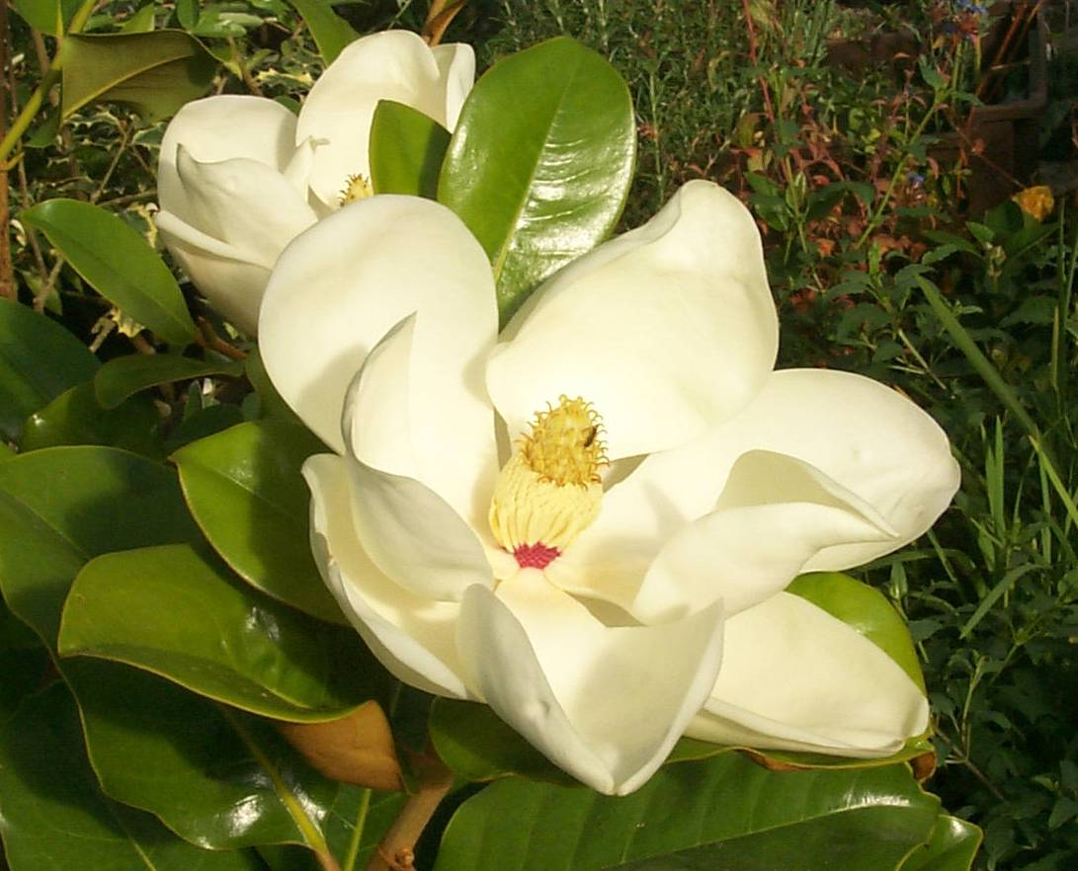
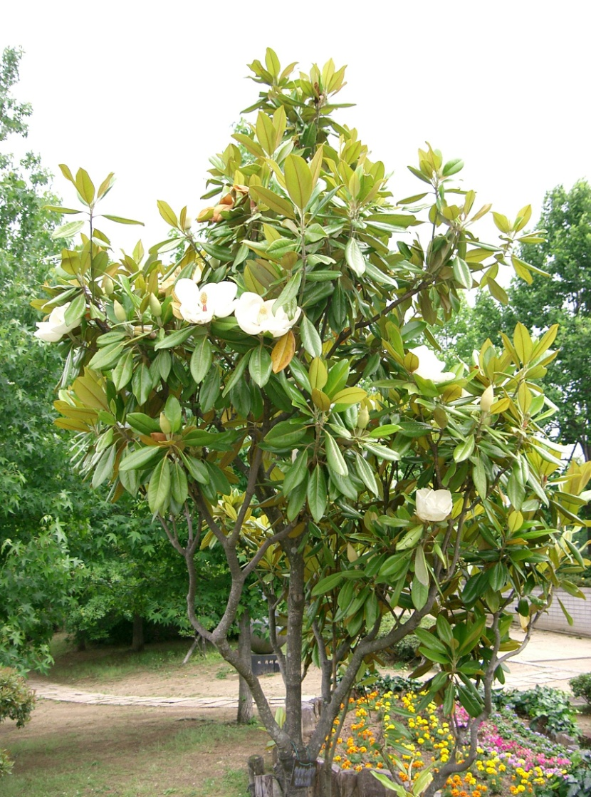
161
Magnolia graniflora cv.
Soutern Magnolia
banwnursery.co.uk
wikimedia.org
Notes:
http://www.banwnursery.co.uk/images/magnolia%20grandiflora%204.jpg
http://upload.wikimedia.org/wikipedia/commons/4/4c/Magnolia_grandiflora10.jpg

Slide 3
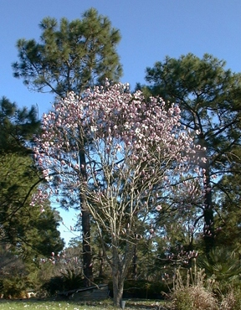
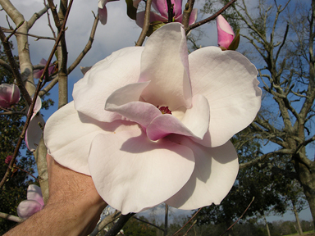
162
Magnolia x soulangiana cv.
Chinese (Saucer) Magnolia
magnoliasociety.org
Notes:
http://www.magnoliasociety.org/checklist_images/Paul%20Cook-Knox.jpg
http://www.magnoliasociety.org/checklist_images/Pink%20Goblet-Knox.jpg

Slide 4
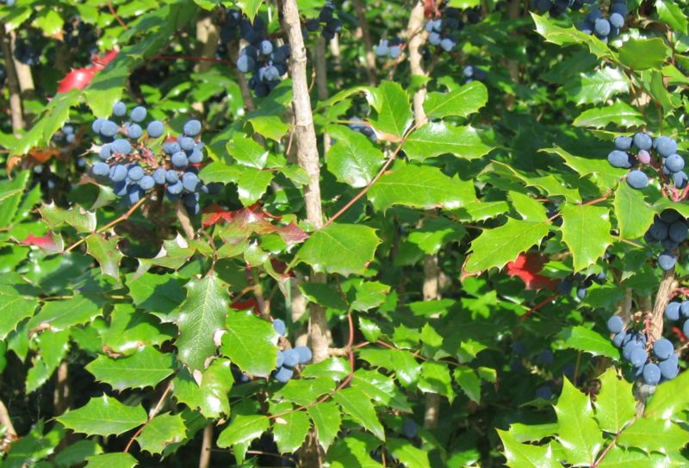
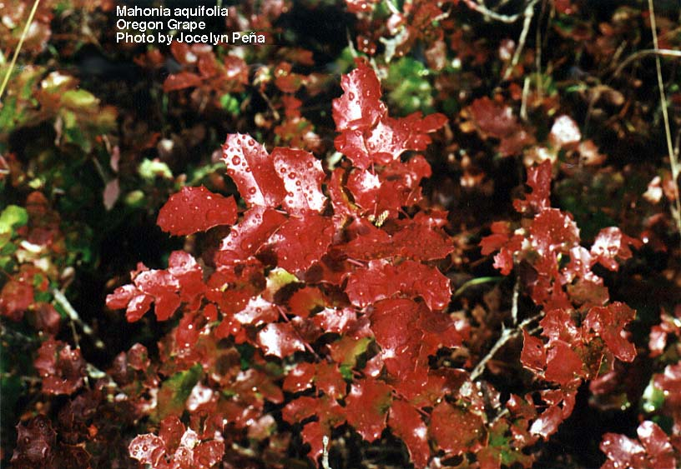
163
Mahonia aquifolia cv.
Oregon Grape
plantcare.com
wolf.mind.net
Notes:
http://www.plantcare.com/oldSite/httpdocs/images/namedImages/Mahonia_Aquifolium.jpg
http://wolf.mind.net/swsbm/Images/New9-2001/Mahonia_aquifolia-3.jpg

Slide 5
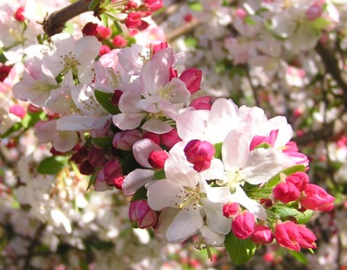
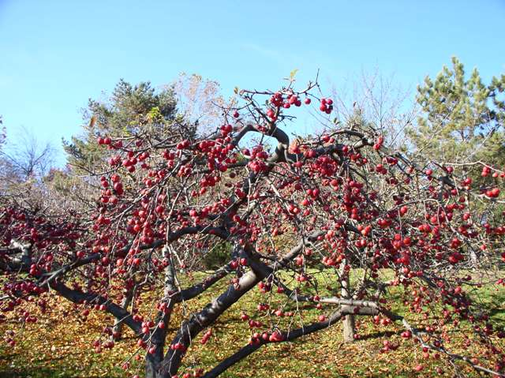
164
Malus spp. & cv.
Flowering Crabapple
bowerbirdz.files.wordpress.com
mobot.org
Notes:
http://bowerbirdz.files.wordpress.com/2008/10/a-crab1.jpg
http://www.mobot.org/gardeninghelp/images/Gardens/Bloom982.jpg

Slide 6
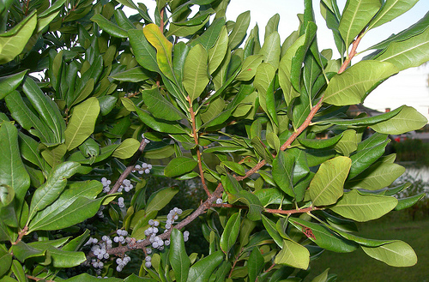
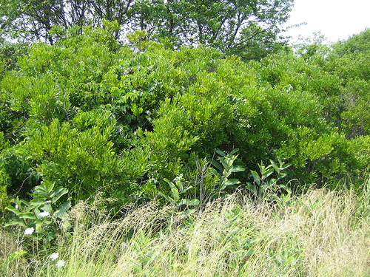
165
Myrica pensylvanica
Bayberry
farm3.static.flickr.com
farm2.static.flickr.com
Notes:
http://farm3.static.flickr.com/2308/2869365858_95799bc51c.jpg
http://farm2.static.flickr.com/1055/946095331_57fe2bc79d.jpg?v=0

Slide 7
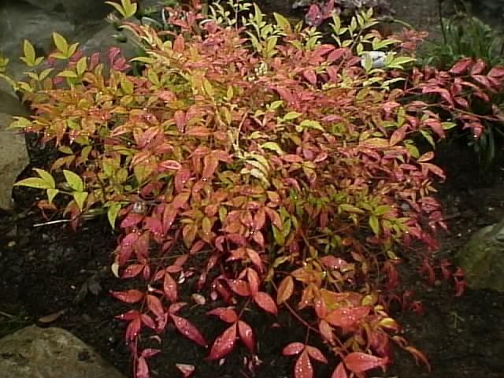
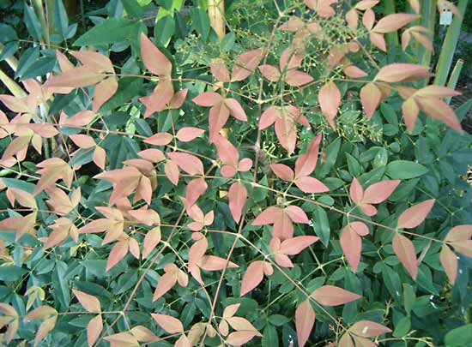
166
Nandina domestica
Heavenly Bamboo
media-2.web.britannica.com
thegardenhelper.com
Notes:
http://www.thegardenhelper.com/pixpg/graphics/nandina.JPG
http://www.google.com/imgres?imgurl=http://media-2.web.britannica.com/eb-media/95/118295-004-961DE976.jpg&imgrefurl=http://www.britannica.com/EBchecked/topic-art/51182/114240/Heavenly-bamboo&usg=__i7BArHDAHe0HkD1KtH2JYLEsOhY=&h=405&w=550&sz=47&hl=en&start=10&sig2=BmKB-jAkVyt2Ow1zf6kBWA&itbs=1&tbnid=Jgl89adXqNpUcM:&tbnh=98&tbnw=133&prev=/images%3Fq%3DNandina%2Bdomestica%2BHeavenly%2BBamboo%26hl%3Den%26sa%3DG%26tbs%3Disch:1&ei=otbRS5yoN4vYswO155nYCQ

Slide 8
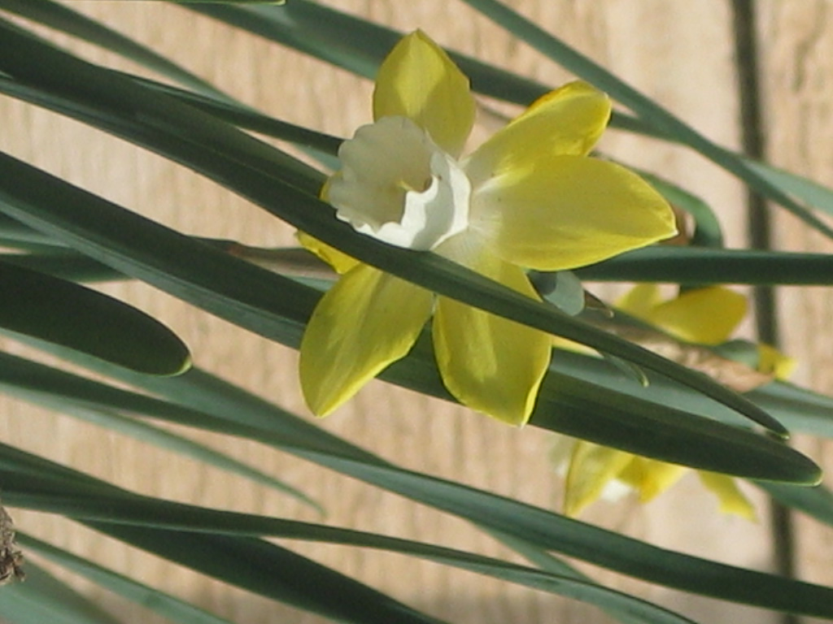
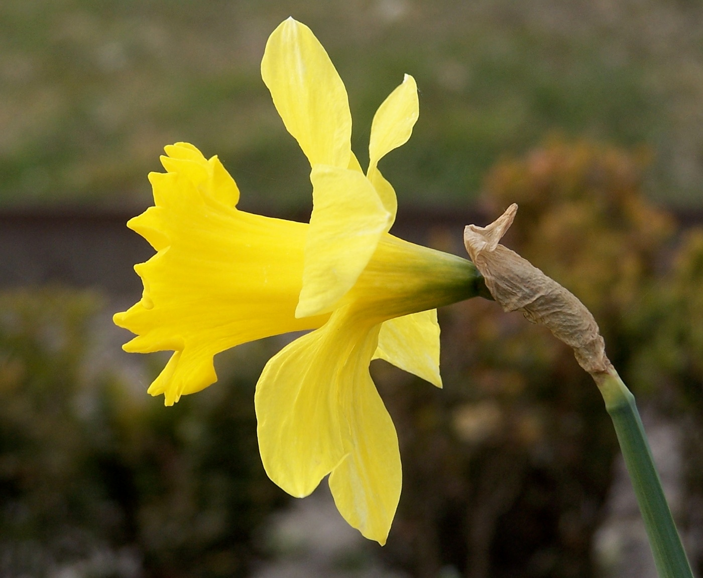
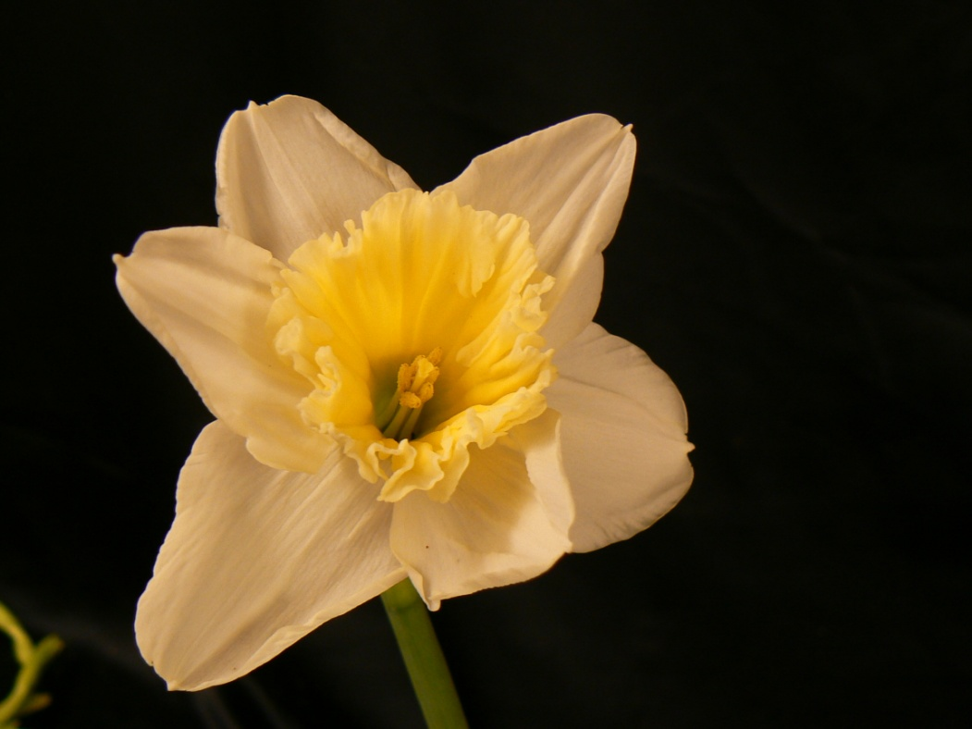
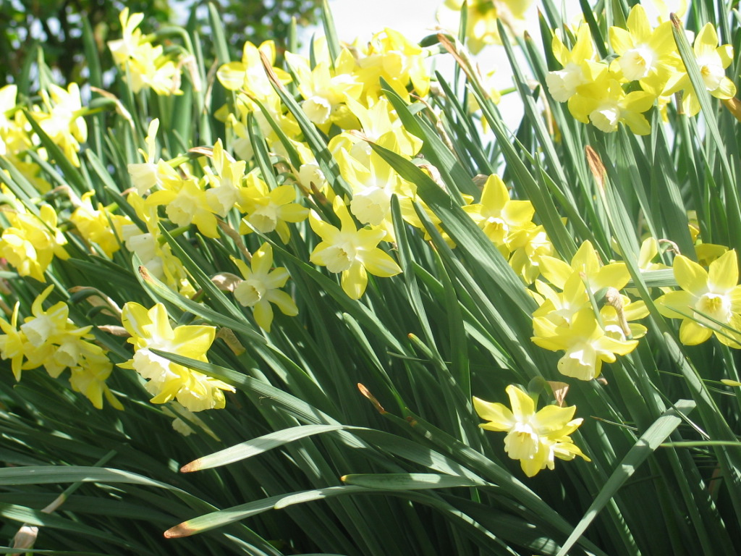
167
Narcissus pseudonarcissus cv.
Daffodil
wikimedia.org
Notes:
Upload.wikimedia.org

Slide 9
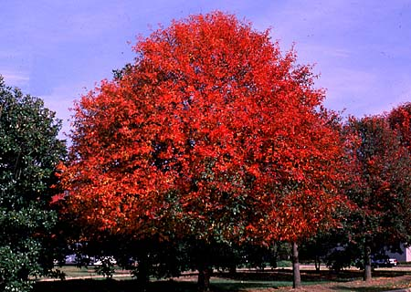
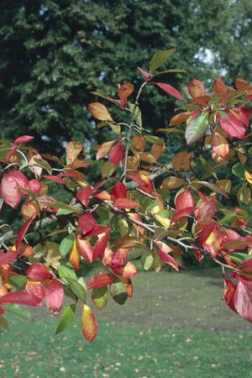
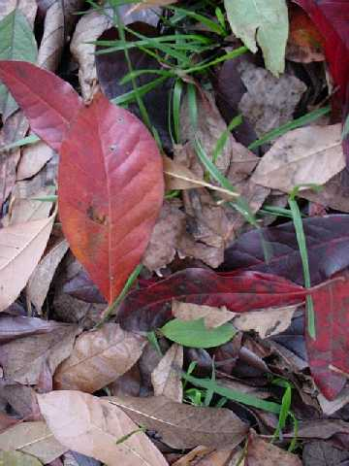
168
Nyssa sylvatica
Sour (Black) Gum
mobot.org
ces.ncsu.edu
rainkc.com
Notes:
http://www.rainkc.com/_ccLib/image/plants/DETA-899.jpg
http://www.ces.ncsu.edu/johnston/homehort2/black_gum.jpg
http://www.mobot.org/plantscience/resbot/flor/wny-niag/nyssa-sylvatica2.jpg

Slide 10
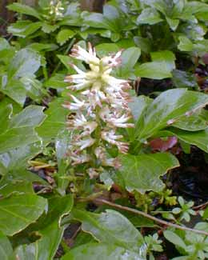
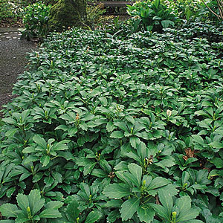
169
Pachysandra terminalis
Japanese Spurge
plantfinder.sunset.com
paghat.com
Notes:
http://plantfinder.sunset.com/images/pachysandra-138-m.jpg
http://www.google.com/imgres?imgurl=http://www.paghat.com/images/pachysandra_latefeb.jpg&imgrefurl=http://www.paghat.com/pachysandra.html&usg=__7PMpKkpKKkN7c5YsiBc7NTkAdP8=&h=325&w=260&sz=15&hl=en&start=4&sig2=FXRiuyDUwiql5nmwB-Pjzg&itbs=1&tbnid=69X5wTxr_PLTjM:&tbnh=118&tbnw=94&prev=/images%3Fq%3DPachysandra%2Bterminalis%2BJapanese%2BSpurge%26hl%3Den%26sa%3DG%26tbs%3Disch:1&ei=zdfRS_vZKoe4tgOw6Nz7Ag

Slide 11
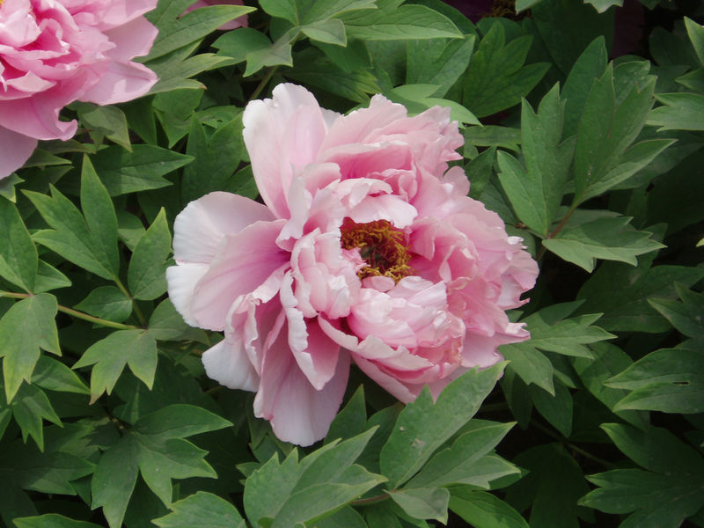
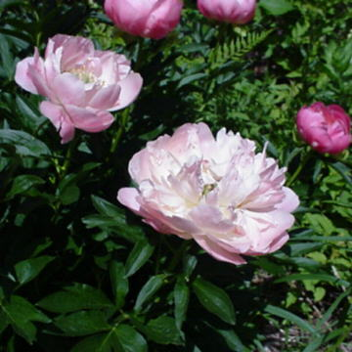
170
Paeonia hybrid cv.
Peony
plants.chebucto.biz
cincinnati.com
Notes:
http://cincinnati.com/blogs/gardening/files/2010/03/800px-PaeoniaSuffruticosa7.jpg
http://plants.chebucto.biz/fleurs/F1270L.jpg

Slide 12
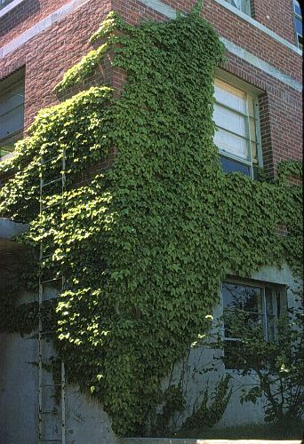
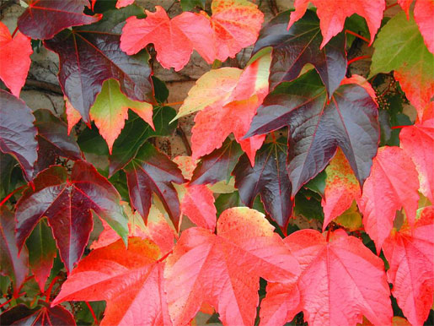
171
Parthenocissus tricuspidata
Boston Ivy
landscape-service.com
datasync.com
Notes:
http://www.landscape-service.com/plants/fullsize/parthenocissust.jpg
http://www.datasync.com/sbe/image/d9885.jpg

Slide 13
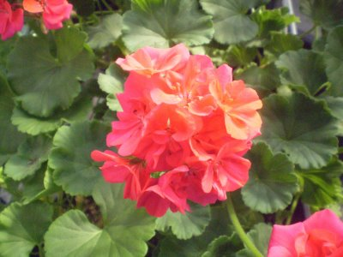
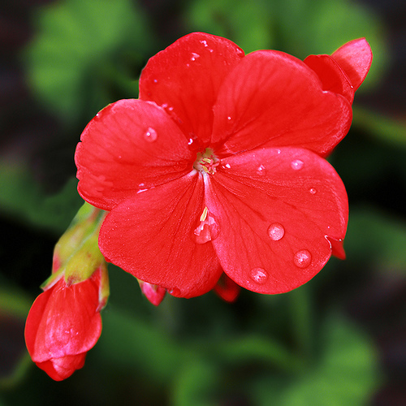
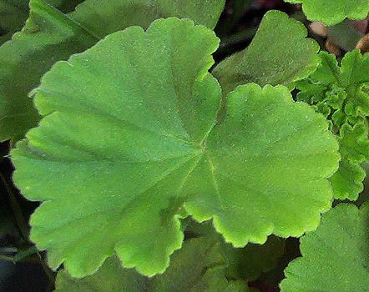
172
Pelargonium x hortorum cv.
Zonal Geranium
farm4.static.flickr.com
4.bp.blogspot.com
classes.hortla.wsu.edu
Notes:
http://farm4.static.flickr.com/3281/3066522457_d5fa94d598.jpg
http://classes.hortla.wsu.edu/hort231/List01/PelargoniumLeaf.jpg
http://4.bp.blogspot.com/_eaKbvlcIK10/Sei5zjRPeHI/AAAAAAAAEzU/-87Z69ZzbYc/s400/pelargonium+x+hortorum+rose+(own).jpg

Slide 14
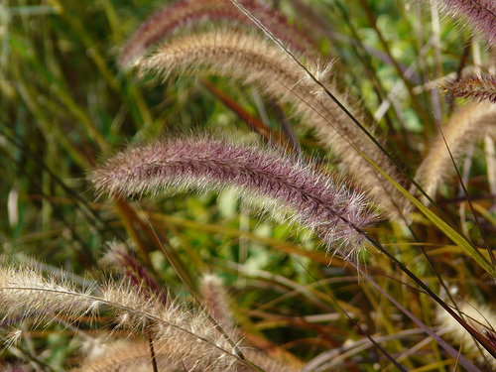
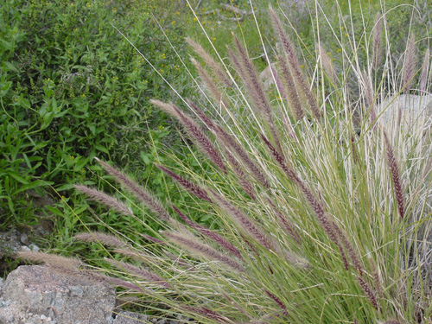
173
Pennisetum ruppelia
Fountain Grass
swbiodiversity.org
farm4.static.flickr.co
Notes:
http://farm4.static.flickr.com/3215/3052146417_e7079bcef2.jpg?v=0
http://swbiodiversity.org/images/vasc_herbarium_images/Poaceae/photos/penset.jpg

Slide 15
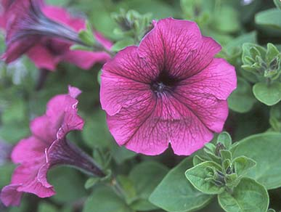
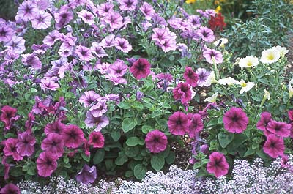
174
Petunia x hybrida cv.
Petunia
oregonstate.edu
Notes:
http://oregonstate.edu/dept/ldplants/images/petunia-h2.jpg
http://www.google.com/imgres?imgurl=http://oregonstate.edu/dept/ldplants/images/petunia-h1.jpg&imgrefurl=http://www.uniprot.org/taxonomy/4102&usg=__KMSXV2P-ejol0WK0CBj6NVfQvm4=&h=265&w=400&sz=55&hl=en&start=12&sig2=ilS3Xg8G-HJjYDO7tC-lsQ&itbs=1&tbnid=AB3rMM_mS_VuPM:&tbnh=82&tbnw=124&prev=/images%3Fq%3DPetunia%2Bx%2Bhybrida%2Bcv.%2BPetunia%26hl%3Den%26sa%3DG%26tbs%3Disch:1&ei=xNrRS83rO5LcsgP01qnlCQ

Slide 16
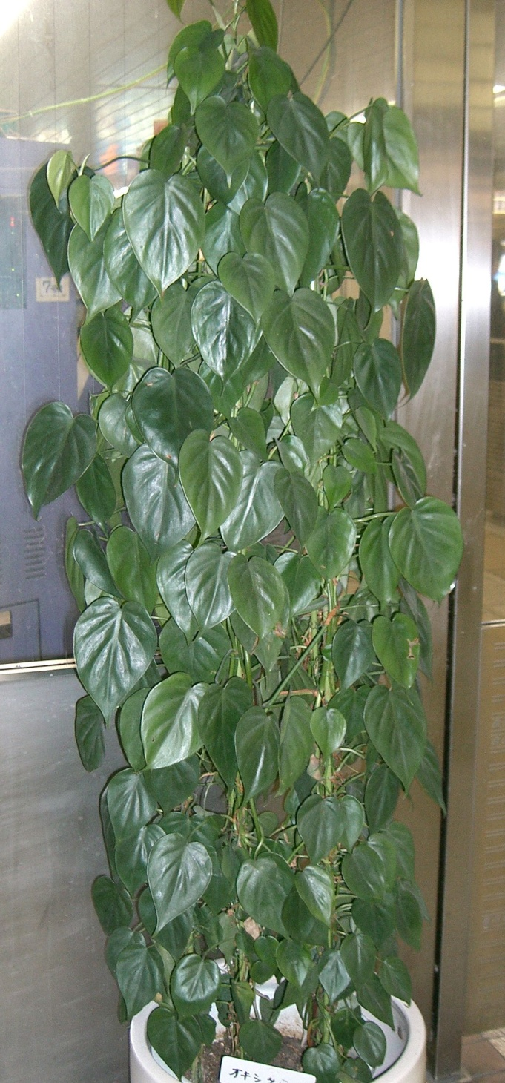
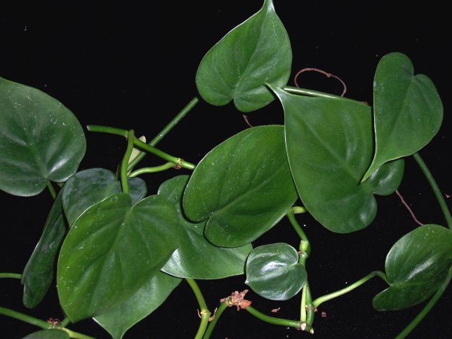
175
Philodendron scandens oxycardium
Heartleaf Philodendron
plantoftheweek.org
wikimedia.org
Notes:
http://www.plantoftheweek.org/image/philos.jpg
http://upload.wikimedia.org/wikipedia/commons/d/d3/Philodendron_scandens_subsp_oxycardium1.jpg

Slide 17
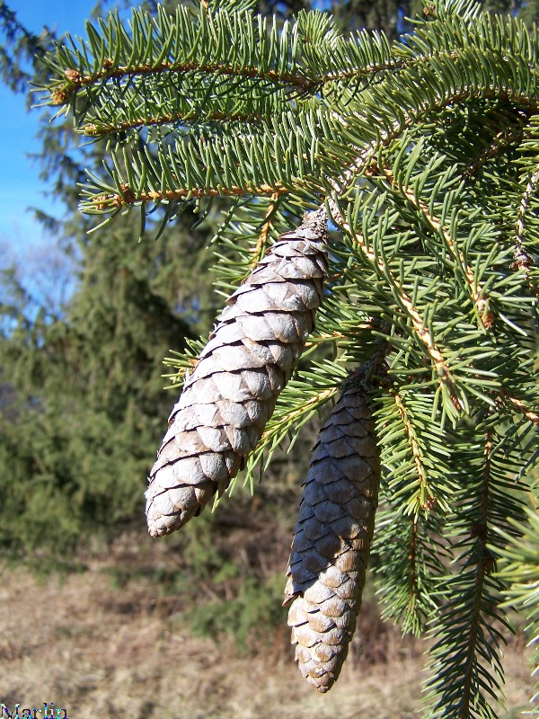
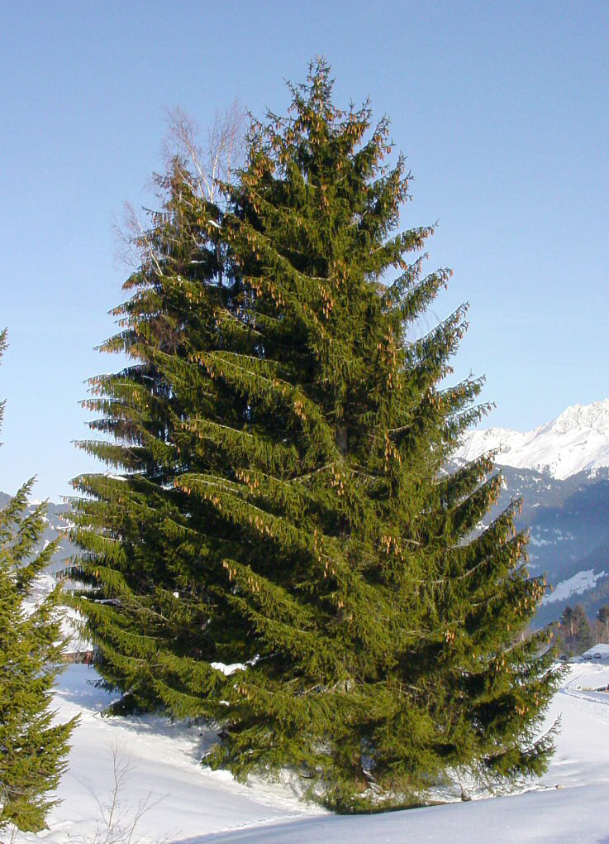
176
Picea abes
Norway Spruce
cirrusimage.com
en.wikivisual.com
Notes:
http://en.wikivisual.com/images/8/81/Picea_abies.jpg
http://www.cirrusimage.com/Trees/spruce/Norway_spruce_3.jpg

Slide 18
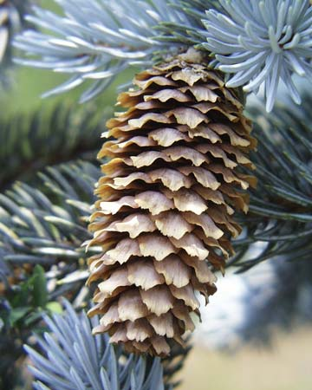
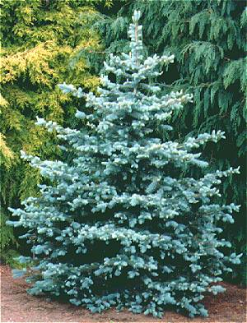
177
Picea pungens
Colorado (Blue) Spruce
bioweb.uwlax.edu
goodnewsgardening.com
Notes:
http://www.goodnewsgardening.com/images/trees/Picea%20Pungens%20glauca.jpg
http://bioweb.uwlax.edu/bio203/s2009/hanford_kyle/images/Blue%20spruce%20cone%20hanging%20Wikipedia.jpg

Slide 19
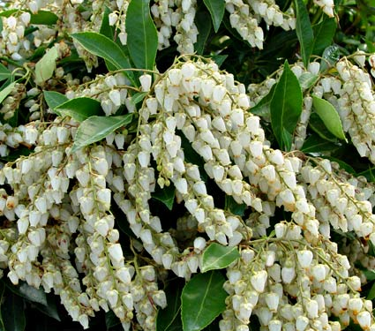
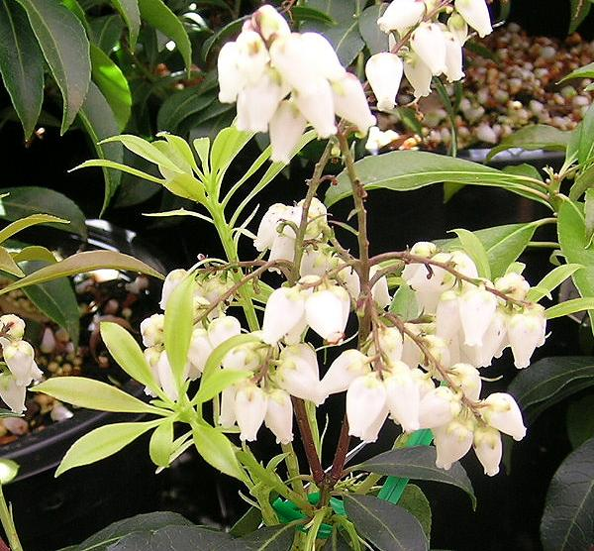
178
Pieris japonica
Lily-of-the-Valley Bush
australian-insects.com
images.whiteflowerfarm.com
Notes:
http://images.whiteflowerfarm.com/66158a.jpg
http://australian-insects.com/lepidoptera/plants/eric/pieris-japonica.jpg

Slide 20
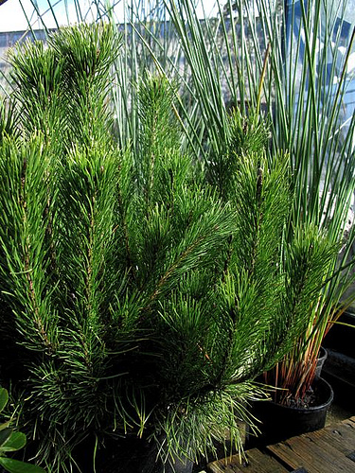
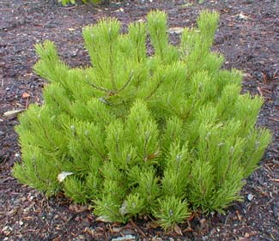
179
Pinus mugo
Mugo Pine
farm4.static.flickr.com
paghat.com
Notes:
http://www.paghat.com/images/mugo_feb.jpg
http://farm4.static.flickr.com/3401/3343452538_e986ec3f83.jpg

Slide 21
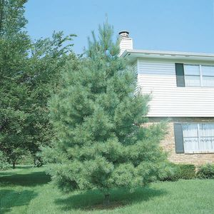
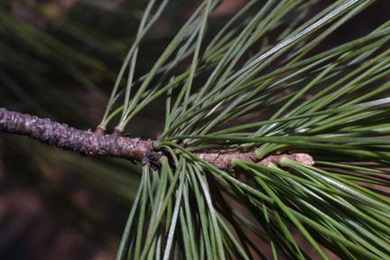
180
Pinus stobus
Eastern White Pine
abnativeplants.com
www.cas.vanderbilt.edu
Notes:
http://www.cas.vanderbilt.edu/bioimages/p/wpist--tw17542.jpg
http://www.abnativeplants.com/_ccLib/image/plants/DETA-11.jpg

Slide 22
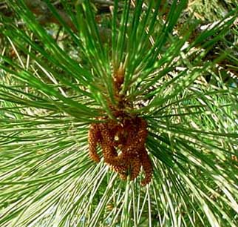
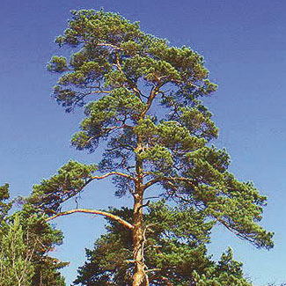
181
Pinus sylvestris
Scotch Pine
aroma-pure.com
Notes:
http://www.aroma-pure.com/images/ScotchPine.jpg

Slide 23
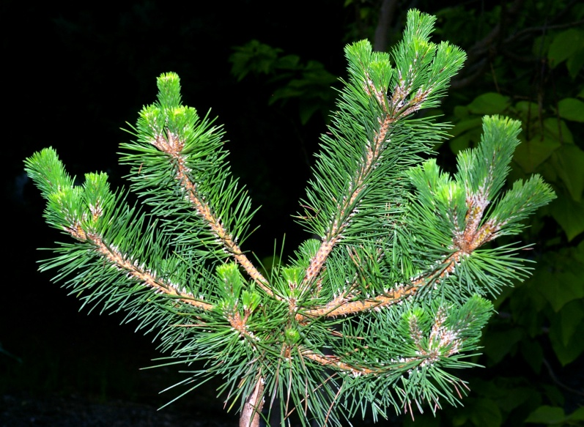
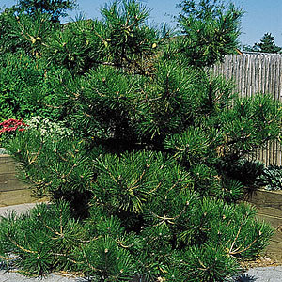
182
Pinus thumbergiana
Japanese Black Pine
greergardens.com
plantfinder.sunset.com
Notes:
http://plantfinder.sunset.com/images/pinus-104-m.jpg
http://www.greergardens.com/images/Conifers/Pinus%20thunbergiana%20Banshoho2.JPG

Slide 24
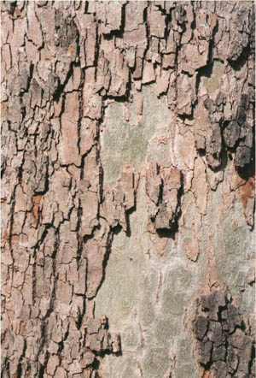
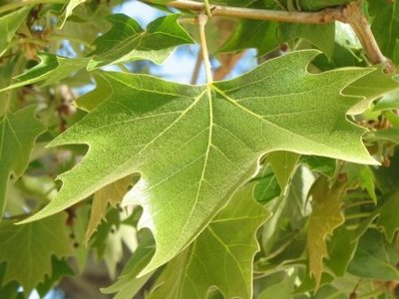

183
Platanus x acerifolia
London Planetree
2.bp.blogspot.com
botgard.ucla.edu
troymi.gov
Notes:
http://www.google.com/imgres?imgurl=http://www.botgard.ucla.edu/html/botanytextbooks/generalbotany/images/barkfeatures/Platanusbark4.jpg&imgrefurl=http://www.botgard.ucla.edu/html/botanytextbooks/generalbotany/barkfeatures/b0483tx.html&usg=__ZIR1RWewO1TnIw2Vv22D_7ghMbM=&h=442&w=300&sz=55&hl=en&start=3&sig2=tclFVcrmt7p0Sd7kzCKzbA&um=1&itbs=1&tbnid=hDW_cX7eKqJuOM:&tbnh=127&tbnw=86&prev=/images%3Fq%3DPlatanus%2Bx%2Bacerifolia%253FLondon%2BPlanetree%26um%3D1%26hl%3Den%26sa%3DN%26tbs%3Disch:1&ei=KfvqS8PpKYaasgP8-uy2Dw
http://2.bp.blogspot.com/_oH7YVmRWh-s/SPJzfgDn0rI/AAAAAAAAB9o/p_K3gSBVkQM/s400/London+plane+leaf.JPG
http://troymi.gov/parksrec/trees/treestoplant/LondonPlanetree3.jpg

Slide 25

184
Poa pratensis cv.
Kentucky Bluegrass
sod-depot.com
Notes:
http://www.sod-depot.com/Mello%20Blue.jpg

Slide 26


185
Podocarpus macrophyllus
Southern Yew
arthurleej.com
img.hgtv.com
Notes:
http://www.arthurleej.com/images/PodoFemale.jpg
http://img.hgtv.com/HGTV/2004/01/14/dl_japanese_yew_lg.jpg

Slide 27



186
Potentilla fruticosa cv.
Shrubby Cinquefoil
thegardenhelper.com
en.wikipedia.org
windowtothegarden.com
Notes:
http://www.windowtothegarden.com/Plant11.jpg
http://en.wikipedia.org/wiki/Shrubby_Cinquefoil
http://www.thegardenhelper.com/Potentilla.htm

Slide 28


187
Prunus laurocerasus cv.
Cherry Laurel
Wikipedia
Notes:
This file has been (or is hereby) released into the public domain by its author, Karduelis at the Turkish Wikipedia project. This applies worldwide.
In case this is not legally possible:
Karduelis grants anyone the right to use this work for any purpose, without any conditions, unless such conditions are required by law.
This image has been (or is hereby) released into the public domain by its author, Karduelis at the Turkish Wikipedia project. This applies worldwide.
In case this is not legally possible:
Karduelis grants anyone the right to use this work for any purpose, without any conditions, unless such conditions are required by law.

Slide 29


188
Prunus serrulata ‘Kwanzan’
Kwanzan Japanese Flowering Cherry
Wikipedia
Notes:
Permission is granted to copy, distribute and/or modify this document under the terms of the GNU Free Documentation License, Version 1.2 or any later version published by the Free Software Foundation; with no Invariant Sections, no Front-Cover Texts, and no Back-Cover Texts. A copy of the license is included in the section entitled "GNU Free Documentation License".
Permission is granted to copy, distribute and/or modify this document under the terms of the GNU Free Documentation License, Version 1.2 or any later version published by the Free Software Foundation; with no Invariant Sections, no Front-Cover Texts, and no Back-Cover Texts. A copy of the license is included in the section entitled "GNU Free Documentation License".

Slide 30

189
Pyracantha coccinea cv.
Firethorn
sacredorigin.com
Notes:
http://sacredorigin.com/images/firethorn_pyracantha_coccinea.jpg

