Slide 1
Nursery/Landscape Plant Identification
M-P
161-189
QUIZ

Slide 2
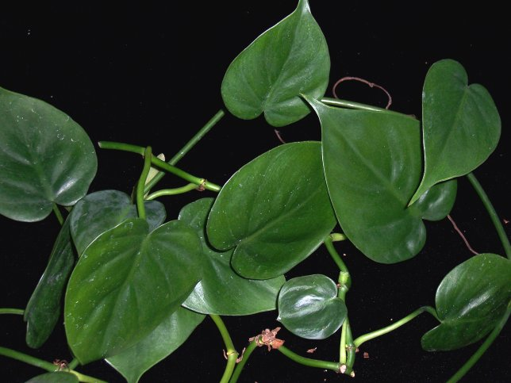
1
Notes:
175 Philodendron scandens oxycardium Heartleaf Philodendron
http://www.plantoftheweek.org/image/philos.jpg
http://upload.wikimedia.org/wikipedia/commons/d/d3/Philodendron_scandens_subsp_oxycardium1.jpg

Slide 3
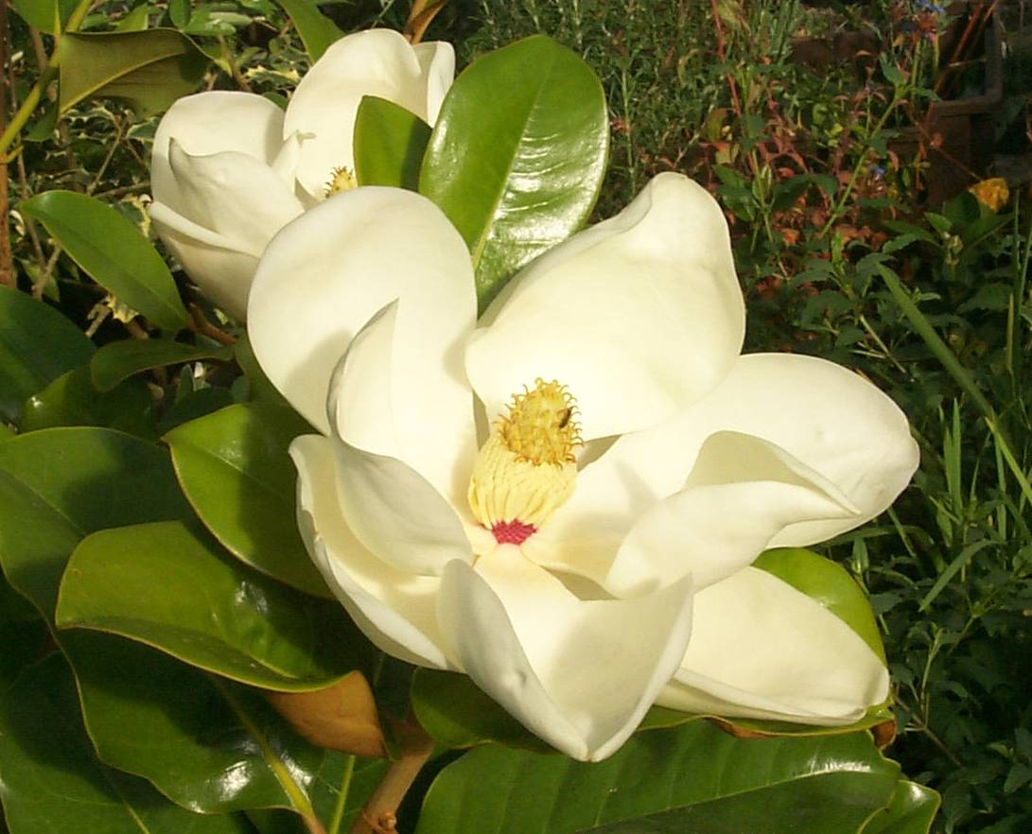
2
Notes:
161 Magnolia graniflora cv. Soutern Magnolia
http://www.banwnursery.co.uk/images/magnolia%20grandiflora%204.jpg
http://upload.wikimedia.org/wikipedia/commons/4/4c/Magnolia_grandiflora10.jpg

Slide 4
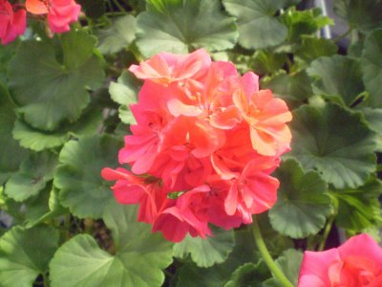
3
Notes:
172 Pelargonium x hortorum cv. Zonal Geranium
http://farm4.static.flickr.com/3281/3066522457_d5fa94d598.jpg
http://classes.hortla.wsu.edu/hort231/List01/PelargoniumLeaf.jpg
http://4.bp.blogspot.com/_eaKbvlcIK10/Sei5zjRPeHI/AAAAAAAAEzU/-87Z69ZzbYc/s400/pelargonium+x+hortorum+rose+(own).jpg

Slide 5
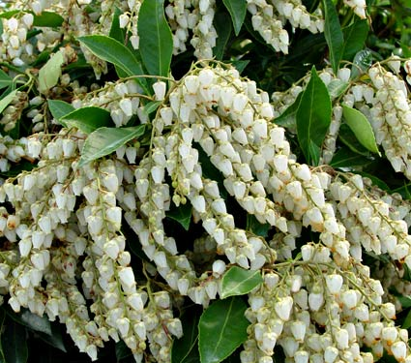
4
Notes:
178 Pieris japonica Lily-of-the-Valley Bush
http://images.whiteflowerfarm.com/66158a.jpg
http://australian-insects.com/lepidoptera/plants/eric/pieris-japonica.jpg

Slide 6
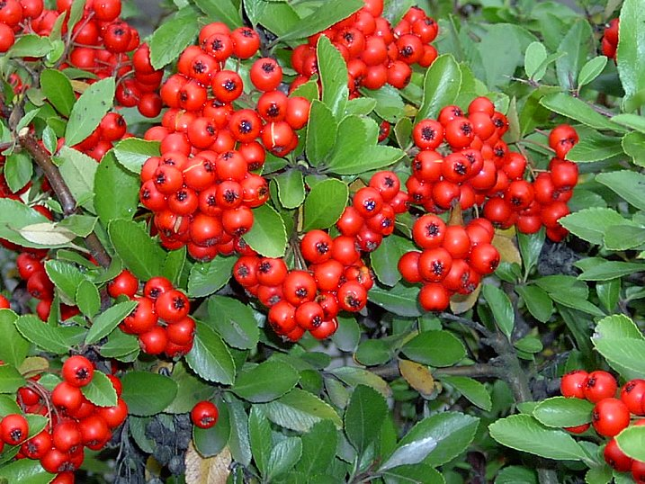
5
Notes:
189 Pyracantha coccinea cv. Firethorn
http://sacredorigin.com/images/firethorn_pyracantha_coccinea.jpg

Slide 7
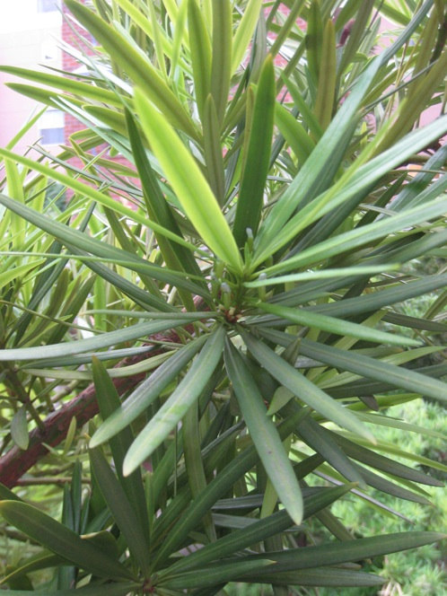
6
Notes:
185 Podocarpus macrophyllus Southern Yew
http://www.arthurleej.com/images/PodoFemale.jpg
http://img.hgtv.com/HGTV/2004/01/14/dl_japanese_yew_lg.jpg

Slide 8
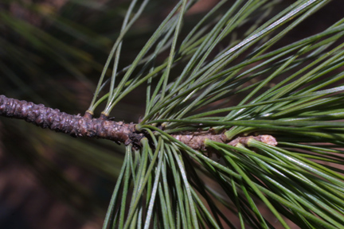
7
Notes:
180 Pinus stobus Eastern White Pine
http://www.cas.vanderbilt.edu/bioimages/p/wpist--tw17542.jpg
http://www.abnativeplants.com/_ccLib/image/plants/DETA-11.jpg

Slide 9
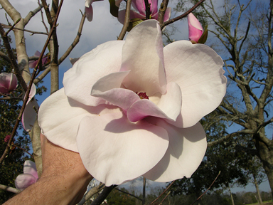
8
Notes:
162 Magnolia x soulangiana cv. Chinese (Saucer) Magnolia
http://www.magnoliasociety.org/checklist_images/Paul%20Cook-Knox.jpg
http://www.magnoliasociety.org/checklist_images/Pink%20Goblet-Knox.jpg

Slide 10
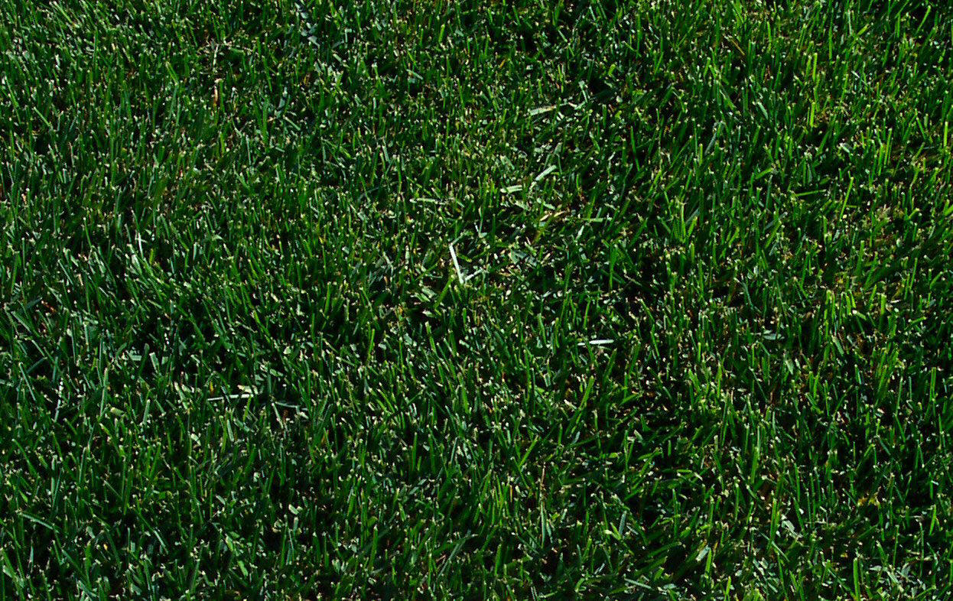
9
Notes:
184 Poa pratensis cv. Kentucky Bluegrass
http://www.sod-depot.com/Mello%20Blue.jpg

Slide 11
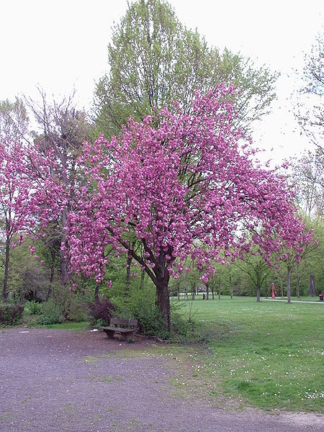
10
Notes:
188 Prunus serrulata ‘Kwanzan’ Kwanzan Japanese Flowering Cherry
Permission is granted to copy, distribute and/or modify this document under the terms of the GNU Free Documentation License, Version 1.2 or any later version published by the Free Software Foundation; with no Invariant Sections, no Front-Cover Texts, and no Back-Cover Texts. A copy of the license is included in the section entitled "GNU Free Documentation License".
Permission is granted to copy, distribute and/or modify this document under the terms of the GNU Free Documentation License, Version 1.2 or any later version published by the Free Software Foundation; with no Invariant Sections, no Front-Cover Texts, and no Back-Cover Texts. A copy of the license is included in the section entitled "GNU Free Documentation License".

Slide 12
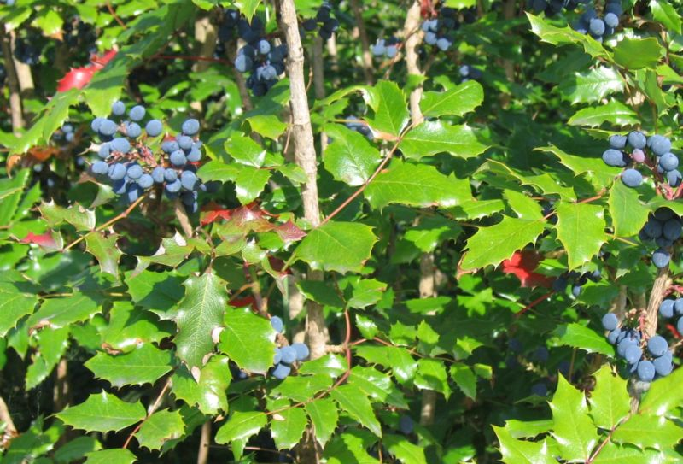
11
Notes:
163 Mahonia aquifolia cv. Oregon Grape
http://www.plantcare.com/oldSite/httpdocs/images/namedImages/Mahonia_Aquifolium.jpg
http://wolf.mind.net/swsbm/Images/New9-2001/Mahonia_aquifolia-3.jpg

Slide 13
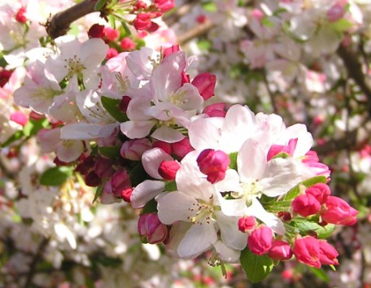
12
Notes:
164 Malus spp. & cv. Flowering Crabapple
http://bowerbirdz.files.wordpress.com/2008/10/a-crab1.jpg
http://www.mobot.org/gardeninghelp/images/Gardens/Bloom982.jpg

Slide 14
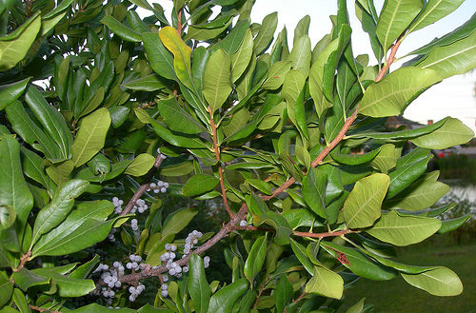
13
Notes:
165 Myrica pensylvanica Bayberry
http://farm3.static.flickr.com/2308/2869365858_95799bc51c.jpg
http://farm2.static.flickr.com/1055/946095331_57fe2bc79d.jpg?v=0

Slide 15
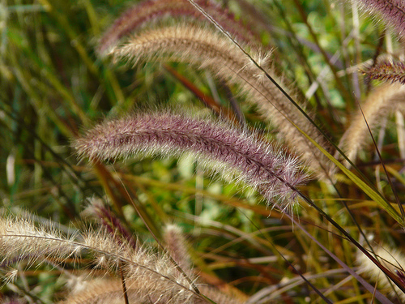
14
Notes:
173 Pennisetum ruppelia Fountain Grass
http://farm4.static.flickr.com/3215/3052146417_e7079bcef2.jpg?v=0
http://swbiodiversity.org/images/vasc_herbarium_images/Poaceae/photos/penset.jpg

Slide 16
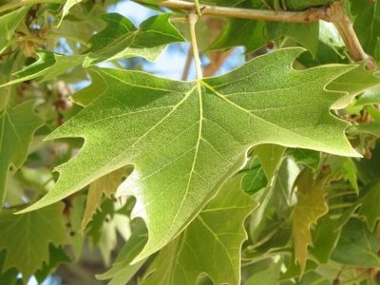
15
Notes:
183 Platanus x acerifolia London Planetree
http://www.google.com/imgres?imgurl=http://www.botgard.ucla.edu/html/botanytextbooks/generalbotany/images/barkfeatures/Platanusbark4.jpg&imgrefurl=http://www.botgard.ucla.edu/html/botanytextbooks/generalbotany/barkfeatures/b0483tx.html&usg=__ZIR1RWewO1TnIw2Vv22D_7ghMbM=&h=442&w=300&sz=55&hl=en&start=3&sig2=tclFVcrmt7p0Sd7kzCKzbA&um=1&itbs=1&tbnid=hDW_cX7eKqJuOM:&tbnh=127&tbnw=86&prev=/images%3Fq%3DPlatanus%2Bx%2Bacerifolia%253FLondon%2BPlanetree%26um%3D1%26hl%3Den%26sa%3DN%26tbs%3Disch:1&ei=KfvqS8PpKYaasgP8-uy2Dw
http://2.bp.blogspot.com/_oH7YVmRWh-s/SPJzfgDn0rI/AAAAAAAAB9o/p_K3gSBVkQM/s400/London+plane+leaf.JPG
http://troymi.gov/parksrec/trees/treestoplant/LondonPlanetree3.jpg

Slide 17
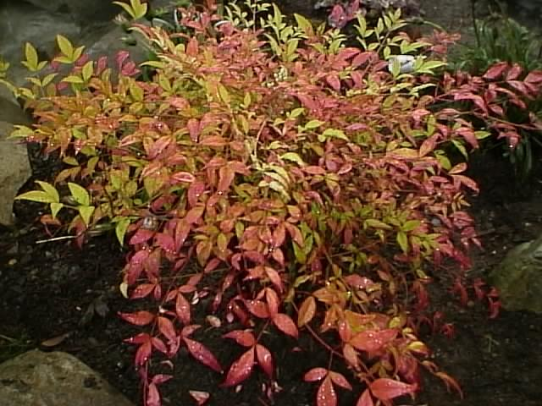
16
Notes:
166 Nandina domestica Heavenly Bamboo
http://www.thegardenhelper.com/pixpg/graphics/nandina.JPG
http://www.google.com/imgres?imgurl=http://media-2.web.britannica.com/eb-media/95/118295-004-961DE976.jpg&imgrefurl=http://www.britannica.com/EBchecked/topic-art/51182/114240/Heavenly-bamboo&usg=__i7BArHDAHe0HkD1KtH2JYLEsOhY=&h=405&w=550&sz=47&hl=en&start=10&sig2=BmKB-jAkVyt2Ow1zf6kBWA&itbs=1&tbnid=Jgl89adXqNpUcM:&tbnh=98&tbnw=133&prev=/images%3Fq%3DNandina%2Bdomestica%2BHeavenly%2BBamboo%26hl%3Den%26sa%3DG%26tbs%3Disch:1&ei=otbRS5yoN4vYswO155nYCQ

Slide 18
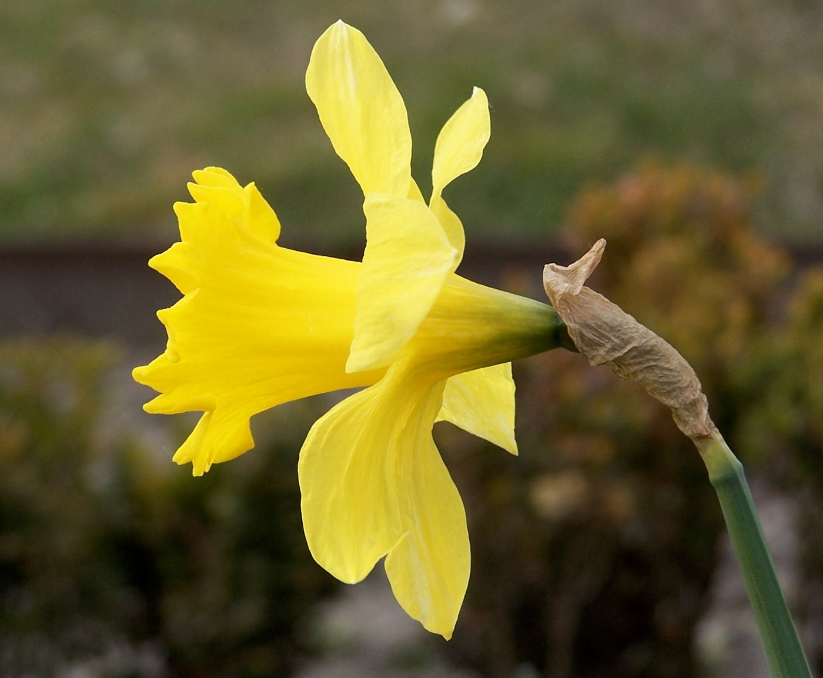
17
Notes:
167 Narcissus pseudonarcissus cv. Daffodil
Upload.wikimedia.org

Slide 19
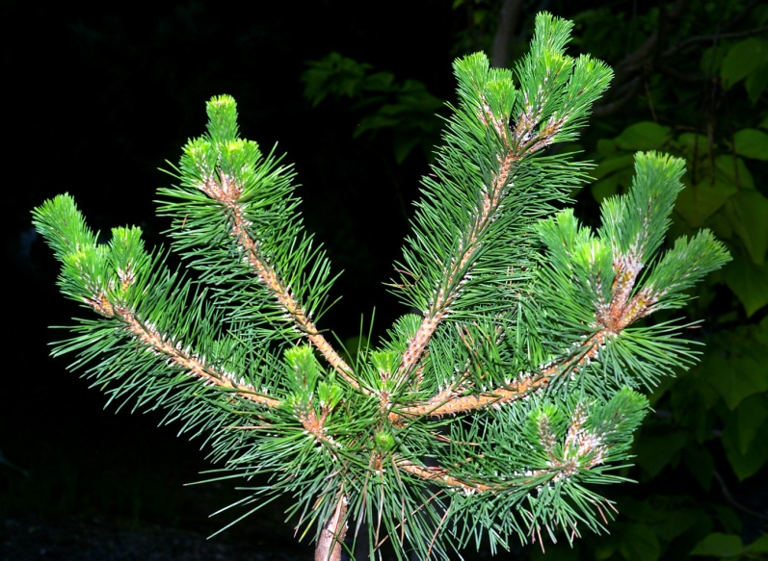
18
Notes:
182 Pinus thumbergiana Japanese Black Pine
http://plantfinder.sunset.com/images/pinus-104-m.jpg
http://www.greergardens.com/images/Conifers/Pinus%20thunbergiana%20Banshoho2.JPG

Slide 20
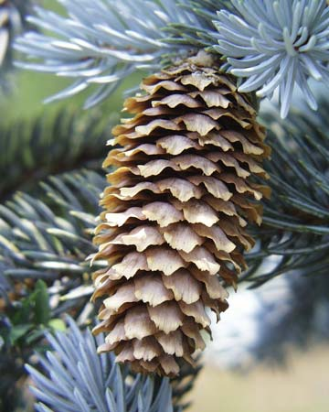
19
Notes:
177 Picea pungens Colorado (Blue) Spruce
http://www.goodnewsgardening.com/images/trees/Picea%20Pungens%20glauca.jpg
http://bioweb.uwlax.edu/bio203/s2009/hanford_kyle/images/Blue%20spruce%20cone%20hanging%20Wikipedia.jpg

Slide 21
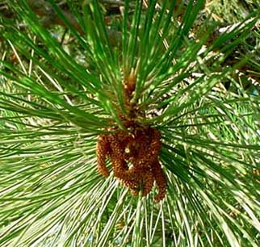
20
Notes:
181 Pinus sylvestris Scotch Pine
http://www.aroma-pure.com/images/ScotchPine.jpg

Slide 22
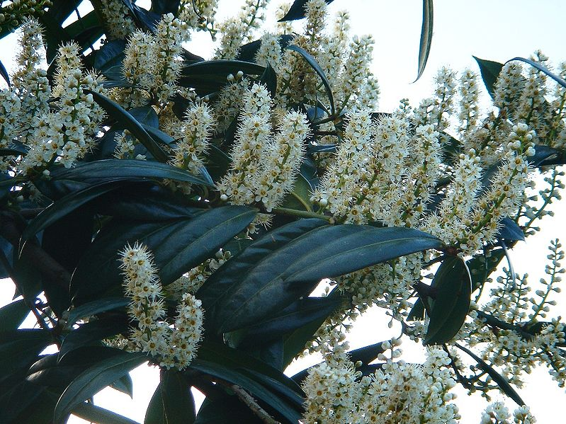
21
Notes:
187 Prunus laurocerasus cv. Cherry Laurel
This file has been (or is hereby) released into the public domain by its author, Karduelis at the Turkish Wikipedia project. This applies worldwide. In case this is not legally possible: Karduelis grants anyone the right to use this work for any purpose, without any conditions, unless such conditions are required by law.
This image has been (or is hereby) released into the public domain by its author, Karduelis at the Turkish Wikipedia project. This applies worldwide. In case this is not legally possible: Karduelis grants anyone the right to use this work for any purpose, without any conditions, unless such conditions are required by law.

Slide 23
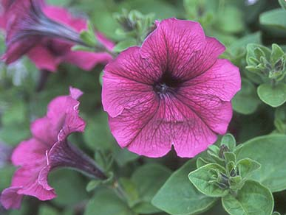
22
Notes:
174 Petunia x hybrida cv. Petunia
http://oregonstate.edu/dept/ldplants/images/petunia-h2.jpg
http://www.google.com/imgres?imgurl=http://oregonstate.edu/dept/ldplants/images/petunia-h1.jpg&imgrefurl=http://www.uniprot.org/taxonomy/4102&usg=__KMSXV2P-ejol0WK0CBj6NVfQvm4=&h=265&w=400&sz=55&hl=en&start=12&sig2=ilS3Xg8G-HJjYDO7tC-lsQ&itbs=1&tbnid=AB3rMM_mS_VuPM:&tbnh=82&tbnw=124&prev=/images%3Fq%3DPetunia%2Bx%2Bhybrida%2Bcv.%2BPetunia%26hl%3Den%26sa%3DG%26tbs%3Disch:1&ei=xNrRS83rO5LcsgP01qnlCQ

Slide 24
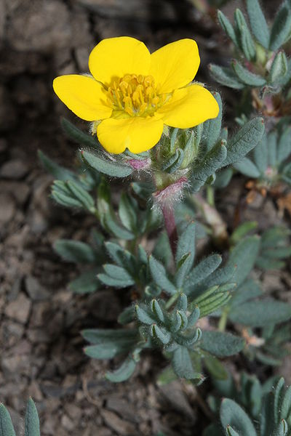
23
Notes:
186 Potentilla fruticosa cv. Shrubby Cinquefoil
http://www.windowtothegarden.com/Plant11.jpg
http://en.wikipedia.org/wiki/Shrubby_Cinquefoil
http://www.thegardenhelper.com/Potentilla.htm

Slide 25
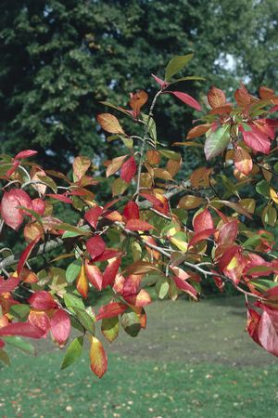
24
Notes:
168 Nyssa sylvatica Sour (Black) Gum
http://www.rainkc.com/_ccLib/image/plants/DETA-899.jpg
http://www.ces.ncsu.edu/johnston/homehort2/black_gum.jpg
http://www.mobot.org/plantscience/resbot/flor/wny-niag/nyssa-sylvatica2.jpg

Slide 26
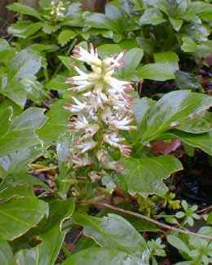
25
Notes:
169 Pachysandra terminalis Japanese Spurge
http://plantfinder.sunset.com/images/pachysandra-138-m.jpg
http://www.google.com/imgres?imgurl=http://www.paghat.com/images/pachysandra_latefeb.jpg&imgrefurl=http://www.paghat.com/pachysandra.html&usg=__7PMpKkpKKkN7c5YsiBc7NTkAdP8=&h=325&w=260&sz=15&hl=en&start=4&sig2=FXRiuyDUwiql5nmwB-Pjzg&itbs=1&tbnid=69X5wTxr_PLTjM:&tbnh=118&tbnw=94&prev=/images%3Fq%3DPachysandra%2Bterminalis%2BJapanese%2BSpurge%26hl%3Den%26sa%3DG%26tbs%3Disch:1&ei=zdfRS_vZKoe4tgOw6Nz7Ag

Slide 27
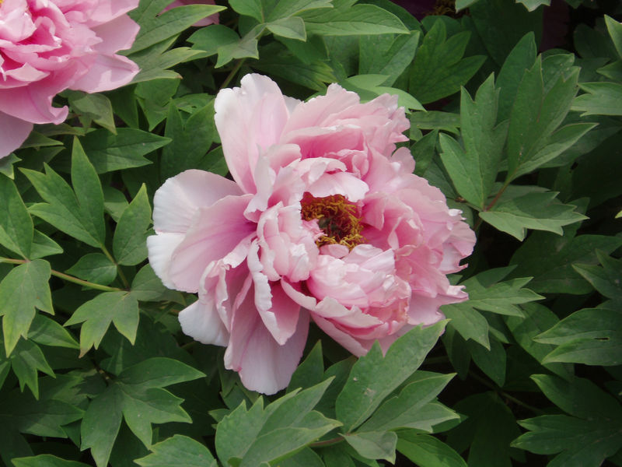
26
Notes:
170 Paeonia hybrid cv. Peony
http://cincinnati.com/blogs/gardening/files/2010/03/800px-PaeoniaSuffruticosa7.jpg
http://plants.chebucto.biz/fleurs/F1270L.jpg

Slide 28
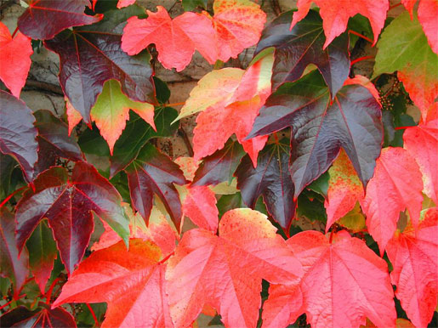
27
Notes:
171 Parthenocissus tricuspidata Boston Ivy
http://www.landscape-service.com/plants/fullsize/parthenocissust.jpg
http://www.datasync.com/sbe/image/d9885.jpg

Slide 29
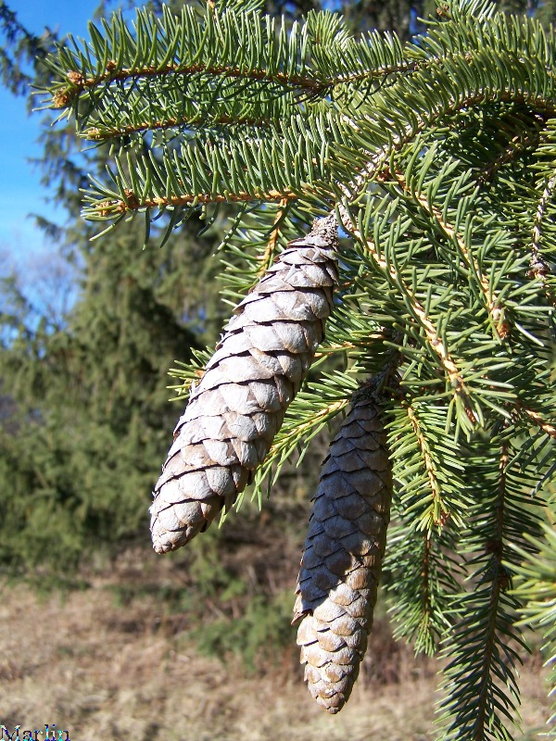
28
Notes:
176 Picea abes Norway Spruce
http://en.wikivisual.com/images/8/81/Picea_abies.jpg
http://www.cirrusimage.com/Trees/spruce/Norway_spruce_3.jpg

Slide 30
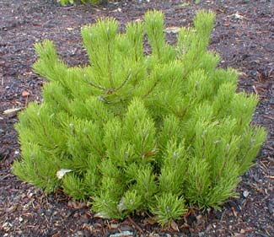
29
Notes:
179 Pinus mugo Mugo Pine
http://www.paghat.com/images/mugo_feb.jpg
http://farm4.static.flickr.com/3401/3343452538_e986ec3f83.jpg

