Slide 1
Nursery/Landscape
Plant Identification
Q-Z
190-216
QUIZ

Slide 2
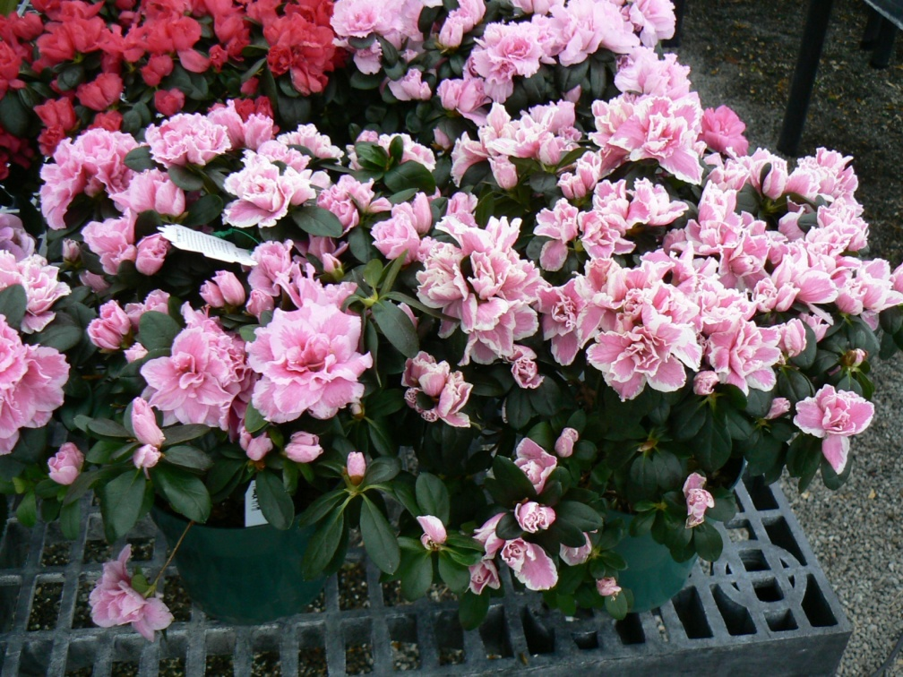
1
Notes:
194
Rhododendron Hybrid
Exbury Hybrid Azalea

Slide 3
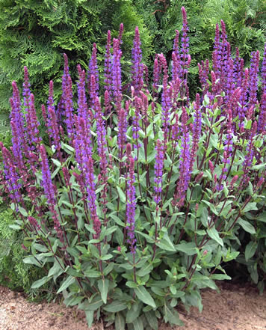
2
Notes:
196
Salvia nemorosa cv.
Meadow Sage
http://gpgreenhouses.ca/images/salviaNemorosaCarradonnaS.jpg
http://www.missouriplants.com/Blueopp/Salvia_farinacea_flower.jpg

Slide 4
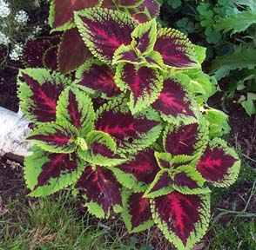
3
Notes:
198
Solenostemon scutellarioides
Coleus
http://pics.davesgarden.com/pics/2001/08/12/poppysue/bdbdec.jpg
http://3.bp.blogspot.com/_eaKbvlcIK10/SG0holYxjnI/AAAAAAAAB_4/04VTJdVtyzY/s400/solenostemon%2Bscutellarioides%2Brainbow%2Bmix%2B(own).jpg

Slide 5
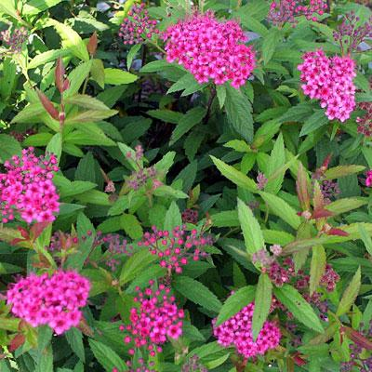
4
Notes:
200
Spiraea x bumalda
Bumalda Spirea
http://www.zahradnictvikub.cz/Foto_druhove/slides/Spiraea%20x%20bumalda%20Anthony%20Waterer.jpg
http://www.lotf.com/plants/shrubs/spireago.jpg
http://www.aragriculture.org/Images/plant_db/shrubs/spiraea_bumalda_flfm.jpg

Slide 6
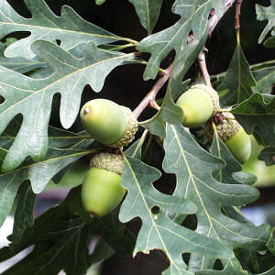
5
Notes:
190
Quercus alba
White Oak
http://www.netstate.com/states/symb/trees/images/white_oak2.jpg
http://naturallandscapenursery.com/White%20Oak.JPG

Slide 7
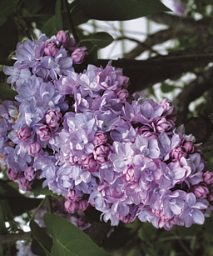
6
Notes:
201
Syringa vulgaris cv.
Common lilac
http://www.finegardening.com/cms/uploadedimages/images/gardening/issues_81-90/041088070-02_med.jpg
http://www.finegardening.com/CMS/uploadedimages/Images/Gardening/Issues_101-110/041106478_lavendar_lady_lilac_xlg.jpg

Slide 8

7
Notes:
202
Tagetes spp. cv.
Marigold
http://3.bp.blogspot.com/_eaKbvlcIK10/SD3hazRgwKI/AAAAAAAABtA/qr05rmOZn6w/s400/tagetes%2Bpatula%2Bvarious%2B(own).jpg
http://www.pekin.net/pekin108/edison/jrviews/fall99/marfest/images/marigold.jpg

Slide 9
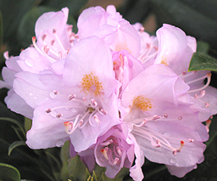
8
Notes:
193
Rhododendron x catawbiense
Catawba Hybrid Rhododendron
http://www.talltreesgroup.com/Rhododendron%20catawbiense%20%27Roseum%20Elegans%27.jpg
http://www.conncoll.edu/ccrec/greennet/arbo/images/cbgchklist/rhodomaximum.jpg

Slide 10
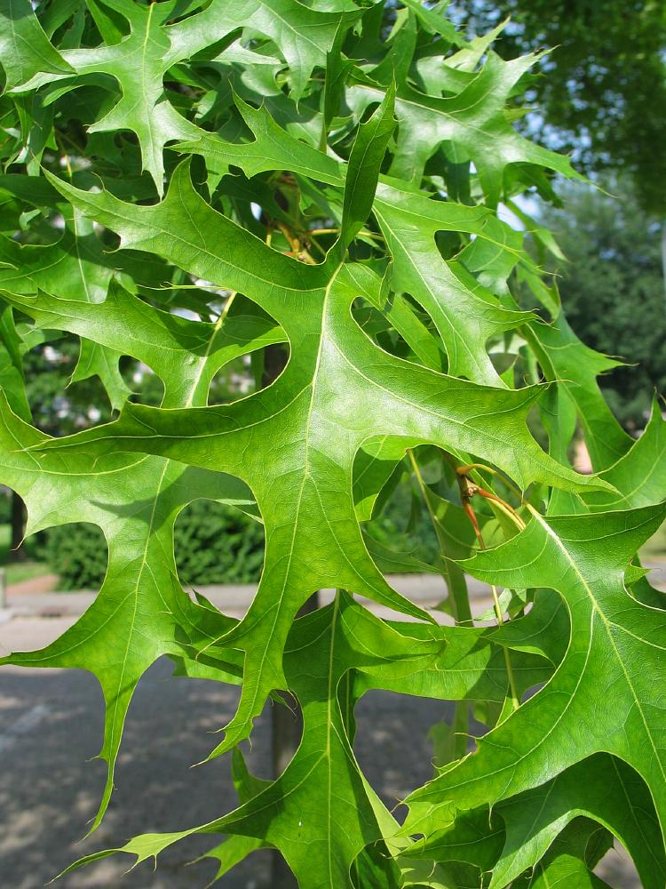
9
Notes:
191
Quercus palustris
Pin Oak
http://www.bomengids.nl/zomer2004/pics/Moeraseik__Quercus_palustris__Pin_oakimg_4632blad.jpg
http://www.uvm.edu/~uvmwalks/1/plantimages/Quercuspalustris06.jpg

Slide 11
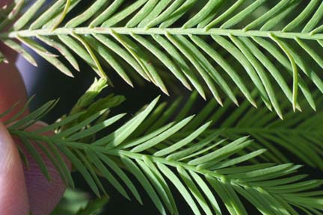
10
Notes:
203
Taxodium distichum
Bald Cypress
http://www.azarboretum.org/plantlist/baldcypress.jpg
http://www.google.com/imgres?imgurl=http://www.cas.vanderbilt.edu/bioimages/biohires/t/htadi2-lfuplow-close12654.JPG&imgrefurl=http://www.cas.vanderbilt.edu/bioimages/image/t/tadi2-lfuplow-close12654.htm&usg=__8vniZdxZGONHX64pJT1VD0dTisw=&h=1440&w=2160&sz=664&hl=en&start=3&sig2=QfuJB_a96yFXFEwLoGruKQ&um=1&itbs=1&tbnid=rQKLwG_wXasVmM:&tbnh=100&tbnw=150&prev=/images%3Fq%3DTaxodium%2Bdistichum%2BBald%2BCypress%26um%3D1%26hl%3Den%26sa%3DG%26tbs%3Disch:1&ei=U4IBTPXZHJT84AawoIzaDQ

Slide 12
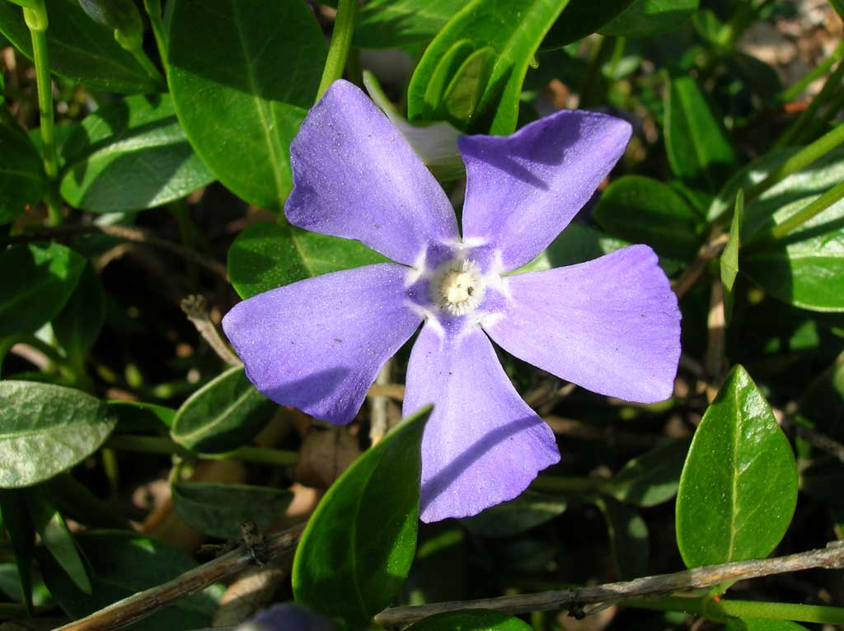
11
Notes:
212
Vinca minor cv.
Periwinkle
http://davidbessler.files.wordpress.com/2008/07/periwinkle1.jpg
http://www.daytonnursery.com/encyclopedia/Perennials/Vinca.htm

Slide 13
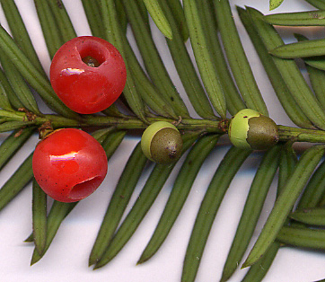
12
Notes:
204
Taxus spp.cv.
Yew
http://www.google.com/imgres?imgurl=http://www.millernursery.com/image/plantPicFiles/SmallWebPics/taxusMediaTautoniS.jpg&imgrefurl=http://www.millernursery.com/plantPages/plantPage.php%3Fplantid%3D335&usg=__UEvdKk_uaHL2jWhRatuSf1cBIPw=&h=356&w=475&sz=44&hl=en&start=10&sig2=iTBWZA8w5wboZMi7dbNTpw&um=1&itbs=1&tbnid=i0qt0_TE8QciWM:&tbnh=97&tbnw=129&prev=/images%3Fq%3DTaxus%2BYew%26um%3D1%26hl%3Den%26sa%3DG%26tbs%3Disch:1&ei=2YEBTJXgMZGC4QbCjrDgDQ
http://michaelweishan.com/gardenblog/wp-content/uploads/2009/08/taxus.jpg

Slide 14
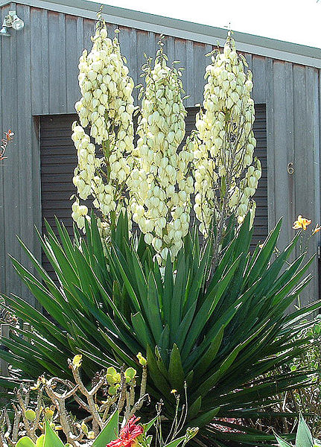
13
Notes:
215
Yucca filamentosa
Adam’s Needle
http://www.royalcrestnurseries.com/catalog/images/Yucca_filamentosa_7g.jpg
http://www.hortmag.com/upload/images/PlantsWeLove/yucca.jpg

Slide 15
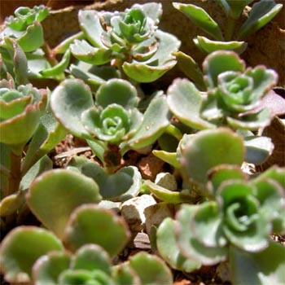
14
Notes:
197
Sedum spurium cv.
Sedum
http://www.cactusjungle.com/images/sedum_spurium_atropurpureum.jpg
http://www.rockwallgardens.com/Sedum_spurium__red_form_23June2006.jpg

Slide 16
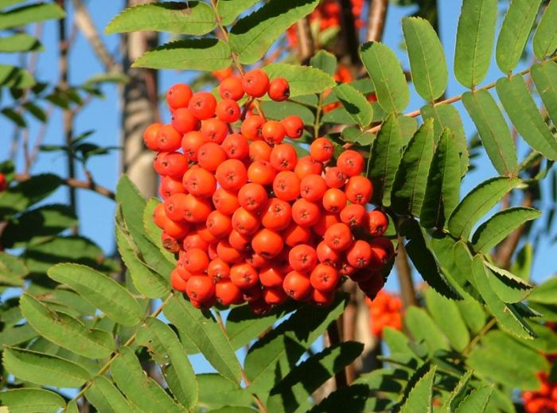
15
Notes:
199
Sorbus aucuparia
European Mountain Ash
http://www.google.com/imgres?imgurl=http://www.dicts.info/img/ud/rowan.jpg&imgrefurl=http://www.dicts.info/picture-dictionary.php%3Fw%3Dmountain&usg=__Q2Qqxu2OfwmxTEwCc5SO3rts99k=&h=519&w=700&sz=72&hl=en&start=2&sig2=389cIaIreeTk6PA2bfBqTA&um=1&itbs=1&tbnid=-9V5S_7ZcrwP-M:&tbnh=104&tbnw=140&prev=/images%3Fq%3DSorbus%2Baucuparia%2BEuropean%2BMountain%2BAsh%26um%3D1%26hl%3Den%26sa%3DG%26tbs%3Disch:1&ei=DIQBTIyYGpSS4garx4XTDQ
http://www.digitalnaturalhistory.com/images/SorbusHybrid1BrigusOct232004.jpg
http://gerrystreenursery.com/pics/European-Mountain-Ash.jpg

Slide 17

16
Notes:
205
Thuja occidentalis cv.
American Arborvitae
http://1.bp.blogspot.com/_Oh85DTQjRFw/RbMDyYCaTvI/AAAAAAAAA7s/ra_ZbfwhWEI/s200/Thuja_orientalis.jpg
http://msuplants.com/images/Thuja/Thujaocci_LF02b_Jun13_sma.jpg

Slide 18
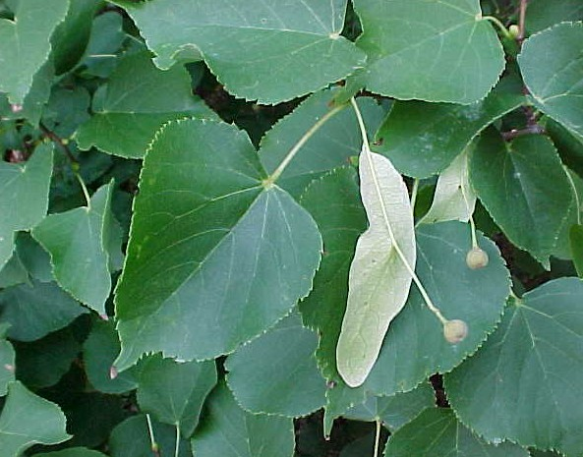
17
Notes:
206
Tilia coardata
Littleleaf Linden
http://img.hgtv.com/HGTV/2003/09/30/tough_tilia_cordata_tree_lg.jpg
http://www.talltreesgroup.com/Tilia%20cordata.jpg

Slide 19
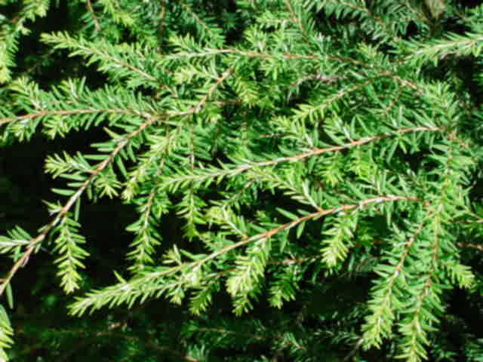
18
Notes:
207
Tsuga canadensis
Canadian Hemlock
http://greenspade.com/wp-content/uploads/2008/01/hemlockcan.jpg
http://www.yorkccd.org/wordpress/wp-content/uploads/2010/01/CanadianHemlockFrond1.jpg

Slide 20
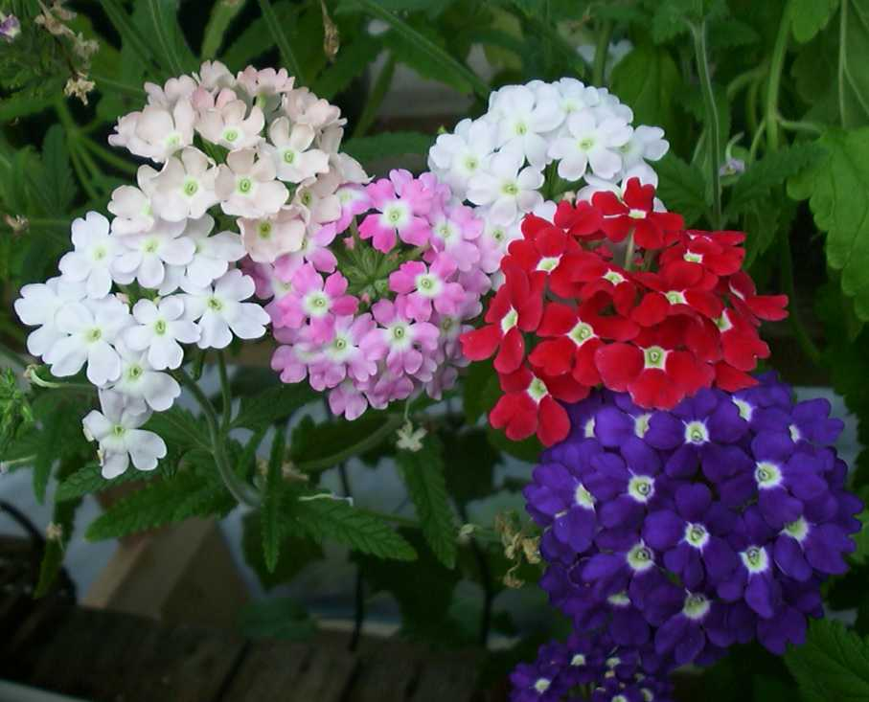
19
Notes:
209
Verbena x hybrida cv.
Garden Verbena
http://www.acgnursery.com/images/verbena-mix.jpg
http://www.magnoliagardensnursery.com/productdescrip/pictures300/Verbena_BabylonR300.jpg

Slide 21
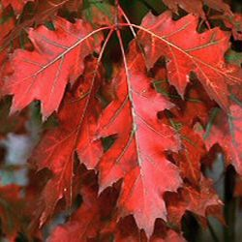
20
Notes:
192
Quercus rubra
Red Oak
http://www.trees-online.co.uk/images/red-oak-tree-quercus-rubra-381.jpg
http://www.aragriculture.org/Images/plant_db/trees/quercus_rubra_fallclfm.jpg

Slide 22
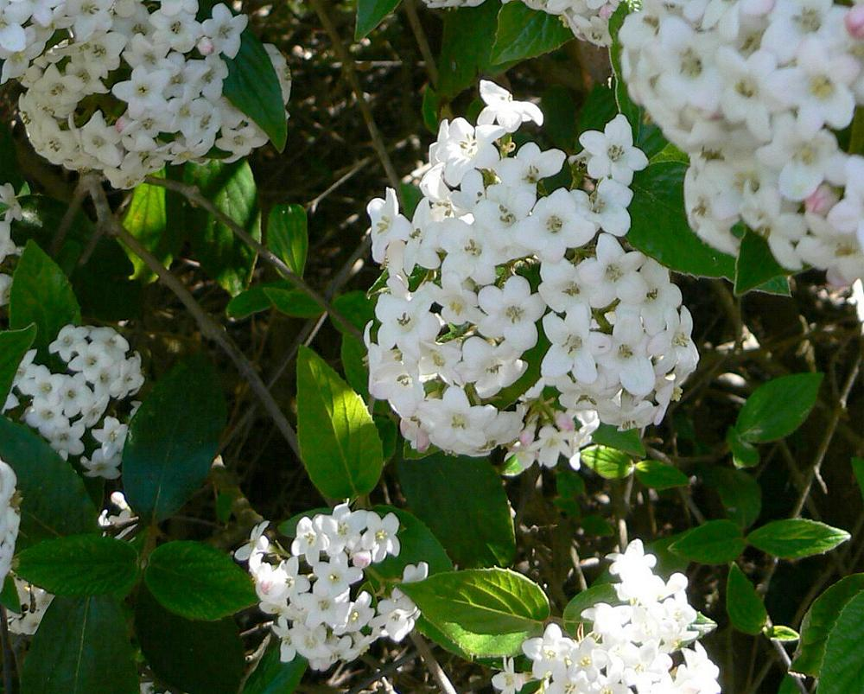
21
Notes:
210
Viburnum x burkwoodii
Burkwood Viburnum
http://media.growsonyou.com/photos/products/28132.jpg
http://australian-insects.com/lepidoptera/plants/capr/viburnum-burkwoodii.jpg

Slide 23
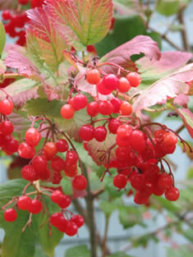
22
Notes:
211
Viburnum trilobum
American Cranberrybush Viburnum
Photo credits to Pat Breen, Oregon State University and Peggy Acott, Portland Nursery

Slide 24
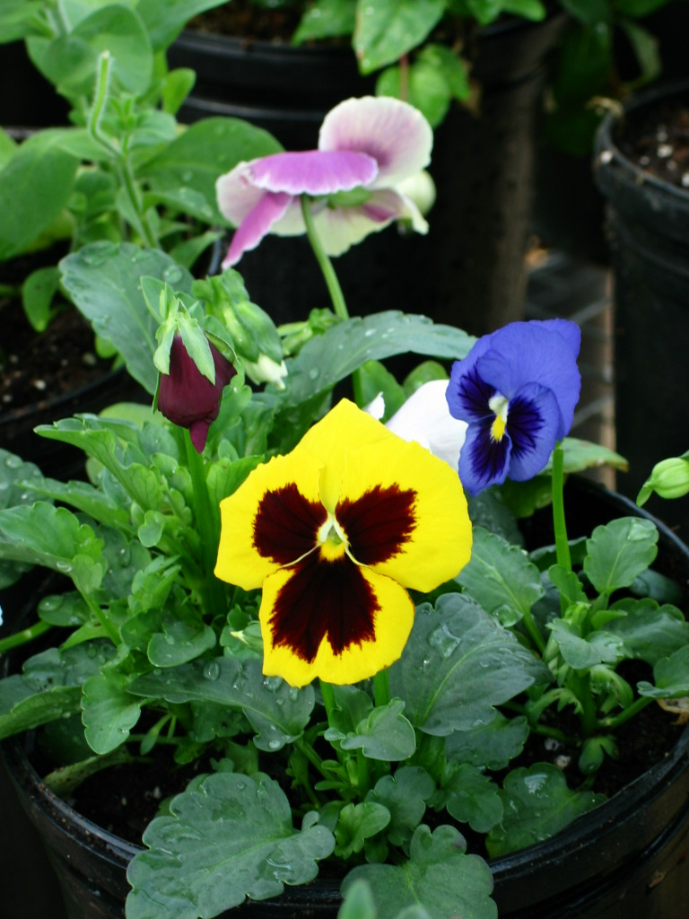
23
Notes:
213
Viola x wittrockiana cv.
Pansy

Slide 25
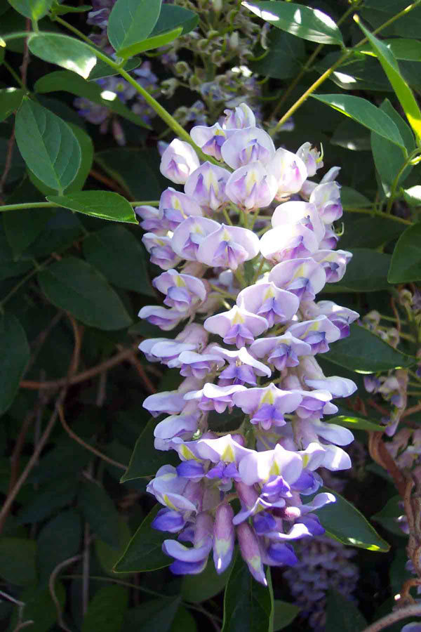
24
Notes:
214
Wisteria sinensis cv.
Chinese Wisteria
http://www.extension.umn.edu/projects/yardandgarden/yglnews/images2/Sept12008/art2-3_600px.jpg
http://www.extension.umn.edu/projects/yardandgarden/yglnews/images2/Sept12008/art2-2_600px.jpg

Slide 26
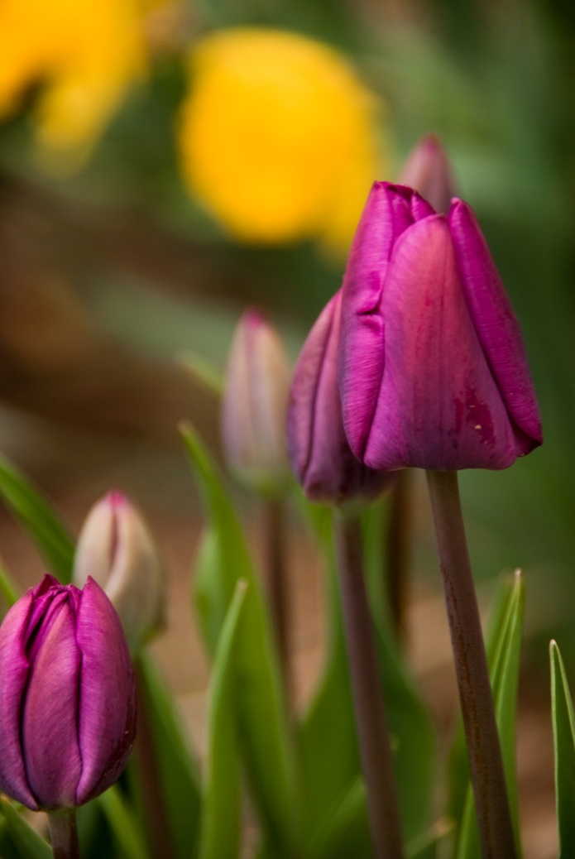
25
Notes:
208
Tulipa spp.cv.
Tulip
http://images.pictureshunt.com/pics/t/tulip_flowers-10324.jpg

Slide 27
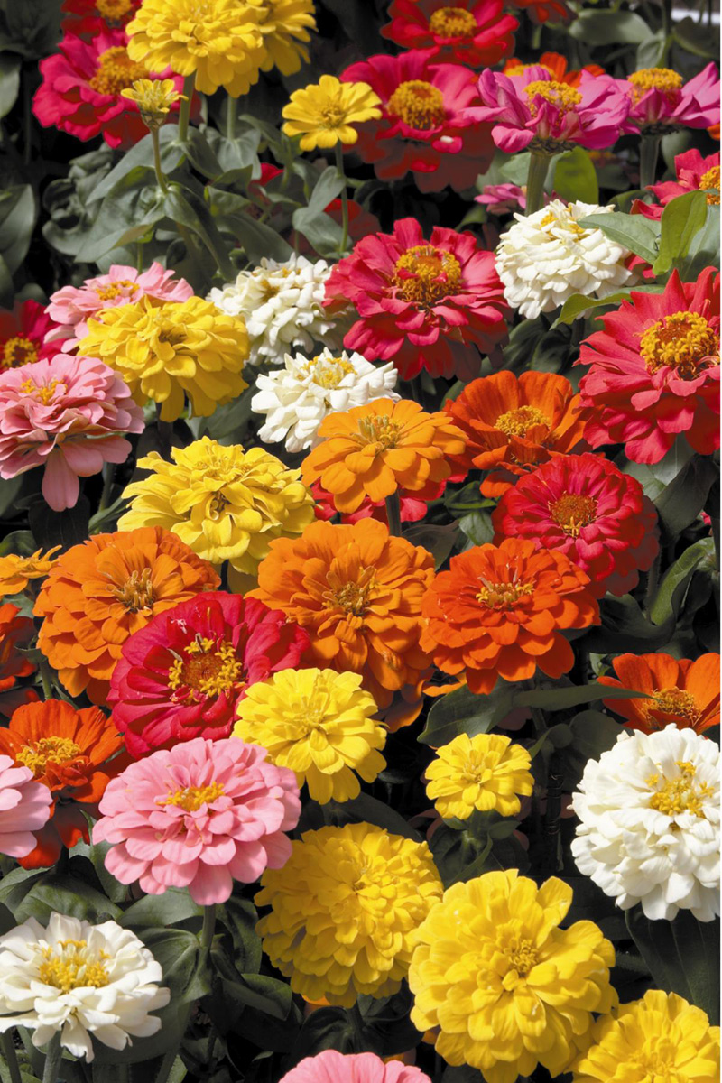
26
Notes:
216
Zinnia elegans
Zinnia
http://www.thewildlifeporch.com/media/blogs/twp/F_Zinnia_DistanceMix.jpg
http://www.desert-tropicals.com/Plants/Asteraceae/Zinnia_elegans3.jpg

Slide 28

27
Notes:
195
Rosa spp. Class Hybrid Tea cv.
Hybrid Tea Rose

