Slide 1
New Chart of Account
Training and Communication
College of Agricultural & Life Science
Sep 6, 2018

Slide 2

TARGET AUDIENCE
Deans & Directors
Leadership Team
25 people
Department Heads
District Directors
Admin Service Team
40+ People
Finance Specialists
R&E Directors
Dean &Directors
9 People
Admin Assistants
Grant Management Office
NEW
Weekly
Monthly
Monthly

Slide 3
TARGET AUDIENCE
Communication
-Timeline & Updates
What? When? Why?
- Impact: Benefits & Challenges
- Communication & Training Plan for the College
Sympathy
Support
Training
- Main Changes:
Fund Levels
- New Terminology
- Reference Sheet
Deans & Directors
9 People
NEW
Weekly
Monthly
Monthly

Slide 4
The Good and The Challenges
Training Sample
Opportunity to rebuild our current reports because they all need to be updated.
Different ways to roll up the data: By Location, By spending authority, By Department, By fund types.
The new banner is going to be easier to learn for new user. Friendlier window based environment.
Slow beginning of year with Chart V Conversion activities at the top of the regular year end activities.
Rollover balances. Sept-15
Argos is the new reporting system and requires good excel skills that our staff need to master.
Limited IT Resources to convert old banner reports and build new Argos Reports

Slide 5
TARGET AUDIENCE
Communication
-Timeline & Updates
What? When? Why?
- Input from CUIIBO
- New Processes
- Reminders
-Q&A Session
Get Alignment & Change Grief
Training
- Chart V in CALS
- Reference Sheet:
Project: Review Chart of Account
- Argos Navigating
- Excel Pivot tables
-Argos/ Banner Reports
Finance
Human Resources
Admin Service Team
40+ People
Finance Specialists
Admin Assistants
Grant Management Office
NEW
Monthly

Slide 6
Terminology Changes
Training Sample
BEFORE | AFTER
DEPT /Roll up CODE | ORG CODE
BUDGET AABXXX | INDEX NUMBER
 | FUND CODE
 | NEW LOCATION CODE
 | NEW ACTIVITY CODE
Example
3 digit: 848
6 Digits: 848XXX
6 Digits: 20XXXX
AGPARM
AGLLLN
A Budget is a spending plan. Not to be confused with INDEX- Number to identify a budget plan
New Fund Codes
New Location Code – For Off Campus Offices. Academic Departments in campus do not have location code
New Activity Code – Spending Authority –LLL First three letters of last name
N First letter of name

Slide 7
Reference Sheet
Training Sample
New - CALS Fund Codes
New - CALS Location Codes

Slide 8
TARGET AUDIENCE
Communication
-Timeline & Updates
What? When? Why?
- Impact: Benefits & Challenges
- Communication & Training Plan for the College
Sympathy
Support
Training
- Understand changes in the New Chart of Accounts
- Become familiar with the New Structure & Codes
-Vandal Web Access How to navigate it.
-Dashboard - Screen Shot Tool
Leadership Team
25 people
Department Heads
District Directors
R&E Directors
Dean &Directors
NEW
Monthly
Monthly
Monthly

Slide 9
Reference Sheet
Training Sample
CALS Department / New Org Codes

Slide 10
Vandal Web
Training Sample
Finance Queries for Non Banner Users:
Go to Vandal Web/Employees
  Budget Availability:
      All expenses and encumbrances: Approved and Pending
      Expenses grouped by PER & NON PER
      It does not work for Gen Ed Funds
      Data is updated daily
  CALS Detail Expenses(Under Budget Queries)
        Only approved expenses and encumbrances but you can search for pending expenses.
        Detail Expenses but not in a nice format
        Payroll details by person name and hours paid.
        It works for all Funds
        Data is updated daily

Slide 11
Vandal Web
Training Sample
Finance Queries for Non Banner Users:
Go to Vandal Web/Employees
  Fund Balance:
      Most relevant for Local Services and Service Centers (Old Y Accounts).
      A lump sum screenshot of revenue, expenses, cost transfers and available cash.
      It does not break expenses by type.
      Pending expenses or encumbrances are not included because it is a “cash balance”
      A positive balance means Deficit. A negative balance means a Surplus.

Slide 12

Dashboard
Training Sample
Cross Walk
Easy conversion from Chart 9 to Chart V Codes
Provide a big picture on the indexes by Departments, Locations, Fund types and spending authority (Activity Codes)
It is an screenshot. New indexes will not be updated
It does not work for grants.
Budget Availability & Fund Balance
Use new Chart V Codes
Provide a YTD balance by Index, Departments, Locations, Fund Types and Spending Authority (Activity Codes)
It is an screenshot. Data changes every day.
It does not work for grants now but has potential to work when grant budgets and balances are rolled over.
          One Place Shopping
          Not easy to replicate - Manual

Slide 13
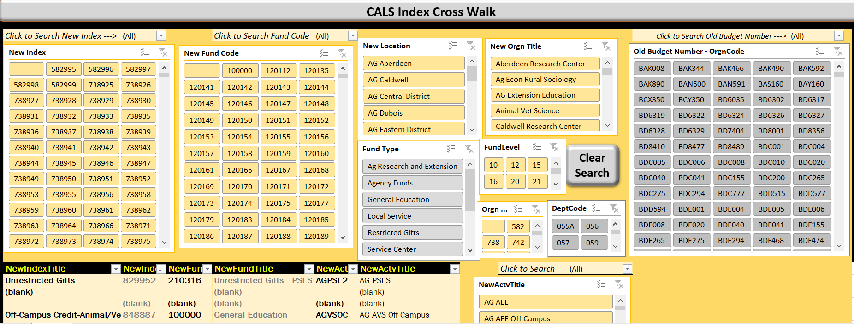
Dashboard
Training Sample

Slide 14
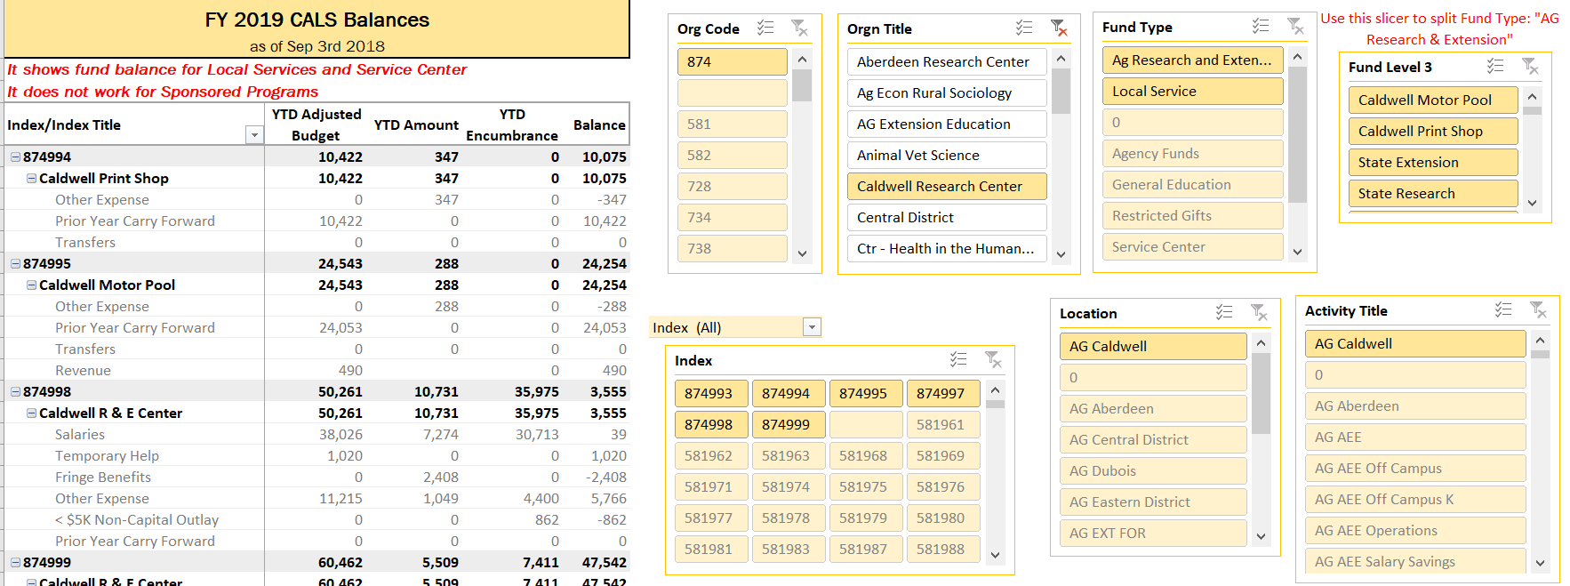
Dashboard
Training Sample

Slide 15
NEXT TARGET AUDIENCE - Faculty
Communication
-Through Leadership Team
- Through Finance Specialists
Training
- Through Finance Specialist
--Vandal Web Access How to navigate it.
Faculty
200+ people
NEW
Monthly
Monthly

