Slide 1
Argos, Excel and Pivot Tables
For DGAs by dummies

Slide 2
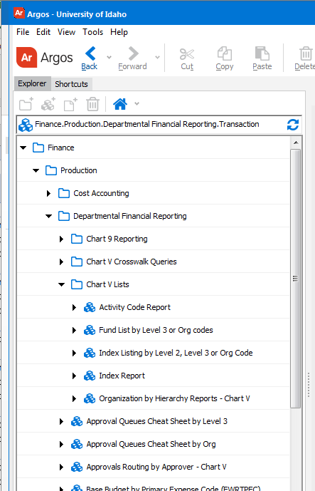
First things first, an Index list
Open Argos
1) Finance
2) Production
3)Department Financial Reporting
4) Chart V lists
5) Index reporting

Slide 3
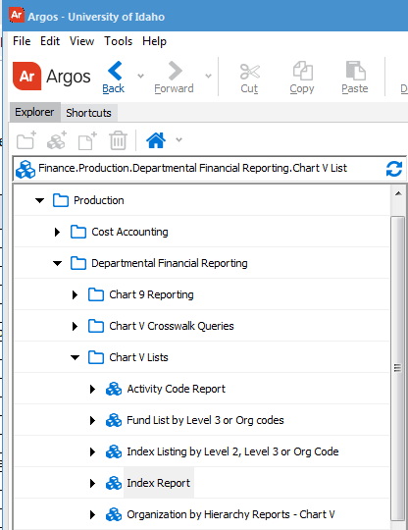
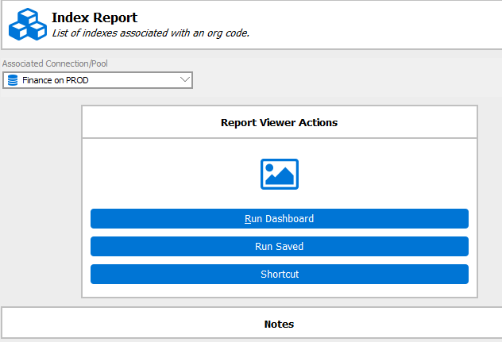
Step by Step

Slide 4
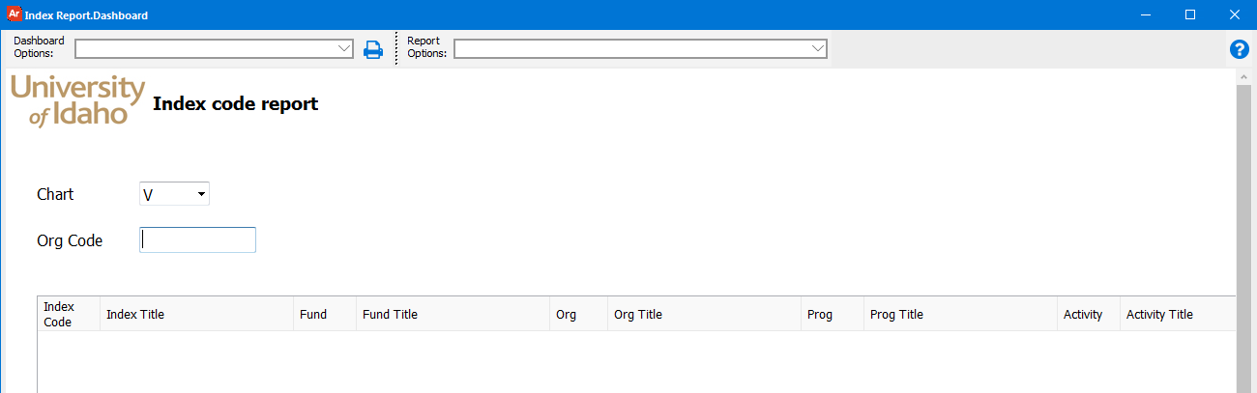
817

Slide 5
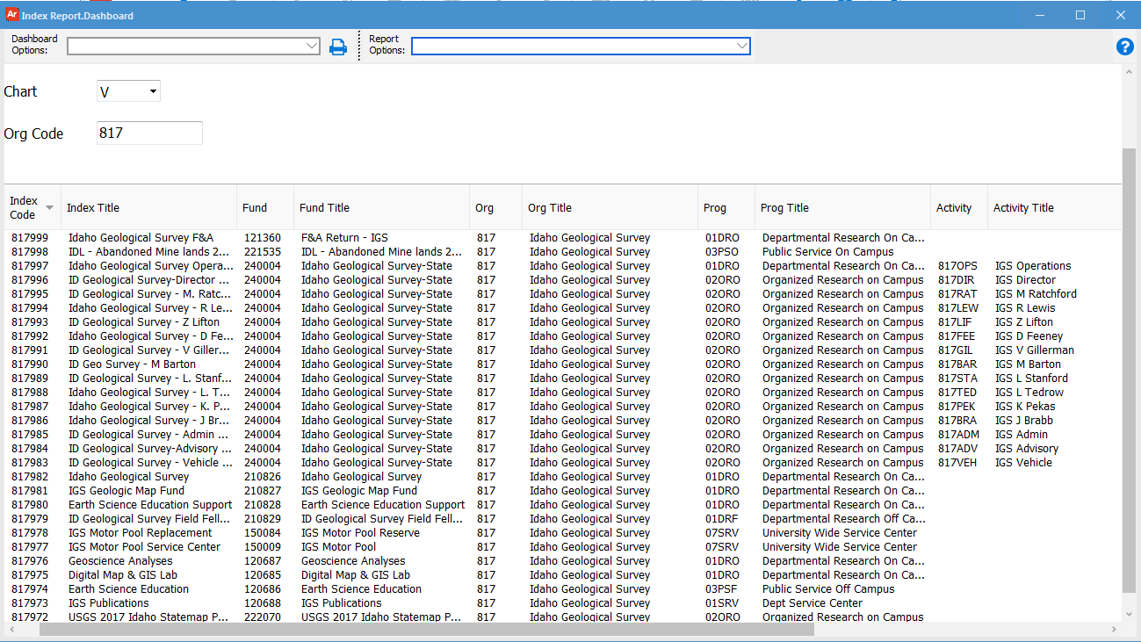
Sort by any category

Slide 6
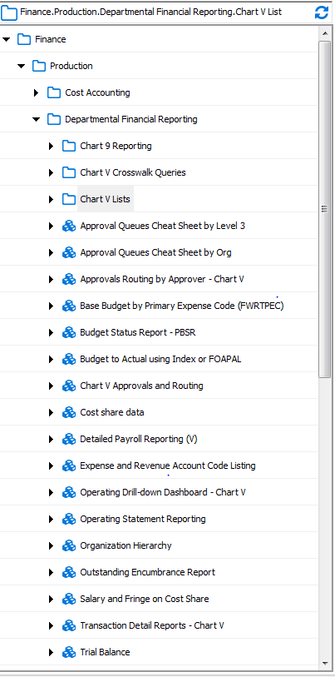
Transaction detail report
Open Argos
1) Finance
2) Production
3)Department Financial Reporting
4) Transaction Detail Reports

Slide 7
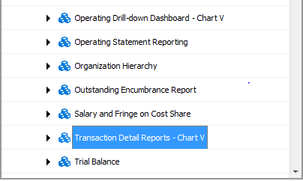
Second verse same as the first

Slide 8
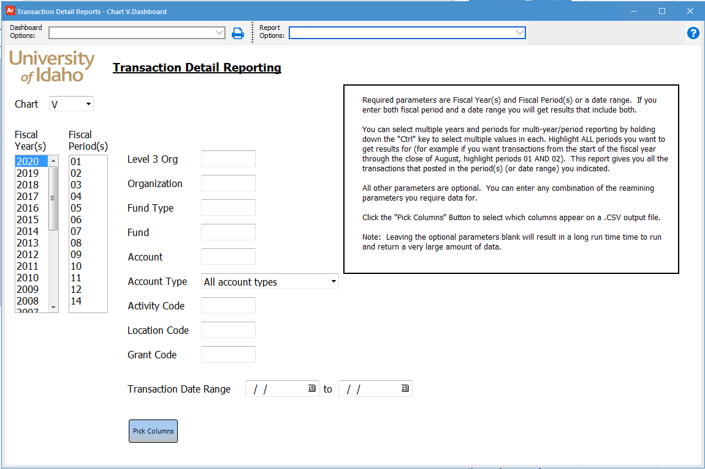
Select Chart
Select Fiscal Year
Select Fiscal Period(s)

Slide 9
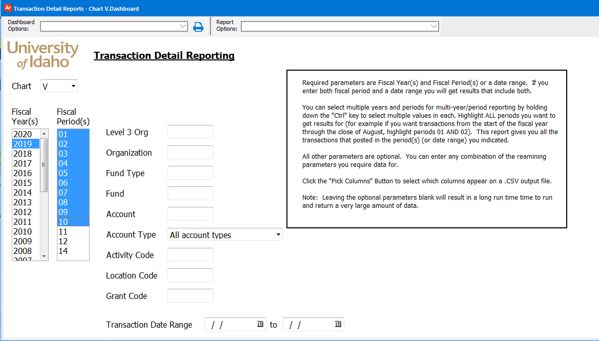
Enter Fund
240004

Slide 10
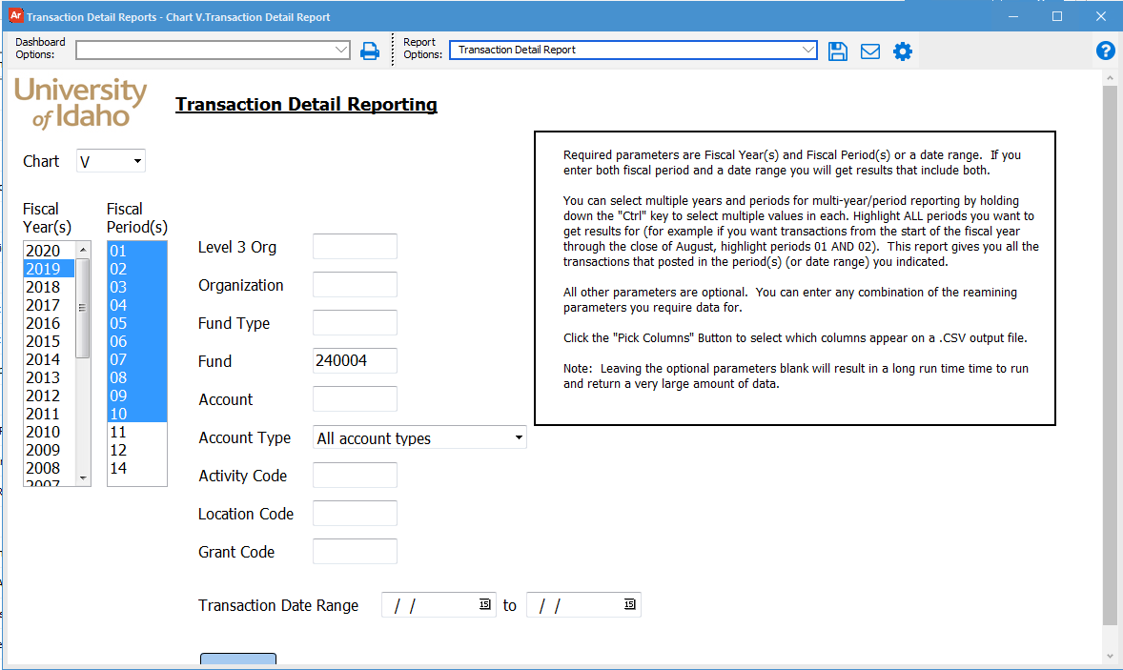

Slide 11
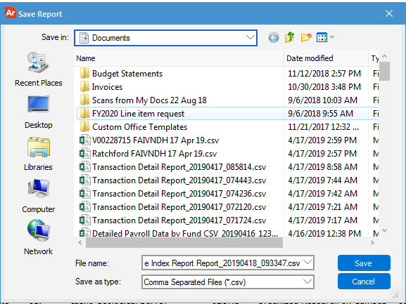
Go Vandals 6 May 19

Slide 12
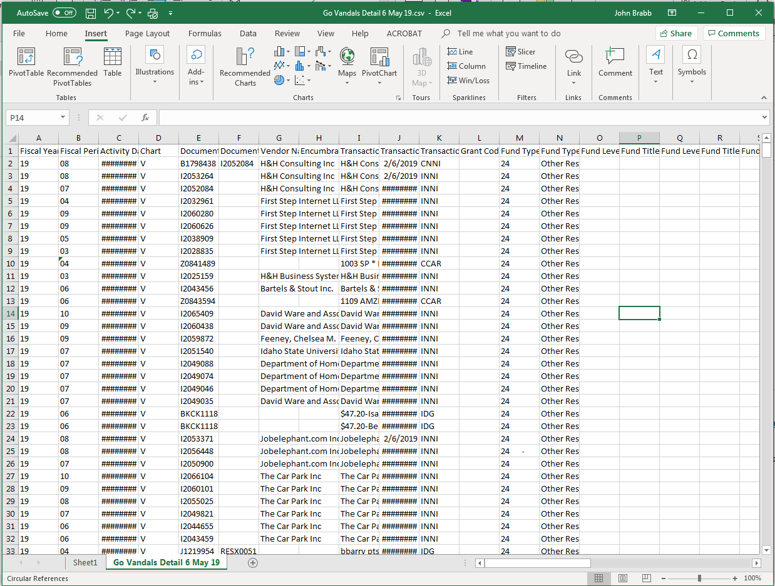
Select “Insert” from
the control bar
2) Select “Table”

Slide 13
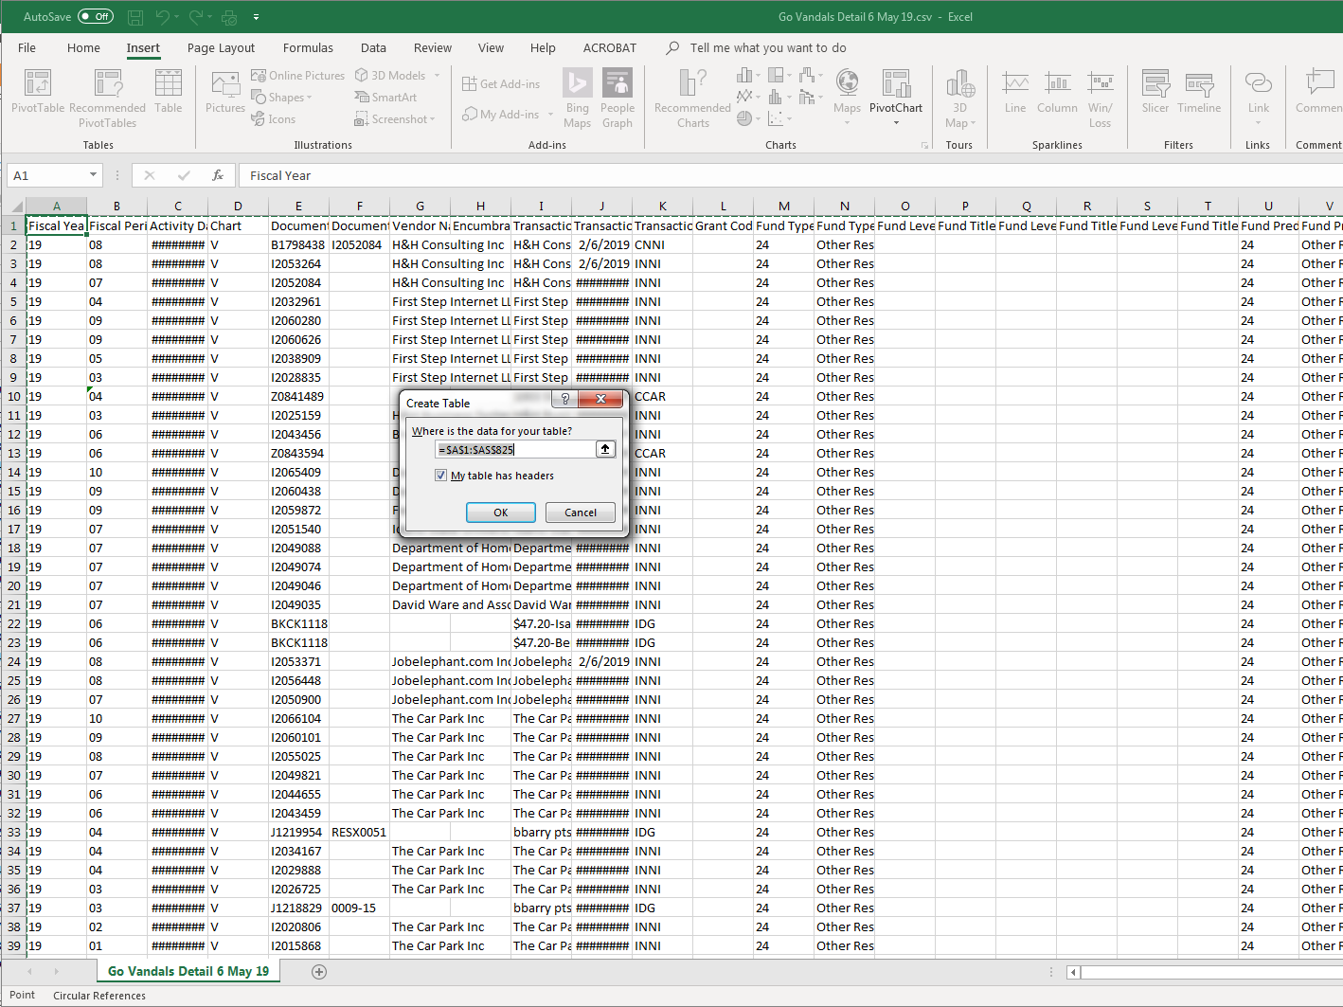
Select “My table
has headers”
2) Select “OK”

Slide 14
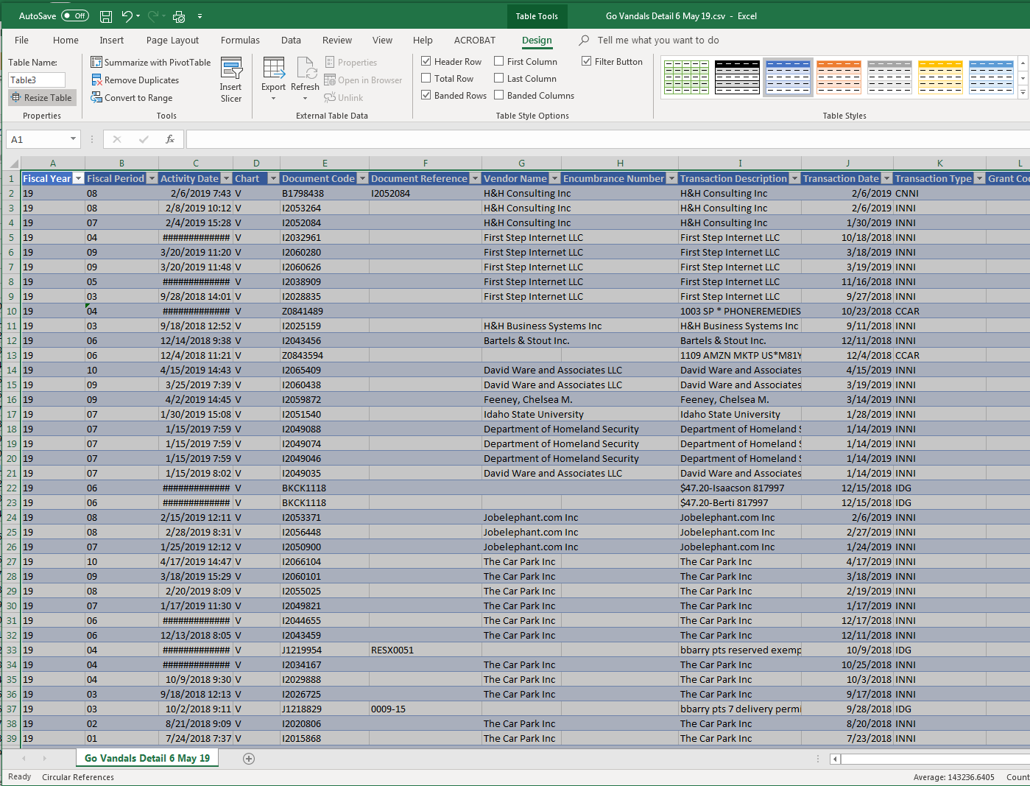
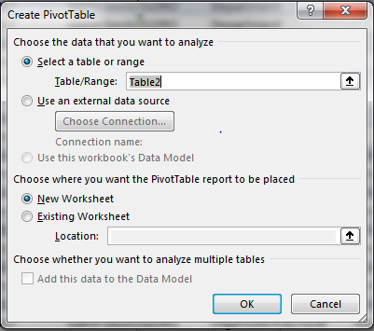
1) Select “Summarize
with pivot table”
2) Select “OK” in
“Create Pivot Table” box

Slide 15
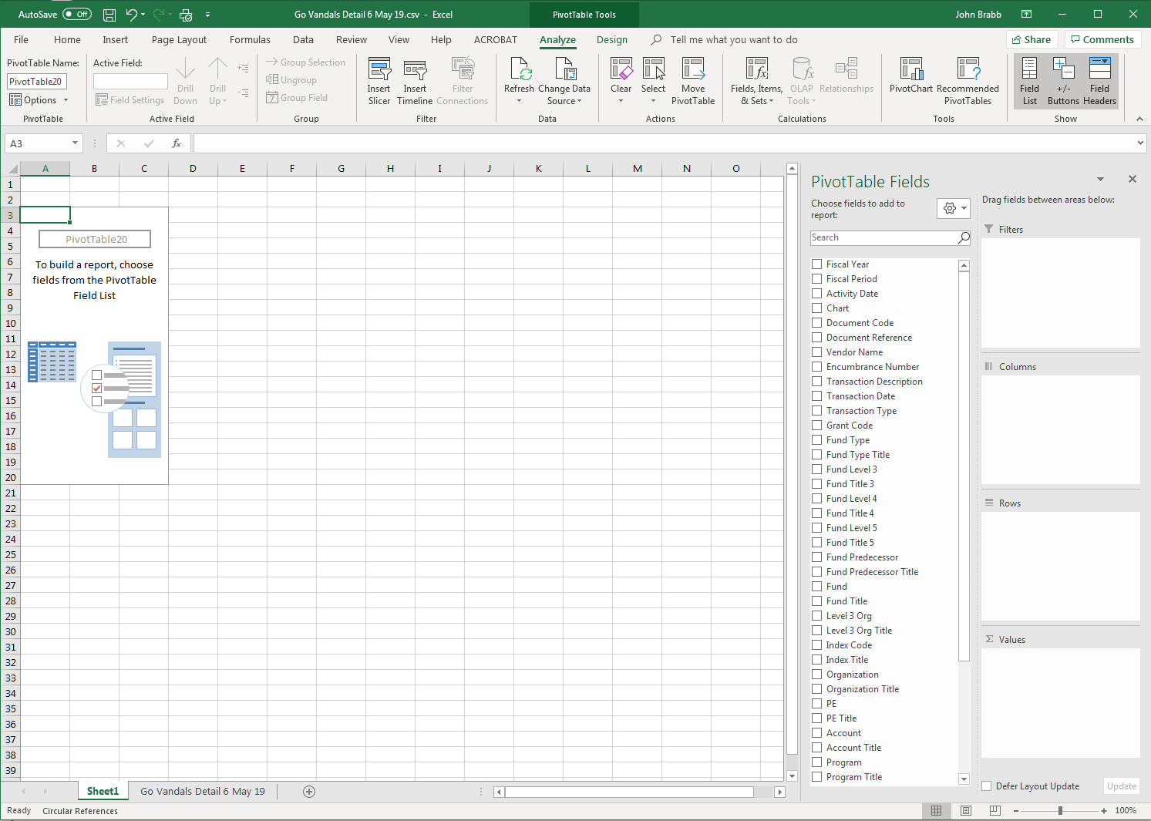
1) Select the fields you want in your table

Slide 16
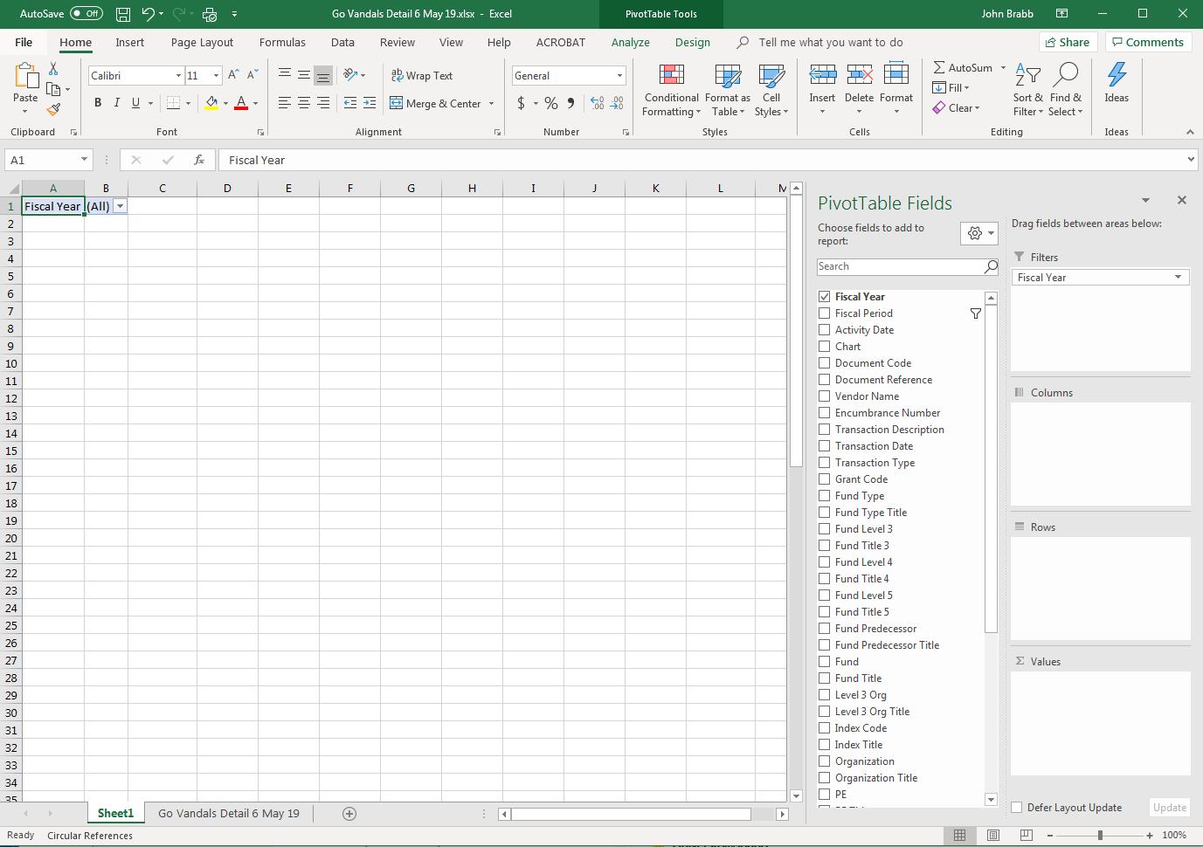
1) Select the fields you want in your table from column 1
1
2
2) Drag fields into the area where you want in column 2.
3) Your report auto fills in the spread sheet
4) This is a basic expense report.

Slide 17
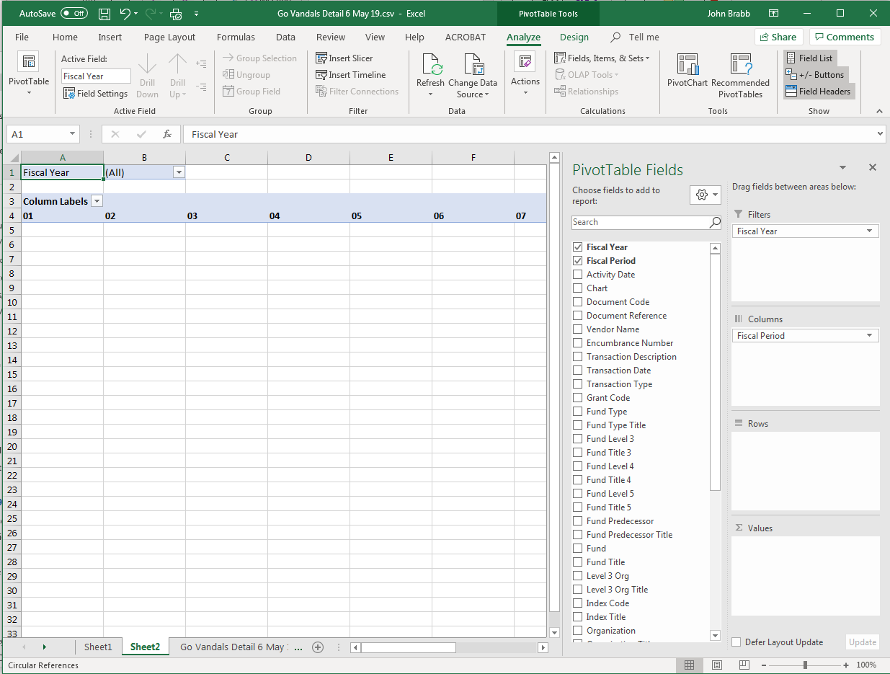

Slide 18
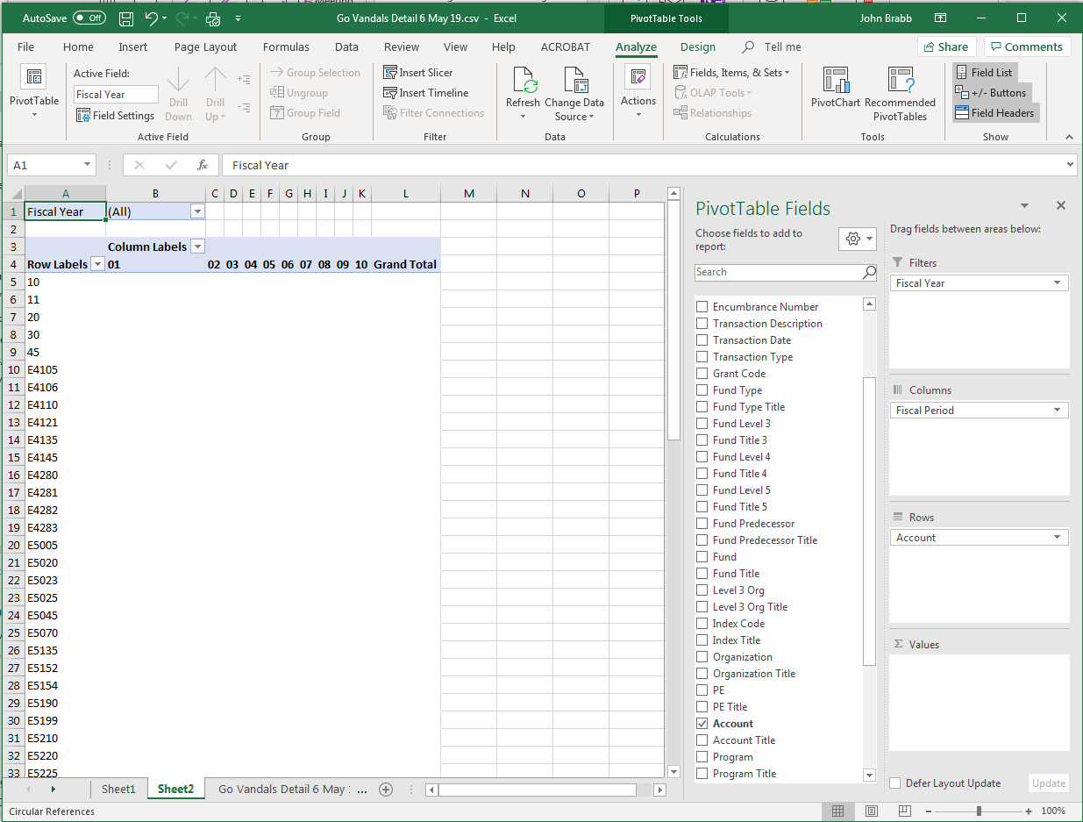

Slide 19
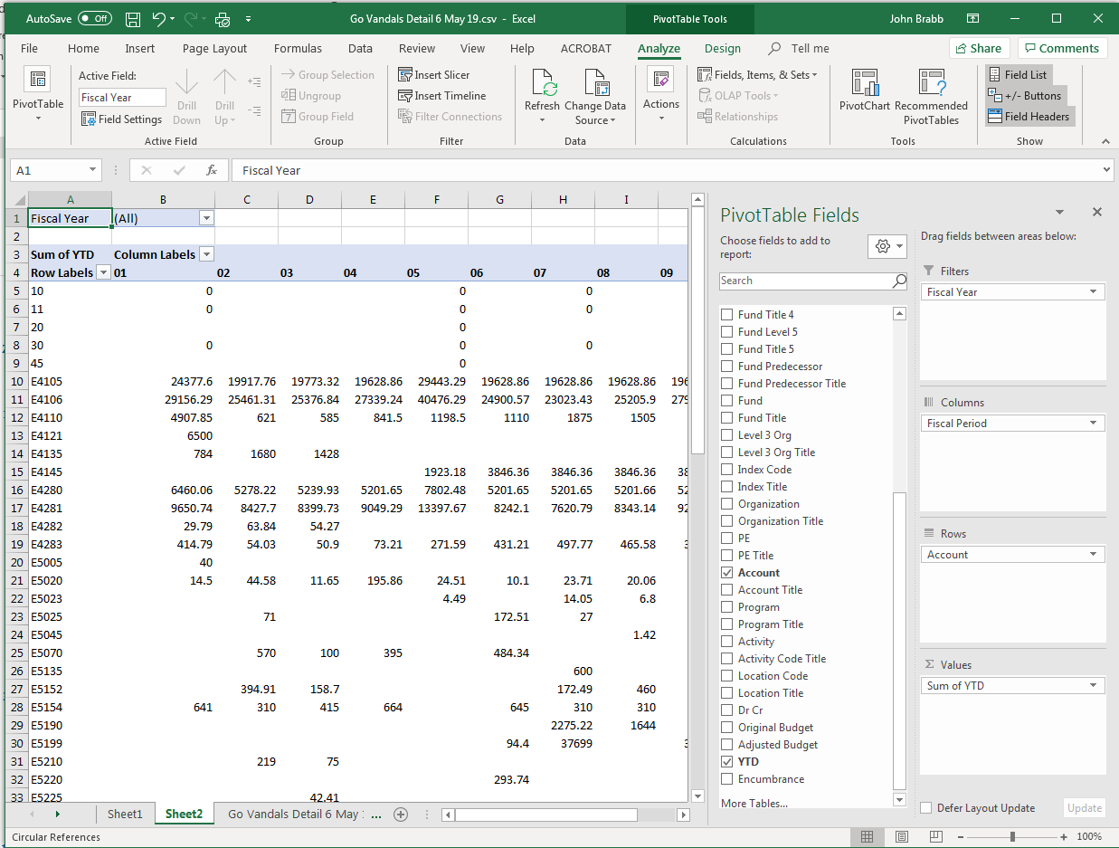

Slide 20
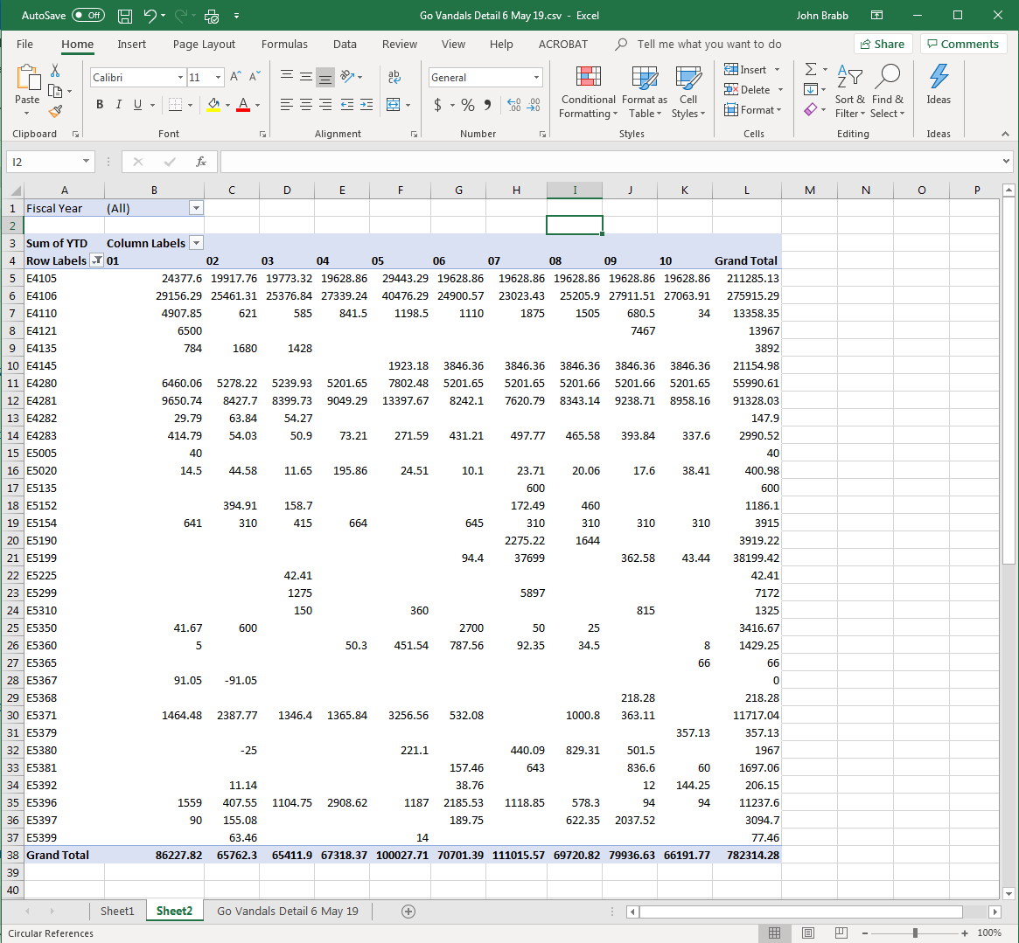

Slide 21
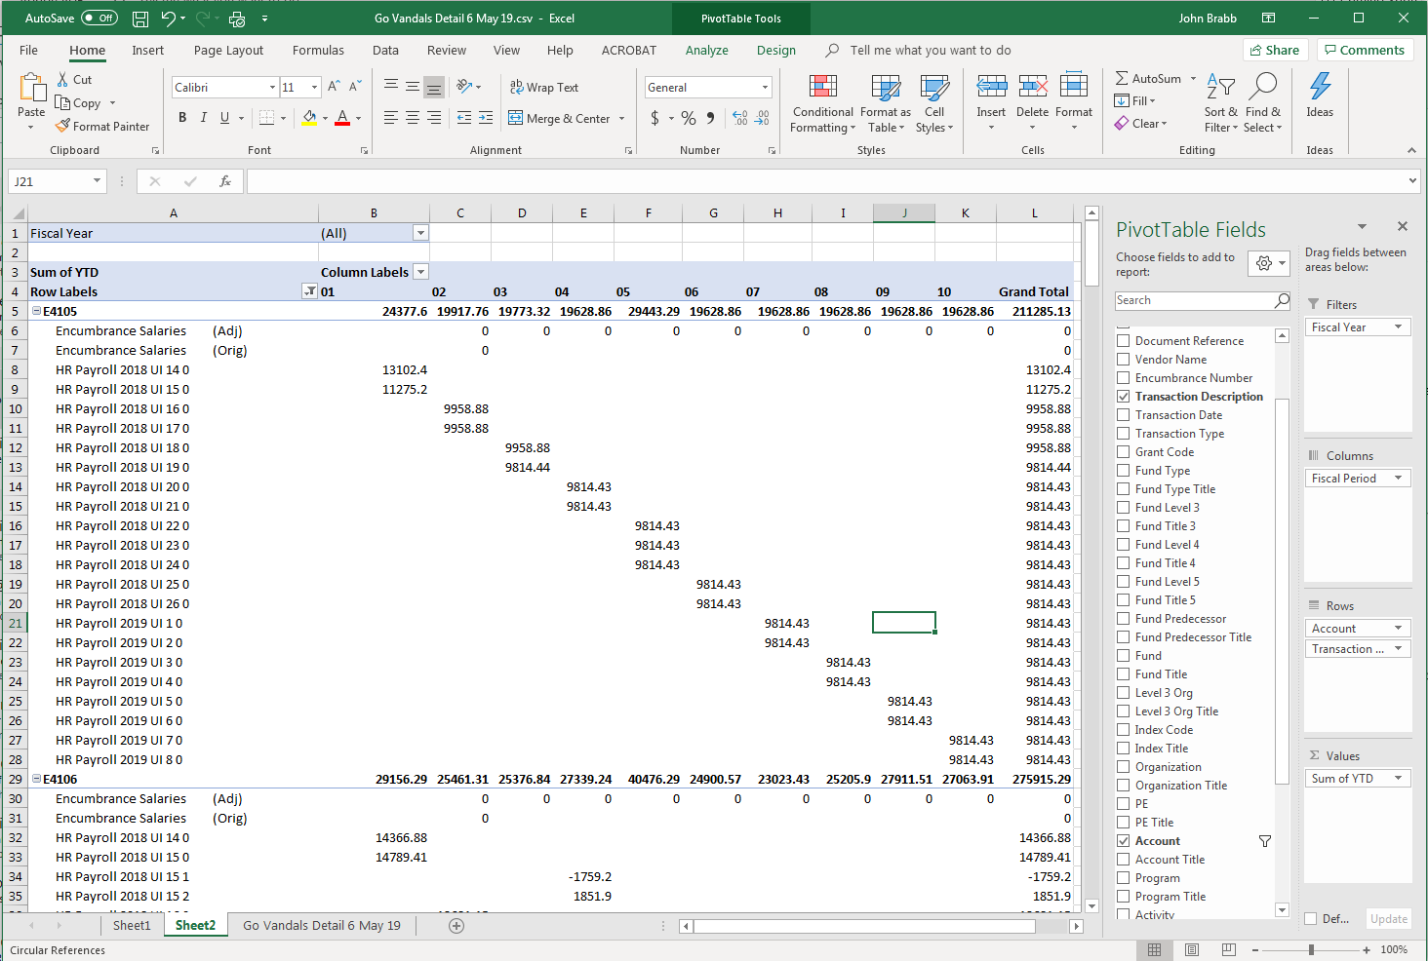
Soooooo, do ya want
more detail?
Let’s add a transaction
description

Slide 22
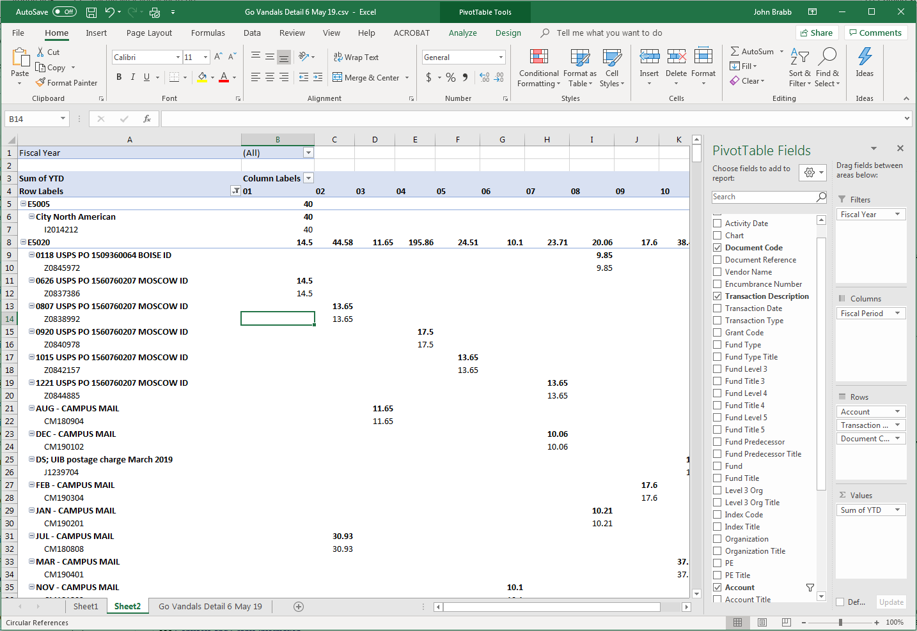
And then a
Document Code

Slide 23
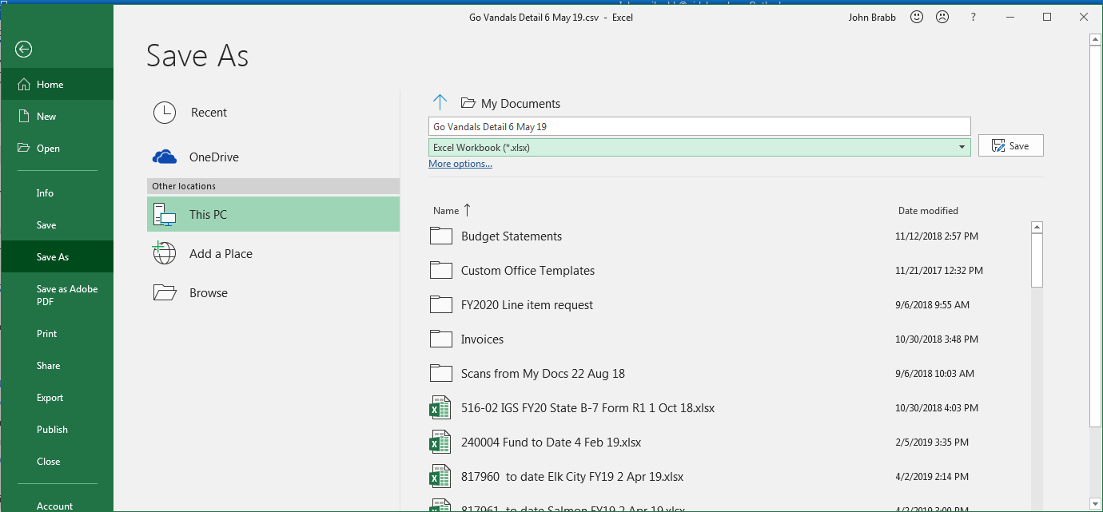
THE FINAL AND MOST IMPORTANT STEP!!!!!!!!
MAKE SURE YOU SAVE IT AS AN EXCEL FILE!!!!!!
If you save it as a CSV file, you will lose all your work.

