Slide 1
CUIBO MEETING
April 24, 2019

Slide 2
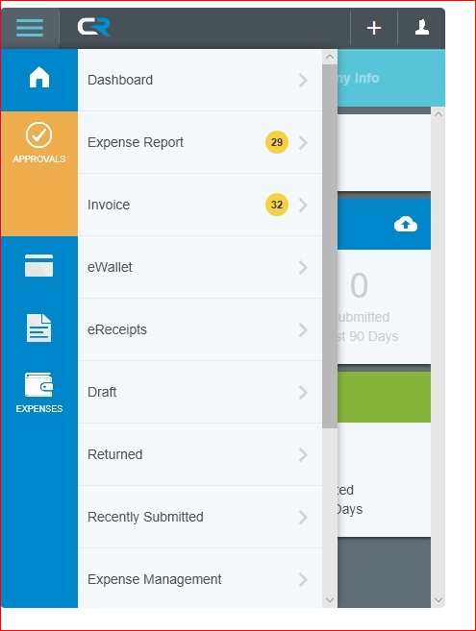

Terminology – Updating to match new technology
Menu
Reports – Pre-Approval Travel and Travel Expense Reports
Non Travel Expense Reports
Dashboard – convenient way to access items
eWallet –digital wallet a secure place to store payment information
eReceipts – a secure place to store receipt images
Hamburger icon – three-lined button in the CR Menu Bar

Slide 3
Who is Eligible for Chrome River
Ability to: Create and enter Reports, upload images, approve pending reports, view Reports and Images.
Must have an active employment record established on Banner.
Must have an active Accounts Payable mailing Address.
No Prior Training –except for the Purchasing Cardholders and record keepers.
If a student or group – must be traveling with an active employee and listed on their Travel Report or submitted on a Non Travel Report.

Slide 4
CR Expense Included
Employee Travel and Expense Payments
Combining: Travel Reimbursements and Travel Purchasing Card Expense into 1 document.
Purchasing Card Purchases both operational purchases and Non Employee Travel combined with Claim Voucher Employee Reimbursement
Can Be submitted on one form or in combination of the forms.

Slide 5
Which Program Should I use?
Vandal Web Travel and Claim Vouchers
Current expenses listed on the Purchasing Card ledgers.
Travel authorizations through April.
Chrome River TR and Expense -Effective Monday April 22:
All new pre-approvals including advances.
Purchasing card reconciliations.
Reimbursements to Employees for supplies or purchases

Slide 6
How Often should Reports be completed
Purchasing Card - Non Travel Reports.
Transactions are daily submitted to CR.
Recommend during the implementation period to continue submitting every 2 weeks.
Re-evaluate after Fiscal Year end.
Travel Expense Reports
Due within 60-90 days after the trip is completed.
Can enter multiple trips on 1 Pre-Approval Report
CR will provide a warning for any expense greater than 90 days.
Re-evaluate whether to “EXPIRE” Pre-approvals after Fiscal Year end.

Slide 7
Delegates – Best Practice
Delegates for the Cardholder or Traveler may:
Approval Delegates may:
Create Report Forms
Access their Settings Menu
Home Screen and Inquiry Reports
Copies of email for the user
CAN NOT approve expense that are routed to the user.
There are No limits to the number of delegates to a user, program was designed to limit the number as a more efficient method of business practice.
Temporarily approve Report Forms for another user.
Acting on their behalf as a proxy.
Examples: out of the office, vacations, delegation of work.
There are NO limits to the number of Approval delegates assigned to a user. Delegate WILL NOT be able to access the user’s Approval Screen, but will approve by documents forward to the delegate.
While you have assigned a proxy, as your approval, you can not be listed as an approver for another user.

Slide 8
Compliance Actions – Error Msg is instant
Warning
Alert the traveler to policies immediately.
Indicates that additional information is required in order to submit the expense report for approvals.
Alerting to outstanding expenses greater than 90 days.
Enter the response or correct the information and resubmit the report.
Violation
Indicates the expense can not be submitted for approval or payment based on established policies.
Remove or adjust the expense item before submitting the report.
If an over ride approval to the violation is made by Administration – it can not be processed in CR and could be subject to Payroll withholding.

Slide 9

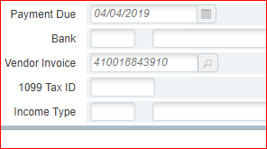
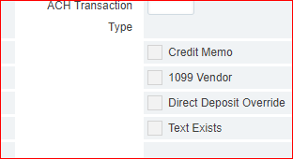
Integration with Banner Finance Invoice

Slide 10
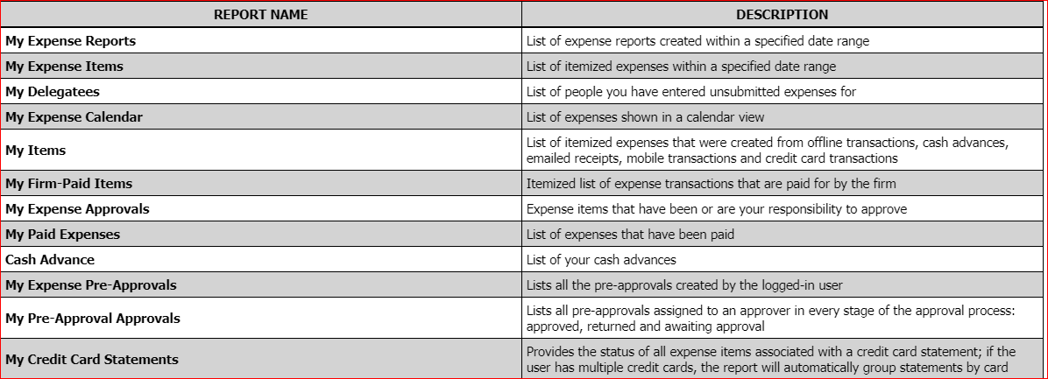
Standard User Reports –

Slide 11
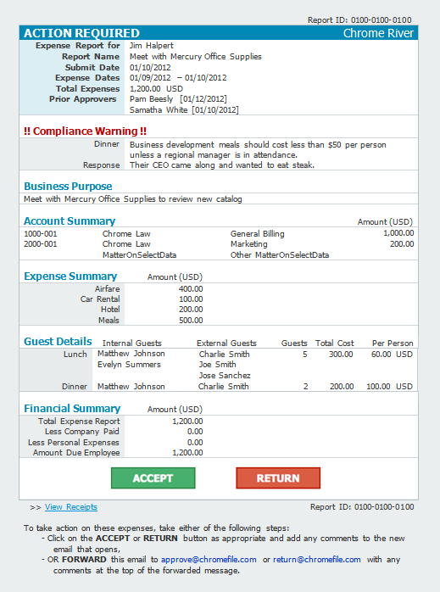

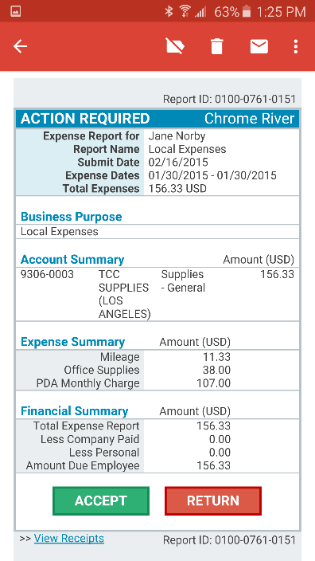

Approvals – be sure to review your settings and preferences.
EMAIL
APPROVALS

Slide 12
Calendar of upcoming Events
Deadlines to be aware of:
April 30, 2019 – Last Day to submit claims on Vandal Web.
April 30, 2019 – Vandal Web will be Retired for the departments.
May 1 through May 3, Accounts Payable will be completing the Vandal Web Processing.
May 3, 2019 any balances remaining on the purchasing card ledgers will be MOVED to the cardholder’s personal AR for repayment to the UI.
May 3, 2019 trips authorizations that are not completed will be re-created on Chrome River. (Not including blanket authorization.)

Slide 13
Program Updates
We currently are working through issues that will be updated soon:
Non Travel Tiles for the Purchasing Card transactions –
  Ecode updates
  Ability to split transactions
  Additional Misc. Tile

Slide 14
Contact Information
Questions: Email crtravel@uidaho.edu
Web Page - https://www.uidaho.edu/finance/controller/accounts-payable/travel-services
Welcome to Chrome River Travel and Expense!

