Slide 1

Animal Science?
Or Fiction
Report Results
Apply What Was Learned
Something is Known
Review and Summarize What Happened
Ask Questions? Problem has Arrived
Record Data
Hypothesize What May Happen
Conduct Test
Develop an Experiment
Cindy Kinder, Extension Educator-Gooding/Camas County
Shannon Williams, Extension Educator-Lemhi County
Notes:
Cindy

Slide 2
Objective for Workshop
What are Science skills
Teaching Science skills
  Inquiry based teaching and learning
Learn about the Scientific Method
Take home example science experiments
Challenge you to use and create more experiments.
Notes:
Cindy
Read the slide
POLL
What is your current knowledge of the scientific method?
None, A Little, Some, A lot
POLL
What is your current knowledge of inquiry based teaching and learning?
None, A Little, Some, A lot

Slide 3
What is Science?
Chemicals, elements, explosions
Exploring
Asking Questions “Inquiry”
Notes:
Cindy
So what is science ….. chemicals, elements, explosions. Right? That is it right?
No, Science is exploring…. How things work or don’t work together,
Science is asking questions …. Inquiry
Some people think they can’t do it because science has so much structure in it. That is not so; is exploring structure?? No
The only real structure science has is the process, the eight steps we will go over. Now if you are going to publish your findings in some scientific journal then there is some specific ways to set up your experiments so they have a true test. But it is still exploring !

Slide 4
What are Science Skills?
Predict, hypothesize, evaluate, state a problem, test, solve
Measure, collect data, use tools, observe, communicate, organize, summarize, analyze, reason
Graph, troubleshoot, redesign, compare
Notes:
Shannon
You hear out there, our kids need more science,
What does that mean??
Why do they need these skills? Job skills!
One way to teach that is using the scientific method.

Slide 5
How can you teach science ?
Lecture teaching: I going to tell you what you feed your project.
Inquiry based teaching: Ask questions, what are you feeding? Why do you feed it that way? What are other ways to feed? Other types of feeds.
Notes:
Shannon – lecture teaching
Cindy inquiry base teaching

Slide 6
Scientific Method
There is something known out in the world; research a topic
A question has arrived or a situation that is different
Hypothesize, give a theory or guess what may happen
Notes:
Cindy
The “process“ of science is very simple; there are eight basic steps. When you look up theses steps some may be labeled different but the concepts are the same.
Read the slide

Slide 7
Scientific Method
4. Develop a method and collect the needed items to test the hypothesis
  In your methods, there is a control and variable. In the control, nothing is changed. In the variable, one thing is different from the control.
Notes:
Cindy
Read the slide
This is where you can get really detailed. Remember to keep it simple.

Slide 8
Scientific Method
5. Do the experiment; Question; Change the method and redo the experiment
6. Record any information and what was seen, smelled, heard, etc.
7. Summarize and interpret what happened
8. Apply what we learned
Notes:
Shannon
Read the slide

Slide 9
Questions?
Report Results
Apply What Was Learned
Something is Known
Review and Summarize What Happened
Ask Questions? Problem has Arrived
Record Data
Hypothesize What May Happen
Conduct Test
Develop an Experiment
Notes:
Shannon
Questions
POLL
Are you using the Scientific Method in your current programs?
Yes ,No

Slide 10
Livestock & Horse Examples
Processed Feeds, Feeding Methods, Feed Storage
Water Quantity
Changing Feeds, Animal Behavior
Frame Size and Market Ready Weights
Notes:
Shannon
These are title of the examples we have in the handout.
Read the slide

Slide 11
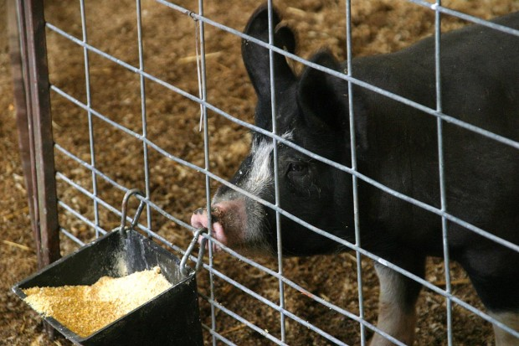
Feed Experiment
Research: Livestock feeds, processing, feeding methods
Situation: Feed is expensive.
Question: What type of feed method is best for me
I think __________ will be the best for my (animal).
Notes:
Cindy
We will go thru the scientific method with the feed experiment
1. What is known? There are different types of livestock feed processing. You can have members do some basic research Google it!
2. Question/Problem: What type of feed process is best?
3. Hypotheses is : I think __________ will be the best for my (animal).

Slide 12
Feed Experiment
5. What you need:
3 types of processed feed
Feeding Methods: pans, self feeder
Conditions: wind, rain
Journal
Notes:
Cindy
Step 4. Develop the method.
These several types of feed processes. What do the kids have at their house. You can even have a discussion about what types of feeds will work for different species or turn that into a science experiment. You can discuss what type of feeding methods will work at home vs at their pen at the fair – another experiment.

Slide 13
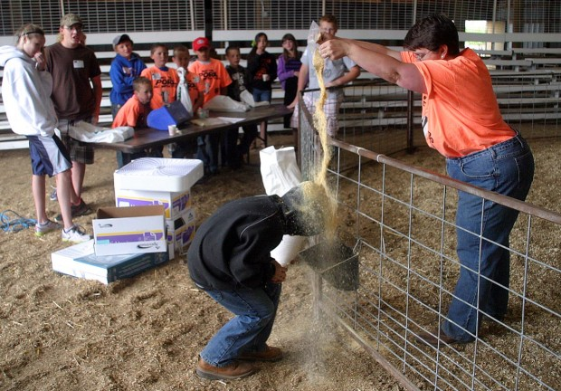
Feed Experiment
5. Do the experiment :
  Research: processed feeds, feeding methods
  Feed the 3 types of feed for each type of feeding method.
  http://magicvalley.com/lifestyles/this-little-piggy-went-to-swine-camp-in-gooding/article_8c2547b9-8135-5e0a-9f98-d272a533589a.html
Notes:
Cindy
Step 5 Do
Research:
Feed 3 times of processed feeds in each feeding method

Slide 14
Feed Experiment
6. Record data collected
7. What happened?
8. Which feeding method are you going to use?
Notes:
Cindy
Step 6 Record data collected
Step 7 Interpret the data, what happened
Step 8 Apply what was learned: Which feeding method are you going to use?
This is how to use the science experiments in the handout.

Slide 15
“Practicing” the Scientific Method
All kids questions are good questions
Notes:
Shannon
Shift gears and practicing the scientific method.
As leaders who want to help youth develop their science skills,
ALL youth questions are valid questions. You may be thinking Holy cow how am I going to do that!
Have them rethink the question help them narrow the focus.

Slide 16
“Practicing” the Scientific Method -Probing Questions
SPAM Test
  Simple
  Practical
  Answerable
  Measurable
Notes:
Shannon
As the questions toward the experiment develop, keep the SPAM test in mind.
Is the question simple? Are you just looking at 1 item, one thing, measuring one thing
Is the question practical? Can you easily get all the “tools” you need to answer the question? Is there enough time? Is the investigation you will do to answer the question safe?
Is the question answerable? Can we repeat the experiment?
Is the question measurable? Is there something to measure/count that will answer the question?

Slide 17
“Practicing” the Scientific Method -Probing Questions
Researchable questions
Experiment questions
Notes:
Shannon
Researchable: Not all questions will lead to an experiment due to situation or information. Some questions can be answered with just research. That is okay!!! Have the youth do the research and read and reach a conclusion. Does the research support/prove or disprove their hypothesis? Example: My animal will have a higher average daily gain on corn vs barley. Simple – yes, practical – yes, answerable – yes, measurable – yes. Problem: don’t want to mess with animal’s diet that is headed to fair. Question is researchable as there is calculations and can run rations using the two different feeds.
Experiment questions: Lots of questions can lead to an experiment, just have to be creative and think outside the box. Lets look at average daily gain in a different way. Feed has to get into the animal to have a high adg. Have youth “build” an animal out of small box or bottle. Determine what they are going to feed it, how much capacity it has at each feeding and how many times a day they are going to feed it. Send the “critter” home with kids and plenty of feed. Have them feed their “critter” between meetings following the guidelines they set. At the next meeting have them determine adg. If they “forgot” to feed a couple of times or underfed, their “adg” will be lower.

Slide 18
“Practicing” the Scientific Method -Probing Questions
Helping the kids learn for themselves
How..
Why…
What….
Notes:
Shannon
Asking good questions is an “art”. Stay away from yes/no questions. Ask questions, that make them think, and give them time to think about the answer. Don’t jump-in with a ready answer just because everyone is quiet. Maybe re-ask the question with different words or break it down into simpler parts. How, Why, What are good ways to start the question.

Slide 19
How to Use Science Experiments
Individuals
Club Activity
County or District Education Activity
Shannon’s example- Demonstrations
Cindy’s example- in newsletters
Notes:
Cindy and Shannon
You can conduct science experiments in a variety of ways as individuals, in a club setting or at a larger education day type activity.
Shannon hopes to have the older youth in Lemhi County do their demonstration on an experiment they conducted. This would be a great way to have members reflect on the experiment.
Cindy will have the experiments printed in the county newsletter; one per month. The introduction will explain what the experiments are for, then the experiment and then probing questions will be asked of the previous months experiment. Hoping to have members reflect on what they did. Some members will pilot keeping a journal of science experiments.

Slide 20
How will you apply what was taught today?
We want to learn from you
Tell us
Notes:
Shannon
How are you going to use this in the programs and activities you are associated with?
POLL
How do you plan to use what you have learned?
Share with leaders, Share with others, Do as an Individual activity ,Do as a club Activity
Do as County or District Education Activity, Demonstrations requirement, In newsletters, Other

Slide 21
ADG Experiment

Slide 22
Your Challenge
Create your own experiment
Use the scientific method template provided
Share it
Notes:
Cindy
Hopefully, you now have a better understanding of the basic scientific method, we explained to you about probing questions and some other science inquiry
We have created a few livestock experiments and showed you some other resources for other experiments. I would like to challenge you in creating your own experiments. All you have to do is follow the template provided. I would also like you to share with the State 4-H Office so all science experiments can be posted to the website.
POLL
Was the information presented?
New to you, Reinforced what you know, Nothing new

Slide 23
Science Experiment Template
Step 1 What do you know, look it up
Step 2 New situation, problem or questions has arrived
Step 3 Hypothesize
Step 4 Develop methods and get materials
Step 5 Do the experiment

Slide 24
Summary for Workshop
What are Science skills
Teaching Science skills
  Inquiry based teaching and learning
Learn about the Scientific Method
Take home example science experiments
Challenge you to use and create more experiments.
Notes:
Shannon
Learn about the Scientific Method the inquiry base learning
Take home example science experiments
Challenge you to use and create more experiments.
Thank you.
POLL
After this workshop what is your current knowledge of the scientific method?
None, A Little, Some, A lot
POLL
Looking back, after this workshop, what was your knowledge BEFORE of the scientific method?
None, A Little, Some, A lot

