Slide 1
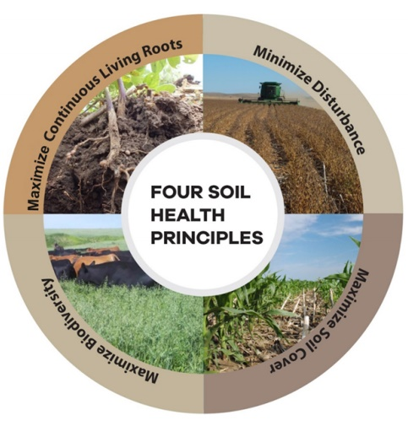
Soil Health Workshop
Mike Thornton
Stanislaw Samborski
Notes:
Add u of I logo

Slide 2
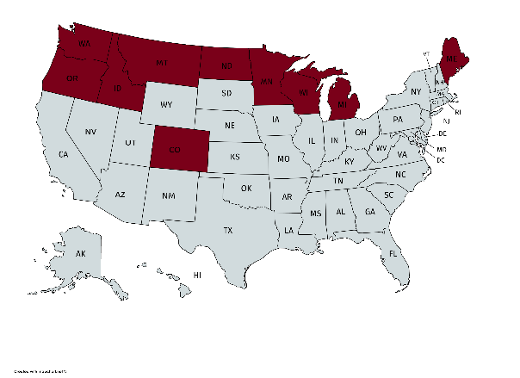
Potato Soil Health Project
Proposal was submitted to the USDA-SCRI in 2018 and funded for ~$8 million
Four Years (requesting extension to 2023)
10 States
ME, MI, WI, MN, ND, CO, ID, WA, OR (and MT indirectly)
24 Collaborators + industry and technical advisory committees
1 PD (Carl Rosen),
3 Co-PDs
16 Co-PIs, and 3 collaborators
Started in September 2018

Slide 3
Determine soil health indicators across U.S.
Biotic (OM, respiration, extractable protein)
Physiochemical (Texture, aggregate stability, compaction, nutrient content)
Soil microbiome (Community analysis of bacteria/fungi populations)
Pathogens (Verticillium, Common Scab, Root Lesion)

Slide 4
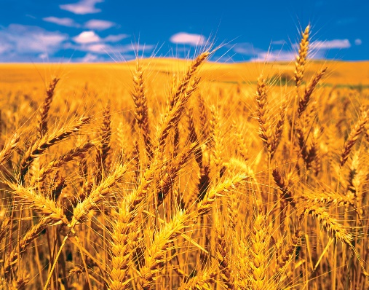
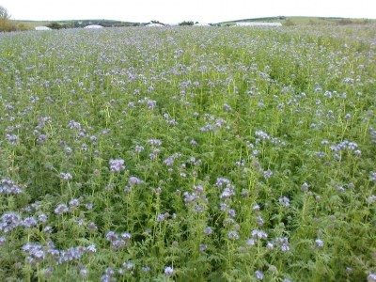
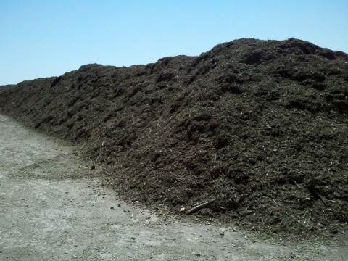
Identify management practices that impact soil health
Long-term Rotation Study
3-year rotation
(potato – silage corn – spring wheat - potato)
2-year rotation
(spring wheat - potato – spring wheat - potato)

Slide 5
Treatments – 2020
3-year rotation
Trt | Fall 2018 | Summer 2019 | Fall 2019 | Spring 2020 | Summer 2020
1. | No treatment | Russet Burbank | No treatment | No treatment | Silage corn
2. | No treatment | Russet Norkotah | No treatment | No treatment | Silage corn
3. | Metam sodium | Russet Norkotah | No treatment | No treatment | Silage corn
4. | No treatment | Russet Norkotah | No treatment | No treatment | Silage corn
5. | No treatment | Russet Norkotah | No treatment | Compost (10 ton/a) | Silage corn
6. | No treatment | Russet Norkotah | No treatment | Compost (10 ton/a) | Silage corn
2-year rotation
Trt | Fall 2018 | Summer 2019 | Spring 2020 | Summer 2020
1. | No treatment | Spring wheat | No treatment | Russet Burbank
2. | No treatment | Spring wheat | No treatment | Russet Norkotah
3. | No treatment | Spring wheat | Metam sodium | Russet Norkotah
4. | No treatment | Summer green manure | No treatment | Russet Norkotah
5. | No treatment | Compost (10 ton/a) fb spring wheat | No treatment | Russet Norkotah
6. | No treatment | Compost (10 ton/a) fb green manure | No treatment | Russet Norkotah

Slide 6
2-year rotation (2020)

Slide 7
3-year rotation (Fall 2020)

Slide 8
3-year rotation (Fall 2020)

Slide 9
Rotation Crop (2021)

Slide 10
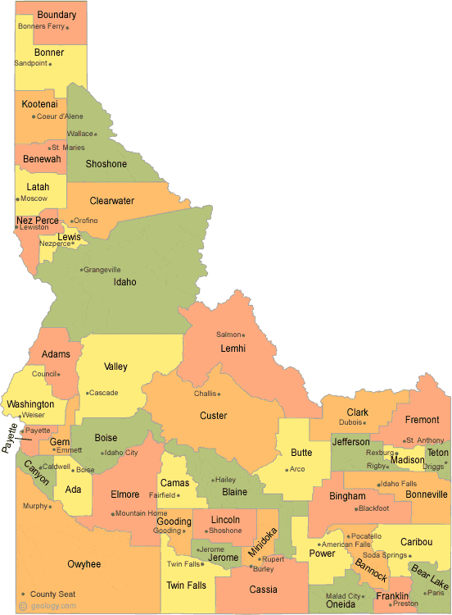
Identify factors in commercial fields associated with soil health

Slide 11
Identify factors in commercial fields associated with soil health
Year | # of fields | Norkotah | Burbank | Teton | Ranger | Norland
2019 | 2 | 2
2020 | 4 |  | 2 |  |  | 2
2021 | 6 |  | 1 | 2 | 1 | 2
2022 | 4

Slide 12
Do any of the soil factors explain variability in yield?
2020 - Burbank
2021 - Teton

Slide 13
Do any of the soil factors explain variability in yield?
2020 - Burbank
2021 - Ranger

Slide 14
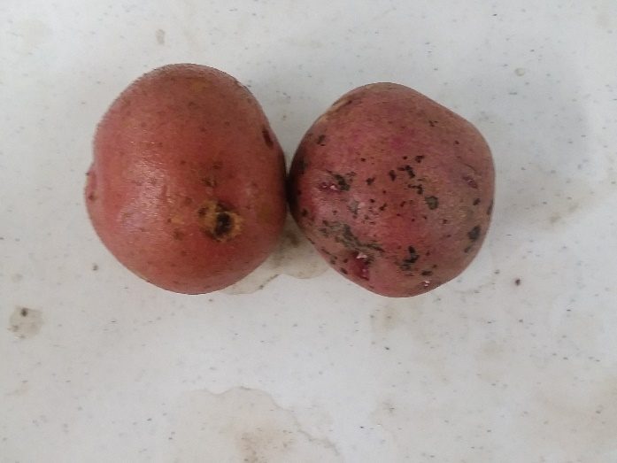
Chloropicrin strip had:
Higher in Specific Gravity
No common scab in either strip
Less black scurf (2021)
2020 – vs Metam K
2021 - vs no fumigant

Slide 15
Plans for 2022:
Returning to 2 fields with 3-year rotation (2019), and 2 with 2-year rotation (2020)
Spin-off projects:
Bruise susceptibility
Nematode community analysis
Soil pathogens

Slide 16
Project website:
https://potatosoilhealth.cfans.umn.edu

