Slide 1
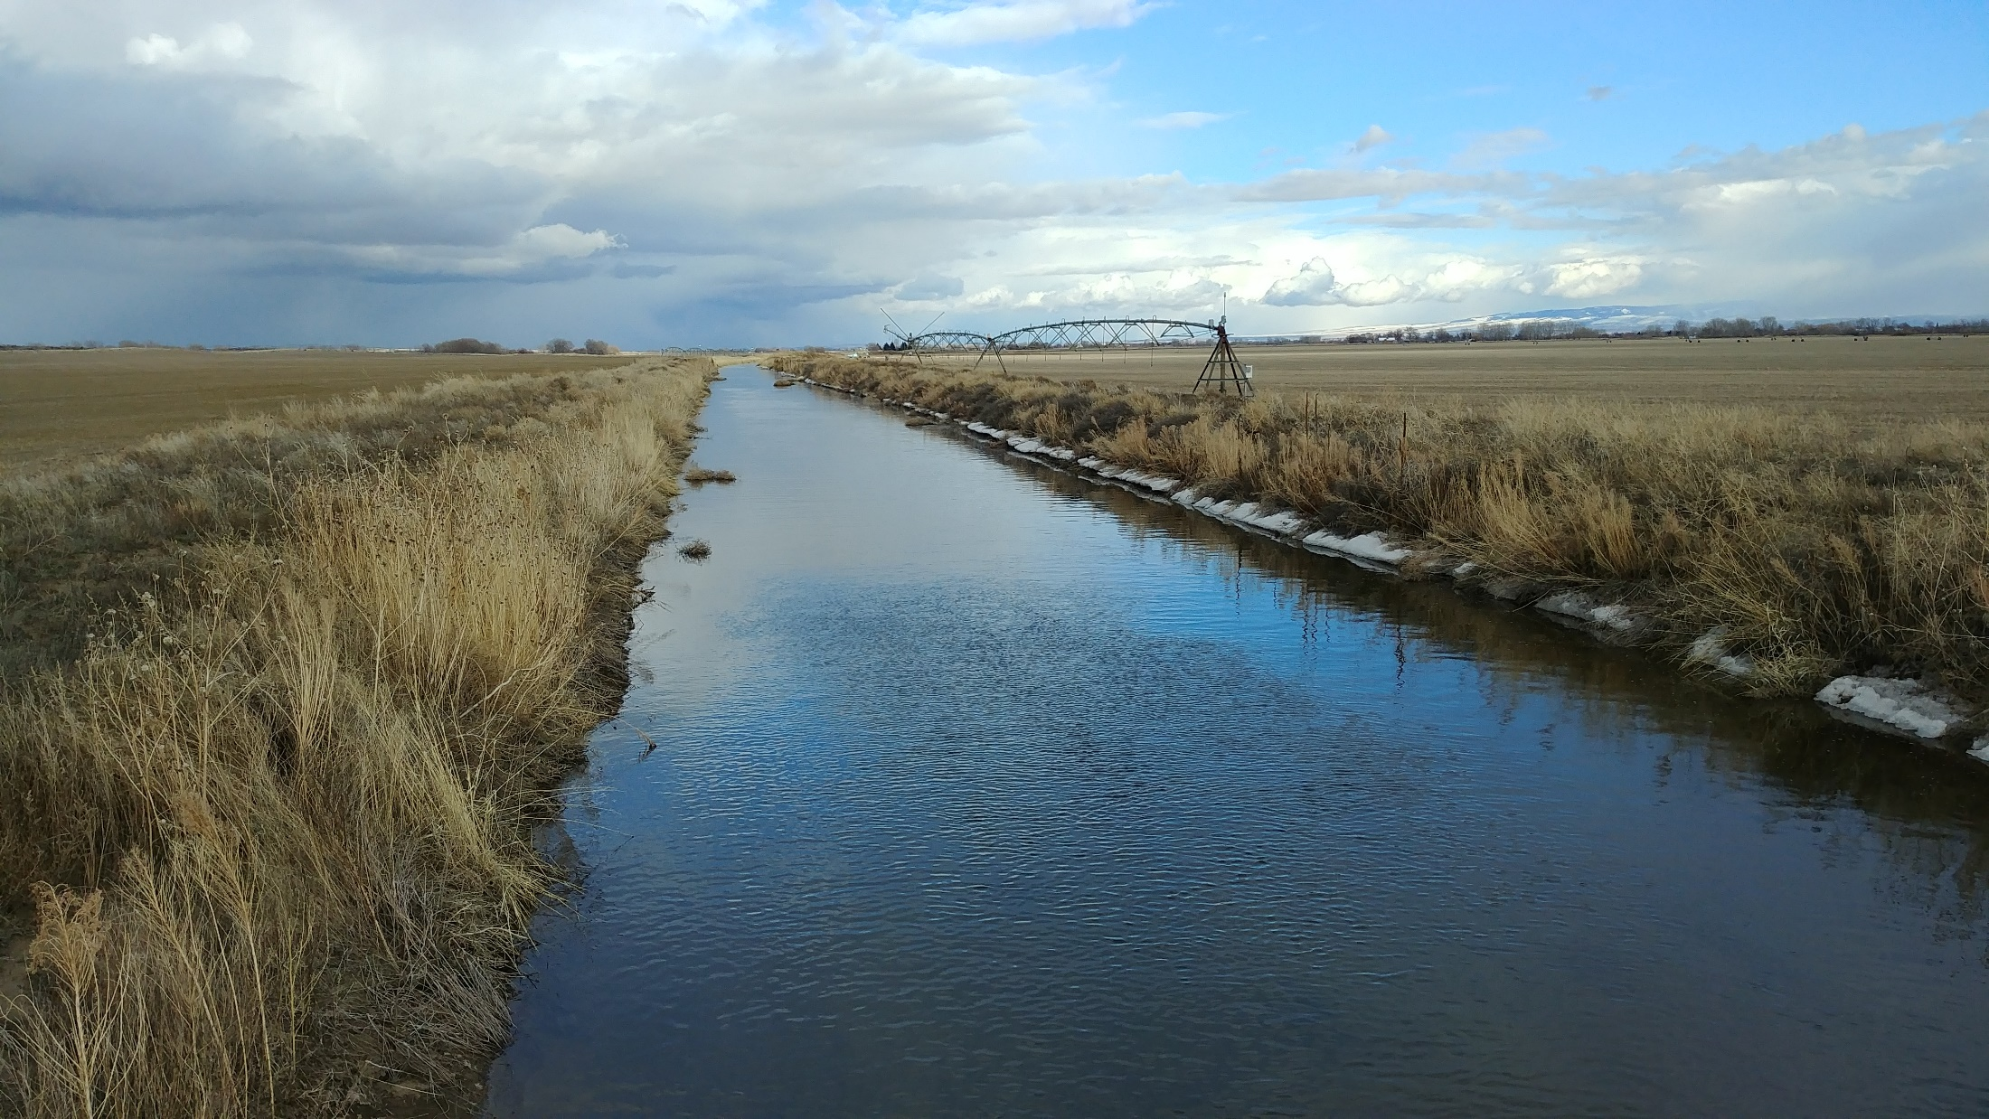

Water flows downhill…
…unless it doesn’t
What happens when physical and paper water are not the same thing?
Rob Van Kirk
Science and Technology Director
Henry’s Fork Foundation
Ashton, Idaho
Idaho Law Review Water Law Symposium, March 22, 2024

Slide 2
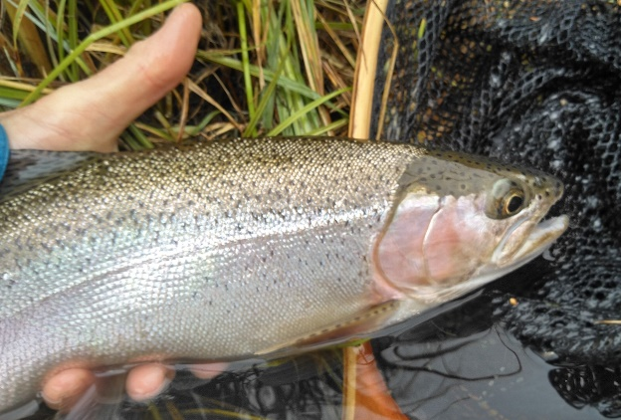
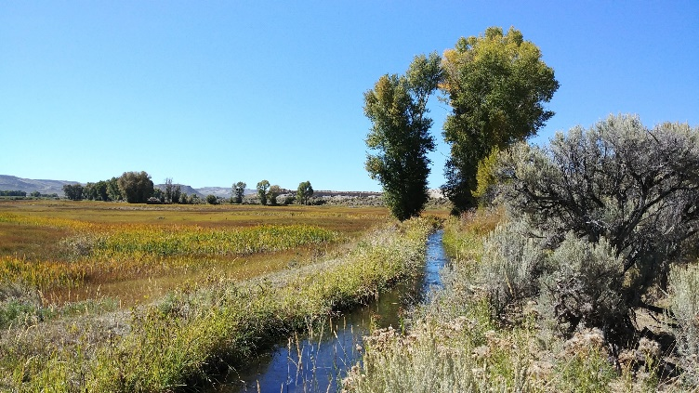
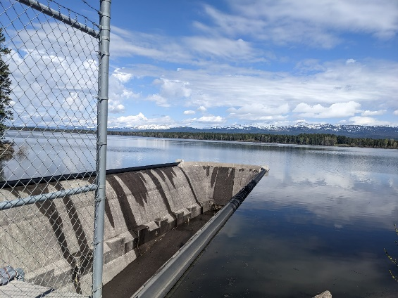
Outline
Perspective from the Snake River headwaters
What is “natural flow”?
Groundwater-surface water interactions
Moving water uphill
Intersection of law, physics, and administration

Slide 4
Trout Fisheries in Snake River Headwaters
World renowned
Economically important
Sociologically important
Span two states
Highly affected by reservoir storage and delivery: Jackson Lake, Palisades Reservoir, Island Park Reservoir
Higher reservoir draft leads to
  Lower fall/winter outflow during refill
  Higher alteration of natural hydrologic regims
  Poor water quality in and downstream during summer
Overarching conservation goal: keep reservoirs as full as possible

Slide 5
That goal is affected by streamflow obligations 100s of miles downstream
427,000 ac-ft spring/summer
(ESA)
5,600 cfs winter 3,900 cfs summer (legal settlement)
500 cfs (ESA)
0 cfs (policy)

Slide 6
Natural flow
Hydrologic definition: “flow that would be in the river in absence of storage, delivery, and withdrawal”

Slide 7
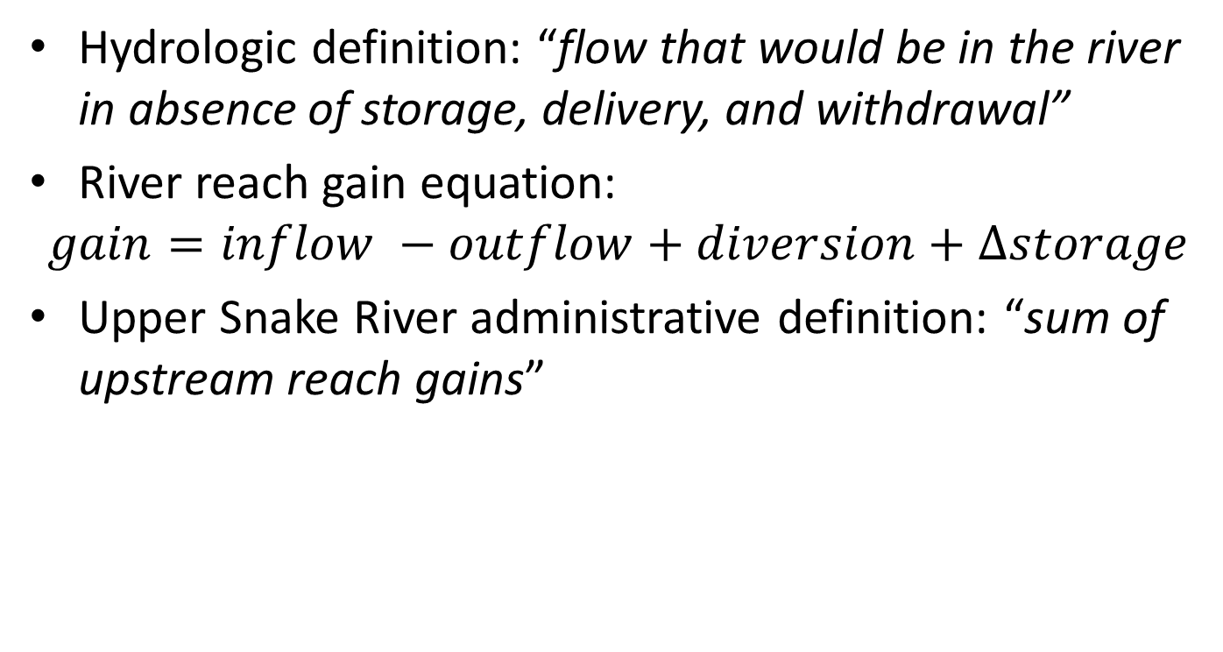
Natural flow
Hydrologic definition: “flow that would be in the river in absence of storage, delivery, and withdrawal”
River reach gain equation:
$$gain=inflow −outflow+diversion+Δstorage$$
Upper Snake River administrative definition: “sum of upstream reach gains”

Slide 8
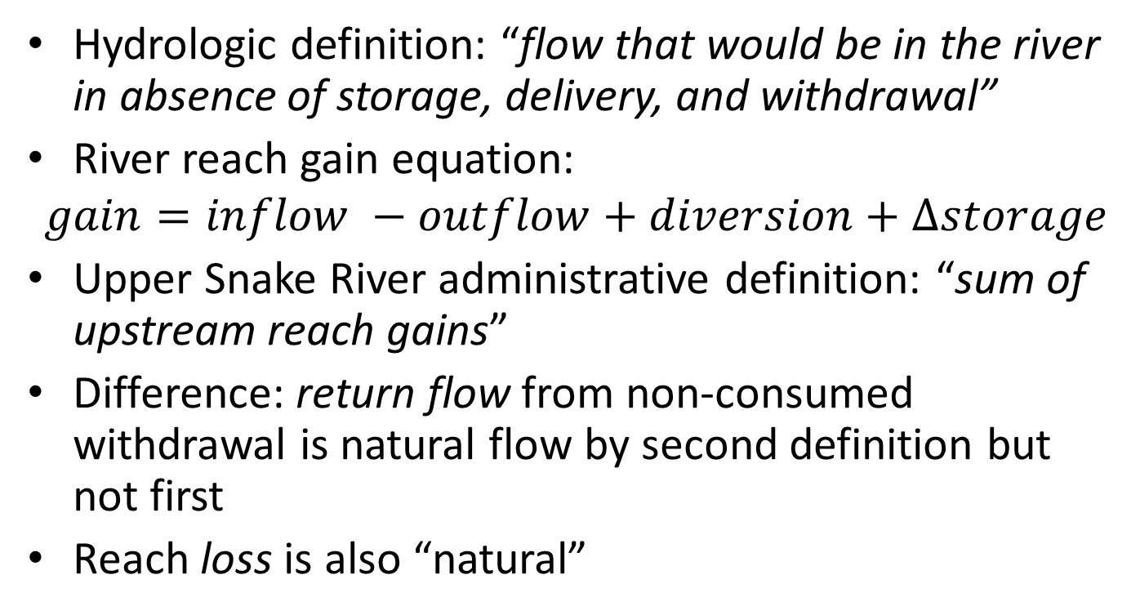
Natural flow
Hydrologic definition: “flow that would be in the river in absence of storage, delivery, and withdrawal”
River reach gain equation:
$$gain=inflow −outflow+diversion+Δstorage$$
Upper Snake River administrative definition: “sum of upstream reach gains”
Difference: return flow from non-consumed withdrawal is natural flow by second definition but not first
Reach loss is also “natural”

Slide 9
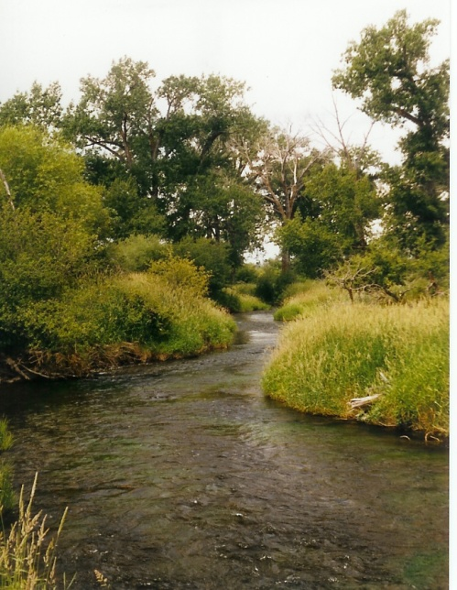
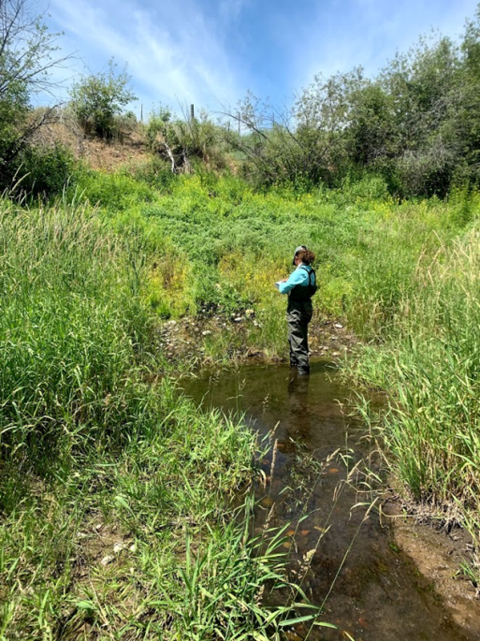
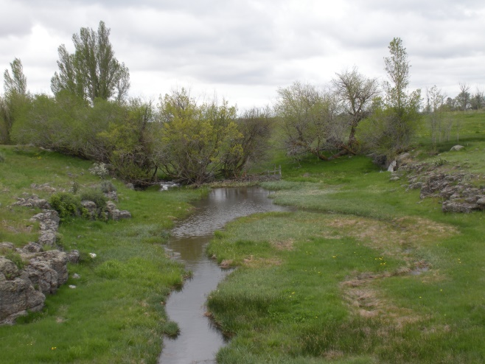
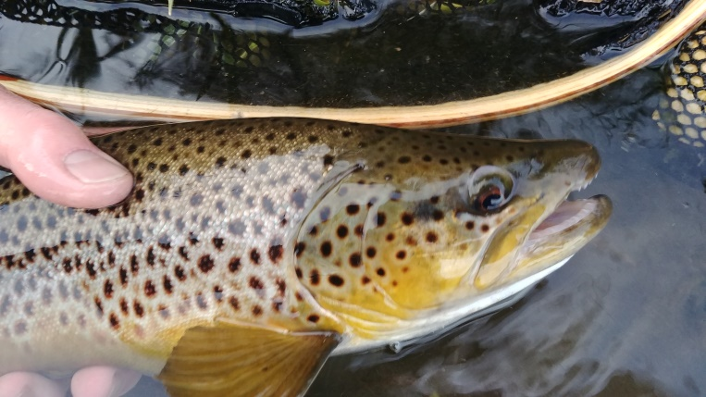
Irrigation seepage has been a major component of hydrologic regimes since late 1800s, providing:
Improved water quality
Floodplain/wetland/riparian habitat
Fisheries
Flood control
Storage without surface reservoirs
GW for municipal/domestic use
Supply for downstream users

Slide 10
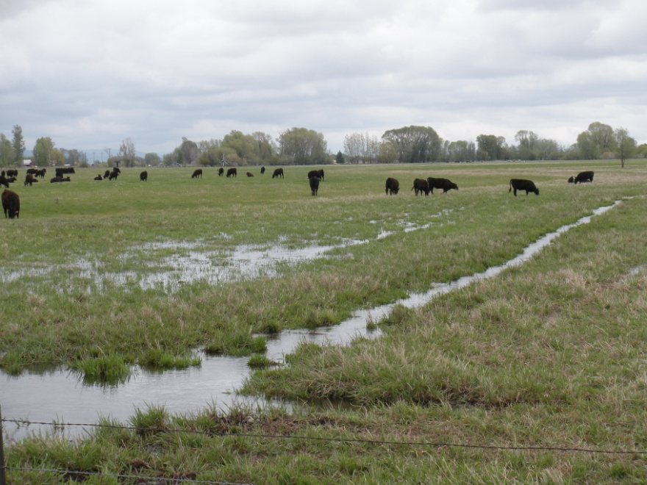
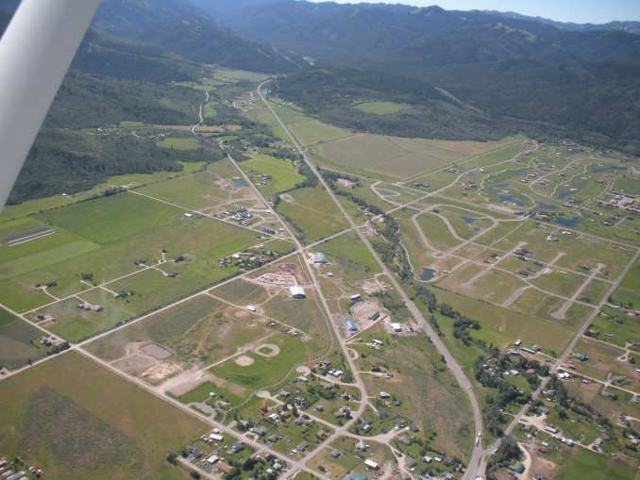
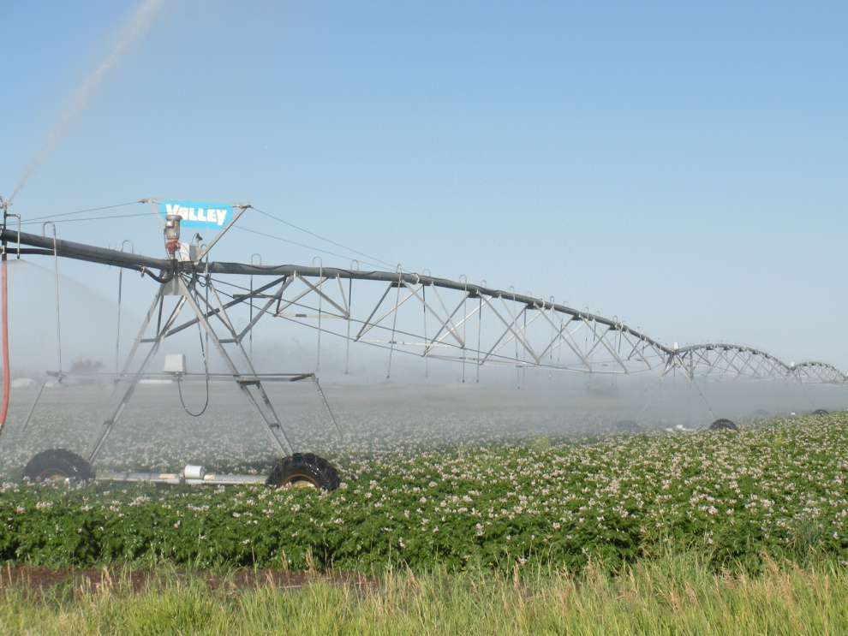
Reasons for groundwater decline
1. Increased irrigation efficiency
  sprinklers vs. flooding
  pipes vs. ditches
2. Increased groundwater pumping
3. Loss of irrigated agricultural land
  loss of irrigation seepage
  Increased groundwater use
Notes:
The net effect of increased efficiency, increased GW pumping, and increased DCMI use has increased total consumptive use.

Slide 11
At intersection of law, physics, and administration:
Is a surface-water user with an implicit right to an upstream user’s return flow explicitly entitled to that water if the upstream user becomes more efficient?
Can the surface-water user issue a water call against that user for becoming more efficient?
If not, is the only remedy a call against groundwater users?
What should happen to water rights on land taken out of agricultural production for development?
We can administer prior appropriation in real time in the surface-water system but can’t in the conjunctive system.

Slide 12
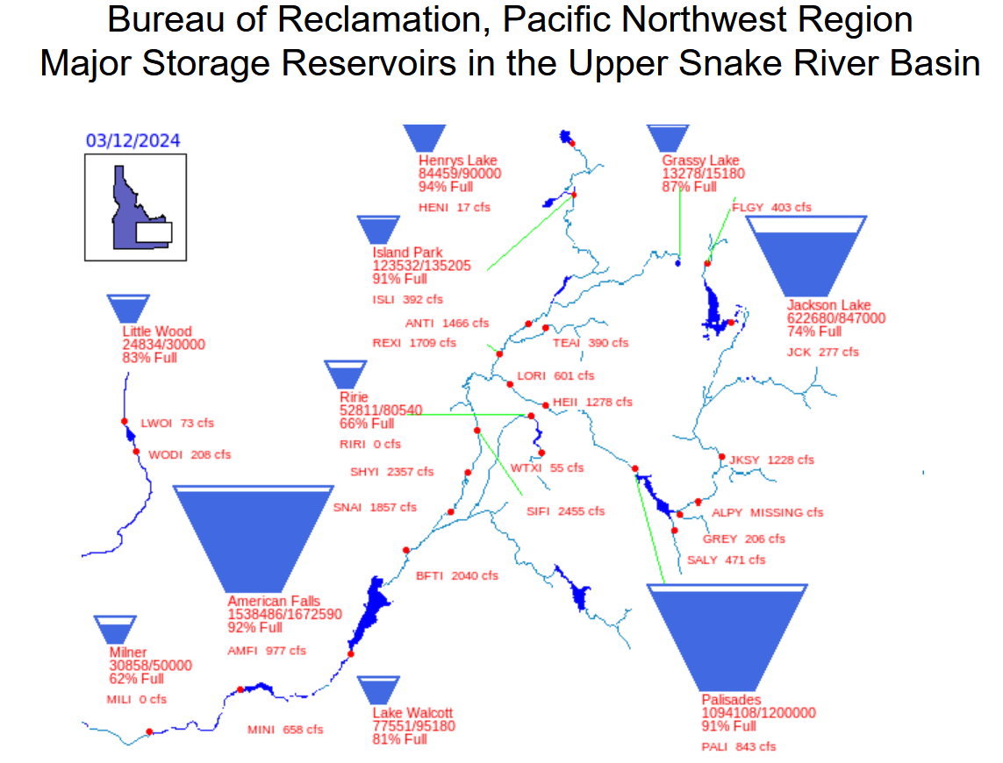
How water moves uphill…a cross-boundary example

Slide 13
How water moves uphill…a cross-boundary example
Jackson Lake
In Wyoming
High value to Wyoming stakeholders
Senior storage rights held by Idaho users

Slide 14
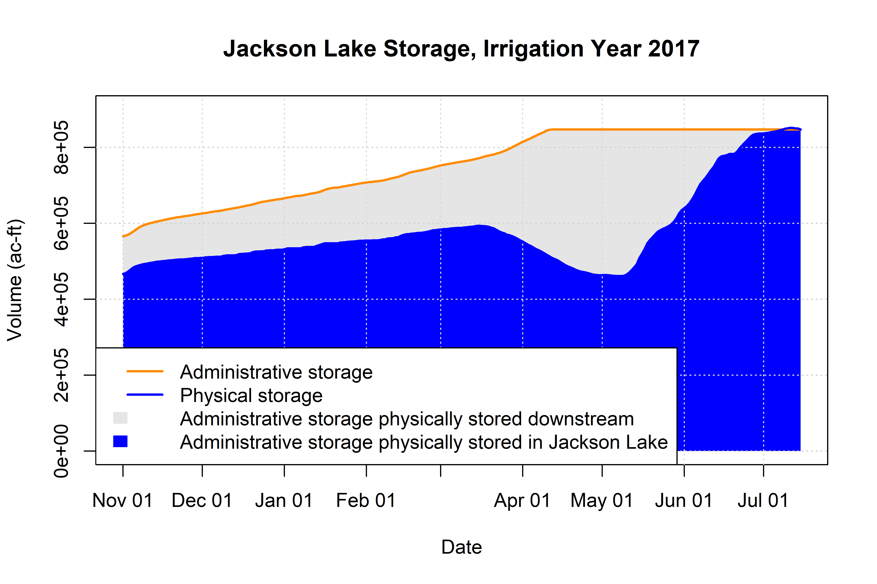

Slide 15
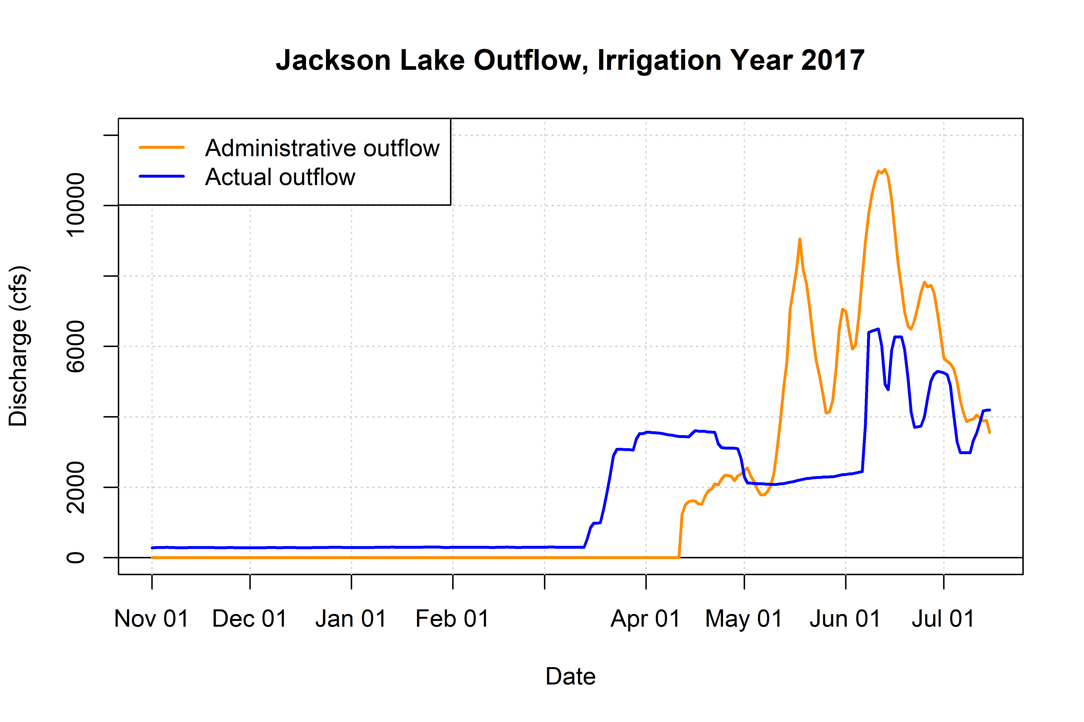
What if paper and physical water were required to be the same?

Slide 16
What if paper and physical water were required to be the same?
Outflow would be 0
Half the year

Slide 17
At intersection of law, administration and physics:
Is a surface-water user with an implicit right to an upstream user’s return flow explicitly entitled to that water if the upstream user becomes more efficient?
Can the surface-water user issue a water call against that user for becoming more efficient?
If not, is the only remedy a call against groundwater users?
What should happen to water rights on land taken out of agricultural production for development?
We can administer prior appropriation in real time in the surface-water system but can’t in the conjunctive system.
Effect of prior appropriation on streamflow depends on how it is administered.

Slide 18
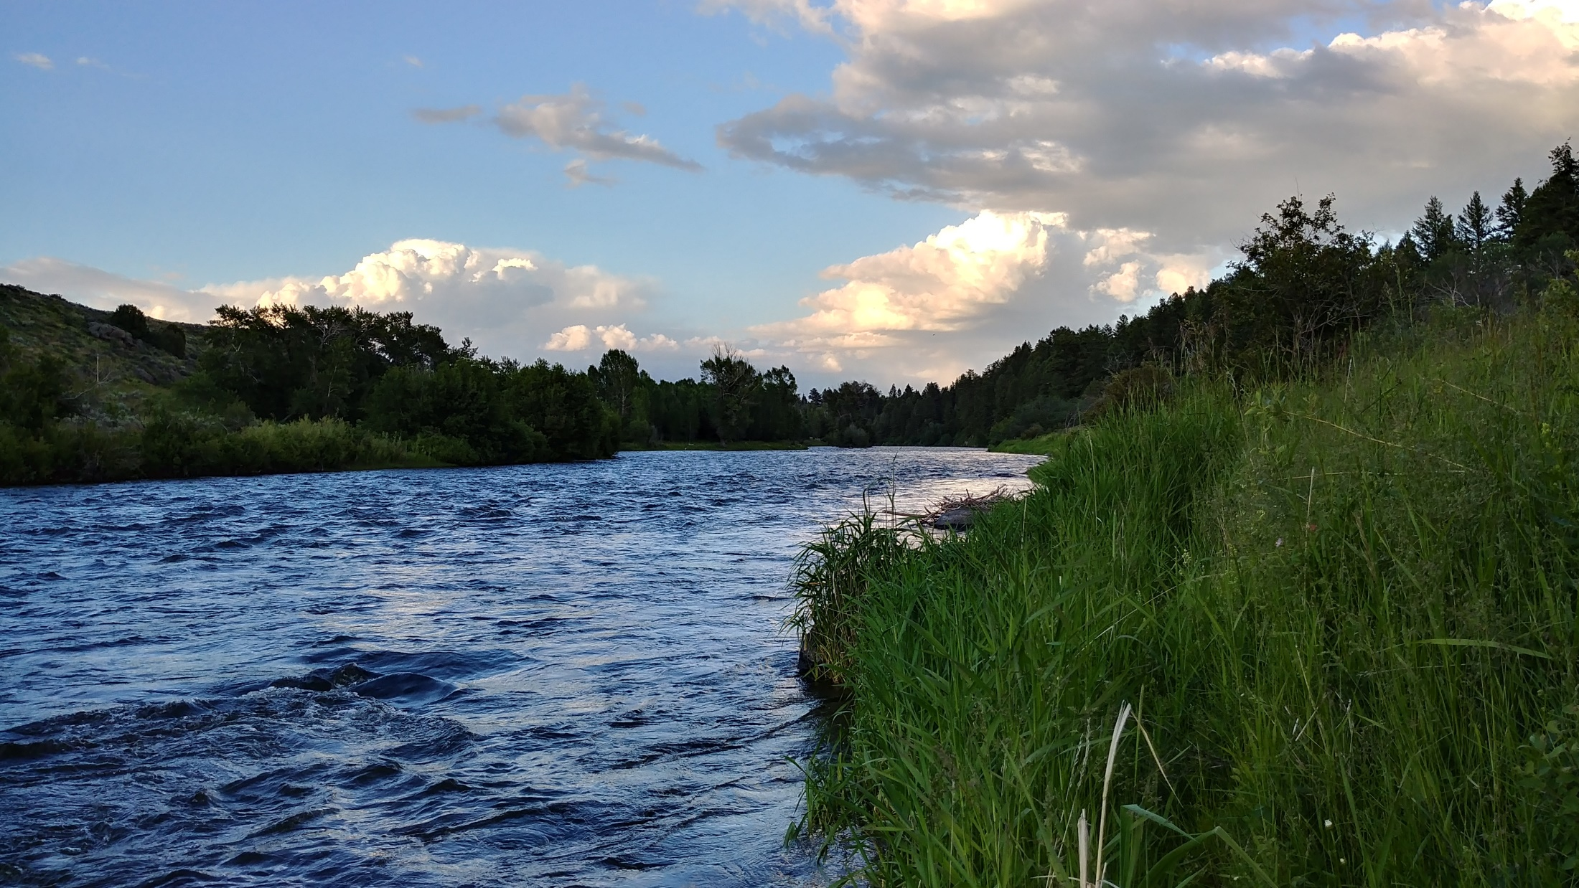
Questions and discussion
Contact: rob@henrysfork.org

Slide 19
References
Baker, J.M., Y. Everett, L. Liegel, and R. Van Kirk. 2014. Patterns of irrigated agricultural land conversion in a western USA watershed: implications for landscape-level water management and land-use planning. Society and Natural Resources: An International Journal 27:1145–1160.
Van Kirk, R., B. Hoffner, A. Verbeten, and S. Yates. 2019. New approaches to providing instream flow for fisheries in the American West: Embracing prior appropriation and the marketplace. Pp. 515–564 in D.C. Dauwalter, T.W. Birdsong, and G.P. Garrett, editors. Multispecies and Watershed Approaches to Freshwater Fish Conservation. American Fisheries Society Symposium 91, Bethesda, MD.
McLaren, J.S.*, T.V. Royer, R.W. Van Kirk, and M.L. Muradian. 2019. Management and limnology drive water temperature patterns in a middle Rockies river-reservoir system. Journal of the American Water Resources Association 55:1323–1334.
Van Kirk, R.W., B.A. Contor, C.N. Morrisett, S.E. Null, and A.S. Loibman. 2020. Potential for managed aquifer recharge to enhance fish habitat in a regulated river. MDPI Water 12:673.
McLaren, J.S., R.W. Van Kirk, A.J. Mabaka, S. Brothers, and P. Budy. 2023. Drawdown, habitat and Kokanee populations in a Western U.S. Reservoir. North American Journal of Fisheries Management 43:339–351.
Morrisett, C.N., R.W. Van Kirk, L.O. Bernier, A.L. Holt, C.B. Perel, and S.E. Null. 2023. The irrigation efficiency trap: rational farm-scale decisions can lead to poor hydrologic outcomes at the basin scale. Frontiers in Environmental Science 11:1188139.

Slide 20
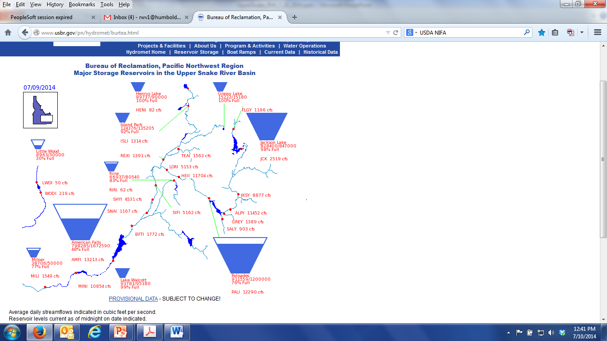
Another example of moving water uphill
Physically delivered from here
Diverted here
World-class fisheries exist in the upper Snake River because of divorce of physical and paper water.
World-class fisheries can be degraded by the same mechanism.
Paper water here
Accounted here

