Slide 1
Effort Reporting and
Cost Share
Wendy Kerr
Office of Sponsored Programs

Slide 2
Quick quiz
1) A PAR is?
A. An accurate estimation of the effort someone devotes to their various activities based on payroll
B. A report only required by the University of Idaho for internal checks
C. An exact account of the time devoted to a sponsored project
D. A real pain
2) Inaccurate effort reporting affects
A. The potential research opportunities for the PI
B. The future funding for the University
C. None of the above
D. A and B
3) Individuals who are paid on a sponsored project are obligated to complete an effort report.
A. True
B. False
C. It depends
4) The current Effort Report can only be certified by
A. The employee
B. The DGA
C. OSP
D. The employee or someone with comprehensive knowledge of their work
E. All of the above
5) Per current UI policy, PARs are certified
A. Weekly
B. Monthly
C. Each Semester
D. Yearly
6) In what scenario would one need to enter text into the “Notes” section of the PAR?
A. If there are no problems with the PAR
B. If a payroll cost transfer needs to be done
C. If the effort reflected in the PAR does not account for actual effort
D. To say hello to Wendy

Slide 3
Topics to be covered
What is Effort Reporting?
Why is it necessary?
Who has to do it?
How is it done?
When is it done?

Slide 4
What is Effort Reporting?

Slide 5
What is Effort Reporting?
The University is required by federal regulations and accounting standards to ensure that the apportionment of compensation for faculty and professional and other staff accurately reflects the work performed by these individuals in connection with sponsored projects
          University of Idaho APM Chapter 45 Section A

Slide 6
What is Effort Reporting?
The University of Idaho uses an after-the-fact payroll distribution certification method
This is accomplished through the certification of PARs – Personnel Activity Reports

Slide 7
Why is it necessary?

Slide 8
Why is it necessary?
Uniform Guidance 200.430 (8) (i) -
Standards for Documentation of Personnel Expenses (1) Charges to Federal awards for salaries and wages must be based on records that accurately reflect the work performed. These records must:
  (i) Be supported by a system of internal control which provides reasonable assurance that the charges are accurate, allowable, and properly allocated;
  (ii) Be incorporated into the official records of the non-Federal entity;

Slide 9
Why is it necessary?
  (iii) Reasonably reflect the total activity for which the employee is compensated by the non-Federal entity, not exceeding 100% of compensated activities (for Institutions of Higher Education, this per the IHE's definition of Institutional Base Salary (IBS);
  (iv) Encompass both federally assisted and all other activities compensated by the non-Federal entity on an integrated basis, but may include the use of subsidiary records as defined in the non-Federal entity's written policy;
  (v) Comply with the established accounting policies and practices of the non-Federal entity (See paragraph (h)(1)(ii) above for treatment of incidental work for IHEs.); and
  (vi) [Reserved]

Slide 10
Why is it necessary?
  (vii) Support the distribution of the employee's salary or wages among specific activities or cost objectives if the employee works on more than one Federal award; a Federal award and non-Federal award; an indirect cost activity and a direct cost activity; two or more indirect activities which are allocated using different allocation bases; or an unallowable activity and a direct or indirect cost activity.
UI’s Policy not yet updated for UG changes so we are still following A-21 guidance. We are moving toward project based reporting, but until we have that reporting in place, and change our APM, we have to follow the APM as it is the official UI policy.
Notes:
Joke here

Slide 11
Who has to do it?

Slide 12
Who has to do it?
A University employee is required to complete a PAR when:
  Salaries/wages are partially or totally provided by:
    A sponsored program
    Federal funds
    Cost share

Slide 13
How is it done?

Slide 14
How is it done?
OSP
  OSP generates the report from employee’s payroll records
  OSP does not create, calculate, or alter the numbers in any way
  The electronic form is then released to the DGA for initial review and cost share entry

Slide 15
How is it done?
DGA’s – approximately 2 weeks before release
  Add cost share data
  Initial check for errors
    Initiate payroll cost transfer if necessary
  Notify OSP of any terminated employees

Slide 16
How is it done?
Employee
  Will receive at least three notices when PARs are due
    Must be completed within 30 working days
Notes:
Wendy breaks in and shows screen shots of the PAR and walks through accurate completion

Slide 17
How is it done?
Employees
  Log in to VandalWeb to access the PAR
  Talk with DGA first if there are problems
    Cost share, effort etc.
  Notes section
    Use for unusual circumstances only.

Slide 18
How is it done?
  Two types of completion
    Regular
      Everything looks the way it should (+/- 5%)
    Provisional
      The PAR is incorrect by a larger deviation than 5%
      Indicate on the PAR that there will be changes
      Initiate payroll cost transfer
      Once the transfer is completed, the PAR amounts will be corrected
      Recomplete, this time as a regular certification

Slide 19
How is it done?
Back to OSP after PARs are completed
  OSP reviews for accuracy
  Notifies DGA and PI if changes are needed
    Cost share over/under what was proposed or mandated
    Notes are confusing or in conflict with the data on the PAR

Slide 20
When is it done?

Slide 21
When is it done?
Effort reports are currently completed once per academic term for exempt & faculty
  Fall
  Mid-Spring
  End of Summer
Classified staff, temporary employees and graduate students required to certify effort monthly

Slide 22
Putting it all together

Slide 23
Putting it all together
Effort reporting is designed to be a best estimate of the effort employees devote to projects, teaching and other activities
The current system allows for +/- 5% deviation from actual effort.
Employees should not complete their PAR if they do not understand or agree with the data – please ask questions of OSP or DGA
This is not a time or labor intensive process, but it does require accuracy and prompt attention.

Slide 24
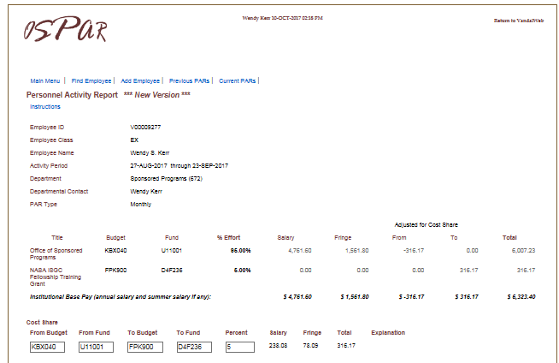
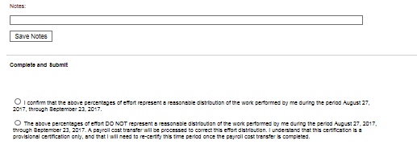
Sample PAR

Slide 25
Cost Share

Slide 26
Types of Cost Share
There are 3 types of cost share -
  Mandatory committed – required by sponsor
  Voluntary committed – not required by sponsor but quantified in proposal so we are required to track
  Voluntary uncommitted - not tracked or recorded

Slide 27
Cost Share
Cost Share is included in the proposal entered in EIPRS.
Awards that have agency required cost share have the cost share listed on the Award Notice. Banner text is also entered
  Line 154 - mandatory cost share
  Line 163 - voluntary committed cost share

Slide 28
Cost Share
  All personnel cost share is entered via the PAR system
Other UI cost share (supplies/travel/etc.) – List of Banner documents sent to Wendy Kerr for entry in OSPRE. Text entered in original Banner document about cost share.
Waived F&A – system calculated
3rd Party Cost share – must have documentation from 3rd Party that cost share occurred from non-federal source.
Cost share is tracked by OSP in OSPRE system

Slide 29
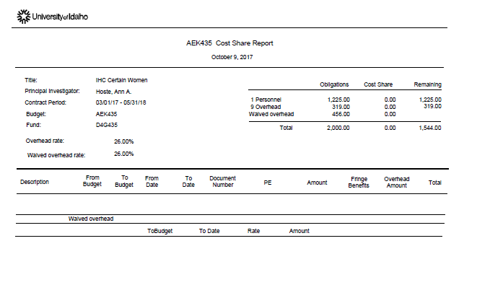
Cost Share
Cost share is tracked by OSP in OSPRE system

Slide 30
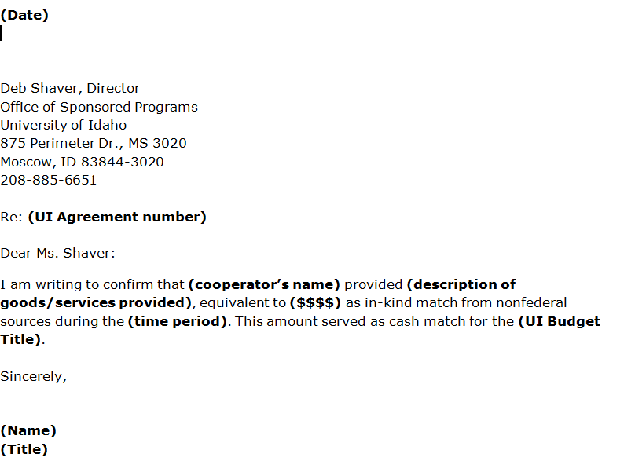
Sample 3rd Party Cost Share
Other UI cost share (supplies/travel/etc.) – List of Banner documents sent to Wendy Kerr for entry in OSPRE. Text entered in Banner about cost share.
Waived F&A – system calculated
3rd Party Cost share – must have documentation from 3rd Party that cost share occurred from non-federal source.

Slide 31
What if I have questions?
For assistance with Effort Reporting or Cost Share, contact the OSP Cost Accounting Unit:
  Office of Sponsored Programs
    Wendy Kerr
    (208) 885-2147
    wendyk@uidaho.edu

