Slide 1
UPDATE – UI Chart of Accounts Process Changes for Sponsored Projects
EFFECTIVE DATE: July 1, 2018

Slide 2
Entering Transactional Data
Grant transactional data will be entered the same way as other types of funding, using the INDEX.
FGAJVCD:
When the INDEX is entered it is important to watch the other fields as they pop up to ensure accuracy.
Grant funds will always start with “22”
The Orgn will be your department code
The program code will start with 01, 02 or 03.
All new indexes start with the department (org) code, but there is no specific differentiation between indexes for grants and indexes for unrestricted funds.

Slide 3
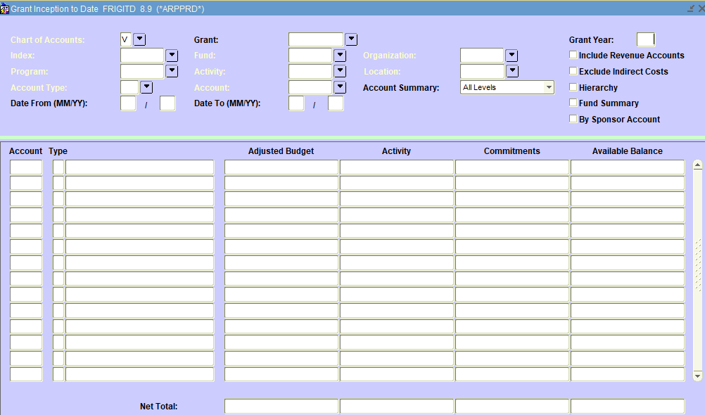
Seeing Posted Transactions by Expense Code
If you want to see total transactions you can still use the Grant Inception to Date (FRIGITD) screen

Slide 4
Use “V” in the Chart of Accounts Field.
If you don’t know your Grant code you can enter either your Index or your Fund and tab to retrieve the grant code.
Use the “Date From” and “Date To” fields to narrow down the range of transactions. Remember that budget transactions also have dates, so if you don’t include those transaction dates in your date range those dollars will not show up.

Slide 5
.
GN0412

Slide 6
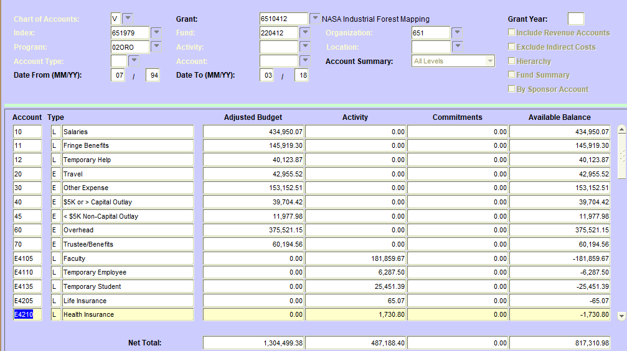
When you page down without entering any dates the system will retrieve all of the applicable transactions from the start date of the grant through the end of the month you are in as long as those transactions have posted. Remember to scroll down to see totals.
GN0412

Slide 7
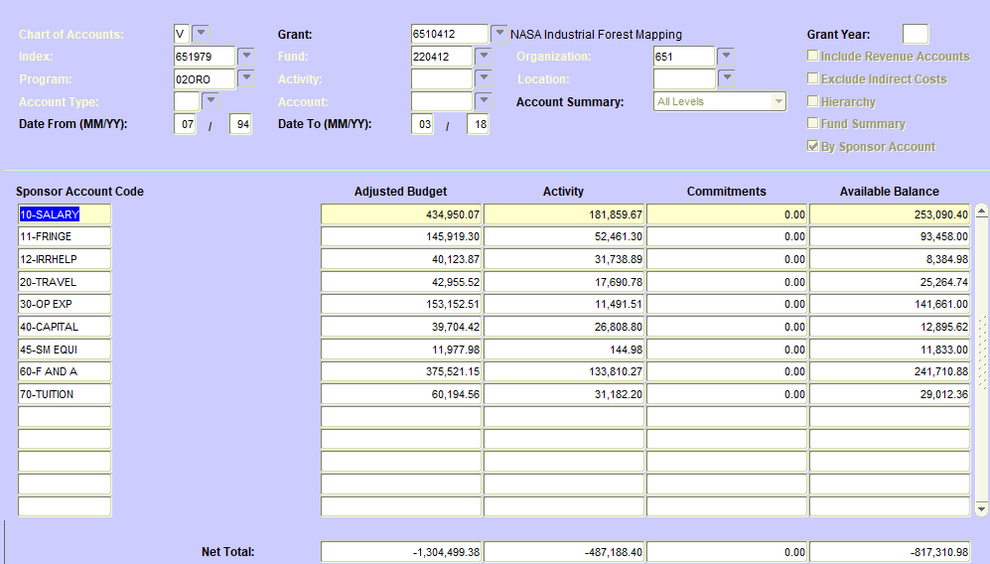
To see the activity in a format that shows the net available balance by category click on the “By Sponsor Account” checkbox before paging down.
GN0412

Slide 8
Viewing individual transactions using FRIGITD
As in the past, you can ‘drill back’ to individual transactions using the Options menu at the top of the form and choosing “Grant Detail Information.”
However, you need to note that what has been brought over to Chart V is the monthly totals by expense code. To see the original documents and document numbers for transactions prior to 7/1/18 you will need to look in Chart 9.

Slide 9
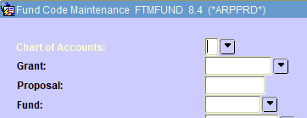
How do I find the old grant code in Chart 9?
All grant codes will be mapped and available in Argos reports if you want to print off a list for your records.
OSP has chosen to create a new proposal code for each new grant code and we are making that new proposal code equal to the old grant code. The proposal code shows up when you enter the grant code in FRAGRNT and is also searchable in the FTMFUND record.

Slide 10
Other New Items
There will be two additional primary expense categories in FRIGITD:
Subawards – 31
Participant Support – 32
We hope to change from each fund having its own grant code to multi-fund budgets under one grant code. In these cases you will be able to look at an individual fund’s transactions and balances by inputting the index or the fund OR you can look at the overall grant balance and transactions by leaving out the index and fund.
Note that the FRIGITD screen also has options for Activity code and Organization.

Slide 11
Future Plans
Companion cost share accounts to track expenses associated with cost share (Est. 7/1/18)
Banner Effort Reporting (Est. 7/1/18 with first live test after 12/31/18)
Electronic Labor Redistribution in Banner

Slide 12
Questions?

