Slide 1
Onboarding New Employees
College of Natural Resources
Notes:
Hi all, my name is Eric Everett and I work with Idaho Cooperative Fish and Wildlife Research Unit within the College of Natural Resources. We’ve been asked to share a bit about out new employee onboarding process. CALs has kindly shared with all of you some of their onboarding documents and we will share our process. This is mostly going to be about RAs and Temporary help, as that is the bulk of our hires.

Slide 2
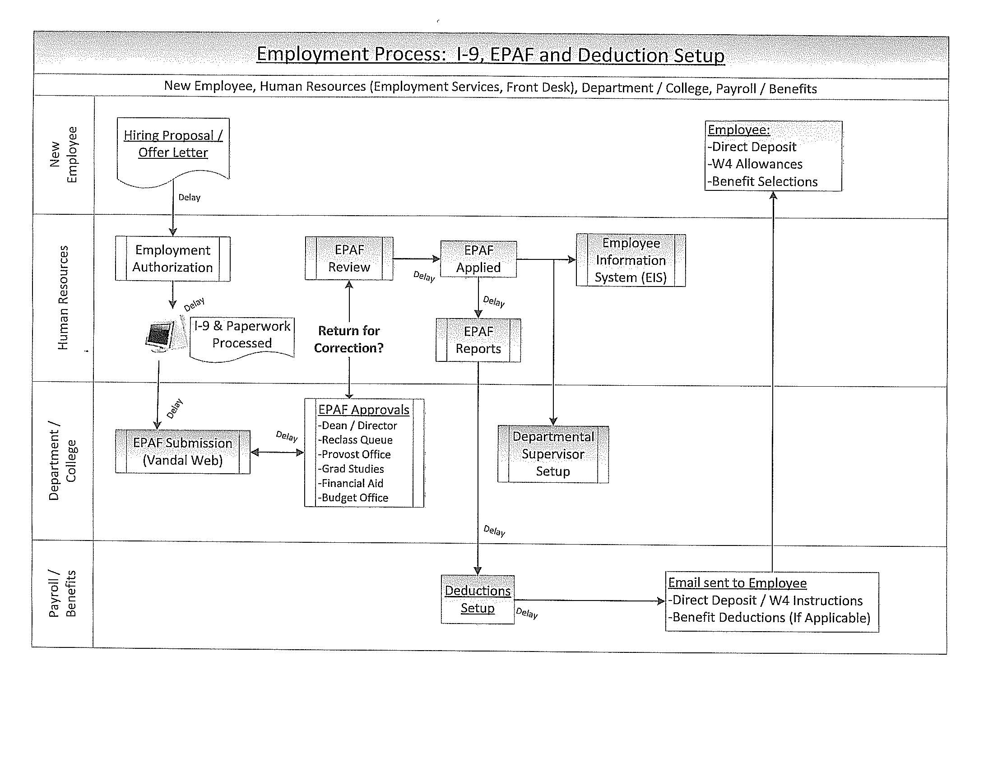
Employment Process (delay, delay, delay)
Notes:
This is a diagram of the Employment Process provided to me by Dan Noble.
I like to use it to emphasize that the hiring process is not quick.
Between each step is an often uncontrollable delay and is often unseen by the employee.

Slide 3
Board Appointed Positions
Work with your Hiring Authority and Human Resources Business Partner on the University hiring process
https://www.uidaho.edu/human-resources/employees/new-employees
Human Resources and your Business Partner can help with any questions you may have (208-885-3638)
Notes:
For board appointed positions (faculty, classified and exempt staff, and post-docs), there are University-wide procedures for hiring and onboarding that we follow.
Work with HR or your College/Departments Hiring Authority.
Once a person is hired, you can follow the University’s onboarding plan located here. Any questions should be directed at HR.

Slide 4
RAs – Initial Steps
Student applies to Graduate Admissions
CNR Graduate Studies Office (GSO) receive the information about the student and forwards it to their potential Major Professor for approval
Once admitted GSO sends a stiped spreadsheet to the Major Professor to get the details regarding the student’s appointment and funding
Notes:
First we will focus on RAs. (TAs have their own special procedure that I believe is university wide.)
First the student applies to Graduate Admissions.
Their info is then forwarded to our Graduate Studies Office who then forward it to a potential major professor, either someone the student has been corresponding with or someone in their field of interest.
Once that professor has agreed to advise the student, GSO will send them a stipend spreadsheet to get all the details of the appointment.

Slide 5
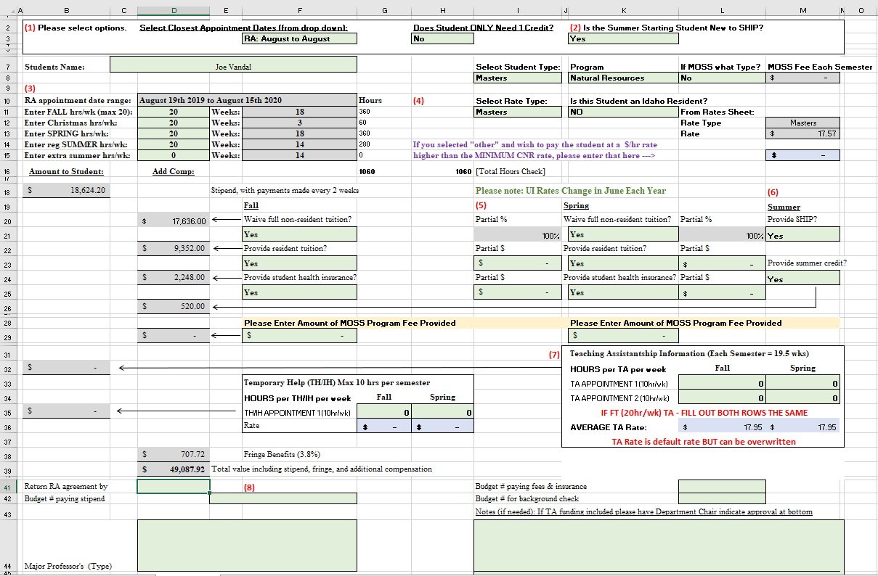
Notes:
This spreadsheet was created to be useful to our fiscal department. It has everything they need to set up an EPAF and for GSO to create offer letters.
PIs are supposed to fill it out, but sometimes you have to hold their had. One PI, who shall remain anonymous send me an email that said “My God. Please say you can help…” when they first saw it.
But it is actually very self-explanatory. You enter the pertinent details about the student, when they are starting, how many hours they will work and rate of pay, and how much of their tuition and fees are being paid by a project.

Slide 6
RAs - Continued
PI completes the form and sends it to our Fiscal Office for approval
It is sent back to the GSO to be used to create the offer letter which is signed and returned
Criminal Background Check is submitted by GSO
Fiscal officer enters EPAF information AFTER THE I-9 IS SIGNED ON OR BEFORE THE FIRST DAY OF WORK
Notes:
After the PI and CNR have approved the form, it is used by the GSO to create an offer letter.
That letter is sent to the student, signed and returned. The GSO then submits a CBC.
Once that is returned as satisfactory, the fiscal office can submit the EPAF. Of course, as will all positions, the employee MUST fill out their I-9 before they can start working.

Slide 7
RAs - What else?
Vandal Card office
  (ID card and account)
Desk/Office
Keys
Register for classes – Department/Grant pays tuition and fees
TRAINING TRAINING TRAINING
  University Required Trainings (Within 30 days)
  Purchasing Card/Travel
  Animal Care and Use
  Defensive Driving
  Lab Safety
Notes:
Work with you Department’s Admin Assistant on these tasks.
Of particular interest is the tuition payments and any training related to their position, for us it is primarily the Animal Care and Use.

Slide 8
Temporary Help – Initial Steps
PeopleAdmin not required if employee will work less that 1385 hours in a 12 month period
Person requesting the position fills out the Temp Help Hiring Form
Department/College submits the CBC (takes about a week)
Employee must complete the I-9 before they start working
You can make arrangements for a remote I-9 with HR
Once the I-9 is completed, the employee will be given a Vandal Number to be used for the EPAF.
Notes:
Temporary Help (or IH) employees are simpler. Employees can be IH is they will work less than 1,385 hours in a 12 month period.
Requestor fills out the Temporary Help Hiring Form, which is similar to CALs form. The department then submits the CBC (required for all CNR positions).
Once that is back and the employee filled out the I-9, Fiscal can submit the EPAF.

Slide 9
Temporary Help - What else?
You can request a UI account on their behalf from your TSP (i.e. sponsor) (V#, CBC, and signed I-9 are required)
Assign a Supervisor in VandalWeb.
Speak with Supervisor to determine what trainings are needed
  University Required Trainings
  Travel Training
  Animal Care and Use Training
  Defensive Driving
  Lab Safety Training
Notes:
What we have learn is that remote IH employees do not automatically have a UI account set up for them because they do not go to the Vandal Card office.
We can contact our Technical Service Provider to sponsor an account for them once we have a V# and a CBC.
Then we can assign a supervisor in VandalWeb, assign the appropriate trainings, and send them to VandalWeb to fill out their timesheet and W-4.

Slide 10
How to keep everything straight
Spreadsheet with all hiring information
Payroll will notify you if non-PERSI employees are approaching the eligibility threshold
Run Argos reports every two weeks before EPAF deadline
Go to Human Resources > Production > Department Reports
  “Upcoming Terminations” – Verify with PI if they need an extension
  “Employees Paid on TS Orgn/Index” – Verify with PI if employees are on correct index
  “TH Hours Worked” – Verify if TH employees are approaching the 1385 hour per year threshold
Notes:
I use a spreadsheet to keep track of all my current IH hires. We can hire 50 or more during a field season. This lets me know when I need to submit hiring and termination EPAFs and where we are in the hiring process.
Payroll will notify you in any IH employees are approaching the PERSI threshold: PERSI eligible if they work 20 hours or more for 11 weeks in a sliding 22 week window.
Every two weeks before the EPAF deadline I run the following Argos reports to avoid Payroll Cost Transfers and Retroactive Pay Requests. Upcoming Termination to see if they are actually terming. Employee list to verify the correct index. TH hours worked to see if they are approaching the yearly threshold.

Slide 11
Questions?
Notes:
Questions?

