Slide 1
DGA Roundtable

Slide 2
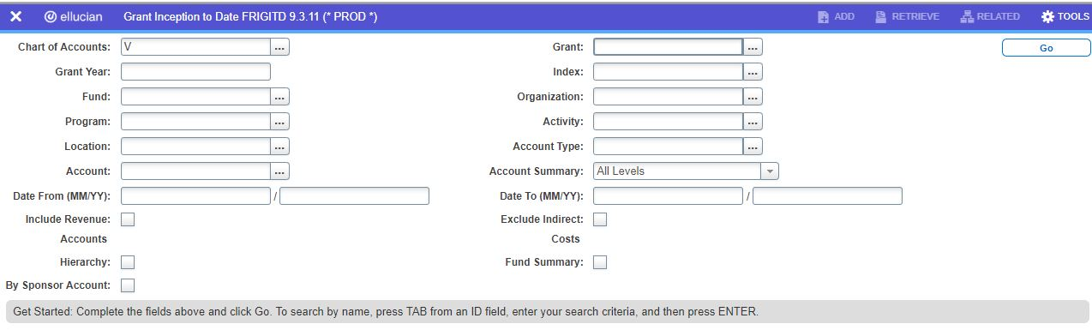
Navigating FRIGITD
To find a Grant with only an index:
Put index into index field and tab through until grant comes up
Same thing can be done with only the fund number

Slide 3
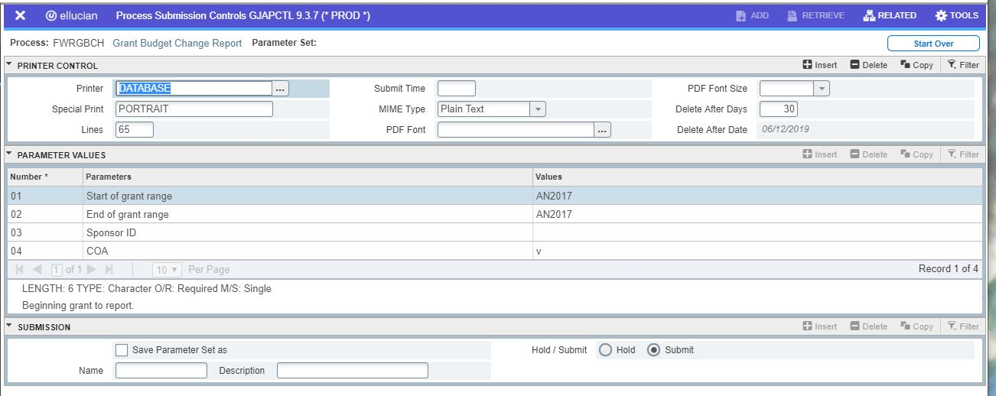
Navigating FWRGBCH

Slide 4
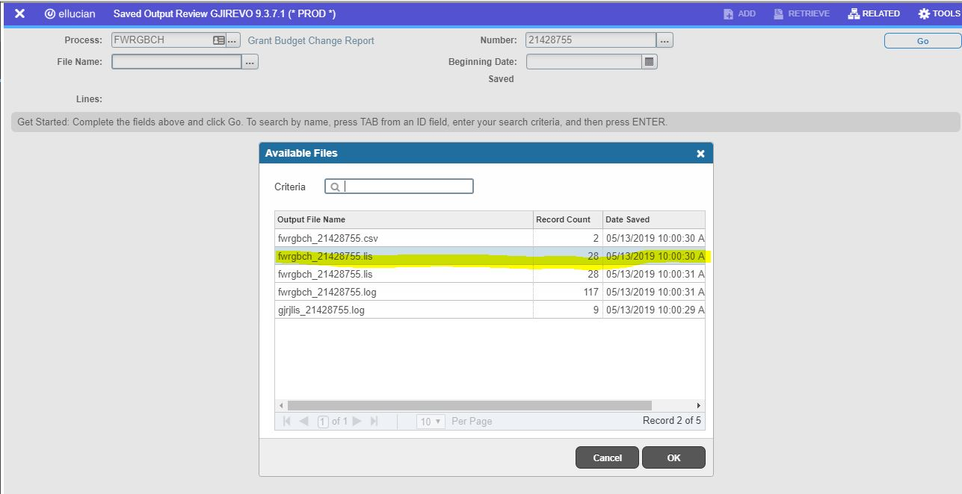
To get Results
Go to related and choose saved output. You want the .lis file.

Slide 5
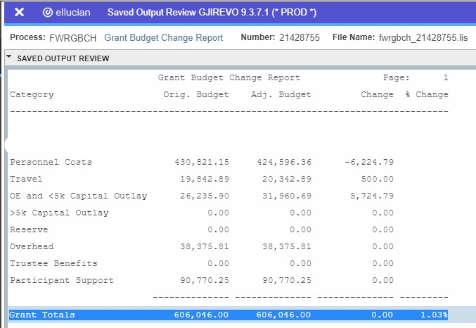
Budget Change report Results

