Slide 1
DGA Roundtable
December 7, 2023
Launch the polls

Slide 2
Osp announcements
Salary Encumbrances Fixed - Michele
POs for Service Agreements in JAGGAER - Michele
Holiday Break Closure and Other Pre-Award Reminders – Eric
Early Setup Reminders – Vicki

Slide 3

CARRYFORWARD Budget Process Changes
Reason for change in carryforward budget process
    Audit of active award agreements vs. amount budgeted
Former process
    Financial Unit reduces 50-Reserve by carryforward amount.
    Once approved by the sponsor, Post Award increases budget categories by approve amount of carryforward.
New process
    Financial Unit reduces each budget category by amount unspent and increases 50-Reserve.
    Once approved by the sponsor, Post Award reduces 50-Reserve and increases the budget categories by approve amount of carryforward.
During closeout of the grant, the Financial Unit will reduce 50.
Reminder, Depts/Colleges cannot use 50 to absorb overspending.
Heather

Slide 4
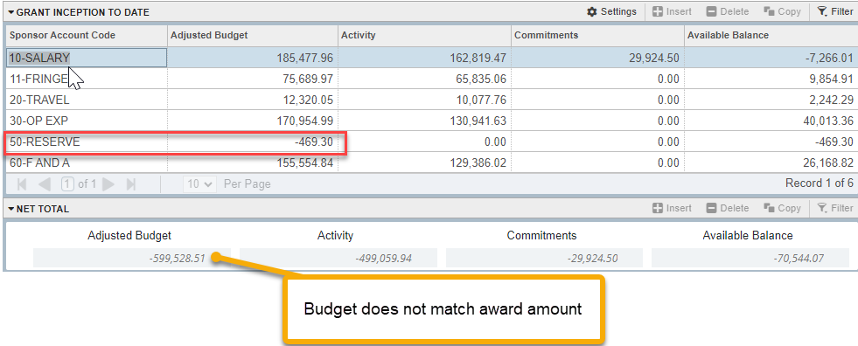
CARRYFORWARD Budget Process Changes Continued
FRIGITD Old Process:
Heather

Slide 5
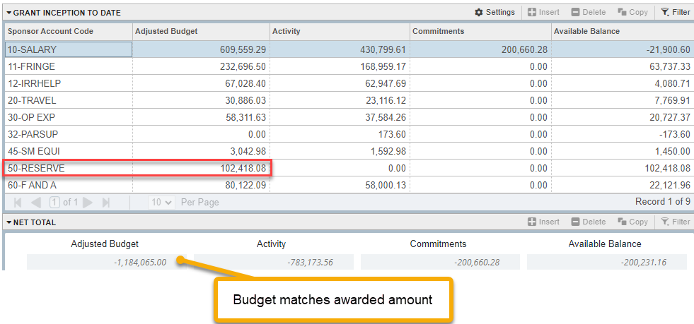
CARRYFORWARD Budget Process Changes Continued
FRIGITD New Process:
Heather

Slide 6
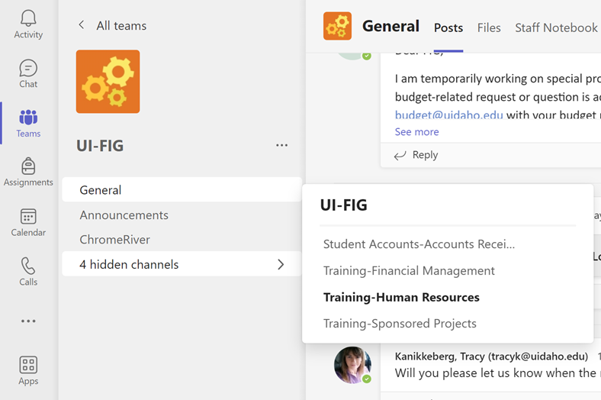
REminder
OSP Manual Location
The OSP manual is available in Teams
Pathway to the manual: Teams – UI-FIG – 4 hidden channels – Training Sponsored Projects – 4 more

Slide 7
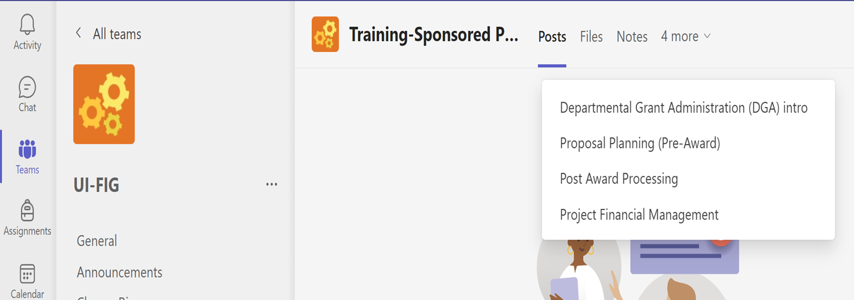
OSP Manual continued

Slide 8

Notice: helpful hyperlinks up ahead
Tip: bookmark hyperlinks in your web browser for future reference

Slide 9
Osp units overview
administration: osp@uidaho.edu
The Director oversees all OSP functions and serves as the Authorized Organizational Representative (AOR) for the University of Idaho
Sarah Martonick
885-2145
smartonick@uidaho.edu
The Administrative Specialist II provides administrative support and coordination to the Director
Ezekiel Morrison
885-6651
emorrison@uidaho.edu
The Assistant Director, Sponsored Operations is responsible for policy and process oversight
Michele Mattoon
885-1019
mmattoon@uidaho.edu

Slide 10
Contract review unit: osp-contracts@uidaho.edu
Responsibility Area: review and negotiation of grants, contracts and agreements; issuance of out-going subawards
Personnel:
Contract Review Officer Associate Contract Review Officer
Claire Freund Cody Mullikin 885-2014
cfreund@uidaho.edu TBD Phone/Email
Questions:
Research agreements
Subaward agreement issuance
Master agreements and non-funded MOUs
Claire

Slide 11
IT division: osp-web@uidaho.edu
Responsibility Area: maintains VERAS and the OSP website and serves as the IT liaison between U of I and the system vendors
Personnel:
Business Processes/Systems Analyst
Blair Ehlert
885-1147
Questions:
VERAS
OSP website

Slide 12
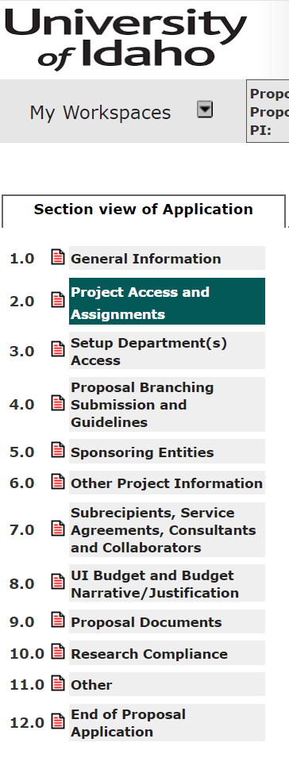
Pre-award: preaward@uidaho.edu
Responsibility Area: reviewing all proposals prior to submission to ensure compliance with both U of I and sponsoring agency policies. Refer to VERAS section 2.5 to see which SPA is assigned to your proposal.
Personnel:
Lead Sponsored Programs Administrator
Eric Everett
885-2098
ericeverett@uidaho.edu
Sponsored Programs Administrator IIs
Tami Clabough Sarah Dengler
885-5154 885-1219
tamic@uidaho.edu sdengler@uidaho.edu
Sponsored Programs Administrator I
Chelsea Franklin
885-6721
cfranklin@uidaho.edu
Questions:
VERAS - Proposal review and submission
Sponsor Portals (Grants.gov, Research.gov, etc.)
Waivers (Cost Share, F&A, APM 45.22)
Just – In –Time Request and Budget Revisions
Eric

Slide 13
Post-award: postaward@uidaho.edu
Responsibility Area: Manage projects that have been funded by a sponsoring agency. Processes all awards, award modifications, requests for prior approval. Prepares and sets up awards in the Banner system.
Personnel:
Lead Grant and Contract Administrator
Vicki Russell
885-4984
vskow@uidaho.edu
Grant and Contract Administrators
Samiksha Gupta Andrea Thomas Vacant
885-5656 885-3866
samig@uidaho.edu andreathomas@uidaho.edu
Questions:
Index, fund and grant code setup in Banner
Awards and modifications
Sponsor prior approvals
Transferring funding between grant indexes
Early setups and advance funding
Annual or progress reporting
Master agreements and MOUs
Vicki

Slide 14
Cost Accounting Unit: osp-cost@uidaho.edu
Responsibility Area: Prepares the F&A rate proposal, performs service center rate reviews, provides data for research and surveys, reviews expenditures for compliance/allowability, tracks cost share, processes subaward invoices, performs risk assessments, oversees effort reporting, and assists with the annual audit and external reviews.
Personnel:
Assistant Director, Sponsored Accounting
Heather Clark
885-8994
heatherclark@uidaho.edu
Senior Cost Accountants
Wendy Kerr Shannon Shumard
885-2147 885-4013
wendyk@uidaho.edu sshumard@uidaho.edu
Grants Compliance Accountants
Bryon Cavolo Vacant
885-6605
bcavolo@uidaho.edu
Questions:
Allowability Budget transfers Fly America Act compliance
Effort reports Cost share Labor redistributions
Service centers Audit
Heather

Slide 15
Financial unit: osp-billing@uidaho.edu
Responsibility Area: Invoicing and financial reporting for sponsors, ensures the collection of funds from sponsors, preforms in-house closes and carryforward analysis, and processes awards for closeout.
Personnel:
Assistant Director, Sponsored Accounting
Heather Clark
885-8994
heatherclark@uidaho.edu
Administrative Financial Technicians
Teri Riedner LeAnn O’Rourke
885-5469 885-0999
triedner@uidaho.edu lorourke@uidaho.edu
Terri Small Rebecca (Becky) Garner
885-2143
tsmall@uidaho.edu rebeccalg@uidaho.edu
Questions:
Award closeouts Carryforward calculations
Invoicing In-house closes
Financial report submissions
Heather

Slide 16
Questions?

Slide 17
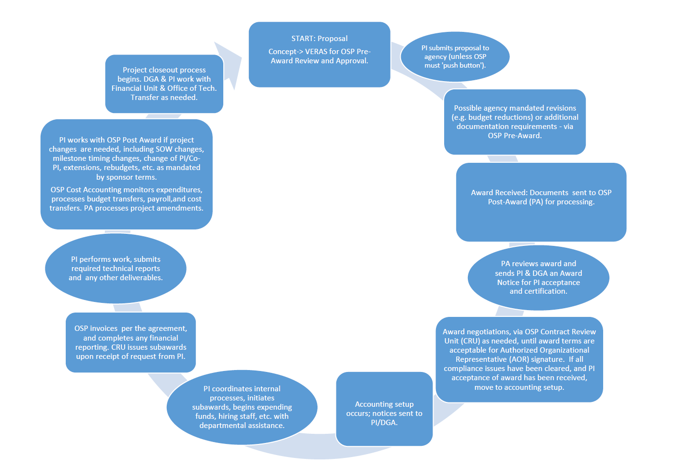
Award Flow Chart
Award Life Cycle

Slide 18
Questions?

Slide 19
Tdx vs veras
When to use veras
Proposals
Sponsor Prior Approvals
Early setup
Note: the above are PI or DGA initiated. Post Award uses VERAS to process agreements and amendments, and initiate award acceptance notices.
Demo where to access in VERAS- Blair

Slide 20
Tdx vs veras cont.
When to use tdx
Everything except proposals, sponsor prior approvals, and early setups
Contract Review – outgoing subawards, non-funded agreements, and fee-for-services
Administrative and Technical – Gift vs Grant, request current and pending support data, and request training
Cost Accounting and Financial – budget transfer requests, off-cycle financial report requests, and initiate early closeout of a grant code
Post Award – submit agreement/amendment not already emailed to OSP by sponsor, new index under an existing grant code, PI/Co-PI leaving process, progress and technical report review and approval, and submit a current and pending support update
Pre-award – submission of Just-in-Time information, requesting a letter of institutional commitment for a proposal, submit a revised proposal budget, and waiver requests for cost share, F&A and PI/Co-PI status/eligibility
Other – request assistance, and status inquiry

Slide 21
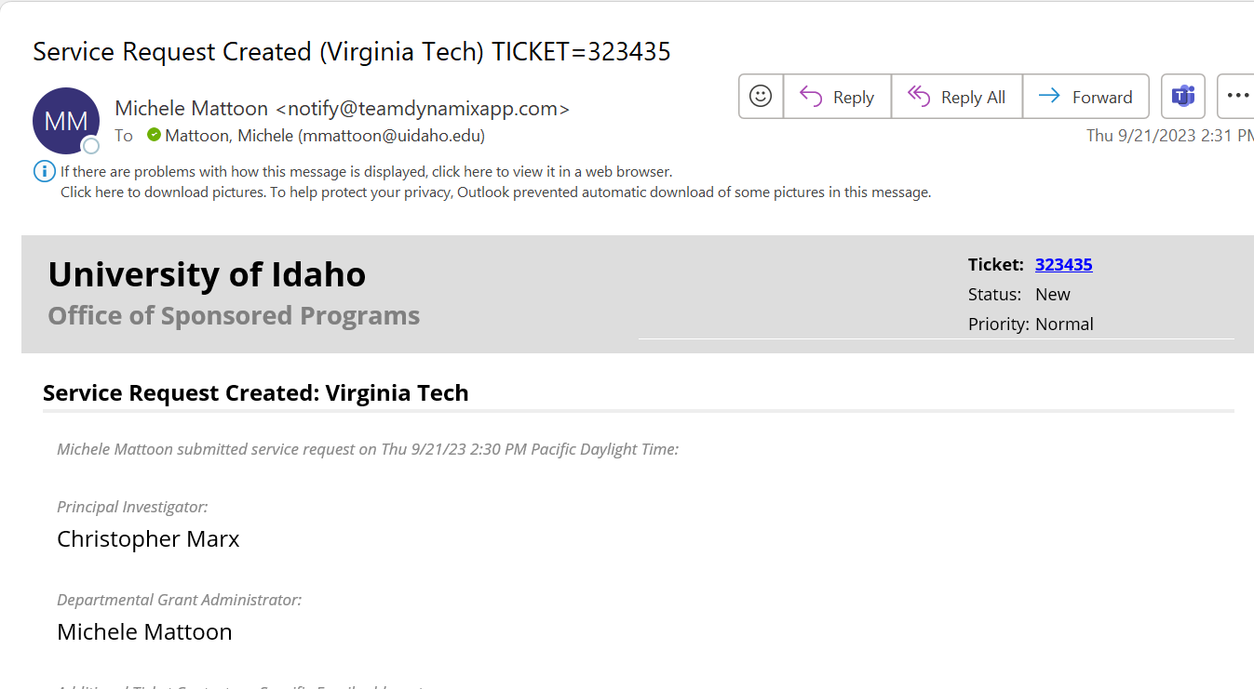
TDX Email
After you submit a TDX ticket you will receive an email notifying you of your ticket
You may click on the ticket number to find current status and ticket details
You may reply to the email to ask questions

Slide 22
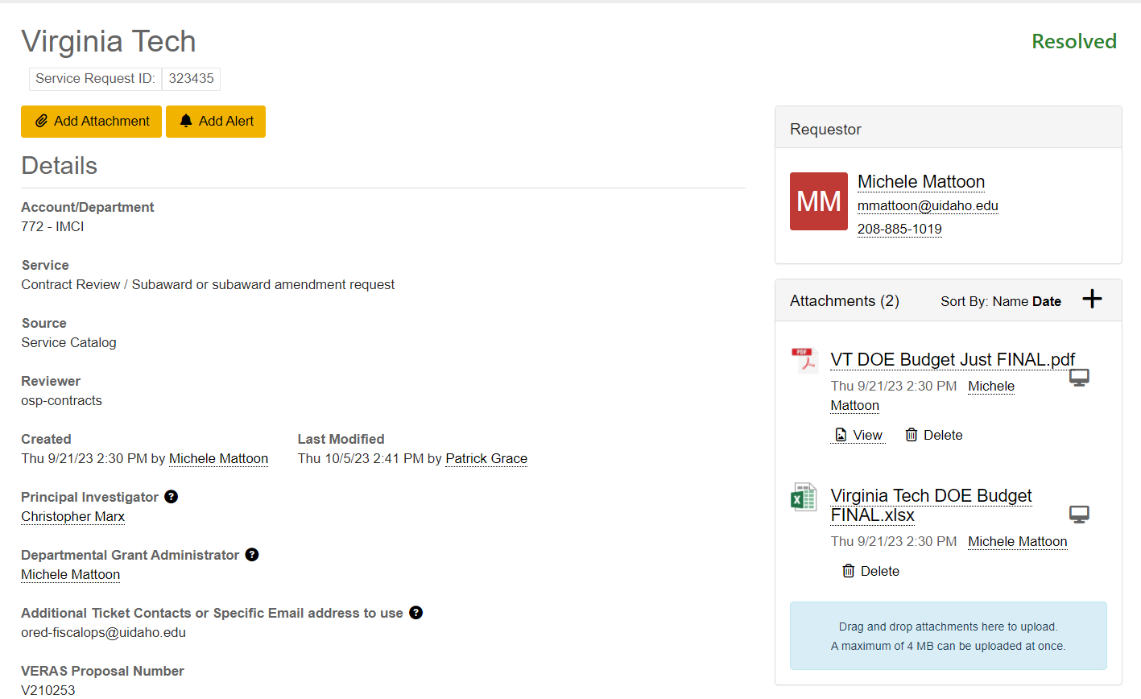
TDX Ticket Details

Slide 23
Tdx Status definitions
Status | Definition
New | The ticket has been received but not assigned.
Assigned - New | The ticket has been assigned to a reviewer, but the reviewer has not taken action yet.
In Process | The ticket reviewer is actively working on the request.
In Process – Pending Customer | The ticket reviewer needs additional information from the requestor.
In Process – Pending Internal | The ticket reviewer needs information or action from other UI units such as Contract Review or Cost Accounting.
In Process – Pending External | The ticket reviewer needs information or action from partners outside of U of I.
Resolved | All work related to the ticket has been completed, and nothing related to the ticket needs to be done in VERAS.
Closed | Work is moving to VERAS, so the ticket is no longer needed.
Cancelled | Either a ticket was not needed or was created as the wrong ticket type.
On Hold | An expected delay from the requestor of at least a week.

Slide 24
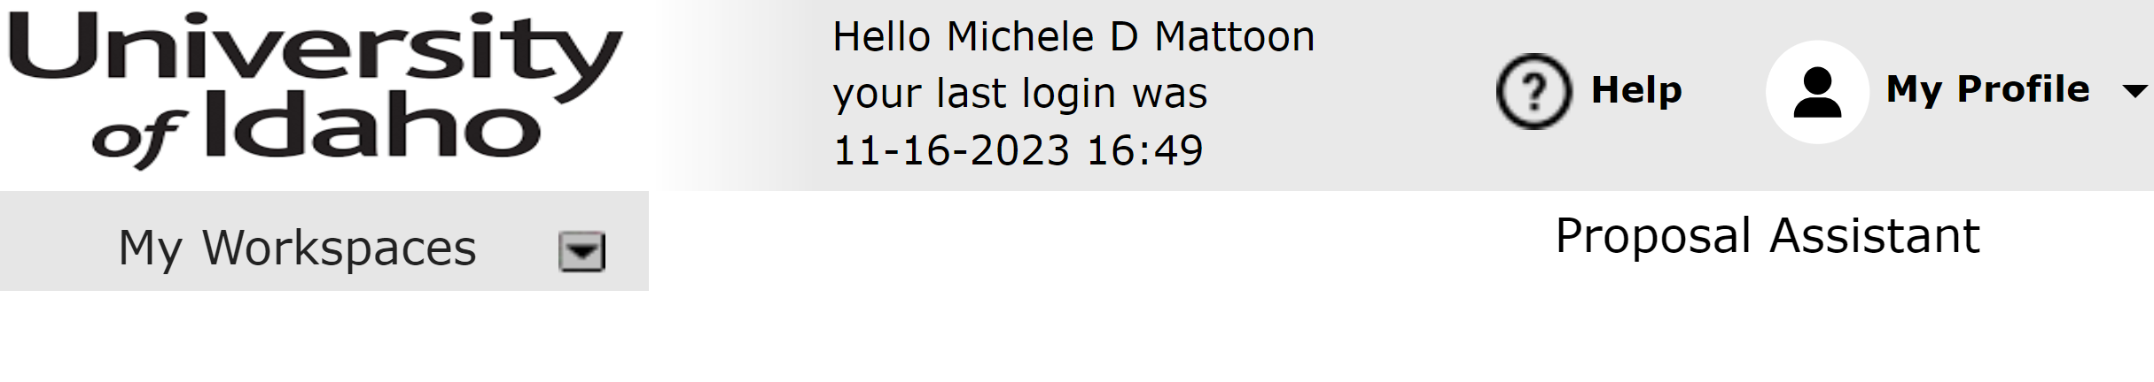
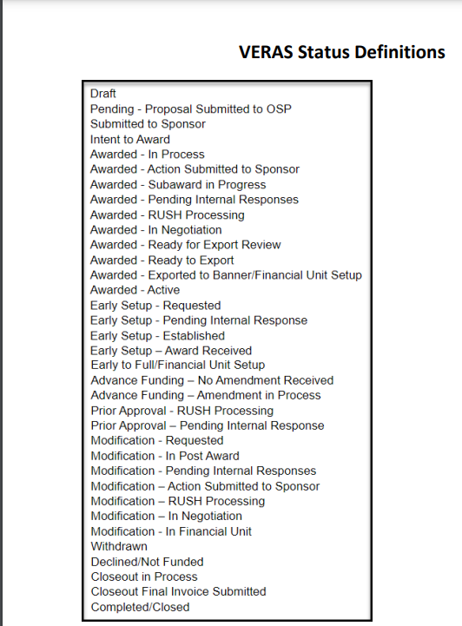
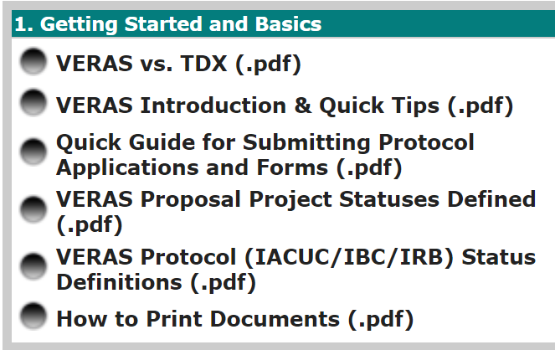
VERAS status definitions
Click on the ? Help in the upper right-hand corner of VERAS
Click on the VERAS Proposal Project Statuses Defined link under 1. Getting Started and Basics.
Demo where to see statuses - Blair

Slide 25
Questions?

Slide 26
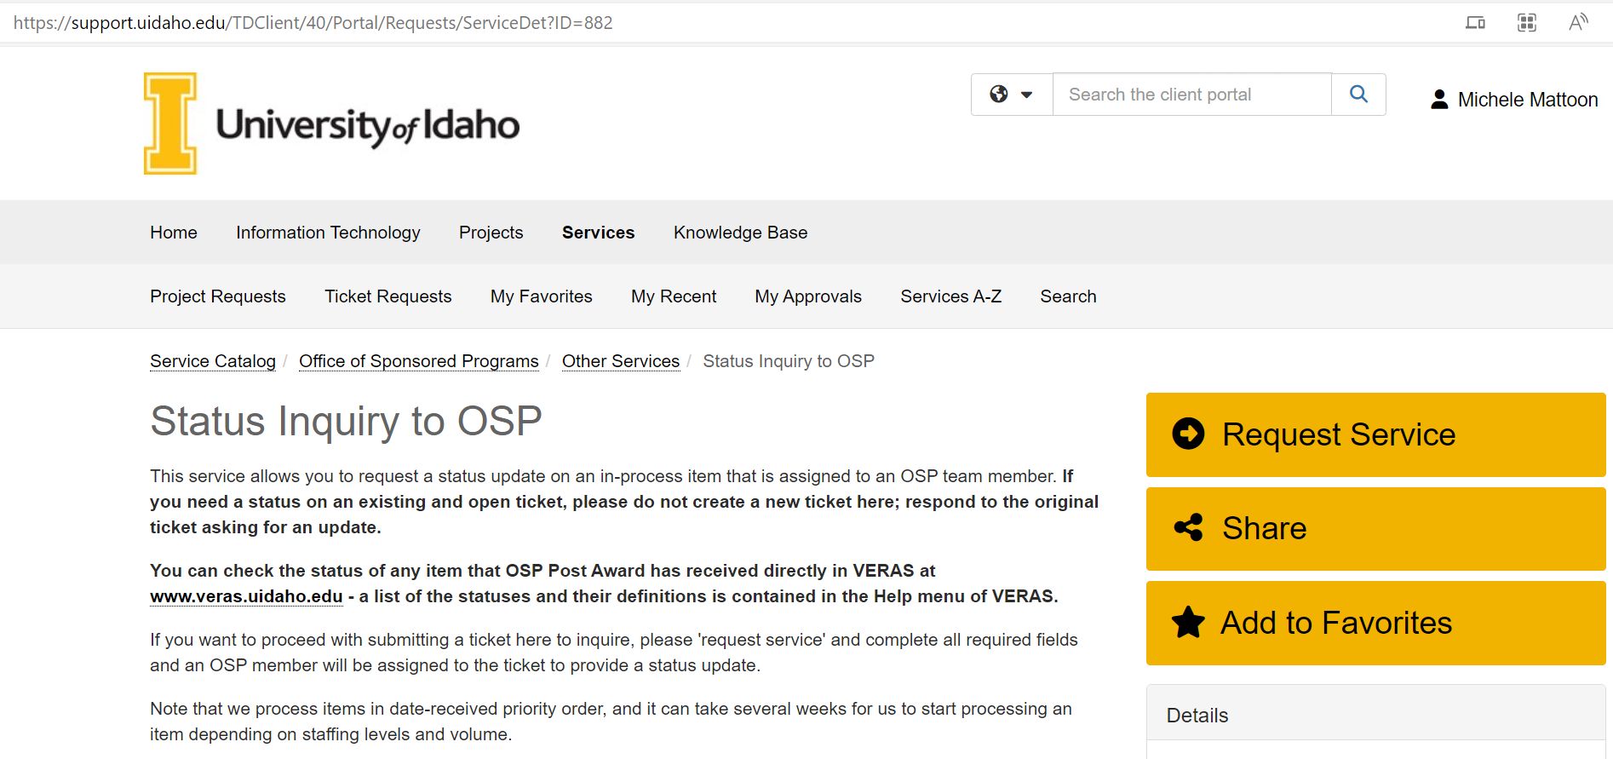
Still need status help
Status inquiry to osp

Slide 27
Future Topics?
Launch poll

