Slide 1
Dga roundtable
Proposals – Level II
F&A
Cost Share
Cost Accounting Standards
March 28, 2024

Slide 2
OSP announcements
VERAS proposal vs TDX Submit Revised Budget ticket – Eric
NSF Updates to the NSF Proposal and Award Policies and Procedures Guide (PAPPG) (NSF 24-1) webinar held on March 12, 2024, is now available on-demand in their Resource Center and on their YouTube page.

Slide 3
Questions?

Slide 4

Facilities and administration costs
FY24 F&A RATES
Organized Research
On Campus Rate - 50%
Off Campus Rate – 26%
On Campus Industry Rate - 57.13%
Off Campus Industry Rate – 31.27%
Instruction
On Campus Rate – 59.7%
Off Campus Rate – 26%
On Campus Industry Rate 83.74%
Off Campus Industry Rate – 50.3%
Other Sponsored Activity (formally known as Public Service/Outreach)
On Campus Rate – 38%
Off Campus Rate – 26%
On Campus Industry Rate – 50.10%
Off Campus Industry Rate – 34.82%
Agriculture & Forestry Experiment Station
Rate – 39%
Industry Rate – 53.32%
State of Idaho Agencies (Does not include federal pass-thru)
Rate – 20%
F&A Intro Video

Slide 5
f&a rate Determination
Step 1: Is the sponsor limiting the F&A?
Typically identified in the RFP, the sponsor’s website or based on a cooperative agreement.
Must provide written evidence of the sponsor limitation in VERAS.
When in doubt ask your SPA within the VERAS correspondence feature.
If yes, then use the sponsor limited rate.
If no, go to step 2

Slide 6
Step 2: Is the sponsor industry/for-profit or a State of Idaho agency?
If yes to industry, use industry rates and continue to step 3.
If yes to State of Idaho agency, use the State of Idaho agency rate of 20%.
If no to both, continue to step 3.

Slide 7
Step 3: Identify the Project Type
Organized Research – Studious and critical inquiry and examination aimed at the discovery and interpretation of new knowledge. Tip: NSF projects are almost always research.
Instruction – Involves teaching, giving instructions or commands, or providing information. Applies to any sponsored project where the primary activities are included as part of the institution's instructional program.
Other Sponsored Activity – Includes all scopes of work performance other than organized research and instruction, for example public outreach and service projects.
then go to step 4

Slide 8
Step 4: Determine Project Location
On campus is the default location unless one of the following applies:
Agricultural and Forestry Experiment Station
For research projects where most of the project work is to be performed in specific locations. See the Resources slide for a link to all the applicable locations.
Off Campus
For projects with at least two-thirds of the work performed off-campus, defined as locations other than university-owned, leased, or operated facilities, the off-campus indirect cost rate will apply to the entire project. F&A associated with physical plant and library are not considered applicable to the project.
With the answers to these questions you will be able to identify the appropriate F&A rate.
Go to step 5 to determine the calculation method.

Slide 9
Step 5: Determine Calculation Method
*Total Direct Costs (TDC)
Default for the State of Idaho Agencies rate.
TDC is the total of all direct costs of the project with no exclusions.
Modified Total Direct Costs (MTDC)
Default method for Organized Research, Instruction, Other Sponsored Activity, and Agriculture & Forestry Experiment Station rates.
MTDC excludes tuition/fees and student insurance, equipment over $5,000, and subcontracts exceeding $25,000.
*Total Project Costs
Total project costs includes F&A in its calculation of F&A.
To convert to TDC rate use the following formula: total project cost rate / (1 – total project cost rate) = TDC rate
Example for a 30% total project cost rate: 30% / (1 - 30%) = 42.8572% TDC rate
Tip: check the RFP to ensure another method isn’t required.
*Calculate using the MTDC method at the UI appropriate rate and choose the lesser of the two

Slide 10
F&A waivers
F&A waivers are rarely granted, as they shift F&A costs to the rest of the university. They may be considered if the project cannot be completed within the sponsor's funding amount.
The Vice President for Research and Economic Development or their delegate are the authorized personnel that can grant a F&A waiver. To request an F&A waiver submit a ticket in TDX early in the proposal process.
Alternatively, PIs should consider reducing their scope of work to decrease the direct cost budget.
F&A waivers are not allowed for industry/for-profit entities.

Slide 11
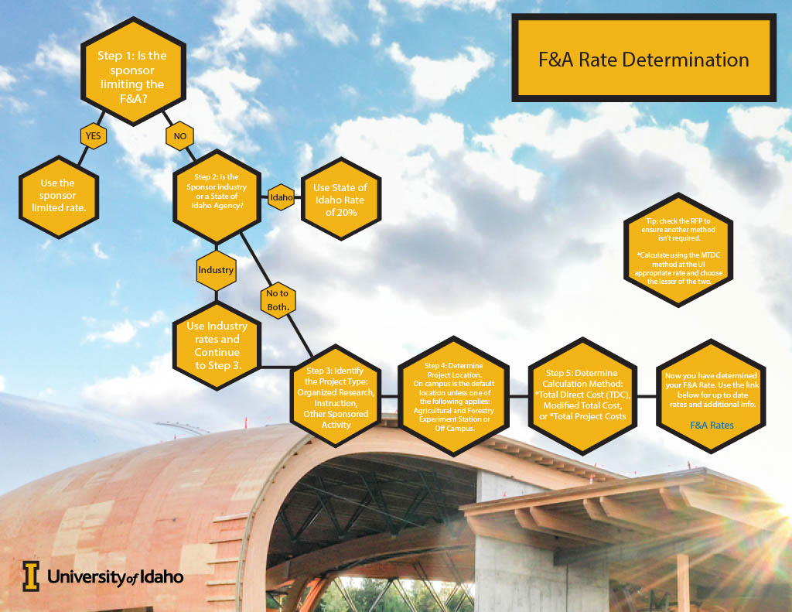

Slide 12
Questions?

Slide 13
Cost Share or Match
Cost share/match refers to the portion of project costs contributed by the University or third parties, beyond the sponsor's funding. It is required when necessary to meet project objectives.
If included in the proposal and award, the committed cost share becomes a binding obligation that must be tracked and reported by the University.
Cost share is typically only provided if mandated by the sponsor.

Slide 14
Cost share types
Mandatory Cost Share: The portion of the University or third-party contribution to a sponsored project which is required by the terms of the project, typically noted in the RFP.
Voluntary Committed Cost Share: Resources that are committed and budgeted for in a sponsored project, that is not required by the sponsor. Voluntary cost share becomes mandatory cost share once the proposal is approved for funding by the sponsor.
Voluntary Uncommitted Cost Share: Voluntary contribution of institutional resources, that is over and above mandatory or voluntary cost share and is NOT quantified. An example of voluntary uncommitted cost share is “The University of Idaho will provide lab space to conduct this research”. This is listed in the proposal, but since there is no quantified amount listed, it is not a commitment of the University.

Slide 15
Cost share policy
Only the minimum amount necessary to meet the sponsor’s cost share requirement is generally allowed, as it impacts the F&A rate.
Offering more than the minimum required cost share must be authorized by the unit administrator, college dean, and VP for Research and Economic Development. Submit a TDX Cost Share Waiver request early, allowing at least up to 5 business days before proposal submission.

Slide 16
cost share funds
University of Idaho funds
- If the sponsor is a federal agency then the cost share may NOT come from another federal source.
- Other sponsored project funds are unallowable to be used as cost share.
Funds from a third party
- Generally, the funds may not be from federal funding sources.
- An itemized letter of commitment signed by an authorized organizational representative is required at the proposal stage.
- After the fact documentation will be required from each third party at the award closeout stage.
In-kind/non-cash contributions
- Must be valued at a defensible rate.

Slide 17
Typical Allowable Cost share expenses
All or part of special-purpose equipment acquisition
The difference between in-state and out-of-state tuition, as currently waived for students on certain employee appointment types (RAs)
PI/co-PI salaries and associated fringe for time worked on the project in excess of the time being charged to the project
F&A/Indirect/Overhead on expenses incurred in support of the project.
F&A may be charged to the cost share expenses in the same manner as it is charged to the sponsor portion of the funding.
Expenses must be allowable as a direct cost to the project.
An exception would be when the sponsor stipulates that indirect costs are unallowable but that any unrecovered indirect costs may be used as cost share.
Note: Cost share expenses must occur during the project period and must directly benefit the project.

Slide 18
Typical unallowable cost share expenses
Existing equipment and office space on any University of Idaho owned or leased property.
Service center fees are normally not allowed.
Expenses unallowable as a direct cost to the project.
Expenses incurred outside the project period.
If the proposed project has cost share be sure to fill out section 8.3 in VERAS.
VERAS Demo

Slide 19
Cost share summary
Types of Cost Share:
Mandatory (required by sponsor)
Voluntary Committed (not required or over what is required and quantified)
Voluntary Uncommitted (not quantified)
Requirements:
Only minimum required cost share allowed
Offering more than required needs authorization
Submit Cost Share Waiver in TDX if voluntary cost share is needed
Allowable Cost Share:
University funds (non-federal and non-sponsored projects funding)
Third-party cost share will need a commitment letter
In-kind contributions valued at defensible rate
Unallowable Cost Share:
Existing equipment/facilities
Service center fees
Unallowable project expenses
Expenses outside project period
Cost share becomes a binding obligation if included in the awarded proposal.

Slide 20
Questions?

Slide 21
Cost Accounting standards
Typically, administrative costs are unallowable on sponsored project funds because they are part of the F&A calculation.
Administrative costs include:
Admin/clerical salaries
Local telephone, including connection charges
Memberships
Postage (other than what is required for sending project surveys, etc.)
Office supplies or office equipment
General purpose software, or hardware

Slide 22
Cost accounting standards exemption
There may be exceptions in rare situations.
In order to charge an administrative cost as a direct cost to a project then all of the following must apply:
- Costs are integral and can be specifically identified with the project scope, or specific project activities.
- Costs are explicitly included in the budget narrative or have the prior written approval of the federal awarding agency.
- The costs are not also otherwise recovered as indirect costs.
A Cost Accounting Standards (CAS) exemption is required when the PI wants to include administrative costs in their budget.
Complete VERAS section 8.4 early in the proposal process to request a CAS exemption.
Notify the VERAS SPA when section 8.4 is filled out so the Cost Accounting Unit may begin review of the request.
VERAS Demo

Slide 23
CAS exemption summary
Typically, administrative costs are unallowable on sponsored projects as they are covered by the F&A rate. These include:
Admin/clerical salaries
Local telephone/postage
Memberships
Office supplies/equipment
General software/hardware
Exemption Required When:
Costs are integral and specifically identifiable to project scope
Costs are explicitly included in budget narrative or have sponsor's prior written approval
Costs are not also recovered as F&A
Process:
Complete CAS Exemption request in VERAS Section 8.4
Submit early in proposal process for review/approval

Slide 24
Questions?

Slide 25

Direct Cost or Indirect Cost?

Slide 26
Next Meeting:
Subawards vs Service Contracts vs Collaborators
Participant Support Costs
Program Income

Slide 27
resources
Description | Where to Find
Agricultural and Forestry Experiment Stations | https://www.uidaho.edu/research/faculty/resources/definitions
Cost Share Waiver TDX ticket | https://support.uidaho.edu/TDClient/40/Portal/Requests/ServiceCatalog?CategoryID=155
Current F&A Agreement | https://www.uidaho.edu/research/faculty/resources/f-and-a-rates
F&A Intro Video | https://www.uidaho.edu/research/faculty/resources/instructional-resources/f-and-a-intro-video
F&A Rates | https://www.uidaho.edu/research/faculty/resources/f-and-a-rates
NSF PAPPG 24-1 Updates | https://nsfpolicyoutreach.com/resources/nsf-proposal-award-policy-updates/
NSF YouTube Channel | https://www.youtube.com/@NSFPolicyOutreach/featured
TDX Tickets | https://support.uidaho.edu/TDClient/40/Portal/Requests/ServiceCatalog?CategoryID=143

Slide 28
Definitions/Acronyms
Definition/Acronym | Description
F&A | Facilities and Administration costs. Also known as Indirect Costs or Overhead. Expenses associated with the administration of sponsored projects, but which are not easily attributable to any specific project, fall into this category.
Federal pass thru | Funds originally issued by a federal agency to a state agency or institution that are then transferred to other state agencies, units of local government, or other eligible groups per the award eligibility terms.
NSF PAPPG | National Science Foundation Proposal and Award Policies and Procedures Guide. NSF proposal and award instructions.
RFP | Request for Proposals.
SPA | Sponsored Programs Administrator.
Unrecovered indirect costs | Indirect costs that are not chargeable to an award due to sponsor limitations.
VERAS | Vandal Electronic Research Administration System. The system UI uses to prepare and approve proposals.

