Slide 1
Dga roundtable
Proposals – Level II
Participant Support Costs
Program Income
Subawards
Service Contracts
May 23, 2024

Slide 2
Osp announcements
Welcome New OSP Employees: Christy Tullis, Grants & Contracts Administrator II, Post Award Unit, 4/15/24 Aquetea Goodman, Sponsored Programs Administrator I, Pre-Award, 5/23/24
Budget Revisions - Wendy
Fee for Service – Claire
2024 Uniform Guidance Updates

Slide 3
2024 Uniform Guidance Updates, effective 10/1/24
The threshold for equipment retention or disposal after a grant period will increase from $5,000 to $10,000. See the Resources page to find a link to learn more about disposal of equipment.
The de minimis indirect cost rate for federal fund recipients will increase from 10% to 15%.
The subaward threshold for applying indirect cost rates will increase from $25,000 to $50,000. See 5/17/24 email from Sarah Martonick.
Revision allows for certain administrative costs associated with closeout to be charged to the final budget period. Further information is being gathered to understand what is allowable.
The revision removes certain prior approval requirements that had been in place for years. Further information is being gathered to understand which prior approvals have been removed.

Slide 4
Questions?

Slide 5
Participant Support Costs
Participant support costs are those costs paid to or on behalf of participants or trainees for conferences, meetings, workshops or similar events.
These costs may include:
Stipends for trainees/participants
Travel, if the event is the sole purpose for the trip
Subsistence (per diem and/or housing or lodging)
Those NOT typically considered participants include:
Speakers, trainers, or service providers
University of Idaho employees (unallowable)

Slide 6
Participant support costs continued
For projects using the MTDC indirect cost methodology, these expenses are not charged indirect costs.
WARNING: Prior sponsor approval is required before rebudgeting between the participant support budget category and any other budget category. They may not be used to offset a deficit in another budget category.
See the Resources page to find a link to learn more about participant support costs.

Slide 7
Questions?

Slide 8
Program Income
Program income is any revenue directly generated by a sponsored project during the award period.
Examples include:
Conference fees Example of this would be registration fees for an NSF sponsored conference.
Sales or user/rental fees of assets purchased by project funds (e.g. livestock, equipment)
Fees for services when the project is providing the service
Sale of items such as books, manuals, software or videos created with project funding
Program income expenses carry the same allowability restrictions as the rest of the sponsored program’s expenses.
Any anticipated program income should be estimated at the proposal stage and shown as an offset to the sponsor's portion of the project budget. Complete VERAS section 8.5.
See the Resources page to find a link to learn more about participant support costs.
Demo VERAS

Slide 9
Questions?

Slide 10
What is a subaward?
Under a subaward, the prime award recipient transfers its responsibility to perform part of the project to another party.
Characteristics of a subrecipient are:
Has responsibility for programmatic decision making
Contributes to the scholarly/scientific conduct of the project as described in the proposal
Requires considerable discretionary judgment and the unique expertise in the performance of the project
Will be considered as a co-author of publications resulting form the work performed
Is not merely providing goods or services, but instead has its performance measured in relation to whether objectives of the project are met
Performs work that involves human subjects or animal studies
Is required to adhere to the applicable program terms and conditions
They will work with you

Slide 11
What is a service contract?
A contract is designed to provide goods or services that is needed to perform the sponsored program.
Characteristics of a contractor/vendor are:
Provides a routine service (e.g., equipment fabrication or repair, data processing, performing routine analytical testing services, etc.)
Provides the goods or services as part of its normal business operations
Provides similar goods or services to many different purchasers
Operates in a competitive environment
Is NOT subject to monitoring or reporting requirements of the prime award
They will work for you

Slide 12
Subawards vs service contracts
Why does it matter? Misclassifying can result in violations of award requirements and result in audit findings.
Subawards may require sponsor prior approval. If auditors review a service contract and conclude, based on the nature of work performed, that it met the parameters of a subaward rather than a contract, they will report finding an unapproved subaward and may question all or a portion of the costs claimed.
Subawards require monitoring. Neglecting to identify a service contract as a subaward, and implement corresponding monitoring procedures, can result in questioned costs and/or internal control findings.
Indirect costs charged on subawards are limited. If a service contract that exceeds $25K (soon to be $50K) is found to be improperly classified, auditors will question the indirect cost amount charged on the portion of the contract that exceeded $25K.
Still need help in determining? Reach out to the proposal’s Sponsored Program Administrator for assistance. Refer to VERAS section 4.9.

Slide 13
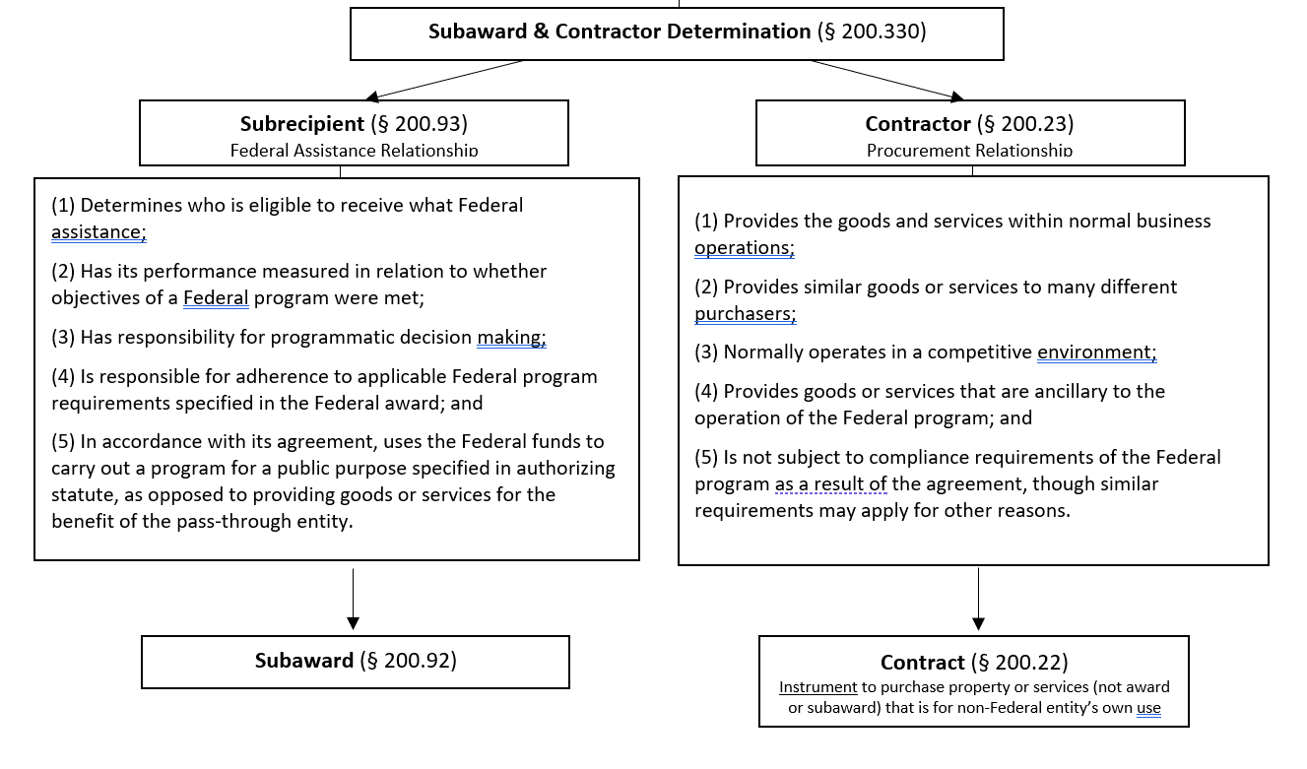

Slide 14
Subawards
We have a subaward included in our proposal. Now what?
At a minimum, each subaward listed in the proposal should contain the following:
Subrecipient commitment form signed by their authorized organizational representative (AOR).
Or a letter of commitment signed by their AOR , if the organization is registered with Federal Demonstration Partnership
Subrecipient detailed line-item budget and budget justification following sponsor’s requirements
Subrecipient statement of work
Upload the documents to VERAS section 7.1 and notify the proposal’s SPA for review.
Have the PI read and answer VERAS section 7.3
Reminder: only the first $50K will be charged indirect costs when using the MTDC method in the U of I budget.
Demo FDP and VERAS

Slide 15
Service contracts
We have a service/consultant included in our proposal budget that will be a service contract if an award is received. Now what?
Each service/consultant included in the proposal budget should contain the following:
Name
Service/consultant quote
Upload the documents to VERAS section 7.2 and notify the proposal’s SPA for review.
Have the PI read and answer VERAS section 7.3
See the Resources page to find a link to learn more about service contracts.
Demo VERAS

Slide 16
Questions?

Slide 17
resources
Description | Where to Find
Equipment Disposal | https://www.uidaho.edu/-/media/uidaho-responsive/files/division-of-finance-and-administration/finance/controller/asset-accounting/guidelines-for-disposal-of-equipment-purchased-with-sponsor-funds.pdf?la=en&rev=fd5d8dafa7e9478ab09632907067db7f
Federal Demonstration Partnership | https://fdpclearinghouse.org/organizations
Participant Support Costs | https://www.uidaho.edu/-/media/uidaho-responsive/files/research/faculty/dga/documents-resources/participant-support-costs-guide.pdf?la=en&rev=b97405c043ea4c588ac17dc6c1dbadea
Program Income | https://www.uidaho.edu/governance/policy/policies/apm/45/13
Service Contracts Information | https://www.uidaho.edu/dfa/finance/contracts-and-purchasing-services/how-do-i-faq; https://www.uidaho.edu/-/media/uidaho-responsive/files/division-of-finance-and-administration/finance/contracts-and-purchasing-services/how-do-i/jaggaer-contracts-training-slides-v2.pdf?rev=37a545c5eb354fbfa7b45e6c3c31d15c
Subaward Information | https://www.uidaho.edu/research/faculty/manage-award/guide/budget/direct-costs/subcontracts
Subrecipient Commitment Form | https://www.uidaho.edu/-/media/uidaho-responsive/files/research/faculty/resources/forms/proposal-forms/subrecipient-commitment-form.pdf?rev=0d0c14978a2c40e385e236913552ba3a

Slide 18
Acronyms and definitions
Acronym or Term | Description
AOR | Authorized Organizational Representative. A person with authority to enter into, administer, and/or terminate grants and make related determinations and findings under the grant. The OSP Director is the U of I’s AOR.
Indirect Costs | Indirect costs represent the expenses of doing research that are not readily identified with any particular sponsored program, but are necessary for the general operation of the institution and the conduct of sponsored program activities it performs.
MTDC | Modified Total Direct Costs. Definition. Method of charging indirect costs that includes direct salaries and wages, applicable fringe benefits, materials and supplies, services, other allowable expenses, travel and up to the first $25K (soon to be $50K) of each subaward.
Prime Award | An award that is the originating source of funding, a part of which may be awarded to a subrecipient via a subaward. Example would be U or I receives a CDC award and then subawards to Oregon State University for a portion of the project’s scope of work. The prime award came from CDC (prime sponsor) to U of I (pass-through sponsor).
SPA | Sponsored Programs Administrator. Office of Sponsored Programs personnel in the Pre-Award Unit. These individuals assist researchers and Departmental Grant Administrators (DGAs) with U of I sponsored programs’ proposals review and submission.

